Slide 1
Omega Hospital
New Hire
General Orientation
Infection Prevention and Control
and
Employee Health
Prepared by Karen Barrois, CIC

Slide 2
Hand Hygiene
#1 way to prevent the transmission of infections
Includes hand washing and hand sanitizing
Hand sanitizing with alcohol-based gel/foams is the preferred method of hand hygiene by the CDC unless hands are visibly soiled
Perform hand hygiene before and after patient contact, before donning gloves and after removing them, after use of the restroom, before and after eating
Perform before invasive procedures

Slide 3
Storage of Supplies
Keep dirty and cleans items separated
Do not return any items to the clean supply room that has been in a patient room
Clean/disinfect all equipment and cover it before storing in the clean supply room
Keep all items 6 inches from the floor and 18 inches from the ceiling

Slide 4
General Infection Prevention and Control
Always provide a safe and clean environment for our patients and staff
Disease transmission is based on the way a disease is transmitted from person to person
elements required for disease transmission
Infectious agent
Reservoir
Portal of exit
Route of transmission
Portal of entry
Susceptible host

Slide 5
General Infection Prevention and Control Actions
No food or drinks are allowed at the nursing station or in patient care areas
No artificial nails, including, but not limited to, acrylic, wraps, or overlaps
Keep your break room clean – this includes the microwave and refrigerator
If you spill it – wipe it
If you drop it – pick it up
Keep linen carts covered and no items on top or hanging from the handles

Slide 6
General Infection Prevention and Control Actions
Alcohol based hand sanitizers are not effective against C. diff – you must wash your hands with soap and warm water
Hospital disinfectants are not effective against C. diff – a 1:10 bleach solution is used
We notify EVS daily when we have a room that must be cleaned/disinfected with bleach
We have bleach wipes, along with PDI disinfectant wipes available on the unit

Slide 7
Disease Transmission
Sources of Infectious Organisms
  Patient
  Personnel
  Visitors
  Patients own normal flora
  Inanimate objects or fomites

Slide 8
Disease Transmission
Susceptible Host
  Immune-compromised due to age, chronic disease, leukemia, lymphoma, surgical procedures, irradiation, antibiotics or immunosuppressive agent

Slide 9
Disease Transmission
Route of Transmission
  Contact-Direct – staff, visitors, other patients
  Contact-Indirect – contaminated objects
  Droplet –large particles that are heavy and fall to the floor/ground quickly that absorbed thru conjunctiva, nose, and mouth
  Airborne – small particles stay suspended in air for long periods of time and are absorbed thru conjunctive, nose and mouth

Slide 10
Disease Transmission
Portal of Entry
  Intact skin and intact mucus membranes is our 1st line of defense
  Most of our natural defenses are bypassed with IVs, catheters, endotracheal tubes, chest tubes, PEG tubes, NG tubes
  Can come from food sources
  Can be vectorborne – animal carriers (dog bites, ticks, insects)

Slide 11
Precautions
We utilize Standard Precautions and Transmission-Based Precautions
Standard Precautions are used on all patients
Transmission-Based Precautions are used to prevent disease specific and type of transmission specific conditions
Transmission-Based Precautions are Airborne, Droplet and Contact

Slide 12
Standard Precautions
Used on all patients, in all departments, all the time
Assume the potential that all patients have a bloodborne pathogen
Reduce the risk of transmission of bloodborne pathogens
  HIV/AIDS
  Hep B
  Hep C

Slide 13
Standard Precautions
Wear gloves when touching blood, body fluids, secretions, excretions and contaminated items
Don new gloves before touching mucous membranes and non-intact skin
Change gloves between procedures on the same patient
Change gloves between patients

Slide 14
Standard Precautions
Wear a mask and eye protection or a face shield to cover eyes, nose and mouth during procedures that may generate splashes or sprays of blood, body fluids, secretions and excretions
Wear a gown (clean, non-sterile) during procedures that may generate splashes or sprays of blood, body fluids, secretions and excretions
Remove gown, gloves, mask, etc. prior to leaving patient room and perform hand hygiene

Slide 15
Standard Precautions
Clean/disinfect patient care equipment between patients
    B/P cuffs
    Glucometers
    Stethoscopes
    Pulse ox

Slide 16
Transmission-Based Precautions
(Isolation)
No physician order needed
Nursing can implement based on microbiology reports and/or signs and symptoms
Ensure that PPE caddy/cart is stocked at the beginning of each shift
Ensure that appropriate isolation sign is visible
Inform the patient and family of reason for isolation and provide appropriate education

Slide 17
Transmission-Based Precautions
(Isolation)
Provide dedicated patient equipment
Cover equipment with a glove, sleeve, etc., if dedicated equipment is not available
Notify receiving department when patient leaves the floor for diagnostic/surgical procedures
Notify receiving facility when patient is transferred to other facility

Slide 18
Transmission-Based Precautions
Airborne Illness Isolation for small particle microbes that can remain suspended in the air such as TB, SARS, Rubeola (measles), Varicella (chicken pox)
Airborne Illness Isolation requires a room with negative air flow and the door must remain closed
Patients on Airborne isolation should have a surgical mask placed on them during transportation
Healthcare workers and visitors should wear a N-95 particulate respirator when entering the room

Slide 19
Transmission-Based Precautions (continued)
Droplet Precautions are used when the disease can be transmitted by inhalation of larger microbes that do not remain suspended in the air for long periods of time
Healthcare workers and visitors should wear a surgical mask when working within 3 feet of the patient or the patient is coughing and sneezing
Droplet Precautions are utilized to prevent the transmission of certain illnesses such as Influenza and meningococcal diseases (meningitis, sepsis, pneumonia), diphtheria, pertussis, mumps, parvovirus B-19

Slide 20
Transmission-Based Precautions (continued)
Contact Precautions are used when the disease can be transmitted by coming into contact with the patient or the patient’s environment
Direct contact is touching the patient
Indirect contact is touching any item in the patient environment such as bed, side rails, over-bed table, telephone, light switch, etc.

Slide 21
Regulatory Agencies
OSHA
The Joint Commission
CDC
SHEA
AIA
Louisiana Health and Hospitals
CMS

Slide 22

TB Exposure Control Plan
Our plan implements recommendations from the CDC, OSHA, and LA State Dept. of Public Health
Includes risk assessment, identification, and management of TB patients
Goal is to provide a safe work environment and healthcare environment that reduces the spread of tuberculosis (TB)

Slide 23
TB Exposure Control Plan
Components
Administrative controls and assignment of responsibility
Risk Assessment
Employee and Volunteer TST
Work Restrictions for Employees with Active TB
Post exposure evaluation and follow-up
Surveillance
Early identification and isolation

Slide 24
TB Exposure Control Plan
Components (continued)
TB patient education
Patient transportation/Timing of Procedures
Visitors
Negative Pressure Room
Respiratory Protection (PPE)
Discharge Planning
Staff education
Housekeeping

Slide 25
TB Exposure Control Plan (continued)
In 2008, Louisiana was ranked 7th in the nation for case rates (new cases per 100,000 population).
Louisiana case rate for 2022 was 2.0 per 100,000
Jefferson Parish case rate was 3.7 in 2022
Region 1 case rate was 3.7 in 2022
Annual review of the plan

Slide 26
TB Exposure Control Plan (continued)
Private room when possible
Cohort only with other known TB patients
Keep door closed
Continuous negative pressure
Notify maintenance department – daily rounds for appropriate air flow
Instruct visitors on wearing N-95 mask
Limit number of visitors

Slide 27
TB Exposure Control Plan (continued)
Suspected unprotected exposures will be investigated
Post-exposure screening will be completed at time of suspected exposure and 12 weeks following suspected exposure
Any conversions will have a post-exposure CXR and will be referred to LA OPH for follow-up

Slide 28
Bloodborne Pathogen Exposure Control Plan
All employees with risk of exposure to blood or other potentially infectious material (OPIM) will be educated
Recommendations from the CDC, OSHA, and LA State Dept. of Public Health are implemented

Slide 29

Bloodborne Pathogen Exposure Control Plan
Pathogens
HIV – Human Immunodeficiency Virus
HBV - Hepatitis B Virus
HCV - Hepatitis C Virus

Slide 30
Bloodborne Pathogen Exposure Control Plan
OPIM (other potentially infectious material) includes human body fluids such as semen, vaginal secretions, cerebrospinal fluid urine, stool, pleural fluid, peritoneal fluid, amniotic fluid, saliva
OPIM also includes any unfixed tissue or organ from a human being (living or dead)
Cell, tissue or organ cultures from, culture medium, or other solutions that contain HIV, HCV, or HBV
Blood, organs, or other tissue from experimental animals infected with HIV, HBV, OR HCV

Slide 31
Bloodborne Pathogen Exposure Control Plan
Risk of exposure will be determined by job classification
Follow Standard Precautions
Food and drinks are not kept in storage areas where blood or OPIM are stored (refrigerators, counter tops, etc.)
Food or beverages will be consumed only in designated areas where there is not a risk of exposure to BBP

Slide 32
Bloodborne Pathogen Exposure Control Plan
Specimens will be collected in an approved regulated container with proper biohazard label
PPE (personal protective equipment) is provided at no cost to employees and should be utilized to protect against exposure
Cuts, scrapes, lacerations will be kept covered by PPE or occlusive dressings
If compromised skin integrity cannot be protected, the employee will not engage in tasks entailing occupational exposure

Slide 33
Bloodborne Pathogen Exposure Control Plan
Perform appropriate hand hygiene
Wear appropriate PPE
Dispose of sharps appropriately, in proper container that is not more than 3/4 full
All work areas are cleaned and disinfected daily and as needed if visibly soiled
Contaminated laundry is handled as little as possible
Compliance will be monitored and recorded in personnel file

Slide 34
Bloodborne Pathogen Exposure Control Plan
Hepatitis B Vaccine is available upon request and is recommended for those with an increased risk of exposure
Post-exposure evaluation and follow-up
Annual Review of the Plan

Slide 35
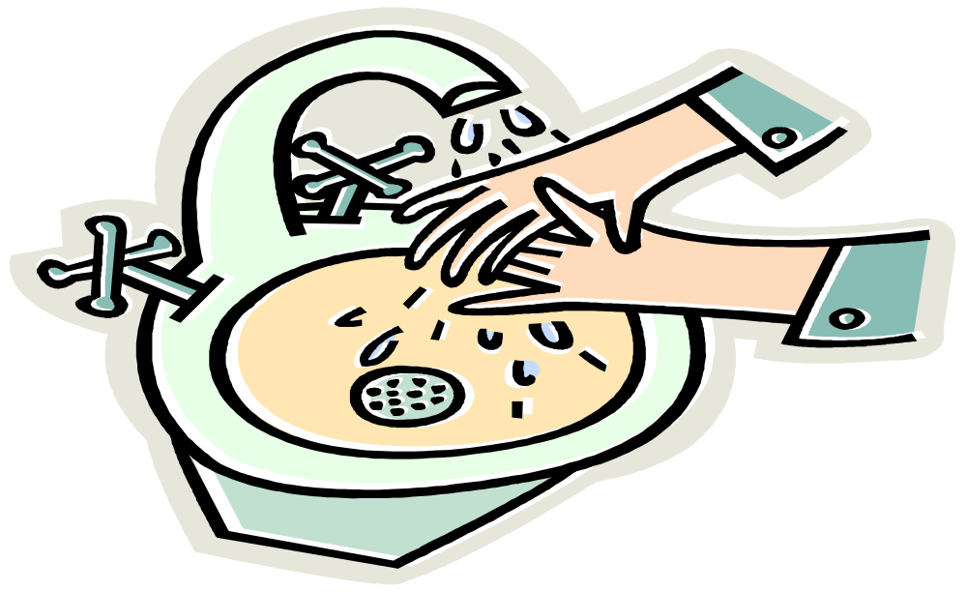
Infection Prevention and Control
Remember, Infection Prevention and Control is in Everyone’s Hands – so Keep Yours Clean

Slide 36
Employee Health
Important to monitor employee illness to assure that disease transmission is not occurring between employees and patients and vise versa
Stay home if you have a fever, diarrhea, vomiting, or s/s of the flu
Inform the Employee Health department if you have been exposed to a communicable disease (TB, chickenpox)
A physician’s release to return to work without restrictions will be required with all communicable illnesses and when out for 3 or more consecutive days

Slide 37
Employee Health
Requirements
Health screening and TB skin test or TB screening upon hire and annually
CXR only if history of positive TST
Fit test for N-95 mask if direct patient contact
Annual health questionnaire, TB screening, and Fit Test
Immunity for measles, mumps, rubella, and varicella upon hire
Removal from schedule if not current

Slide 38

Employee Health
Immunizations
Hepatitis B Vaccine is offered to those with risk of exposure to blood and any employee upon request, if not previously received
Hep B Vaccine is a series of 3 injections given over 6 months
Blood sample drawn 1 month after series is completed to check immune status
Seasonal Influenza Vaccine given annually
Vaccines are given at no charge to the employee
Keep our patients/staff safe and get the Flu Vaccine annually

Slide 39
Omega Hospital IC and EH New Hire Orientation
QUESTIONS?

