Slide 1
MongoDB project
Completed by:
Elizaveta Polushina
Hakan Kurtulus

Slide 2
Project statements
PROBLEM FORMULATION
To get acquainted with MongoDB database system
MAIN TASK
To demonstrate the ability to use the acquired knowledge in practice: create a cluster storing the data multiple items in a distributed way

Slide 3
Horizontal Scaling
Complex within configuration but has a number of advantages:
Theoretically infinite scaling
Better data security as machines can be located in different data centers (if one of the machines falls down there are other ones remain)

Slide 4
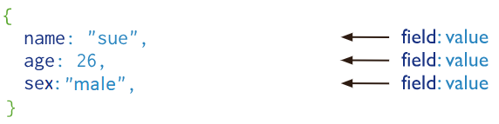
Data compilation

Slide 5
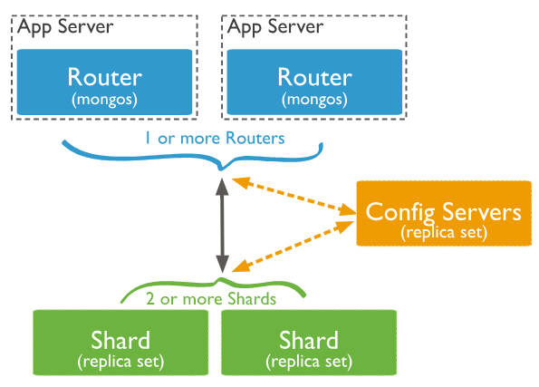
Cluster to be set up

Slide 6
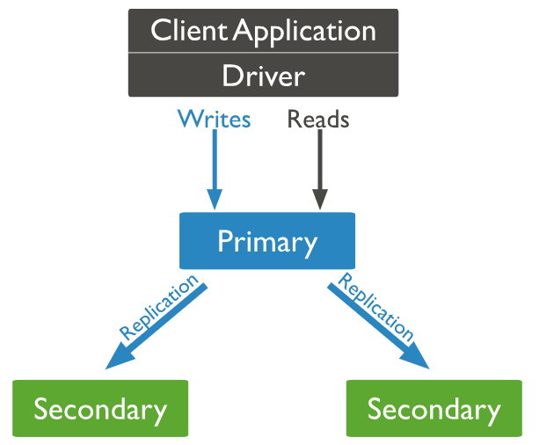
Config Replica Set

Slide 7
Shard Replica Set

Slide 8
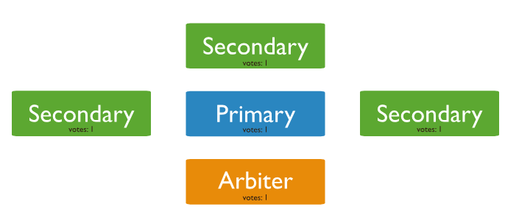
Arbiter

Slide 9
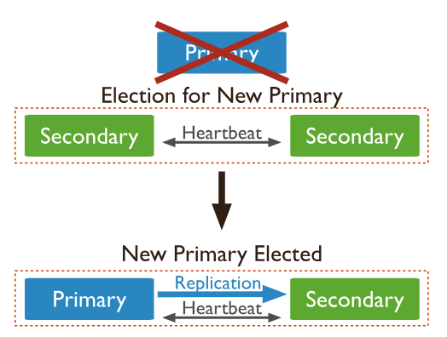
Election

Slide 10
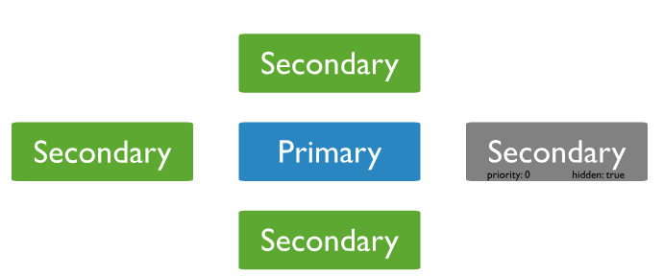
Hidden Secondary

Slide 11

It’s time for practice!

