Slide 1
Obuda University John von Neumann Faculty of Informatics
RFID Security Access
Control System
Hakan Kurtulus, HXMKGP

Slide 2
RFID Security Access Control System
Component List
Hardware Components
Raspberry Pi 3
RFID RC522 Sensor
Languages
PHP
HTML/CSS
JavaScript
Python
Frameworks
Laravel
Vue JS
Socket.io
`
Database Technologies
Redis
MySQL

Slide 3
RFID Security Access Control System
Workflow Timeline
1. Step
Hardware Component
Connections
In order to drive a RFID module, required module and some external modules are installed.
3. Step
Test RFID Sensor
START
RFID Module is connection to Raspberry Pi 3 GPIO pins.
2. Step
Install Required
Driver Modules
After installing all necessary modules, the RFID sensor is tested with example code comes with driver module.

Slide 4
4. Step
Creation Main Function
In Python
After detection of card id with sensor, this data send through API connection between Python Function and Laravel Framework in PHP Language.
6. Step
Web Socket Server Creation
After testing the sensor, the main function is defined in Python Language to read tag id of card. In this function, after reading tag id of card the data is sent to PHP application to process.
5. Step
PHP Application Development
In order to make this work in real-time application, Web socket technology is use for this purpose. Help of Laravel Framework, when a new card is detected by sensor, new event is broadcasting to clients instantly through “main-channel”.

Slide 5
As a last step, access history of the user is stored on database in order to check when the user accessed secured area with a timeline form.
7. Step
Database Structure Design
END
With help of MySQL some users are defined on “users” table and unique card id is defined each of them. When ever new card is detected PHP code search thorough users to find matched card id with user.
8. Step
Access History of the User

Slide 6
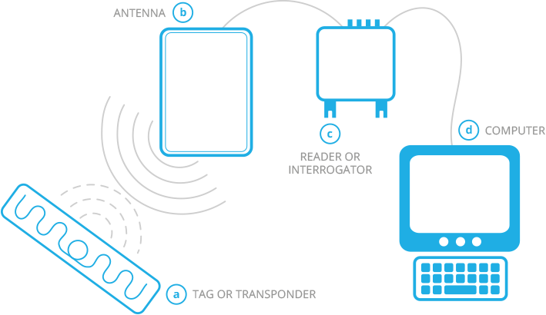
RFID Security Access Control System
How It Works
RFID (Radio-Frequency Identification) systems consist of three components: an RFID tag or smart label, an RFID reader, and an antenna.
RFID tags contain an integrated circuit and an antenna, which are used to transmit data to the RFID reader.
The RFID reader features a two-way radio transmitted-reciever (transceiver), sometimes referred to as an interrogator. The transceiver transmits an encoded radio signal to interrogate the tag. The radio signal essentially wakes or activates the tag. In turn, the tag transponder converts the radio signal into usable power, and responds to the reader.

Slide 7
RFID Security Access Control System
Future Improvements
Creation a new function to handle edit user details
Give opportunity to user to change card id in case of breaking the card
Put a limit for wrong card attempt
Your ideas?

Slide 8
THANK YOU FOR
YOUR ATTENTION

