Slide 1

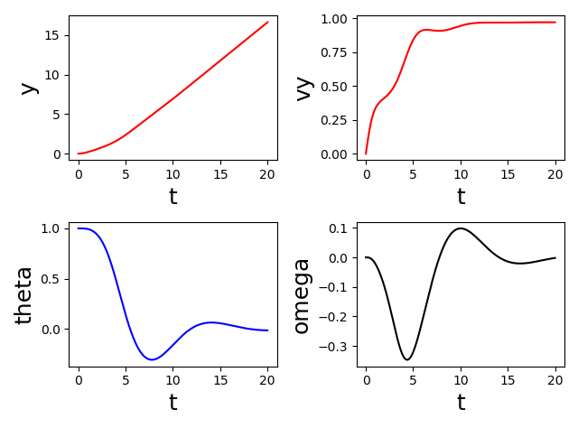
Houston, We Have a Problem: Modeling a Rocket Launch
Owen Meilander Advisor: Dr. Rob Knop
Abstract
I used computational methods to follow an object (for instance a rocket) that is subject to gravity and thrust, calculating the effect of air resistance and the resulting forces and torques on the object. I use a simple model of air as a collection of non-interacting particles without more complex fluid dynamic interactions. I modeled the object as a collection of flat panes and a declining mass of fuel. By tracking the movements and rotation of this object, I used this program to model the stability of rockets as they fly through air and show how quickly things can spin out of control.
Design 1
Conclusion
https://www.grc.nasa.gov/WWW/K-12/airplane/atmosmet.html
Ball Bearing Model of Air
Problems
Methods
Design 2
Extensions
Theta = 0.1
References
https://www.grc.nasa.gov/WWW/K-12/airplane/atmosmet.html
Acknowledgements
I would like to thank Dr. Rob Knop for his assistance both in and out of the classroom. Also, the use of his physvis program was pivotal to the visualization of this project.

