Slide 1

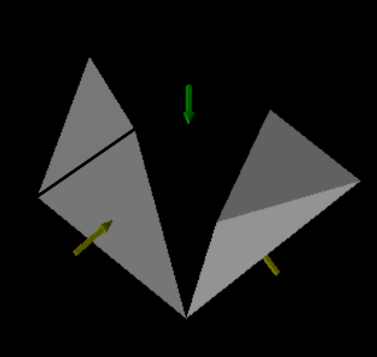
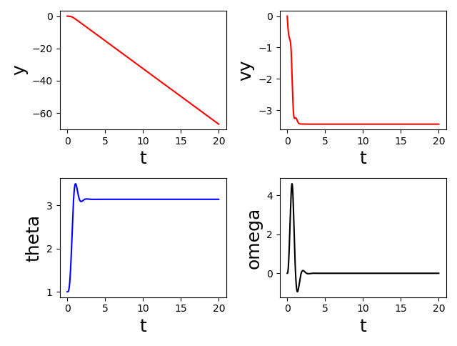
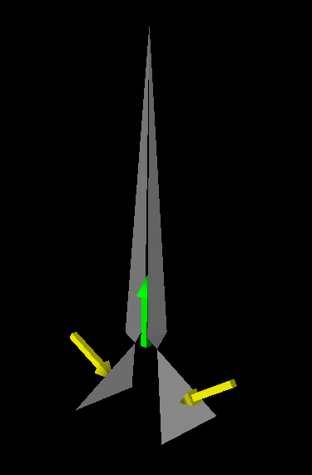
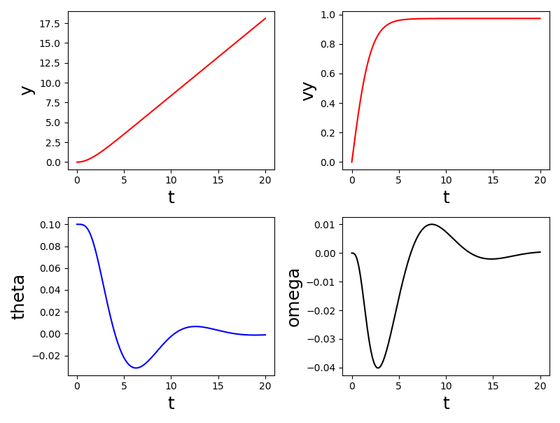
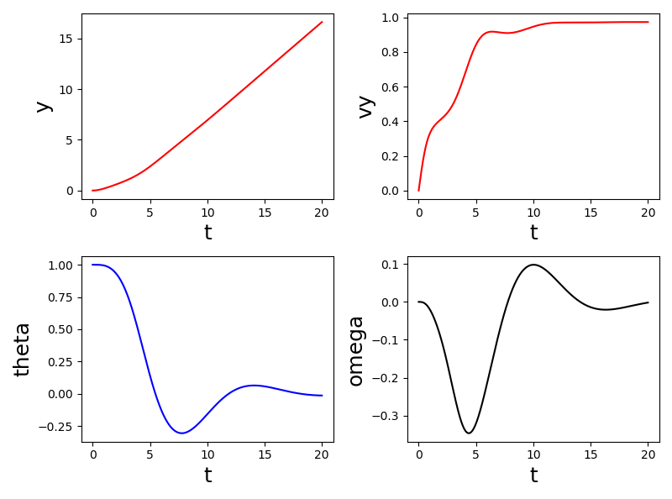

Houston, We Have a Problem: Modeling a Rocket Launch
Owen Meilander Advisor: Dr. Rob Knop
Abstract
We used computational methods to follow an object (for instance a rocket) that is subject to gravity and thrust, calculating the effect of air resistance and the resulting forces and torques on the object. We use a simple model of air as a collection of non-interacting particles without more complex fluid dynamic interactions. We modeled the object as a collection of flat panes and a declining mass of fuel. By tracking the movements and rotation of this object, We used this program to model the stability of rockets as they fly through air and show how quickly things can spin out of control.
Design 1
Project Extensions
Further work on this program will include the incorporation of 3D rotations of larger, more lifelike objects. Additionally, We plan to switch the air model to more realistic fluid model. This accounts for the more complex interactions between air molecules to accurately describe the forces as the velocity of the rocket nears the speed of sound.
Ball Bearing Model of Air
Theta Initial = 0.1
There are many ways to model the interactions between Air molecules and an object flying through it. The most common for an on-Earth flight is to imagine each molecule of air as group of non-interacting ball bearing that is running into the object’s surface. The equation for the force of air resistance derived from this model is as follows.
$$F_{air}=\frac{1}{2}ρC_{D}Av^{2}$$
Where rho is the density of the air and $C_{D}$is the drag coefficient. My program uses this model but calculates the number of collisions between each pane and an air molecule to find the change in momentum, and therefore the force on the object.
References
https://www.grc.nasa.gov/WWW/K-12/airplane/atmosmet.html
https://github.com/rknop/physvis
Acknowledgements
Figure 1. Representation of the first design made of four triangles, two creating a roof-like point with the other two being perfectly vertical off the top. This design is unstable because it is observed flipping over and flying upside-down at an angle of pi radians.
We would like to thank Dr. Rob Knop for his assistance both in and out of the classroom. Also, the use of his physvis program was pivotal to the visualization of this project.
Methods
Creation of Air and Fuel Tank:
The Air Object keeps track of the wind speed and change in air density as the rocket ascends through the atmosphere.
The Fuel Tank Object keeps track of the strength and direction of the thrust along with how long the engine will burn.
Creation of Panes and Object:
The Pane object is made using three locations as the vertices of a triangle to create a single pane. It is also tasked with the calculation of the force of air resistance on each of the panes.
The Object is a collection of panes combined with the model of air and the fuel tank. It is also tasked with the calculation of the acceleration through the use of an RK4 integrator.
Air Resistance:
We perform a set of definitions to calculate the total resistive force on the object. Through this we can calculate the acceleration of the object and its terminal velocity
We also performed a set of definitions to calculate the torque on each of the panes. This allowed us to be able to examine the stability of different arrangements of panes
Different models:
We created two separate objects to test different stabilities. The first has a pointed top and flat sides to imitate a vehicle such as SpaceX’s Falcon 9. The second model has stability wings to balance out the torques from the air resistance as was inspired by Russia’s Soyuz rocket
Visualization:
Finally, we modeled the rocket using physvis, an opensource package created by Dr. Knop to emulate the visualization functions of vpython
Conclusion
Design 2
We observe that while there is more drag and therefore more fuel would be needed to get to orbit, a design with stability wings is unsurprisingly more stable throughout flight to a surprisingly high initial angle.
We conclude that the ball bearing model of air is a satisfactory model at low speeds near the surface of the Earth.
Finally, we conclude that rockets are very difficult to make. This is only a 2d model and it was extremely challenging to design.
Theta Initial = 0.1
Model Problems
One problem in the ball bearing model of air it that the interaction between molecules is neglected. At low speeds, these interactions are negligible. However, at speeds near the speed of sound these interactions cause massive problems for rockets as the resistance factor is greatly increased. This increase is compensated by the rocket throttling down while hitting this point referred to as Max-Q.
One problem with our model is that it is reliant on a thrust that is locked in the upward direction no matter the angle of the rocket to guarantee that the rocket begins to move vertically upward. This is believable at small angles because rockets rely on the gimbal of their engines to maintain stability. However, these engines can only gimbal a few degrees, not the almost 60 degrees of our second test on the second model.
Most apparently, this only works for 2D rotations of unrealistic objects. No rocket like this could be built or function like this.
Theta Initial = 1.0
Figure 2. Representation of model two made of six triangles with the first four similar to the first design and the final two acting as stability wings. This design is stable and remains flying vertical even at starting angles greater than 1.0 radians.

