Slide 1
Movie Recommendation System: Top 5 Personalized Recommendations
Using collaborative filtering with MovieLens Dataset
-Orangel Mendez(Flatiron School)
Notes:
Good afternoon, my name is orangel mendez. Today I will present a movie recommendation system that provides the top 5 personalized movies for each user based on explicit ratings given to those films.

Slide 2
Business Understanding
Objective:
To increase user engagement and viewership within the streaming platform, paramount plus.
We are tasked to Develop a model recommending the top 5 movies to each user. Based on their ratings, preferences and viewing history.
Notes:
How can we provide a personalized movie recommendations to users based on their ratings?
How can we handle the “cold start” problem for new users or movies?

Slide 3
Data Overview
Dataset: MovieLens
Key features:
User IDs, Movie IDs, Ratings, Timestamps
Metadata:
Movie titles, genres
Number of users, movies and ratings
Notes:
100K+ ratings, 9743 movies selections

Slide 4
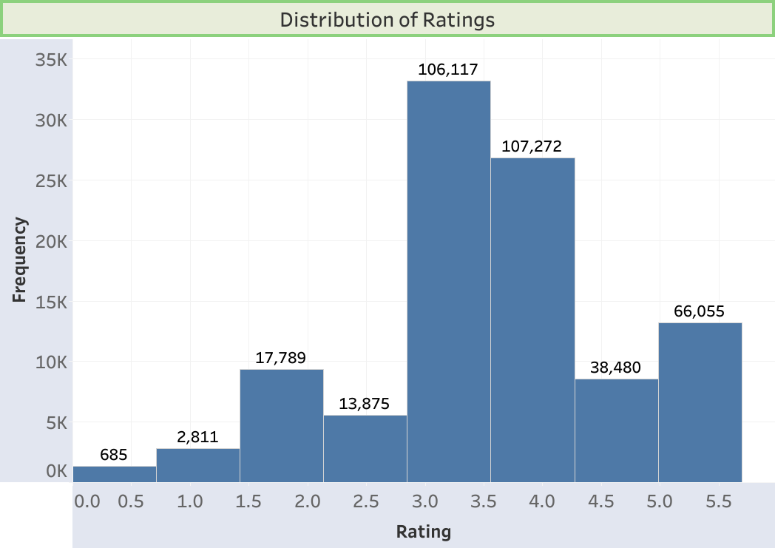
Notes:
Demonstrates the explicit ratings provided by users. The ratings show 106K – 107K votes averaging a score of 3 – 4

Slide 5
Methodology
Collaborative Filtering:
Using SVD to address matrix sparsity
Approach: Leveraging user-based similarities in ratings to recommend top 5 movies for each user.
Metrics Used: RMSE, Cosine similarity, Pearson Correlation
Cold start problem: Hybrid model
Combine collaborative filtering with content-based filtering
Notes:
SVD, a good technique for matrix factorization.
Effectively used in recommendation systems, and commonly used in collaborative filtering models for dimensionality reduction, and sparsity issues.
Cosine similarity matrix: RMSE, 0.886
Pearson similarity matrix: RMSE, 0.885

Slide 6
Evaluation Metrics
Chosen metrics:
RMSE
commonly used metric for evaluating recommendation systems
SVD
a good technique for matrix factorization
Notes:
provides several important advantages:
Sensitive to Large Errors: helps identify when the system makes large prediction mistakes.
Measuring Prediction Accuracy: provides a clear and interpretable measure of how close the predicted ratings are
a normalized metric, meaning it takes the square root of the average squared errors. This allows for better comparability across different datasets or models
Continuous Feedback: calculated on a continuous scale, it provides smooth feedback to guide model tuning

Slide 7
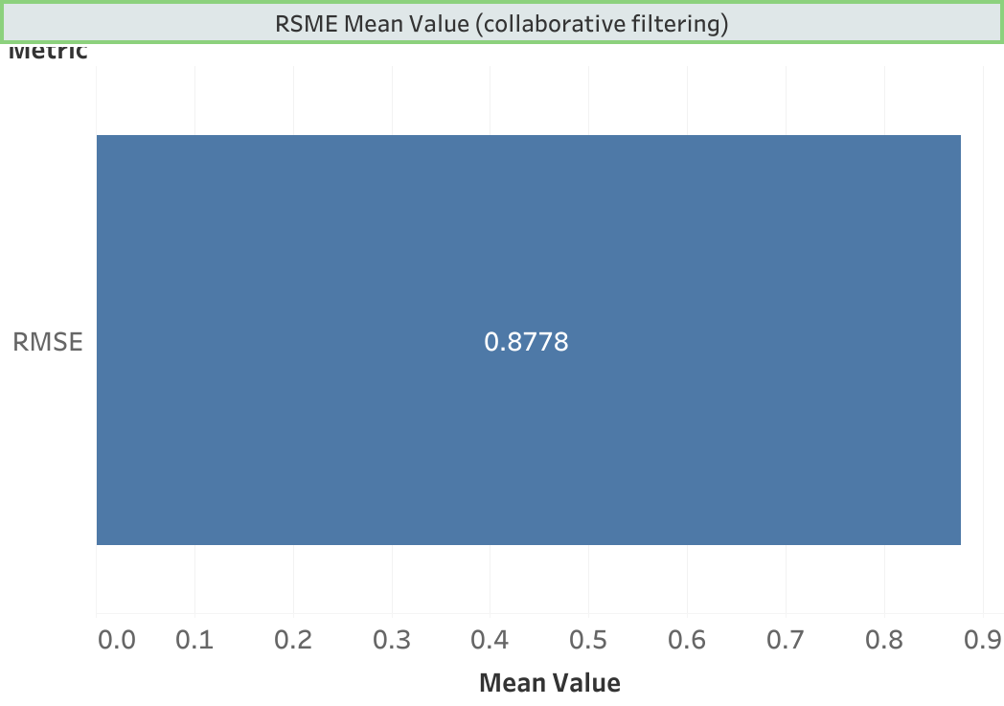
Notes:
The optimized model the RMSE is 0.8778

Slide 8
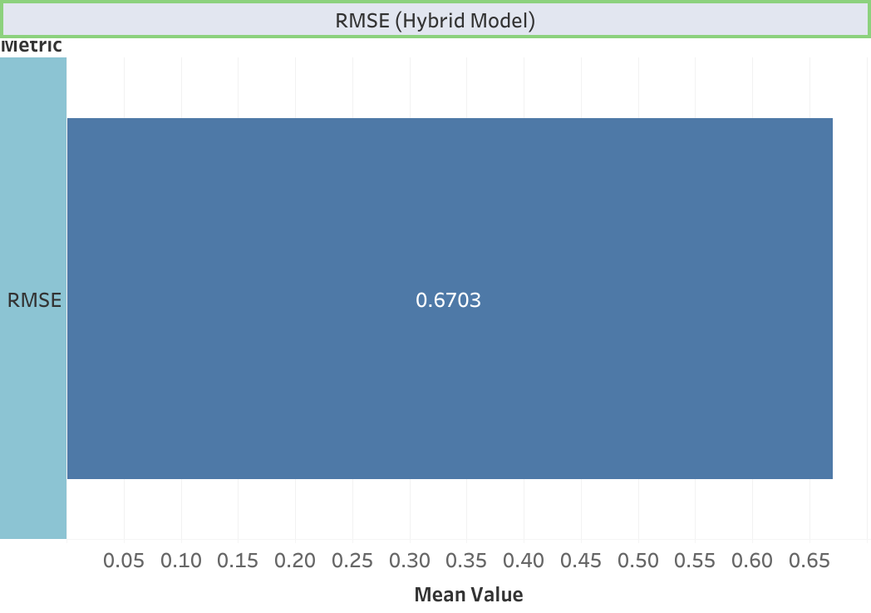
Notes:
The hybrid model gives RMSE score 0.6703

Slide 9
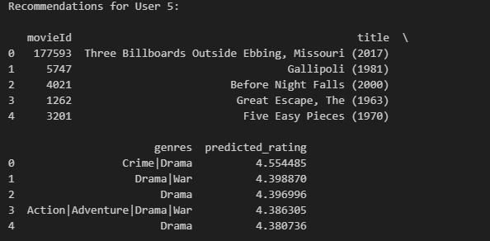
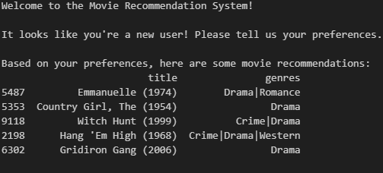
Key Findings
Collaborative Filtering
Hybrid Model
Notes:
Using collaborative filtering we can see the model provides recommendations based on explicit data provided by users past rating preferences.
Using a hybrid model of collaborative-filtering and content-base filtering, we address the cold start issue of a new user, based on their own preferred movie genre.

Slide 10
Next Steps
Analyze the clusters or patterns in ratings.
Use these insights to fine-tune the recommendation model.
improving the quality of recommendations.
Notes:
Do certain users rate higher consistently?

Slide 11
Conclusion
The model recommends movies for users based on their preferences and history. For new users to the platform, it provides options based on the highest ratings given to those films based on the preferred genre.
Notes:
We want increase the quality within the recommendation system, increasing the RMSE score for better predictions, and increase quality for a better user experience.

