Slide 1
Analytics Using Python Day-1 – Introduction
Cyrus Lentin

Slide 2
Anaconda
Anaconda is the leading open data science platform powered by Python.
The open source version of Anaconda is a high performance distribution of Python
It includes over 100 of the most popular Python packages for data science
Additionally, you'll have access to over 720 packages that can easily be installed with conda

Slide 3
Spyder
Scientific PYthon Development EnviRonment
Spyder is a powerful interactive development environment for the Python language
Spyder is an open-source & cross-platform IDE
Spyder has advanced editing, interactive testing, debugging and introspection features
Spyder is also a numerical computing environment with the support of Python libraries:
NumPy (linear algebra),
SciPy (signal and image processing) or
matplotlib (interactive 2D/3D plotting)
pandas (data manipulation)
Spyder integrates with IPython (enhanced interactive Python interpreter)

Slide 4
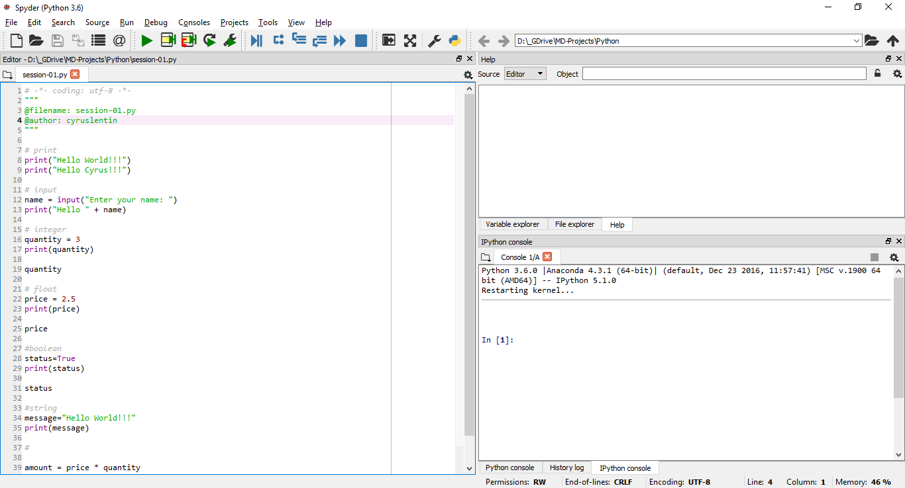
Spyder – First Look

Slide 5
iPython
IPython is a command shell for interactive computing in Python
IPython provides the following features:
Interactive shells
An interface with support for code, text, mathematical expressions, inline plots and other media
Support for interactive data visualization and use of GUI toolkits
Flexible, embeddable interpreters to load into one's own projects
Tools for parallel computing

Slide 6
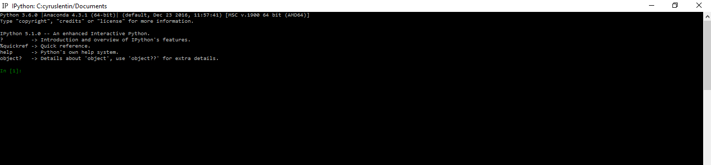
iPython – First Look

Slide 7
iPython Cell
Bullets

Slide 8
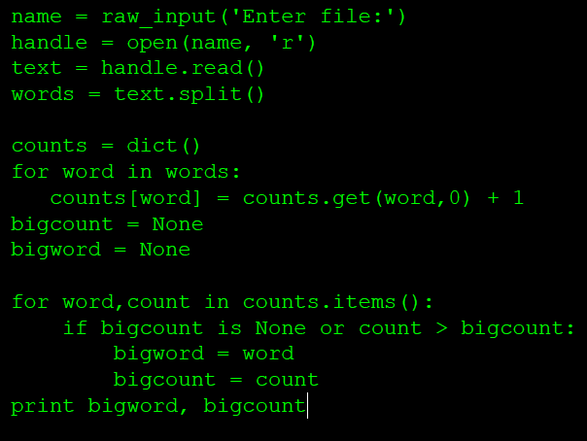
Python Code – First Look

Slide 9
SpyderFamiliarization
iPython
help
credit
license
Editor
Open file
Make Changes
Save File
Preferences
Specify global working directory
Files Opened From – Current File Directory
Files Created In – Current File Directory

Slide 10
Constants
Fixed values such as numbers, letters, and strings are called “constants”
The value does not change
Numeric constants are noted without quotes
String constants use single quotes (') or double quotes (")

Slide 11
Variables
A variable is a named storage in the memory
Data can be stored in a variable and later retrieve the data using the variable “name”
Programmers get to choose the names of the variables
Contents of a variable can be changed in later statement

Slide 12
Python Variable Name Rules
Must start with a letter or underscore _
Must consist of letters and numbers and underscores
Case Sensitive
Valid: spam eggs spam23 _speed
Invalid: 23spam #sign var.12
Different: spam Spam SPAM

Slide 13
Reserved Words
Reserved words can not be used as variable names / identifiers
and del for is raise assert elif
from lambda return break else
global not try class except if or
while continue exec import pass
yield def finally in print as with

Slide 14
Assignment Statements
Value is assigned to a variable using the assignment statement (=)
An assignment statement consists of
an expression on the right-hand side of (=)
and
a variable to store the result on the left hand side of (=)

Slide 15
Numeric Operators
+ Addition
- Subtraction
* Multiplication
/ Division
** Power
% Remainder
Note: Order Of Precedence - BODMAS

Slide 16
Type
In Python variables, literals and constants have a “type”
Python understand there is difference between an integer number and a string
For example “+” means
“addition” if variable is a number
and
“concatenate” if variable is a string
Types in Python:
int, float, long, complex
str
bytes
tuple
frozen set

Slide 17
Exercise
Session-01.Py

Slide 18
Type Conversions
Numeric Conversion
When you put an integer and float in an expression, the integer is implicitly converted to a float
You can control this with the built-in functions int() and float()
String Conversions
You can also use int() and float() to convert between strings and numbers
You will get an error if the string does not contain numeric characters

Slide 19
Comparison Operators
Comparison Operators
Boolean expressions ask a question and produce a Yes or No result which we use to control program flow
Boolean expressions made using comparison operators that evaluate to
True / False
Yes / No
Comparison operators look at variables but do not change the variables
Operators
< Less than
<= Less than or Equal
== Equal to
>= Greater than or Equal
> Greater than
! = Not equal
Note: “=” is used for assignment

Slide 20
Compound Statements
if …. elif …. else
for
while

Slide 21
Headings
Bullets

Slide 22
Headings
Bullets

Slide 23
Headings
Bullets

