Slide 1

AUTODEV
Autodev
Control for agentic
software delivery
An open control plane that governs
coding agents and keeps their
changes reviewable.
Capability baseline is provisional. Validate before a pilot.
01
Notes:
Autodev gives teams a control plane for agentic software delivery. Teams can choose their coding agents while retaining policy, isolation and reviewable evidence. The capability baseline is provisional. The next step is a bounded pilot, not a production-readiness claim.
Supporting source material
Original slide 1:
Autodev is an open, governed control plane for multi-agent software delivery. Replace coding agents, models, skills and execution providers while retaining deterministic policy, isolation, approval, evaluation and evidence. It is not another coding chatbot, IDE, source-control platform or compliance certification.
Source: user-supplied Autodev specification, 8 October 2026. Capability status is provisional and requires validation before a pilot. Implemented denotes described core capabilities, Optional denotes integration/operator choices, and Roadmap denotes future work.
Visual: AI-generated conceptual illustration, 9 October 2026. Not a product screenshot, measured result or certification. Image source: image-d61ed5b5dab983c03f30db0a3bef6a02.jpg

Slide 2

AUTODEV
Agent autonomy creates
an accountability gap
Agents can act
Teams remain accountable
What could it access?
Who authorized the action?
What evidence supports it?
Prompts alone cannot answer these questions.
Change code, run tools, publish changes.
02
Notes:
The product problem is accountable execution. Once agents invoke tools and prepare real repository changes, teams need to know the scope, authority and evidence behind each action. This is a qualitative product thesis, not a market-size or measured-risk claim.
Supporting source material
Original slide 2:
Coding agents operate asynchronously, invoke tools and prepare real repository changes. This is a qualitative progression of authority, not a measured risk score. Publication introduces consequences beyond a local working copy.
Source: user-supplied Autodev specification, 8 October 2026. Capability status is provisional and requires validation before a pilot. Implemented denotes described core capabilities, Optional denotes integration/operator choices, and Roadmap denotes future work.
Original slide 3:
The operating gap is accountability across identity, scope, executed controls, irreversible actions and behavioral change. These five questions define the minimum control surface for a pilot.
Source: user-supplied Autodev specification, 8 October 2026. Capability status is provisional and requires validation before a pilot. Implemented denotes described core capabilities, Optional denotes integration/operator choices, and Roadmap denotes future work.
Visual: AI-generated conceptual illustration, 9 October 2026. Not a product screenshot, measured result or certification. Image source: image-dfa086a9827a1e5390a39ef286f65d19.jpg

Slide 3

AUTODEV
Every change follows a governed workflow
01 Define the task
02 Execute in
isolation
03 Inspect the
evidence
04 Approve
publication
Local policy controls authority. The workflow controller owns phase transitions.
03
Notes:
Autodev separates execution location, capability authorization and workflow timing. Every typed tool call passes governance. Missing capability means deny, and deny wins. Read-only stages may run concurrently. Writes remain serialized. Humans approve publication boundaries. These described core capabilities require validation before a pilot.
Supporting source material
Original slide 4:
Sandbox, governance and workflow are independent controls. Sandbox defines execution location and resource access. Governance authorizes semantic capabilities. Workflow determines whether an authorized capability fits the current phase. Prompts are not a security boundary. Nesting is schematic and does not imply that one boundary replaces the others.
Source: user-supplied Autodev specification, 8 October 2026. Capability status is provisional and requires validation before a pilot. Implemented denotes described core capabilities, Optional denotes integration/operator choices, and Roadmap denotes future work.
Original slide 6:
Connect a repository or start with an empty workspace. Create an isolated worktree and verify agent identity before selecting the workflow and promoted roles. Research, design and plan lead into implementation, tests and security review. Inspect the actual diff and evidence before approving commit, push or pull-request creation. Read-only stages may run concurrently when the workflow allows it. Write-capable work stays serialized. Durable artifacts cross explicit agent handoffs.
Source: user-supplied Autodev specification, 8 October 2026. Capability status is provisional and requires validation before a pilot. Implemented denotes described core capabilities, Optional denotes integration/operator choices, and Roadmap denotes future work.
Original slide 7:
Resolve the typed tool request to a semantic capability, intersect the agent declaration with local policy, then apply organization, task, environment and workflow context. Missing capability means deny. Imported agents and skills cannot grant themselves authority. Allow only permits sandbox execution. Require approval pauses the action for an authorized human. Denials and approval outcomes also enter the evidence record. Commit, push, pull-request creation and deployment are explicit security-sensitive boundaries.
Source: user-supplied Autodev specification, 8 October 2026. Capability status is provisional and requires validation before a pilot. Implemented denotes described core capabilities, Optional denotes integration/operator choices, and Roadmap denotes future work.
Visual: AI-generated conceptual illustration, 9 October 2026. Not a product screenshot, measured result or certification. Image source: image-7b646e84127a425f97dc87f286655eb0.jpg

Slide 4
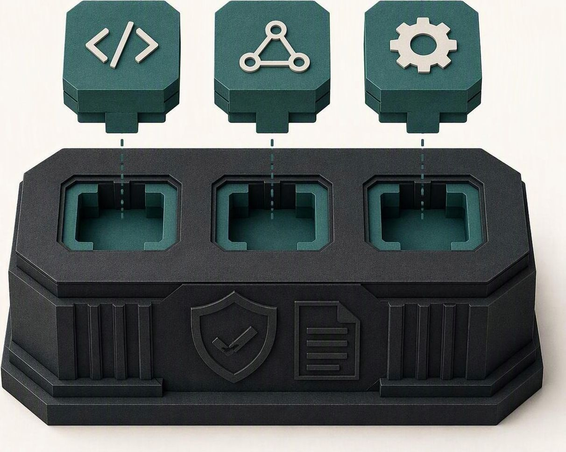
AUTODEV
The agent can change.
The control contract stays.
Stable policy. Comparable evidence.
Replaceable components
Connect agents, models and execution
providers through adapters.
Evidence before promotion
Evaluate a frozen agent version and
dataset, then compare regressions.
Complements existing coding and delivery tools.
External integrations are optional and require configuration and verification.
04
Notes:
The strategic positioning is a stable governance and evidence contract across replaceable components. Agent release uses isolated evaluation and regression comparison tied to a frozen version and dataset. This is the supplied positioning, not a competitor feature audit or a proven moat. External integrations remain optional and provisional.
Supporting source material
Original slide 9:
Autodev keeps the policy and evidence contract stable while adapters change. Agents may come from local YAML or imported .agent.md. Skills include native packs, SKILL.md, GitHub and skills.sh. Models include Copilot, Ollama and Foundry. Sandbox options include Docker and Azure dynamic sessions. Governance can combine local policy with the Microsoft Agent Governance Toolkit. Evaluators include native, Vally and Waza. Interfaces include Web, REST, CLI and MCP. External integration availability is optional and provisional.
Source: user-supplied Autodev specification, 8 October 2026. Capability status is provisional and requires validation before a pilot. Implemented denotes described core capabilities, Optional denotes integration/operator choices, and Roadmap denotes future work.
Original slide 8:
Task evidence links identity, policy version, typed tool events, actual Git diff, tests, scanner findings, approvals and telemetry. The promotion pipeline starts with draft agents and static lint, uses human-reviewed scenarios and a frozen dataset hash, then runs isolated evaluation with native and optional Vally and Waza evidence. Compare regressions before promotion. Evaluation runs are isolated from product tasks and sessions.
Source: user-supplied Autodev specification, 8 October 2026. Capability status is provisional and requires validation before a pilot. Implemented denotes described core capabilities, Optional denotes integration/operator choices, and Roadmap denotes future work.
Original slide 11:
This comparison expresses the supplied positioning, not a product-by-product feature audit. Controls, execution environments and evidence vary by product and configuration. Autodev is complementary to Copilot, Cursor, Devin, OpenHands and GitLab. Do not infer that these products lack controls or that Autodev provides certification.
Source: user-supplied Autodev specification, 8 October 2026. Capability status is provisional and requires validation before a pilot. Implemented denotes described core capabilities, Optional denotes integration/operator choices, and Roadmap denotes future work.
Visual: AI-generated conceptual illustration, 9 October 2026. Not a product screenshot, measured result or certification. Image source: image-b1a09ebcd5205b66cd324e85186337cc.jpg

Slide 5
AUTODEV
A defined baseline,
with clear limits
DESCRIBED BASELINE
ROADMAP / FUTURE WORK
Governed tool execution
Isolated worktrees
Human publication approval
Linked task evidence
Authentication hardening
Signed evidence
Team-scale reliability
Fine-grained authorization
The pilot must validate the baseline before broader adoption.
No production-readiness, compliance-certification or full Agent Hypervisor conformance claim.
05
Notes:
The supplied specification describes a baseline, not proven production readiness. Validate capabilities before pilot execution. Optional integrations need configuration and verification. All roadmap horizons are future work without committed dates. Authentication hardening, signed evidence, PostgreSQL and high availability must not be implied to exist today. Autodev provides no compliance certification and must not be represented as fully Agent Hypervisor conformant.
Supporting source material
Original slide 13:
All three horizons are future work. Now prioritizes operational trust, import review, authentication hardening, signed evidence and evaluation reliability. Next builds team-scale operations, PostgreSQL and HA, fine-grained authorization and a managed sandbox broker. Then adds an adapter SDK, continuous evaluation, compliance exports and fleet SRE. These are direction-setting priorities, not committed delivery dates. Ask the audience to pilot one bounded engineering workflow.
Source: user-supplied Autodev specification, 8 October 2026. Capability status is provisional and requires validation before a pilot. Implemented denotes described core capabilities, Optional denotes integration/operator choices, and Roadmap denotes future work.
Original slide 16:
Optional appendix C. Autodev is an engineering workbench, not a compliance certification. Do not represent it as fully Agent Hypervisor conformant. Implemented labels in this deck describe the supplied baseline and remain provisional. Optional integrations require configuration and verification. Roadmap items are future work. Signed evidence, auth hardening and other roadmap controls must not be implied to exist today. No regulatory compliance or production readiness claim follows from this deck.
Source: user-supplied Autodev specification, 8 October 2026. Capability status is provisional and requires validation before a pilot. Implemented denotes described core capabilities, Optional denotes integration/operator choices, and Roadmap denotes future work.
Original slide 10:
The local configuration combines Next.js and FastAPI with SQLite, file evidence and a Docker worktree sandbox. The cloud deployment pattern includes OIDC, organization RBAC, containerized API and workers, PostgreSQL, Redis Streams, Blob storage, Azure Container Apps dynamic sessions, Key Vault, workload identity and ACR. Observability may use OpenTelemetry, Prometheus, Tempo and Grafana locally, with Azure Monitor and capacity alerts in cloud. Operator configuration and external infrastructure are optional. Team-scale PostgreSQL and HA hardening remain roadmap work, not a claim of production readiness.
Source: user-supplied Autodev specification, 8 October 2026. Capability status is provisional and requires validation before a pilot. Implemented denotes described core capabilities, Optional denotes integration/operator choices, and Roadmap denotes future work.

Slide 6

AUTODEV
A four-week pilot
can test the value
One bounded engineering workflow
For example, dependency updates.
01 Select the task and baseline
02 Configure policy and evaluation
03 Run with publication approval
04 Review results and decide
Measure accepted changes, review effort, quality and cost.
Proposed pilot. Set thresholds in advance. No performance improvement is assumed.
06
Notes:
The proposed next step is a four-week pilot around one repetitive, testable workflow. In week one, choose the task and set baselines and decision thresholds. In week two, encode the agent, skills, policy and frozen evaluation suite. In week three, run isolated tasks with publication approval. In week four, review the evidence and decide whether to expand. Track accepted changes per week, review minutes per accepted change, test and security pass rates, rework, policy denials, approval latency and cost per accepted change. No benchmark or improvement is assumed.
Supporting source material
Original slide 12:
Proposed four-week pilot: select one repetitive, testable task class in week one. Encode the agent, skills, policy and frozen evaluation suite in week two. Run in isolation with publication approval in week three. Review evidence and decide whether to expand in week four. Candidate tasks are dependency updates, framework migrations, test generation, documentation maintenance and security remediation. Set pilot-specific baselines and thresholds before execution. No benchmark or performance improvement is asserted.
Source: user-supplied Autodev specification, 8 October 2026. Capability status is provisional and requires validation before a pilot. Implemented denotes described core capabilities, Optional denotes integration/operator choices, and Roadmap denotes future work.
Visual: AI-generated conceptual illustration, 9 October 2026. Not a product screenshot, measured result or certification. Image source: image-e3e7ba10e7500c22dbef619cba9ed236.jpg

Slide 7
AUTODEV / TECHNICAL BACKUP
Control-plane architecture
Access
Web, REST, CLI and MCP through identity and organization RBAC
Orchestration
Workflow controller, agent registry, sessions and execution jobs
Control
Governance and policy engine with a separate approval service
Evidence
Durable events, artifacts, approvals and evaluation records
Optional adapters: model providers, Docker or Azure execution, and observability backends.
Provisional architecture. External infrastructure and integrations require verification.
07
Notes:
Technical backup. The FastAPI control API and Next.js workbench coordinate workflow and execution services. The workflow controller owns phase transitions. Typed tool calls pass governance before sandbox execution. Publication approval is a separate boundary. Optional model, execution and observability integrations require configuration and verification. Team-scale database and high-availability hardening remain roadmap work.
Supporting source material
Original slide 5:
The workflow controller owns phase transitions, never the model. Clients reach the FastAPI control API through identity and organization RBAC. Registry and execution services coordinate agents and jobs. Every typed tool call reaches the governance and policy engine before execution. The approval service gates publication separately. Providers and observability backends are optional configured integrations.
Source: user-supplied Autodev specification, 8 October 2026. Capability status is provisional and requires validation before a pilot. Implemented denotes described core capabilities, Optional denotes integration/operator choices, and Roadmap denotes future work.
Original slide 10:
The local configuration combines Next.js and FastAPI with SQLite, file evidence and a Docker worktree sandbox. The cloud deployment pattern includes OIDC, organization RBAC, containerized API and workers, PostgreSQL, Redis Streams, Blob storage, Azure Container Apps dynamic sessions, Key Vault, workload identity and ACR. Observability may use OpenTelemetry, Prometheus, Tempo and Grafana locally, with Azure Monitor and capacity alerts in cloud. Operator configuration and external infrastructure are optional. Team-scale PostgreSQL and HA hardening remain roadmap work, not a claim of production readiness.
Source: user-supplied Autodev specification, 8 October 2026. Capability status is provisional and requires validation before a pilot. Implemented denotes described core capabilities, Optional denotes integration/operator choices, and Roadmap denotes future work.

Slide 8

AUTODEV / TECHNICAL BACKUP
Evidence for each task and each agent release
TASK RECORD
Identity and policy version
Tool events, diff, tests and scans
Human decisions and approvals
AGENT RELEASE GATE
Human-reviewed scenarios
Frozen version and dataset hash
Isolated evaluation and regression comparison
Evaluation runs stay separate from product tasks and sessions.
Described baseline is provisional. External evaluators are optional.
08
Notes:
Technical backup. Task evidence links identity, policy, typed tool events, actual diffs, tests, scanner output and approvals. Promotion requires the evaluated agent version, suite, dataset and frozen hash to match. Native evidence can combine with optional Vally and Waza evaluators. Evaluation records stay separate from product tasks and sessions. Validate all described capabilities before a pilot.
Supporting source material
Original slide 8:
Task evidence links identity, policy version, typed tool events, actual Git diff, tests, scanner findings, approvals and telemetry. The promotion pipeline starts with draft agents and static lint, uses human-reviewed scenarios and a frozen dataset hash, then runs isolated evaluation with native and optional Vally and Waza evidence. Compare regressions before promotion. Evaluation runs are isolated from product tasks and sessions.
Source: user-supplied Autodev specification, 8 October 2026. Capability status is provisional and requires validation before a pilot. Implemented denotes described core capabilities, Optional denotes integration/operator choices, and Roadmap denotes future work.
Original slide 14:
Optional appendix A. Conceptual system-design view of the supplied architecture. The task is the durable unit of intent. A session carries agent and workflow context. Execution jobs pass governance and execute in a sandbox. Events record lifecycle and typed-tool results, artifacts capture diffs, tests and scanner output, and approvals capture human decisions. Evaluation records stay in a separate namespace from product tasks and sessions.
Source: user-supplied Autodev specification, 8 October 2026. Capability status is provisional and requires validation before a pilot. Implemented denotes described core capabilities, Optional denotes integration/operator choices, and Roadmap denotes future work.
Visual: AI-generated conceptual illustration, 9 October 2026. Not a product screenshot, measured result or certification. Image source: image-9565e5b1792b28ad635fdfbdaa9d0b44.jpg

