Slide 1
02
Question 2: Outreach Prioritization
Outreach Prioritization
Rank sellers by outreach readiness, not just historical spend.
Standalone Q2 section deck. The master title slide is intentionally omitted.
Initial findings: seller activity, paid usage, fee concentration, and spike context.
Outreach prioritization: compare outreach readiness with total-fee ranking.
Seller-level scored output: preview the final prioritization file.
Outreach Prioritization
01 / 21

Slide 2
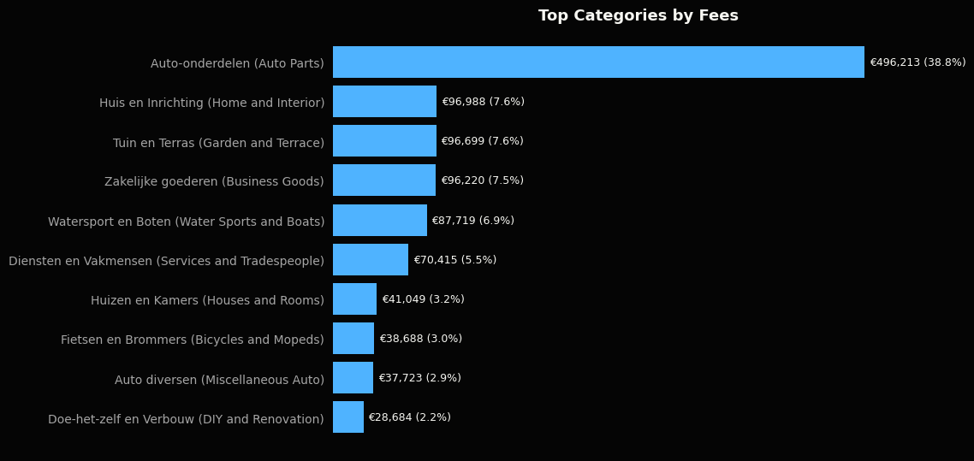
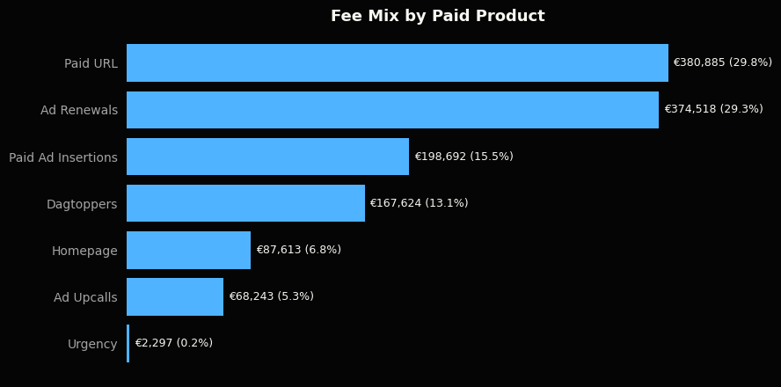
02
1. Initial Findings
Outreach Prioritization
02 / 21

Slide 3
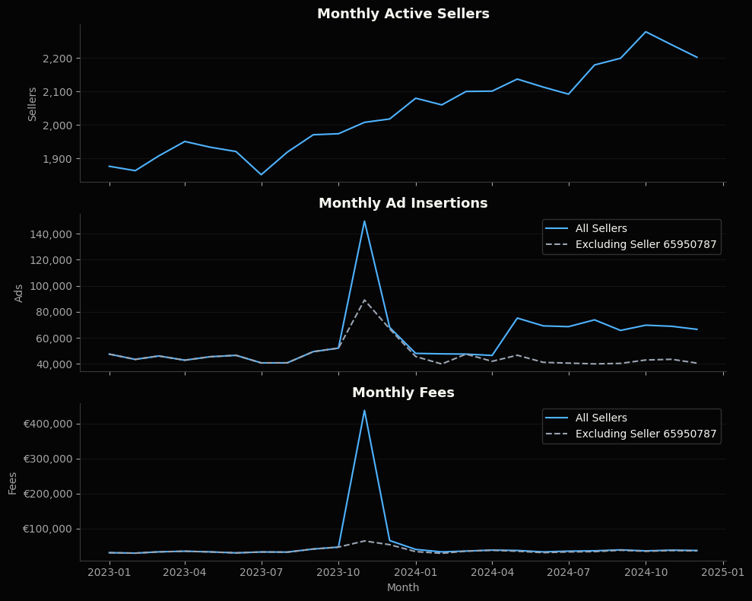
02
1.1 Anomaly Overview
Seller 65950787 in Auto-onderdelen explains the extreme November fee spike.
Even excluding that seller, November remains elevated in ads and fees.
The remaining lift is broader across sellers/categories, not another single obvious anomaly.
Seller ID | 65950787
Month | 2023-11
Category | Auto-onderdelen (Auto Parts)
Paid Ad Insertions | 60,622
Paid URL Features | 60,550
Paid URL Fees | €361,604
Total Fees | €373,857
Share of Monthly Ads | 40.5%
Share of Monthly Fees | 85.4%
Outreach Prioritization
05 / 21

Slide 4
02
1.2 Initial Findings Summary
These visuals summarize where seller activity, paid usage, and category fees concentrate.
The sample is clean: no missing values, duplicate seller-month-category rows, or negative metric values.
Free ad insertions dominate activity; ad renewals and paid insertions are the main paid-usage counts.
Paid URL and ad renewals drive most fees.
Auto-onderdelen is the largest category in fee terms.
Outreach Prioritization
06 / 21

Slide 5
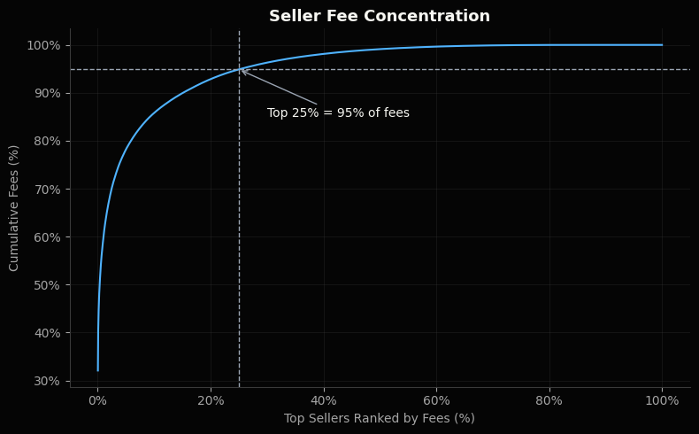
02
2. Outreach Prioritization
Seller activity is highly skewed
Logical first cut: targets sellers with proven willingness to pay.
However, fees-based targeting might be too narrow.
Can miss sellers who are active, consistent, growing, broad-category, or already using several paid products.
First batch should balance commercial value with bundle relevance.
Outreach Prioritization
07 / 21

Slide 6
02
2.1 Outreach Readiness
Goal: rank outreach readiness, not just historical spend.
Why: fee-only ranking misses sellers who are active, growing, broad-category, or already using paid products.
Spike callback: the November spike shows why raw spend alone is too brittle; percentile-based signals keep extreme sellers from dominating the outreach list.
Approach: convert each signal to a seller percentile rank, then take a simple average of the six scores into an outreach readiness score.
Group: sellers in the top 25% of outreach readiness score are the outreach ready group.
Signal | Purpose | Definition
Recent paid usage | Current paid-product need / activity | Paid marketplace actions in the last 6 months
Consistency | Reliability as a subscription candidate | Number of months with seller activity across 2023-2024
Category breadth | Fit for professional seller page / bundle value | Number of categories used across 2023-2024
Recent growth | Momentum | Recent paid usage vs prior 6 months, with +1 smoothing
Total fees | Historical willingness to pay | Total fees paid across 2023-2024
Paid product breadth | Familiarity with multiple paid products | Number of distinct paid marketplace product types used across 2023-2024
Each signal is on a 0-100 percentile scale. Very large raw values improve rank but do not dominate the total score.
Outreach Prioritization
08 / 21

Slide 7
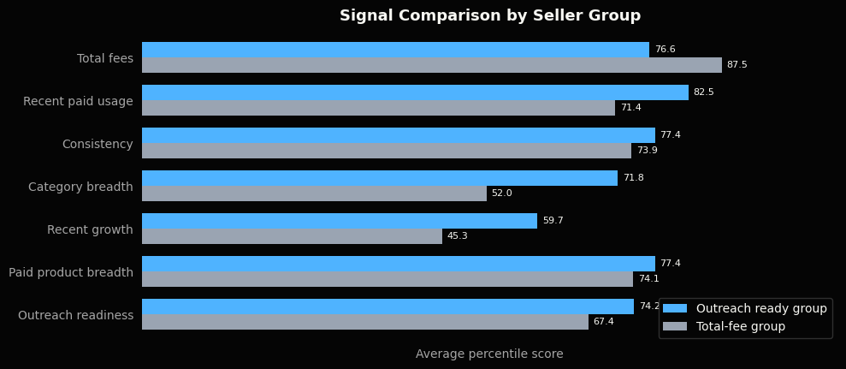
02
2.1 Outreach Readiness / Seller Profile
The outreach-ready group is stronger on non-fee signals than a pure fee-based rank.
Outreach Prioritization
10 / 21

Slide 8
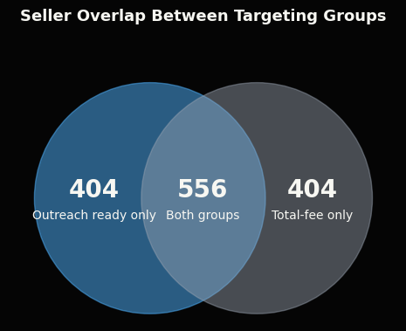
02
2.1 Outreach Readiness / Selection Summary
Metric | Neither | Both groups | Outreach ready only | Total-fee only
Sellers | 2,476 | 556 | 404 | 404
Avg fees / seller | €18 | €1,907 | €51 | €382
Avg 6mo fees / seller | €6 | €310 | €22 | €61
Avg active months | 8.8 | 21.6 | 20.0 | 17.3
Avg recent paid usage | 9.2 | 505.8 | 208.8 | 19.2
Avg categories | 5.1 | 9.1 | 13.4 | 3.5
Avg paid product breadth | 2.2 | 4.9 | 4.2 | 3.8
Median 6mo paid action growth | +0% | +12% | +87% | -17%
Outreach Prioritization
12 / 21

Slide 9
02
2.2 Bundle Choice
After selecting the outreach-ready group, use a separate bundle-fit score to suggest which bundle to pitch.
Score: simple average of the percentile ranks for paid visibility usage, paid product breadth, and listing volume.
Why: Plus adds extra visibility stickers and links from each ad to the seller's other ads, so it fits sellers already using visibility products or managing enough listings to benefit from cross-ad promotion.
Group: sellers in the top 40% of bundle fit score inside the outreach ready group are targeted for Plus.
Targeted for Basic group: sellers in the outreach ready group who are not targeted for Plus are targeted for Basic.
Signal | Use in bundle fit score? | Reason
Paid visibility usage | Yes | Direct match to Plus benefits: more visibility and cross-ad promotion.
Paid product breadth | Yes | Sellers using multiple paid products already understand paid value.
Listing volume | Yes | Direct match to Plus cross-ad value: more ads means more inventory to promote from each listing.
Category breadth | No | Useful for outreach readiness, but listing volume is a clearer fit for cross-ad promotion.
Recent paid usage | No, not directly | Useful for outreach readiness, but too broad for bundle choice; the bundle fit score uses visibility-specific usage instead.
Consistency | No | Good subscription-fit signal, but it does not distinguish Basic vs Plus.
Recent growth | No | Shows momentum, but not which bundle fits better.
Total fees | No | Shows willingness to pay, but would make Plus selection too spend-driven.
Outreach Prioritization
14 / 21

Slide 10
02
2.2 Bundle Choice / Target Groups
Suggested split: target Plus for the highest bundle-fit sellers in the outreach ready group. In this first pass, use the top 40% as a practical starting point; recalibrate after outreach using response and conversion data.
Alternative: use no fixed 40%; show sellers ranked by bundle fit score and let Sales choose based on capacity.
Future improvement: calibrate this split with response, conversion, and upgrade data after outreach starts.
The table below compares sellers targeted for Plus with sellers targeted for Basic inside the outreach ready group. Fee values are averages per selected seller; signal values are average percentile scores.
 | Target Group | Selected Sellers | Avg fees per seller | Avg paid visibility score | Avg paid product breadth score | Avg listing volume score | Avg bundle fit score | Avg outreach readiness score
0 | Targeted for Plus group | 384 | €2,230 | 89.6 | 87.6 | 85.6 | 87.6 | 77.5
1 | Targeted for Basic group | 576 | €389 | 68.9 | 70.7 | 69.1 | 69.6 | 72.0
Outreach Prioritization
15 / 21

Slide 11
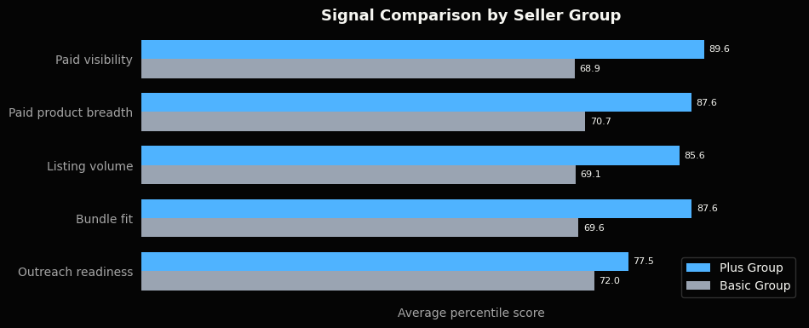
02
2.2 Bundle Choice / Bundle Score Profile
Bundle fit separates high-visibility, multi-product, high-volume sellers from the Basic target group.
Outreach Prioritization
16 / 21

Slide 12
02
2.3 Recommendation / Next Step
Recommendation
Use the outreach ready group for the first outreach batch.
Target sellers who are active, consistent, multi-category, growing, and already familiar with paid products.
These traits are closer to likely outreach response than fee history alone.
Next Step: Outcome-Based Ranking
After initial outreach, supervised learning could replace the manual score.
Train on response, conversion, and post-signup value.
Keep the ranking explainable for stakeholders and leadership.
Outreach Prioritization
17 / 21

