Slide 1
01 Identify
02 Prioritize
Rank sellers by outreach readiness and bundle fit
03 Monitor
04 Scale
01 / 12

Slide 2
02
1. Framing
3,840
83%
960
25%
sample sellers
likely SMBs
first-batch target
of sample prioritized
Basic
professional trust
Plus
professional trust +
attention + cross-promotion
Verified seller icon, professional seller page, and extra pictures for more visibility.
Everything in Basic, plus visibility stickers and links from every ad to the seller's other ads.
Approach
Review activity, fees, and anomalies; then build a broader outreach readiness score.
Outreach Prioritization
02 / 12

Slide 3
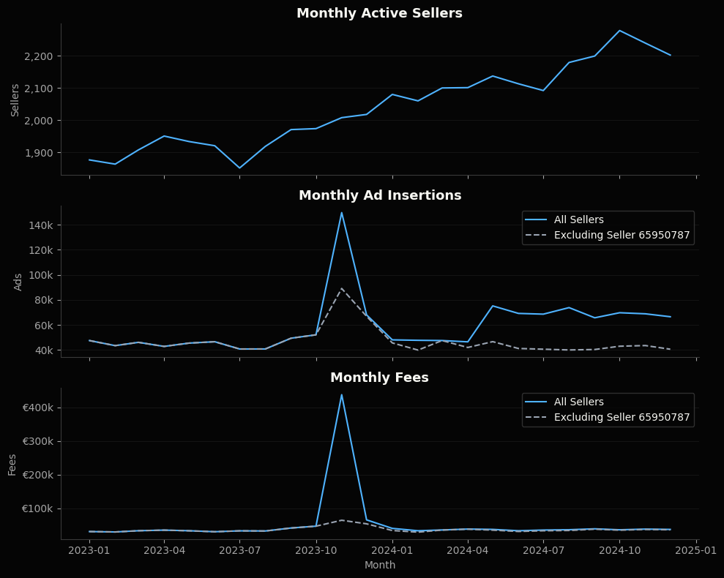
02
1. Data Snapshot
Data quality is strong: no missing values, duplicate seller-month-category rows, or negative metrics.
Anomaly Overview
November 2023 has a visible spike, partly driven by seller 65950787 in Auto-onderdelen explains most extreme November fee spike.
Even excluding that seller, November remains elevated in ads and fees. The remaining lift is broader across sellers/categories, not another single obvious anomaly.
Outreach Prioritization
03 / 12

Slide 4
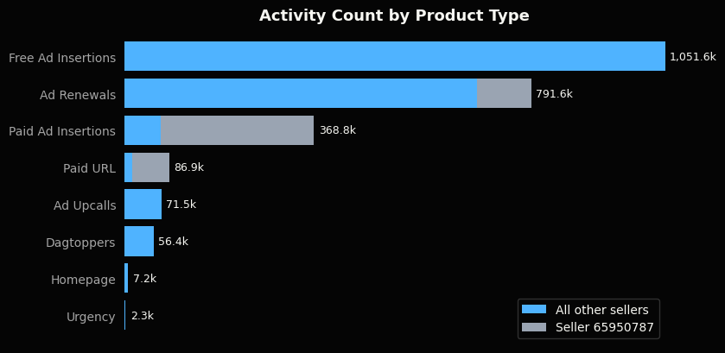
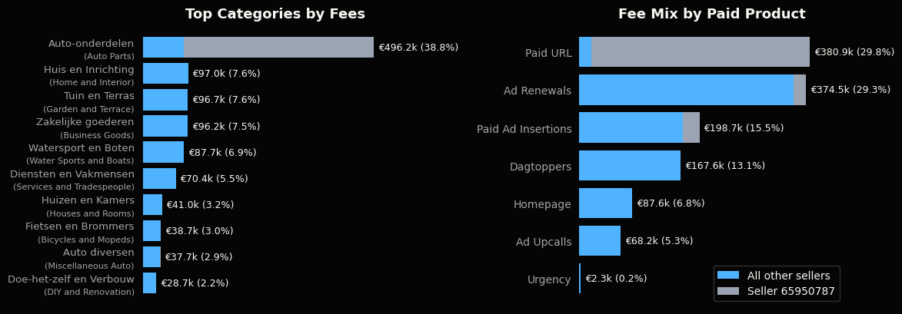
02
1. Data Snapshot
Outreach Prioritization
04 / 12

Slide 5
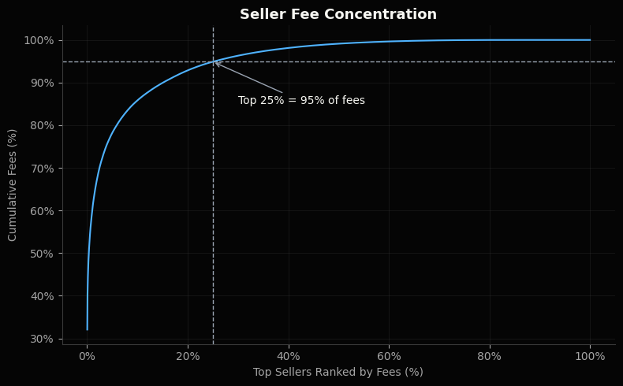
02
2. Outreach Prioritization
Seller activity is highly skewed: a small group drives much of the volume and fees.
Ranking by total fees
Ranking sellers by total fees is as a baseline initial prioritization approach: target sellers with the strongest historical willingness to pay.
Outreach Prioritization
05 / 12

Slide 6
02
2.1 Outreach Readiness
Goal: rank outreach readiness, not just historical spend.
Why: the first outreach batch should prioritize sellers who are both commercially valuable and likely to see value in a bundle.
Approach: convert each signal to a seller percentile rank, then take a simple average of the six scores.
Group: sellers in the top 25% of Outreach-Readiness score are the outreach-ready group.
Signals used in the outreach-readiness score
Recent paid usage
Consistency
Category breadth
Current paid-product need / activity
Reliability as a subscription candidate
Fit for professional seller page / bundle value
Paid marketplace actions in the last 6 months
Number of months with seller activity across 2023-2024
Number of categories used across 2023-2024
Recent growth
Total fees
Paid product breadth
Momentum
Historical willingness to pay
Familiarity with multiple paid products
Recent paid usage vs prior 6 months, with +1 smoothing
Total fees paid across 2023-2024
Number of distinct paid marketplace product types used across 2023-2024
Each signal is on a 0-100 percentile scale; very large raw values improve rank but do not dominate the score.
Outreach Prioritization
06 / 12

Slide 7
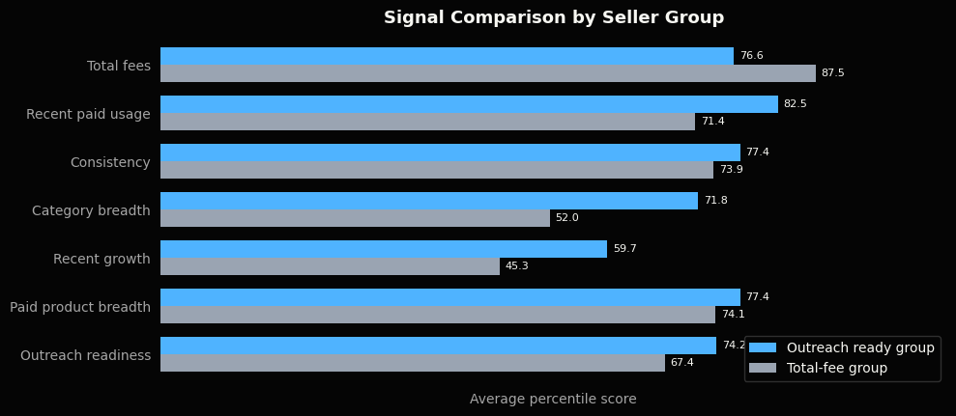
02
2.1 Outreach Readiness
Seller Profile by Outreach Scoring Method
Outreach Prioritization
07 / 12

Slide 8
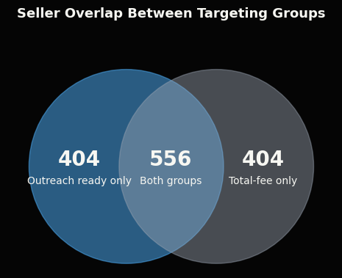
02
2.1 Outreach Readiness
Metric | Neither | Group Overlap | Outreach- ready group only | Total-fee group only
Sellers | 2476 | 556 | 404 | 404
Avg Fees per Seller | €18 | €1,907 | €51 | €382
Avg 6mo Fees per Seller | €6 | €310 | €22 | €61
Avg Active Months | 8.8 | 21.6 | 20.0 | 17.3
Avg Recent Paid Usage | 9.2 | 505.8 | 208.8 | 19.2
Avg Category Count | 5.1 | 9.1 | 13.4 | 3.5
Avg Paid Product Breadth | 2.2 | 4.9 | 4.2 | 3.8
Median 6mo Paid Action Growth Rate | +0% | +12% | +87% | -17%
Seller Group Selection Summary
Outreach Prioritization
08 / 12

Slide 9
02
2.2 Bundle Choice
After selecting the outreach-ready group, use a separate bundle-fit score to suggest which bundle to pitch.
Score: simple average of percentile ranks for paid visibility usage + paid product breadth + listing volume.
Why: Plus fits sellers already using visibility products or managing enough listings to benefit from cross-ad promotion.
Criteria: Sellers in the top 40% of bundle fit score inside the outreach ready group are targeted for Plus, the rest for Basic
Used in bundle-fit score
Not used for bundle choice
directly maps to Plus value
Paid visibility usage
Direct match to Plus benefits: more visibility and cross-ad promotion.
New Signal
Category breadth
Listing volume is a clearer fit for cross-ad promotion.
Count of paid visibility actions*
Recent paid usage
Too broad for bundle choice; the bundle-fit score uses visibility-specific usage instead.
Paid product breadth
Sellers using multiple paid products already understand paid value.
Count of distinct paid product types
Consistency
Does not distinguish Basic vs Plus.
Listing volume
Direct match to Plus cross-ad value: more ads means more inventory to promote from each listing.
New Signal
Recent growth
Does not distinguish Basic vs Plus.
Total ad insertions (free + paid)
Each signal is on a 0-100 percentile scale; very large raw values improve rank but do not dominate the score.
Total fees
Shows willingness to pay, but would make Plus selection too spend-driven.
* Paid visibility actions: Dagtoppers, Homepage, Paid URL, Ad Upcalls, and Urgency actions.
Outreach Prioritization
10 / 12

Slide 10
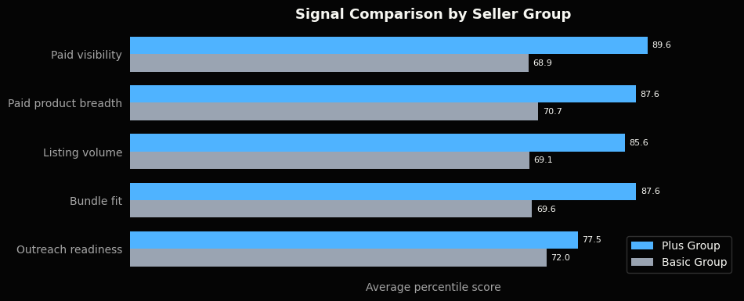
02
2.2 Bundle Choice
Suggested split: target Plus for the highest bundle-fit sellers in the outreach ready group; use the top 40% as a practical starting point.
Alternative: use no fixed 40%; show sellers ranked by bundle fit score and let Sales choose based on capacity.
Future improvement: calibrate this split with response, conversion, and upgrade data after outreach starts.
Metric | Targeted for Plus | Targeted for Basic
Selected Sellers | 384 | 576
Avg fees per seller | €2,230 | €389
Avg paid visibility score | 89.6 | 68.9
Avg paid product breadth score | 87.6 | 70.7
Avg listing volume score | 85.6 | 69.1
Avg bundle fit score | 87.6 | 69.6
Avg outreach readiness score | 77.5 | 72.0
Outreach Prioritization
11 / 12

Slide 11
02
2.3 Recommendations
Recommendation
Use the outreach ready group for the first outreach batch.
It keeps commercial value in the model, but avoids over-indexing on historical spend.
It adds sellers who are active, consistent, multi-category, growing, and already familiar with paid products.
These traits are closer to likely outreach response than fee history alone.
Full seller-level CSV available as q2_scored_sellers.csv
Next Step: Outcome-Based Ranking
After initial outreach, supervised learning could replace the manual score.
Train on response, conversion, and post-signup value.
Keep the ranking explainable for Sales and leadership.
Outreach Prioritization
12 / 12

