Slide 1
01 Identify
02 Prioritize
03 Monitor
Track bundle adoption, revenue, and customer quality
04 Scale
01 / 12

Slide 2
03
1. Dashboard Framing
Goal: monitor whether SMB Bundles are gaining traction, converting to paid usage, and creating measurable value.
Use controls such as filters and breakdown dimensions for deep-dive.
Suggested data enrichments:
Extra revenue and seller-outcome data to assess impact
SMB likelihood, Outreach readiness, and various seller activity dataset for detailed segmentation
Structure: Three Dashboard Views
Sales Overview
Goal
Track launch traction and monetized adoption
Main question
Are bundles gaining commercial traction?
Customer Quality
Goal
Monitor conversion, retention, and segment differences
Main question
Are registrations becoming retained paid customers?
Business Impact
Goal
Quantify value for Marktplaats and sellers
Main question
Are bundles creating measurable value?
SMB Bundle Dashboard
02 / 16

Slide 3
03
2. Sales Overview
KPI Snapshot
What is the latest headline readout?
2025-04-29
2,709 (+0% w/w)
0 (+0% w/w)
Reference date
Active paid bundles
Active trial bundles
41 (+156% vs prior 4wk)
40.9% (+0.1pp w/w)
€88,373 (+0% vs prior 4wk)
New registration in 4wk
Plus share of active paid bundles
Modeled revenue in 4wk
SMB Bundle Dashboard
03 / 16

Slide 4
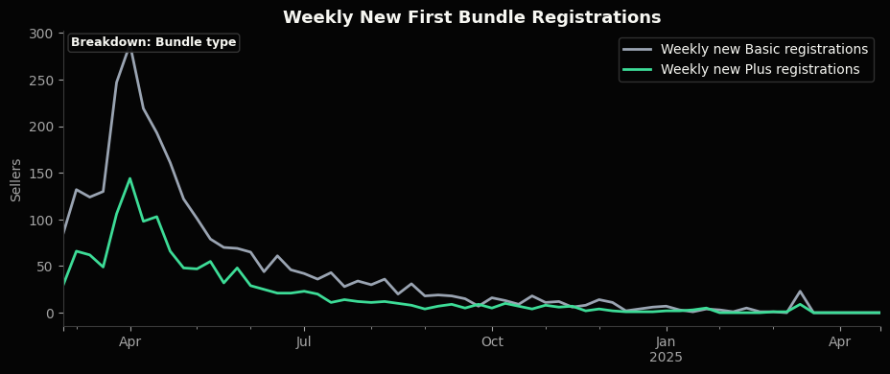
03
2. Sales Overview
New Registrations Trend
Is launch demand growing, stable, or fading?
Caveat: registrations = trial starts, not paid subscriptions start.
Controls: date range, customer type (SYI/Pro), bundle type.
SMB Bundle Dashboard
05 / 16

Slide 5
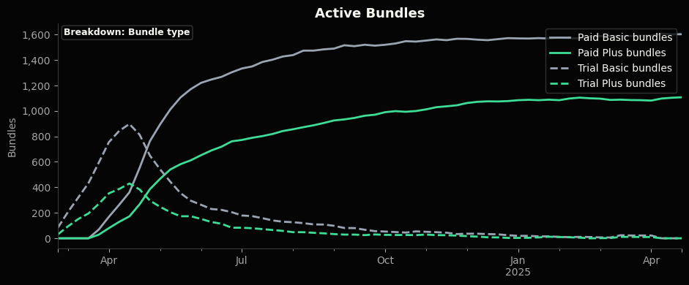
03
2. Sales Overview
Active Bundles Trend
Is the bundle base turning into paid adoption?
Controls: date range, customer type (SYI/Pro), , bundle.
SMB Bundle Dashboard
06 / 16

Slide 6
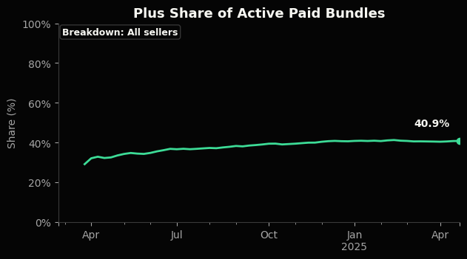
03
2. Sales Overview
Plus Share Trend
Is the paid base shifting toward Plus?
Controls: date range and customer type.
SMB Bundle Dashboard
07 / 16

Slide 7
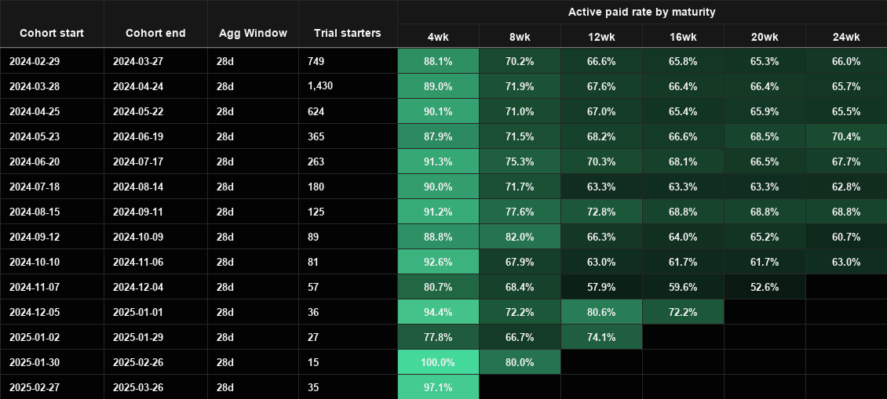
03
3. Customer Quality
Cohort Health
Do cohorts stay active paid after trial and later billing cycles?
Caveat: blank cells are immature checkpoints, not zero conversion.
SMB Bundle Dashboard
08 / 16

Slide 8
03
3. Customer Quality
Segmentation Health Snapshot
Potential Segmentation Merge
Segment dimension | Segment value | Registrations | Paid conversion at 28d | % Plus of active paid bundles | Active paid bundles | Current no-bundle share
Customer type | SYI | 3,137 | 89.1% | 40.9% | 2,093 | 33.3%
Customer type | Pro | 939 | 89.5% | 40.7% | 616 | 34.4%
First bundle type | Basic-first | 2,791 | 89.4% | 25.5% | 1,845 | 33.9%
First bundle type | Plus-first | 1,285 | 88.7% | 73.6% | 864 | 32.8%
Potential merge | Why it helps
SMB likelihood score | Separates likely business sellers from lighter consumer-like sellers.
Outreach readiness score | Shows whether sales-prioritized sellers convert and retain better.
Historical spend tier | Distinguishes high and low-spend
Seller size / activity tier | Identifies whether bundles work better for large or small sellers.
Outreach batch / channel | Connects launch execution to registration and paid conversion quality.
SMB Bundle Dashboard
12 / 16

Slide 9
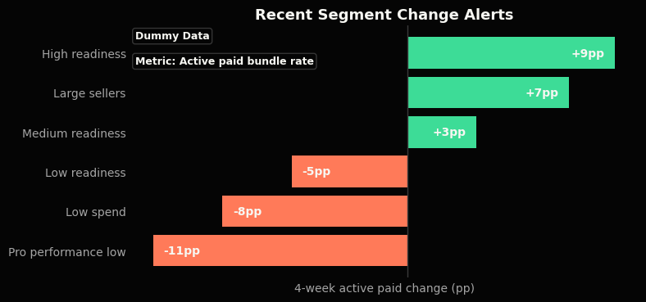
03
3. Customer Quality
Segment Change Alerts
Which segments changed sharply in the last 4 weeks? Highlights where follow-up is most urgent.
Controls: displayed metrics can be dynamically selected, as well as comparison time window.
Caveat: dummy data.
SMB Bundle Dashboard
12 / 16

Slide 10
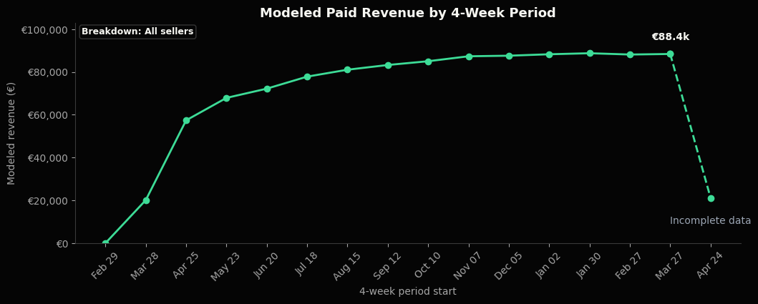
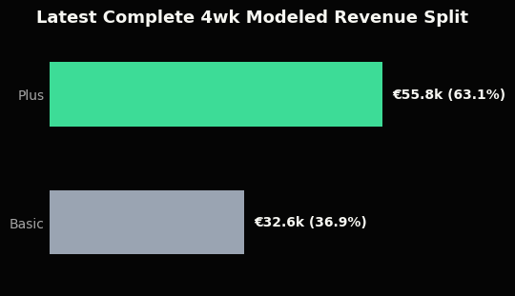
03
4. Business Impact
Are bundles creating measurable value for Marktplaats and sellers?
Current data supports: modeled paid revenue and bundle revenue mix.
Still missing: actual invoiced revenue and seller outcome data.
Modeled Bundle Revenue
Is paid adoption translating into subscription revenue?
Caveat: modeled from intervals and list prices; not invoiced or incremental revenue.
SMB Bundle Dashboard
14 / 16

Slide 11
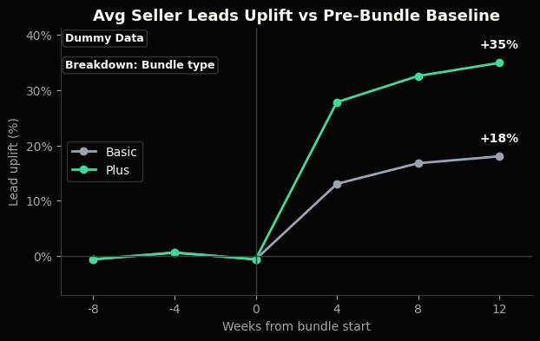
03
4. Business Impact
Seller Outcome Uplift
Do bundles help sellers generate more leads?
Controls: breakdown by bundle type,
Caveat: dummy data, requires seller-level lead data
SMB Bundle Dashboard
16 / 16

