Slide 1
SMB Bundle Strategy
Home Assignment for Senior Marketing Analyst role at Marktplaats
Omer Tal, June 2026
01
02
03
04
Identify
Prioritize
Monitor
Scale
Find likely SMB sellers using seller behavior and attributes
Rank sellers by outreach readiness and bundle fit
Track bundle adoption, revenue, and customer quality
Use Lifecycle and in-product prompts to grow adoption

Slide 2
01 Identify
Find likely SMB sellers using seller behavior and attributes
02 Prioritize
03 Monitor
04 Scale
01 / 08

Slide 3
01
1. SMB Identification
SMB likelihood is inferred from repeated commercial behavior across setup, paid intent, listing activity, category focus, and buyer demand.
Signal Map
Business Markers
Paid Usage
Seller Activity
Category Focus
Buyer Demand
Corporate bank flag
External URL
Paid features
Pro CPC, invoices
Listing volume
Active and recent listings
Repeated category
Category-specific thresholds
Engaged ads
Unique buyers, engagement rate
Scoring Flow
Raw seller data
Seller-level signals
Weighted score
Ranked SMB list
schemas and columns
one row per seller
evidence strength
prioritized outreach
SMB Identification
02 / 08

Slide 4
01
1.1 Direct Business Markers
Signal: fields that directly indicate business setup or off-platform commercial presence.
Potential Metrics
Scoring window: latest corporate bank flag; external URL usage over last 12 months.
Metric | Columns Used | Why Useful
Corporate bank account flag | Bank account is corporate y/n | Direct business setup signal.
External URL attached across multiple ads | External URL attached to the ad y/n | Suggests off-platform business presence or lead routing.
SMB Identification
03 / 08

Slide 5
01
1.2 Paid Usage
Signal: sellers who repeatedly pay for visibility, Pro traffic, or invoiced services are more likely to be commercial sellers.
Potential Metrics
Scoring window: last 12 months.
Metric | Columns Used | Why Useful
Paid feature usage | Feature type | Captures repeated use of paid visibility products.
Paid feature spend | Feature fee | Measures willingness to pay for visibility.
Paid listing fees | Insertion fee | Captures paid listing behavior outside feature purchases.
Pro CPC usage | CPC, Ad id | Indicates performance-oriented selling.
Pro paid traffic scale | CPC, Daily number of clicks | Estimates the scale of paid Pro traffic.
Invoice months | Invoice month | Captures recurring billing, not just one-off payments.
Invoice amount | Total invoice amount | Captures scale of invoiced spend.
SMB Identification
04 / 08

Slide 6
01
1.3 General Seller Activity
Signal: sellers that repeatedly list and stay active look more business-like than one-off sellers.
Potential Metrics
Scoring window: last 12 months; recent listing activity uses last 3 months.
Metric | Columns Used | Why Useful
Ads in last 12 months | User id, Ad id, Ad start date/time | Captures seller volume.
Active months | Ad start date/time | Captures persistence.
Max concurrent live ads | Ad start date/time, Ad end date/time | Captures maintained inventory.
Recent listing activity | Ad start date/time | Keeps outreach focused on reachable sellers.
SMB Identification
05 / 08

Slide 7
01
1.4 Category Specialization
Signal: SMBs often show repeated supply within the same category or subcategory.
Potential Metrics
Scoring window: last 12 months; use main category and specific subcategory.
Metric | Columns Used | Why Useful
Category-adjusted repeated listings | Ad category | Repeated listings are more meaningful in some categories than others.
Threshold Examples
High-value / dealer-like: Cars; Motorcycles; Caravans and Camping; Water Sports and Boats; Car Parts
Service / business: Business Goods; Services and Tradespeople; Jobs
Lower threshold: a few listings can already suggest commercial supply.
Lower threshold: the category itself is closer to business activity.
Consumer resale: Clothing - Women; Clothing - Men; Books; Children and Babies; CDs and DVDs; Games
Broad / mixed: Miscellaneous; Home and Furnishings; Garden and Terrace; Hobby and Leisure; Collectibles
Higher threshold: several listings can still be normal household selling.
Higher threshold or require another signal, because category alone is noisy.
SMB Identification
06 / 08

Slide 8
01
1.5 Buyer Engagement Aggregated by Seller
Signal: one popular ad can be consumer behavior; repeated buyer engagement across ads is more SMB-like.
Potential Metrics
Scoring window: last 12 months.
Metric | Columns Used | Why Useful
Engaged ads | Ad id, Page, Click | Avoids one-ad outliers.
Unique engaged buyers | Buyer id, Seller id | Captures breadth of demand.
Months with engagement | Message date/time, traffic event date/time | Captures persistence.
Engagement rate | Page, Click, Daily number of impressions | Controls for exposure where possible.
SMB Identification
07 / 08

Slide 9
01
2. Decision Mechanism
Create a ranked seller list by scoring each seller-level SMB signal based on strength; categories organize the signals, but the final score is built from the signals themselves.
Weight | General Rule | Example Signals
Highest | Direct evidence of business setup. | Corporate bank account flag.
High | Clear paid selling behavior. | Recurring invoice months, Pro CPC usage, paid feature spend.
Lower | SMB-like behavior that is useful but noisier. | High listing volume, repeated listings in the same category, business-prone categories, buyer engagement across ads.
Output: ranked sellers with user_id, smb_score, confidence tier, top reasons, and recommended action.
Supervised Model Scoring If true SMB labels become available, replace manual weights with a supervised model using the same seller-level features. Keep the output explainable so stakeholders can see why each seller was prioritized.
SMB Identification
08 / 08

Slide 10
01 Identify
02 Prioritize
Rank sellers by outreach readiness and bundle fit
03 Monitor
04 Scale
01 / 12

Slide 11
02
1. Framing
3,840
83%
960
25%
sample sellers
likely SMBs
first-batch target
of sample prioritized
Basic
professional trust
Plus
professional trust +
attention + cross-promotion
Verified seller icon, professional seller page, and extra pictures for more visibility.
Everything in Basic, plus visibility stickers and links from every ad to the seller's other ads.
Approach
Review activity, fees, and anomalies; then build a broader outreach readiness score.
Outreach Prioritization
02 / 12

Slide 12
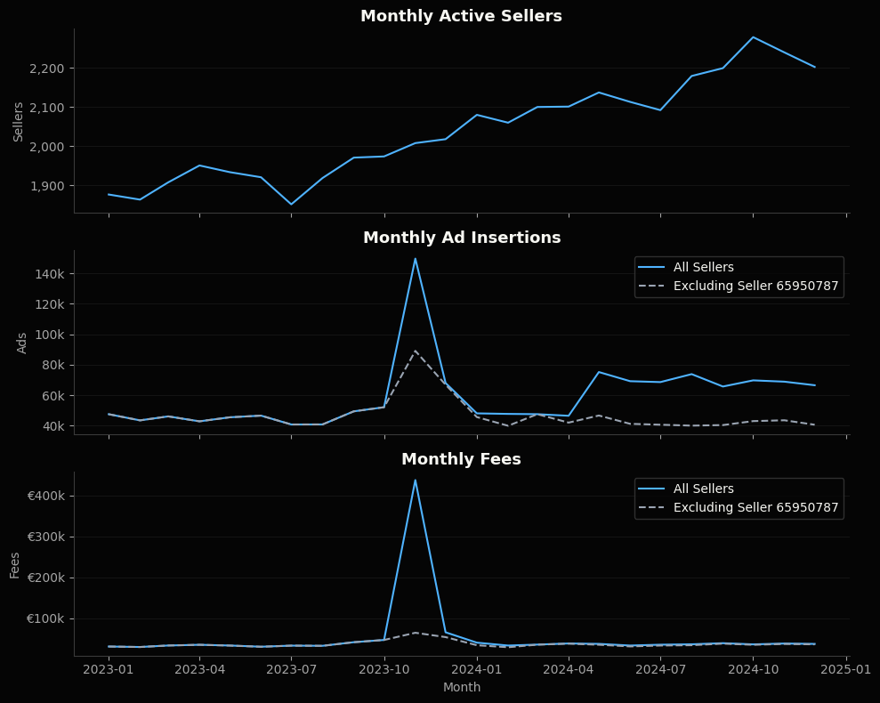
02
1. Data Snapshot
Data quality is strong: no missing values, duplicate seller-month-category rows, or negative metrics.
Anomaly Overview
November 2023 has a visible spike, partly driven by seller 65950787 in Auto-onderdelen explains most extreme November fee spike.
Even excluding that seller, November remains elevated in ads and fees. The remaining lift is broader across sellers/categories, not another single obvious anomaly.
Outreach Prioritization
03 / 12

Slide 13
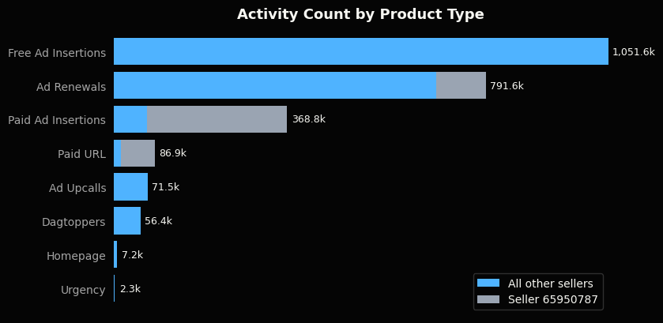
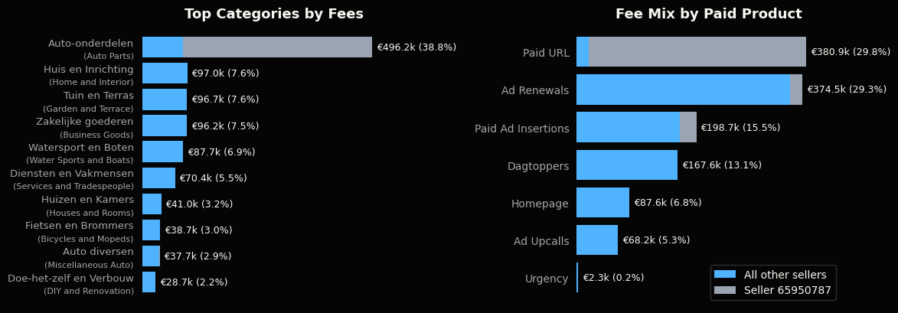
02
1. Data Snapshot
Outreach Prioritization
04 / 12

Slide 14
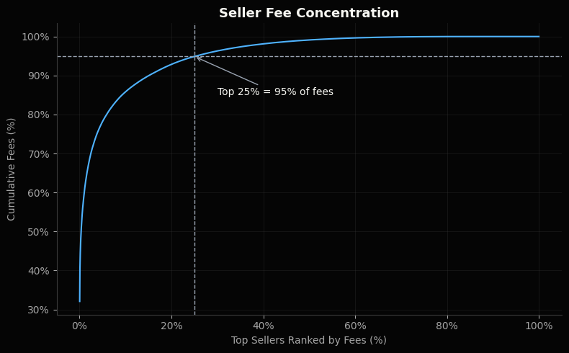
02
2. Outreach Prioritization
Seller activity is highly skewed: a small group drives much of the volume and fees.
Ranking by total fees
Ranking sellers by total fees is as a baseline initial prioritization approach: target sellers with the strongest historical willingness to pay.
Outreach Prioritization
05 / 12

Slide 15
02
2.1 Outreach Readiness
Goal: rank outreach readiness, not just historical spend.
Why: the first outreach batch should prioritize sellers who are both commercially valuable and likely to see value in a bundle.
Approach: convert each signal to a seller percentile rank, then take a simple average of the six scores.
Group: sellers in the top 25% of Outreach-Readiness score are the outreach-ready group.
Signals used in the outreach-readiness score
Recent paid usage
Consistency
Category breadth
Current paid-product need / activity
Reliability as a subscription candidate
Fit for professional seller page / bundle value
Paid marketplace actions in the last 6 months
Number of months with seller activity across 2023-2024
Number of categories used across 2023-2024
Recent growth
Total fees
Paid product breadth
Momentum
Historical willingness to pay
Familiarity with multiple paid products
Recent paid usage vs prior 6 months, with +1 smoothing
Total fees paid across 2023-2024
Number of distinct paid marketplace product types used across 2023-2024
Each signal is on a 0-100 percentile scale; very large raw values improve rank but do not dominate the score.
Outreach Prioritization
06 / 12

Slide 16
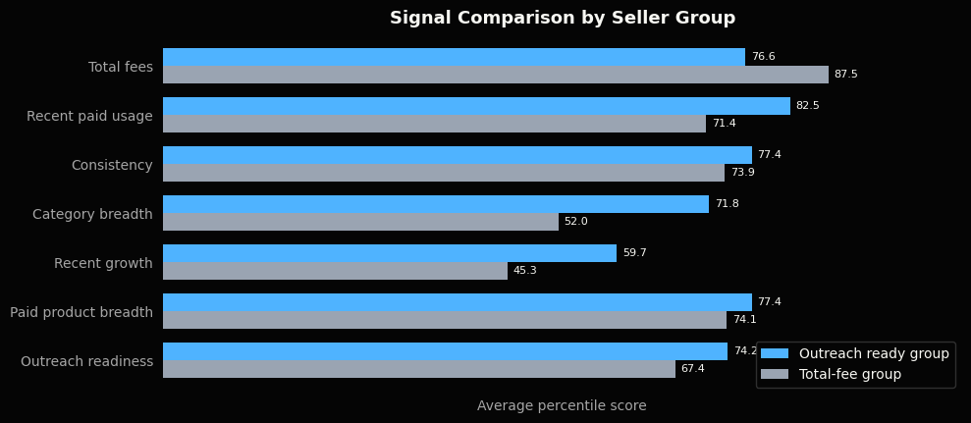
02
2.1 Outreach Readiness
Seller Profile by Outreach Scoring Method
Outreach Prioritization
07 / 12

Slide 17
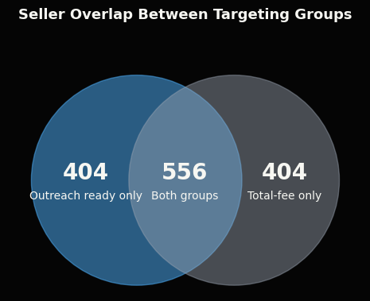
02
2.1 Outreach Readiness
Metric | Neither | Group Overlap | Outreach- ready group only | Total-fee group only
Sellers | 2476 | 556 | 404 | 404
Avg Fees per Seller | €18 | €1,907 | €51 | €382
Avg 6mo Fees per Seller | €6 | €310 | €22 | €61
Avg Active Months | 8.8 | 21.6 | 20.0 | 17.3
Avg Recent Paid Usage | 9.2 | 505.8 | 208.8 | 19.2
Avg Category Count | 5.1 | 9.1 | 13.4 | 3.5
Avg Paid Product Breadth | 2.2 | 4.9 | 4.2 | 3.8
Median 6mo Paid Action Growth Rate | +0% | +12% | +87% | -17%
Seller Group Selection Summary
Outreach Prioritization
08 / 12

Slide 18
02
2.2 Bundle Choice
After selecting the outreach-ready group, use a separate bundle-fit score to suggest which bundle to pitch.
Score: simple average of percentile ranks for paid visibility usage + paid product breadth + listing volume.
Why: Plus fits sellers already using visibility products or managing enough listings to benefit from cross-ad promotion.
Criteria: Sellers in the top 40% of bundle fit score inside the outreach ready group are targeted for Plus, the rest for Basic
Used in bundle-fit score
Not used for bundle choice
directly maps to Plus value
Paid visibility usage
Direct match to Plus benefits: more visibility and cross-ad promotion.
New Signal
Category breadth
Listing volume is a clearer fit for cross-ad promotion.
Count of paid visibility actions*
Recent paid usage
Too broad for bundle choice; the bundle-fit score uses visibility-specific usage instead.
Paid product breadth
Sellers using multiple paid products already understand paid value.
Count of distinct paid product types
Consistency
Does not distinguish Basic vs Plus.
Listing volume
Direct match to Plus cross-ad value: more ads means more inventory to promote from each listing.
New Signal
Recent growth
Does not distinguish Basic vs Plus.
Total ad insertions (free + paid)
Each signal is on a 0-100 percentile scale; very large raw values improve rank but do not dominate the score.
Total fees
Shows willingness to pay, but would make Plus selection too spend-driven.
* Paid visibility actions: Dagtoppers, Homepage, Paid URL, Ad Upcalls, and Urgency actions.
Outreach Prioritization
10 / 12

Slide 19
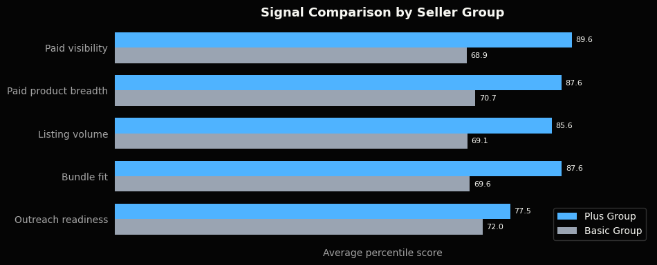
02
2.2 Bundle Choice
Suggested split: target Plus for the highest bundle-fit sellers in the outreach ready group; use the top 40% as a practical starting point.
Alternative: use no fixed 40%; show sellers ranked by bundle fit score and let Sales choose based on capacity.
Future improvement: calibrate this split with response, conversion, and upgrade data after outreach starts.
Metric | Targeted for Plus | Targeted for Basic
Selected Sellers | 384 | 576
Avg fees per seller | €2,230 | €389
Avg paid visibility score | 89.6 | 68.9
Avg paid product breadth score | 87.6 | 70.7
Avg listing volume score | 85.6 | 69.1
Avg bundle fit score | 87.6 | 69.6
Avg outreach readiness score | 77.5 | 72.0
Outreach Prioritization
11 / 12

Slide 20
02
2.3 Recommendations
Recommendation
Use the outreach ready group for the first outreach batch.
It keeps commercial value in the model, but avoids over-indexing on historical spend.
It adds sellers who are active, consistent, multi-category, growing, and already familiar with paid products.
These traits are closer to likely outreach response than fee history alone.
Full seller-level CSV available as q2_scored_sellers.csv
Next Step: Outcome-Based Ranking
After initial outreach, supervised learning could replace the manual score.
Train on response, conversion, and post-signup value.
Keep the ranking explainable for Sales and leadership.
Outreach Prioritization
12 / 12

Slide 21
01 Identify
02 Prioritize
03 Monitor
Track bundle adoption, revenue, and customer quality
04 Scale
01 / 12

Slide 22
03
1. Dashboard Framing
Goal: monitor whether SMB Bundles are gaining traction, converting to paid usage, and creating measurable value.
Use controls such as filters and breakdown dimensions for deep-dive.
Suggested data enrichments:
Extra revenue and seller-outcome data to assess impact
SMB likelihood, Outreach readiness, and various seller activity dataset for detailed segmentation
Structure: Three Dashboard Views
Sales Overview
Goal
Track launch traction and monetized adoption
Main question
Are bundles gaining commercial traction?
Customer Quality
Goal
Monitor conversion, retention, and segment differences
Main question
Are registrations becoming retained paid customers?
Business Impact
Goal
Quantify value for Marktplaats and sellers
Main question
Are bundles creating measurable value?
SMB Bundle Dashboard
02 / 16

Slide 23
03
2. Sales Overview
KPI Snapshot
What is the latest headline readout?
2025-04-29
2,709 (+0% w/w)
0 (+0% w/w)
Reference date
Active paid bundles
Active trial bundles
41 (+156% vs prior 4wk)
40.9% (+0.1pp w/w)
€88,373 (+0% vs prior 4wk)
New registration in 4wk
Plus share of active paid bundles
Modeled revenue in 4wk
SMB Bundle Dashboard
03 / 16

Slide 24
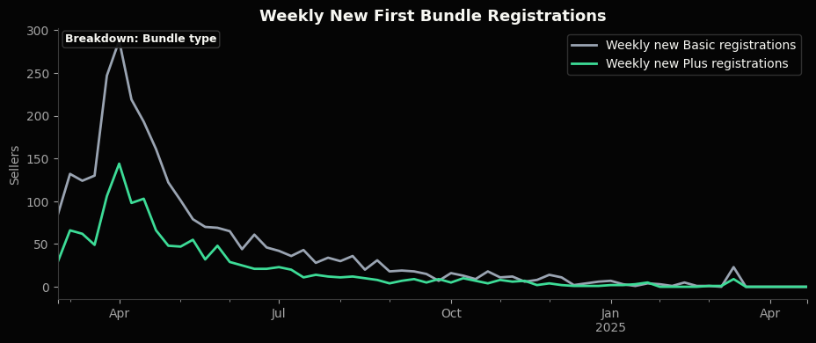
03
2. Sales Overview
New Registrations Trend
Is launch demand growing, stable, or fading?
Caveat: registrations = trial starts, not paid subscriptions start.
Controls: date range, customer type (SYI/Pro), bundle type.
SMB Bundle Dashboard
05 / 16

Slide 25
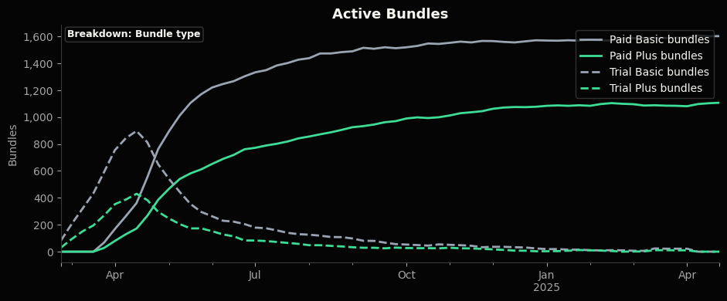
03
2. Sales Overview
Active Bundles Trend
Is the bundle base turning into paid adoption?
Controls: date range, customer type (SYI/Pro), , bundle.
SMB Bundle Dashboard
06 / 16

Slide 26
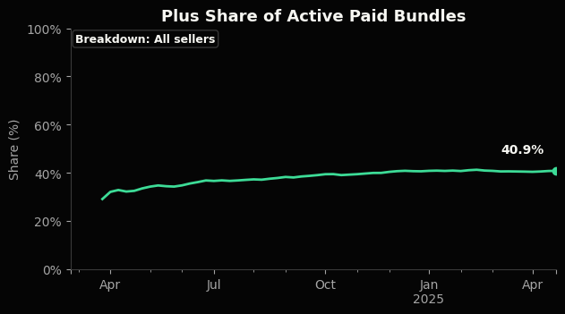
03
2. Sales Overview
Plus Share Trend
Is the paid base shifting toward Plus?
Controls: date range and customer type.
SMB Bundle Dashboard
07 / 16

Slide 27
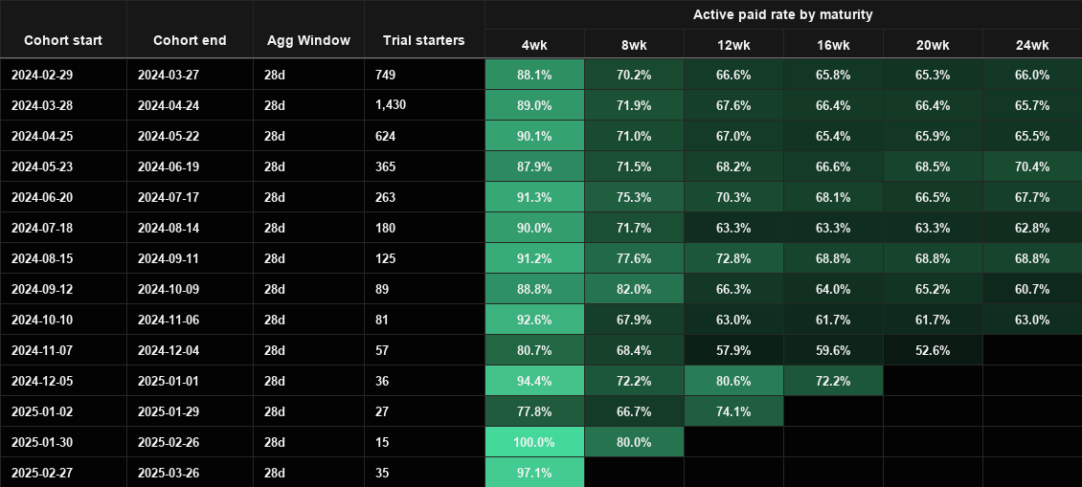
03
3. Customer Quality
Cohort Health
Do cohorts stay active paid after trial and later billing cycles?
Caveat: blank cells are immature checkpoints, not zero conversion.
SMB Bundle Dashboard
08 / 16

Slide 28
03
3. Customer Quality
Segmentation Health Snapshot
Potential Segmentation Merge
Segment dimension | Segment value | Registrations | Paid conversion at 28d | % Plus of active paid bundles | Active paid bundles | Current no-bundle share
Customer type | SYI | 3,137 | 89.1% | 40.9% | 2,093 | 33.3%
Customer type | Pro | 939 | 89.5% | 40.7% | 616 | 34.4%
First bundle type | Basic-first | 2,791 | 89.4% | 25.5% | 1,845 | 33.9%
First bundle type | Plus-first | 1,285 | 88.7% | 73.6% | 864 | 32.8%
Potential merge | Why it helps
SMB likelihood score | Separates likely business sellers from lighter consumer-like sellers.
Outreach readiness score | Shows whether sales-prioritized sellers convert and retain better.
Historical spend tier | Distinguishes high and low-spend
Seller size / activity tier | Identifies whether bundles work better for large or small sellers.
Outreach batch / channel | Connects launch execution to registration and paid conversion quality.
SMB Bundle Dashboard
12 / 16

Slide 29
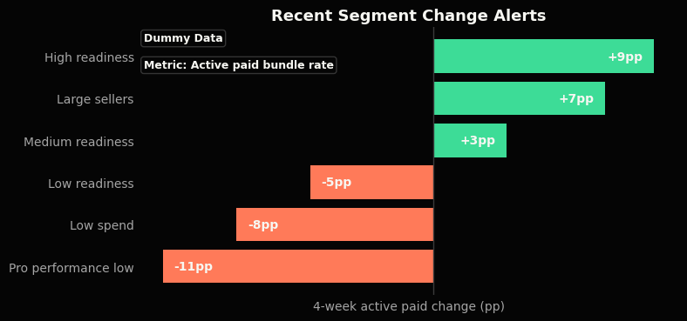
03
3. Customer Quality
Segment Change Alerts
Which segments changed sharply in the last 4 weeks? Highlights where follow-up is most urgent.
Controls: displayed metrics can be dynamically selected, as well as comparison time window.
Caveat: dummy data.
SMB Bundle Dashboard
12 / 16

Slide 30
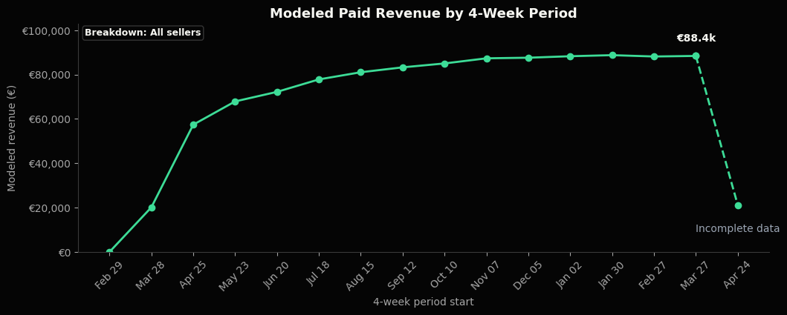
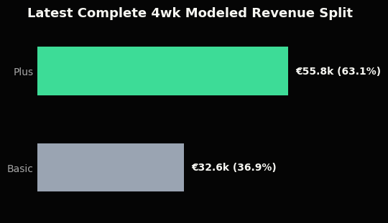
03
4. Business Impact
Are bundles creating measurable value for Marktplaats and sellers?
Current data supports: modeled paid revenue and bundle revenue mix.
Still missing: actual invoiced revenue and seller outcome data.
Modeled Bundle Revenue
Is paid adoption translating into subscription revenue?
Caveat: modeled from intervals and list prices; not invoiced or incremental revenue.
SMB Bundle Dashboard
14 / 16

Slide 31
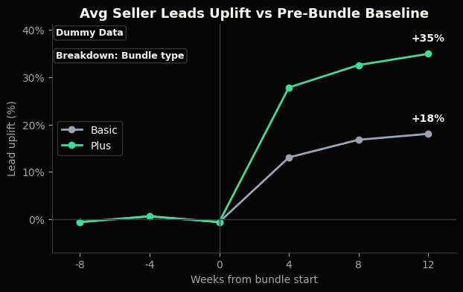
03
4. Business Impact
Seller Outcome Uplift
Do bundles help sellers generate more leads?
Controls: breakdown by bundle type,
Caveat: dummy data, requires seller-level lead data
SMB Bundle Dashboard
16 / 16

Slide 32
01 Identify
02 Prioritize
03 Monitor
04 Scale
Use Lifecycle and in-product prompts to grow adoption
01 / 07

Slide 33
04
1. Campaign Objective
Promote SMB bundles to active sellers with a high SMB likelihood score, then sequence outreach by readiness so the strongest candidates receive the first conversion push.
1. Campaign Objective
Potential Future Campaigns
Promote SMB bundles to active sellers with a high SMB likelihood score (from question #1).
Start with sellers who also have a high readiness score (from question #2), then expand to broader seller groups.
Reactivation campaign for SMB sellers with declining performance.
Upsell campaign from Basic to Plus.
Campaign Flow
High SMB likelihood
High readiness
Broader expansion
Incremental impact
Q1 business signal
Q2 first-wave priority
Tier 2 + Tier 3
holdout-based KPIs
Marketing Campaign Proposal
02 / 07

Slide 34
04
2. Target Audience
Base audience: active sellers without a bundle.
Use SMB-likelihood and Outreach-Readiness scores to narrow the audience focus.
Start with Tier 1; scale to other tiers if successful.
Audience Segments
Segment | Audience | Campaign role
Tier 1 | High SMB likelihood + high readiness | Direct conversion push: upgrade now
Tier 2 | High SMB likelihood + medium readiness | Education and nurture: explain bundle benefits
Tier 3 | Medium SMB likelihood + medium/low readiness | Light-touch awareness and interest validation
Excluded | Low SMB likelihood | Avoid intrusive promotion to likely consumers
Marketing Campaign Proposal
03 / 07

Slide 35
04
3. Channels
Use two complementary channels: lifecycle CRM for behavior-triggered outreach and in-platform prompts for high-intent seller moments.
Channel Mix
Lifecycle CRM
In-platform Prompts
Email / CRM journeys triggered by seller behavior, such as repeated listing, paid-feature use, competitive-category activity.
Prompts in high-intent seller surfaces: seller dashboard, listing creation, listing management, and paid-feature purchase flows.
How They Work Together
CRM creates the targeted outreach path; in-platform prompts reinforce the message at the moment of seller intent.
Marketing Campaign Proposal
04 / 07

Slide 36
04
3.1 Lifecycle CRM
Use email / CRM journeys triggered by seller behavior.
Examples of Triggers
Trigger
Trigger
Seller lists repeatedly
Seller uses paid features
Purpose
Purpose
Promote bundle when commercial intent is high
Position bundle as a structured visibility product
Trigger
Trigger
Seller operates in competitive category
Seller receives buyer interest but has no bundle
Purpose
Purpose
Promote differentiation benefit
Promote visibility/professionalization as next step
Marketing Campaign Proposal
05 / 07

Slide 37
04
3.2 In-platform Prompts
Use prompts in high-intent seller surfaces.
Prompt Surfaces
Surface
Surface
Seller dashboard
Listing creation flow
Why this moment works
Why this moment works
Natural moment to link bundles to better performance
Bundle can improve listings from day one
Surface
Surface
Listing management page
Paid-feature purchase flow
Why this moment works
Why this moment works
Bundle is a broader upgrade than one-off ad fixes
Bundle is a structured alternative to single visibility purchases
Marketing Campaign Proposal
06 / 07

Slide 38
04
4. KPIs
Measure incremental adoption, diagnose channel response, and monitor seller-fit guardrails.
Primary KPI
Incremental SMB Bundle adoption rate (paid)
Definition
Exposed adoption rate minus holdout adoption rate
Why it matters
Separates real lift from natural adoption.
Secondary KPIs
Guardrail KPIs
Definition
Share of exposed sellers who click through
Why it matters
Diagnoses channel and placement relevance.
Guardrails ensure the campaign does not overfit to short-term adoption at the expense of seller fit, product trust, or support burden.
Click-through rate
Early cancellation / downgrade rate
Definition
Share of adopters who cancel or downgrade early
Why it matters
Flags poor-fit or over-pushed sellers.
Trial start rate
Definition
Share of exposed sellers who start a bundle trial
Why it matters
Shows whether interest becomes action.
Definition
Exposed bundle revenue minus holdout bundle revenue
Why it matters
Links adoption to business value.
Seller opt-out or complaint rate
Definition
Share of exposed sellers who opt out or complain
Why it matters
Caps campaign pressure before trust suffers.
Bundle revenue uplift
Marketing Campaign Proposal
07 / 07

Slide 39
Home Assignment for Senior Marketing Analyst role at Marktplaats
Omer Tal, June 2026
Thank You
01
02
03
04
Identify
Prioritize
Monitor
Scale
Find likely SMB sellers using seller behavior and attributes
Rank sellers by outreach readiness and bundle fit
Track bundle adoption, revenue, and customer quality
Use Lifecycle and in-product prompts to grow adoption

