Slide 1
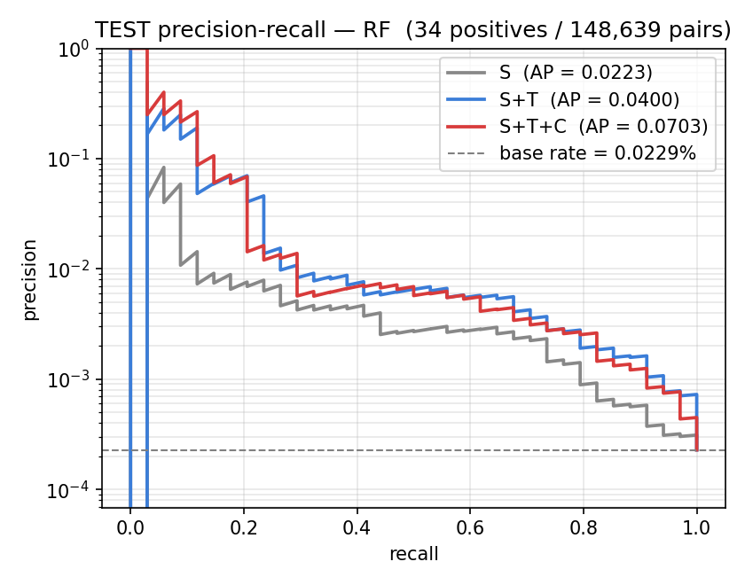
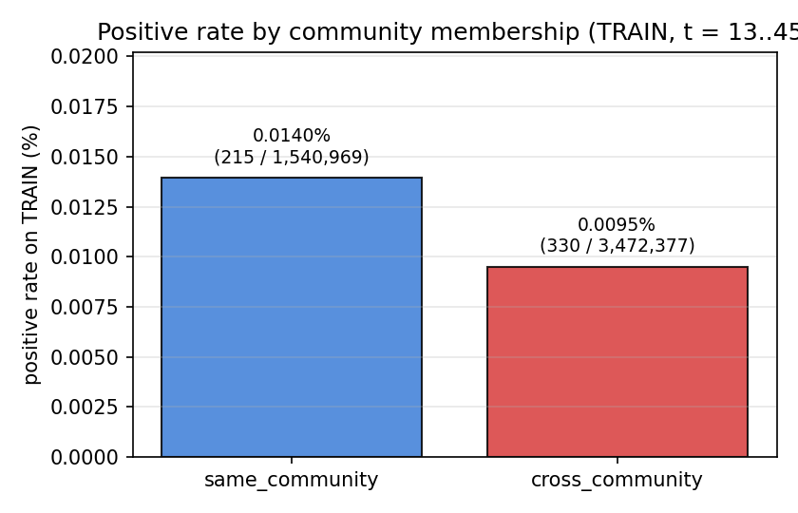
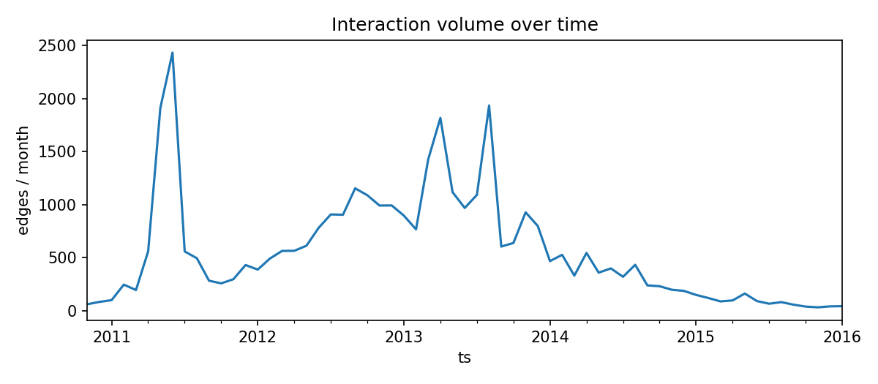
Early Warning of Distrust in Bitcoin-OTC
Community-Aware Prediction of New Negative Trust Edges in a Temporal Signed Network
Ömer Faruk Güler · Hacettepe University · BBM462 Final Project · omer55glr@gmail.com
1 · Motivation
4 · Pipeline
7 · Main Results
Online trust marketplaces depend on user-to-user ratings.
Negative ratings carry early information about emerging distrust.
Goal — at end of month t, rank pairs (u, v) by
P(new negative directed edge u → v in t + 1)
Applications: moderation · fraud surveillance · reputation
Five interpretable stages — no leakage, fixed seeds.
Adding temporal features produces the largest improvement.
Random Forest, test fold (t = 48, 49)
Raw events
u → v, rating, ts
Feature set | ROC-AUC | PR-AUC
S | 0.88 | 0.02
S + T | 0.95 | 0.04
S + T + C | 0.94 | 0.07
Monthly snapshots
cumulative; last-rating-wins state
Candidates + labels
2-hop, core-active, no existing u → v −
• + T → largest, most consistent jump
• + C → further PR-AUC gain; ROC near saturation
• LR shows the same ordering at lower absolute PR-AUC.
2 · Why It Is Not Generic Link Prediction
36 features (5 families)
structural · trust · temporal · community
• Sign-dependent — predicting any edge ≠ predicting a negative edge
• Heavily imbalanced — ~10% of edges negative; new monthly negatives much rarer
• Time-causal — only pre-snapshot information allowed
→ ranking metrics (ROC-AUC, PR-AUC), not threshold metrics
LR / RF
fitted, scored, ranked
Leakage boundary: only events with ts ≤ end_of_month(t) enter features.
5 · Feature Groups · 36 features
Fig 2 — RF precision-recall curves on the test fold.
3 · Dataset and Task
(S) Structural · 12
CN, Jaccard, Adamic-Adar, PA · signed degrees · reciprocity · prior interaction
(+) Trust-summary · 4
Mean rating given/received · negative-given ratio · negative-received ratio
8 · Interpretation
Bitcoin-OTC (SNAP)
35,592 ratings · 5,881 users · Nov 2010 – Jan 2016
Edge tuple: (u → v, rating ∈ [−10, +10], timestamp)
90% positive · 10% negative · reciprocity 0.79
Task formulation
Predict probability that an ordered pair (u, v) receives a new negative rating in (t, t + 1].
Temporal information dominates.
Recency and decayed activity drive importance in both models.
Community-aware features add a nuanced refinement.
Mostly on PR-AUC; ROC-AUC is already saturated.
Naive cross-community-distrust is NOT supported.
At the pair level, neighborhood overlap is the strongest community signal — distrust appears on weakly-embedded ties.
(+T) Temporal · 12
Days since last activity · recent-window counts · exponentially decayed aggregates (τ = 60 d)
(+C) Community-aware · 8
Louvain on G⁺ · same_community · sizes · neighborhood overlap · boundary fractions
6 · Experimental Setup
Models — Logistic Regression · Random Forest
(no hyperparameter tuning)
Forward-time split — no shuffle, no leakage:
Fig 3 — Training positive rate: same vs cross-community pairs.
Fig 1 — Monthly interaction volume; tail decay motivates the eligible pool.
Split | Months | Pairs | Positives
TRAIN | t = 13 – 45 | 5.0 M | 545
VAL | t = 46, 47 | 184 k | 16
TEST | t = 48, 49 | 149 k | 34
9 · Conclusion & Future Work
This project
• A precise temporal signed-network task, defined end-to-end
• An interpretable, leakage-controlled feature pipeline
• Temporal features → strongest, most consistent improvement
• Community features → smaller, nuanced refinement
Future work
• External replication on Bitcoin-Alpha
• Stronger learning baselines and graph embeddings
• Conditional analyses of community signal
Metrics: ROC-AUC · PR-AUC Seeds: all fixed at 42
10 · Additional Validation · Robustness consistent with the main story
Rolling-origin evaluation
25 disjoint monthly test folds · 425 positives total.
Wilcoxon p ≤ 1.4 × 10⁻⁴ for the (S+T) − S ROC-AUC delta under both models, after Holm-Bonferroni correction.
Recency-only baseline
A parameter-free recency-only ranker reaches
ROC-AUC ≈ 0.89 — the temporal signal is robust and supported by simple recency information.
Bootstrap (B = 1000)
Paired stratified bootstrap on the locked fold.
95% percentile CIs agree with the across-fold results; no contradictions.
References: Kumar et al. (ICDM 2016) · Blondel et al. (J Stat Mech 2008) · Bertazzi et al. (SocInfo 2018) · Leskovec & Krevl, SNAP (2014).
Reproducibility: all seeds fixed at 42 · code organized in src/ and scripts/ · intermediate artifacts persisted under data/ and results/.

