Slide 1
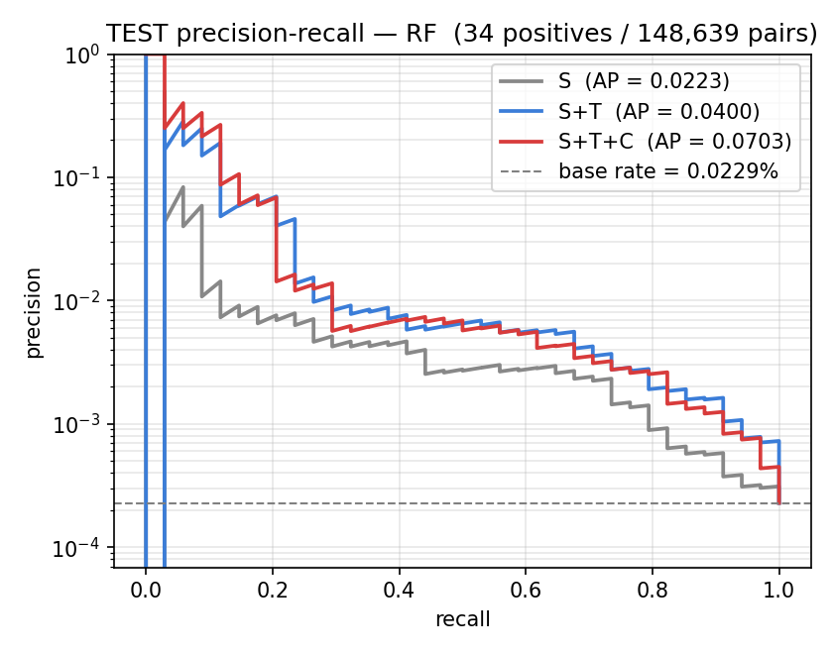
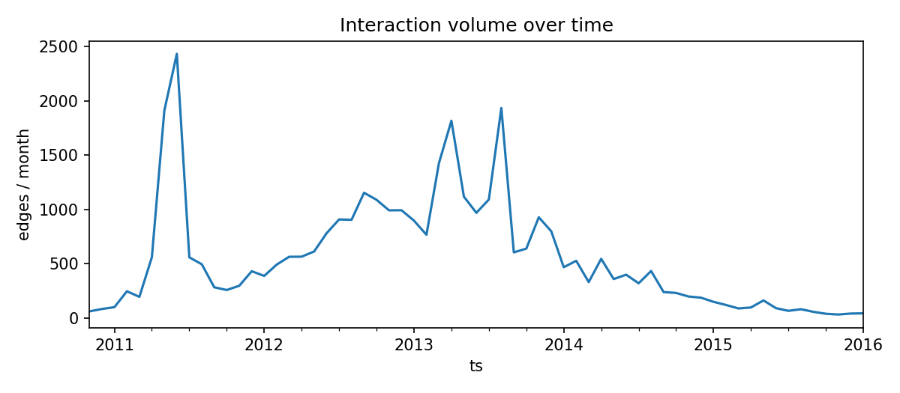
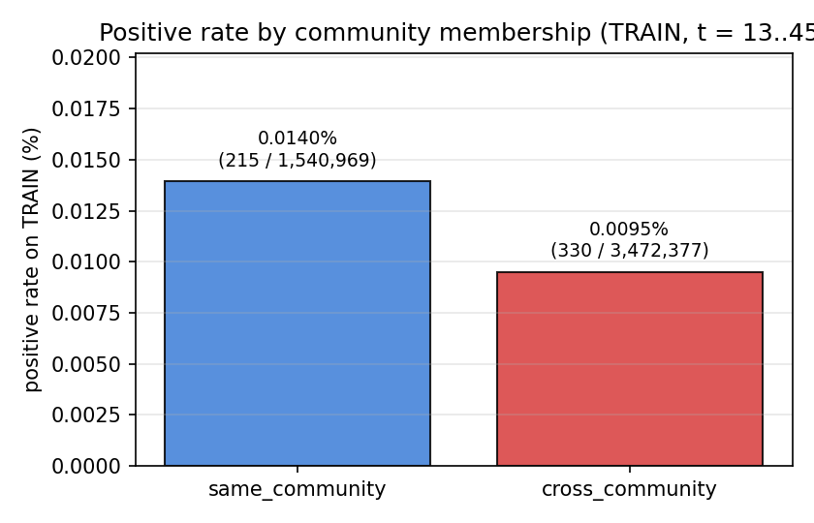
Early Warning of Distrust in Bitcoin-OTC
An Interpretable Temporal-Network Pipeline for Predicting New Negative Trust Edges
Ömer Faruk Güler · Hacettepe University · BBM462 Final Project · omer55glr@gmail.com
Forecasting where distrust will appear, one month before it happens.
Negative ratings in trust marketplaces are rare, time-sensitive, and high-stakes — yet there is no principled framework for predicting, at the pair level, where new distrust will emerge next.
We ask: at the end of month t, can we rank user pairs (u, v) by their probability of receiving a new negative directed rating in (t, t + 1] ?
Context
Our Approach
Results
Why this is hard
• Sign-dependent — any edge ≠ negative edge
• Heavily imbalanced — rare events
• Strict temporal causality
• Ranking metrics — ROC-AUC, PR-AUC
We developed an interpretable, leakage-controlled prediction pipeline
for new negative trust edges in a temporal signed network.
Headline finding
ROC-AUC
0.88 → 0.95
structural → structural + temporal
the largest single jump in our ablation
Raw events
u → v, rating, ts
Snapshots
monthly, cumulative
Candidates
+ labels (2-hop, core)
36 features
5 interpretable families
Models
LR / RF
Leakage boundary: only events with ts ≤ end_of_month(t)
Random Forest, held-out test fold
Dataset
Bitcoin-OTC (SNAP)
35,592 ratings
5,881 users
Nov 2010 — Jan 2016
Edge: (u → v, r ∈ [−10, 10], ts)
≈ 90 % positive
≈ 10 % negative
reciprocity 0.79
Feature families · 36 features in 4 interpretable groups
S Structural · 12
CN · Jaccard · AA · PA · signed degrees · reciprocity
+ Trust-summary · 4
mean rating given/received · negative ratios
+T Temporal · 12
recency · recent counts · decay (τ = 60 d)
+C Community · 8
Louvain · same_community · neighborhood overlap
Feature set | ROC-AUC | PR-AUC
S | 0.88 | 0.02
S + T | 0.95 | 0.04
S + T + C | 0.94 | 0.07
Models Logistic Regression · Random Forest no tuning · seeds = 42
+ T largest, most consistent improvement
+ C further PR-AUC gain; ROC near saturation
LR shows the same ordering at lower absolute PR-AUC.
Evaluation forward-time split, ranking metrics
Split | Months | Pairs | Positives
TRAIN | t = 13 – 45 | 5.0 M | 545
VAL | t = 46, 47 | 184 k | 16
TEST | t = 48, 49 | 149 k | 34
Monthly interaction volume.
RF precision-recall curves, test fold.
Interpretation
① Temporal information is the dominant signal.
Recency and decayed activity drive feature importance in both models. A simple recency-only ranker reaches ROC-AUC ≈ 0.89, confirming that the temporal signal is robust and supported by simple recency information.
② Community-aware features add a nuanced refinement.
Community features mostly improve PR-AUC under Random Forest; ROC-AUC is already saturated. The improvement is real but modest — community is a refinement, not the headline.
③ Pair-level overlap matters more than community label.
The naive cross-community-distrust intuition is not supported. Same-community pairs have a slightly higher empirical positive rate. At the pair level, neighborhood overlap is the strongest community signal — distrust appears on weakly-embedded ties, often within the same broader trust community.
Training positive rate by community membership. Same-community pairs are not the safer ones.
Conclusion & Future Work
We developed
• A precise temporal signed-network prediction task
• An interpretable, leakage-controlled pipeline
• Temporal features → strongest, most consistent improvement
• Community features → smaller, nuanced refinement
Future work
• External replication on Bitcoin-Alpha
• Stronger learning baselines and graph embeddings
• Conditional analyses of community signal
• Rolling-origin validation extended across snapshots
ADDITIONAL VALIDATION Rolling-origin over 25 monthly test folds (425 positives total) confirms the temporal lift (Wilcoxon p ≤ 1.4 × 10⁻⁴, Holm-corrected). Bootstrap CIs on the locked fold agree with the across-fold results.
REFERENCES Kumar et al. (ICDM 2016) · Blondel et al. (J Stat Mech 2008) · Bertazzi et al. (SocInfo 2018) · Leskovec & Krevl, SNAP (2014).
REPRODUCIBILITY Code in src/ and scripts/ · seeds fixed at 42 · intermediate artifacts persisted under data/ and results/ .

