Slide 1
Early Warning of Distrust
in Bitcoin-OTC
Community-Aware Prediction of New Negative Trust Edges
Ömer Faruk Güler
Hacettepe University · BBM462 Final Project
1 / 8

Slide 2
Why This Is Not Generic Link Prediction
Sign-dependent — predicting any edge ≠ predicting a negative edge
Heavily imbalanced — ≈ 10 % of edges negative; new monthly negatives much rarer
Time-causal — only pre-snapshot information can enter the model
→ ranking metrics (ROC-AUC, PR-AUC), not threshold metrics
2 / 8

Slide 3
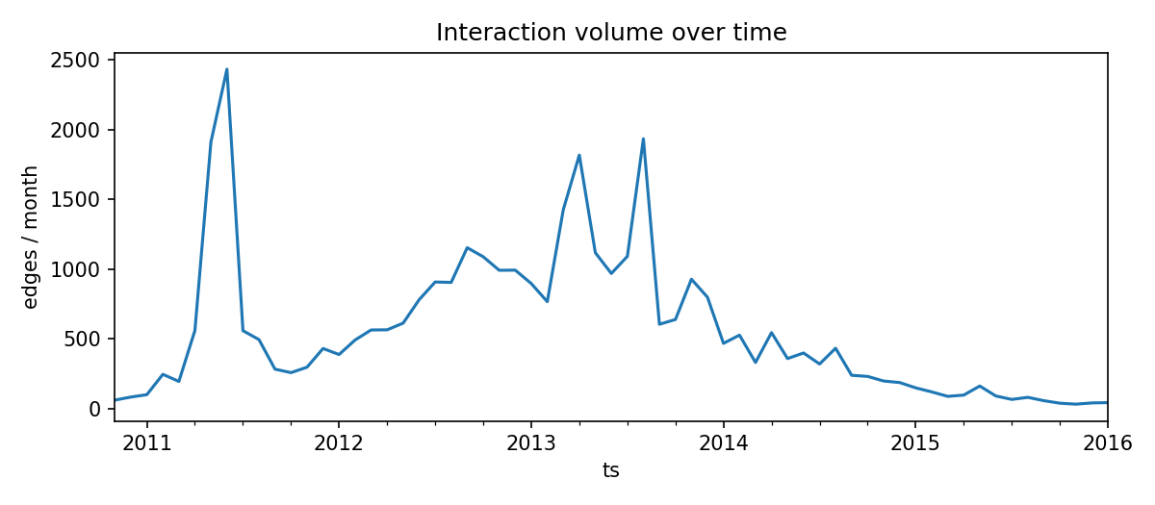
Dataset and Task
35,592 ratings · 5,881 users · 63 months
Edge: (u → v, rating ∈ [-10, +10], timestamp)
≈ 90 % positive · 10 % negative · reciprocity 0.79
Task — at end of month t, rank pairs (u, v) by
P(new negative directed edge u → v in t + 1)
Bitcoin-OTC monthly interaction volume
3 / 8

Slide 4
Interpretable Feature Pipeline
Raw events
Monthly snapshots
Candidates + labels
36 features
LR / RF
(S) Structural
CN, Jaccard, AA, PA · signed degrees · reciprocity · prior interaction
(+ Trust-summary)
Mean rating given/received · negative ratios
(+ T) Temporal
Days since last activity · recent counts · decayed aggregates (τ = 60 d)
(+ C) Community-aware
Louvain on G⁺ · same-community · neighborhood overlap · boundary fractions
Strict leakage boundary: only events with ts ≤ end_of_month(t).
4 / 8

Slide 5
Models and Evaluation
Models — Logistic Regression and Random Forest (no hyperparameter tuning)
Feature sets — S → S + T → S + T + C
Metrics — ROC-AUC, PR-AUC (heavy class imbalance)
Verification — rolling-origin over 25 monthly folds (425 positives total)
Split | Months | Pairs | Positives
TRAIN | t = 13 – 45 | 5.0 M | 545
VAL | t = 46, 47 | 184 k | 16
TEST | t = 48, 49 | 149 k | 34
Forward-time split — no shuffle, no leakage.
5 / 8

Slide 6
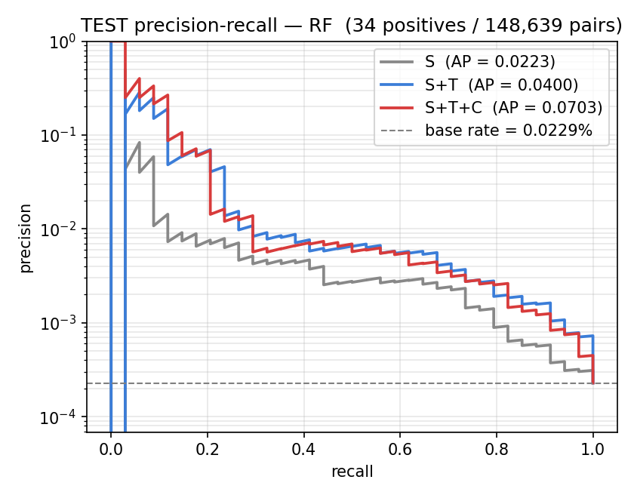
Temporal Features Drive the Largest Improvement
Feature set | ROC-AUC | PR-AUC
S | 0.88 | 0.02
S + T | 0.95 | 0.04
S + T + C | 0.94 | 0.07
+ T → largest, most consistent jump
+ C → further PR-AUC gain; ROC-AUC near saturation
Rolling-origin verification confirms temporal lift across folds
Random Forest test-set results; PR-AUC curves on the right.
6 / 8

Slide 7
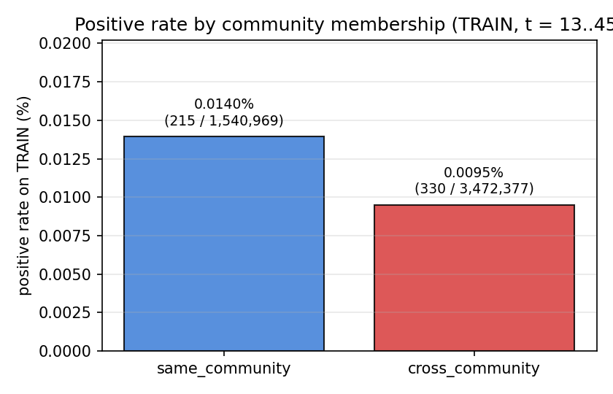
What the Results Tell Us
Temporal information is the strongest signal
Recency + decayed activity dominate feature importance
Community features add a nuanced, PR-oriented refinement
ROC-AUC saturates near 0.95 — most ranking power already in S + T
Pair-level neighborhood overlap matters more than community label
Same-community pairs are not the safer ones — descriptive, not causal
Same vs. cross-community positive rate (training data).
7 / 8

Slide 8
Conclusion and Future Work
This project
• A precise temporal signed-network task, defined end-to-end
• An interpretable, leakage-controlled pipeline
• Temporal features → strongest, most consistent improvement
• Community features → smaller, more nuanced refinement
Future work
• External replication on Bitcoin-Alpha
• Stronger learning baselines
• Deeper community-conditioning analyses
Thank you · Questions welcome.
8 / 8

