Slide 1
Cloudinary Uploading with a direct call to the API

Slide 2
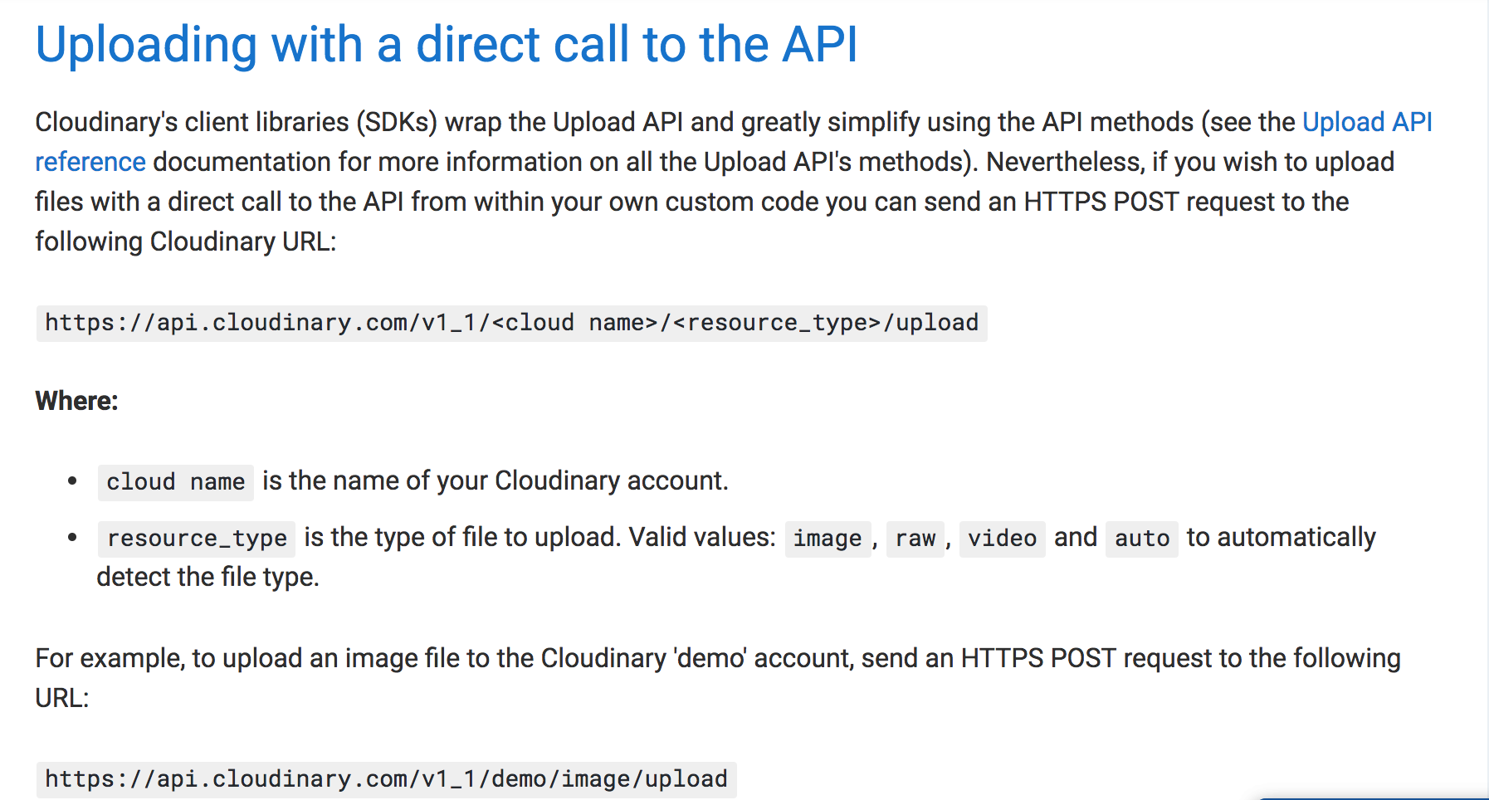
Documentation:
Link: https://cloudinary.com/documentation/upload_images#uploading_with_a_direct_call_to_the_api

Slide 3
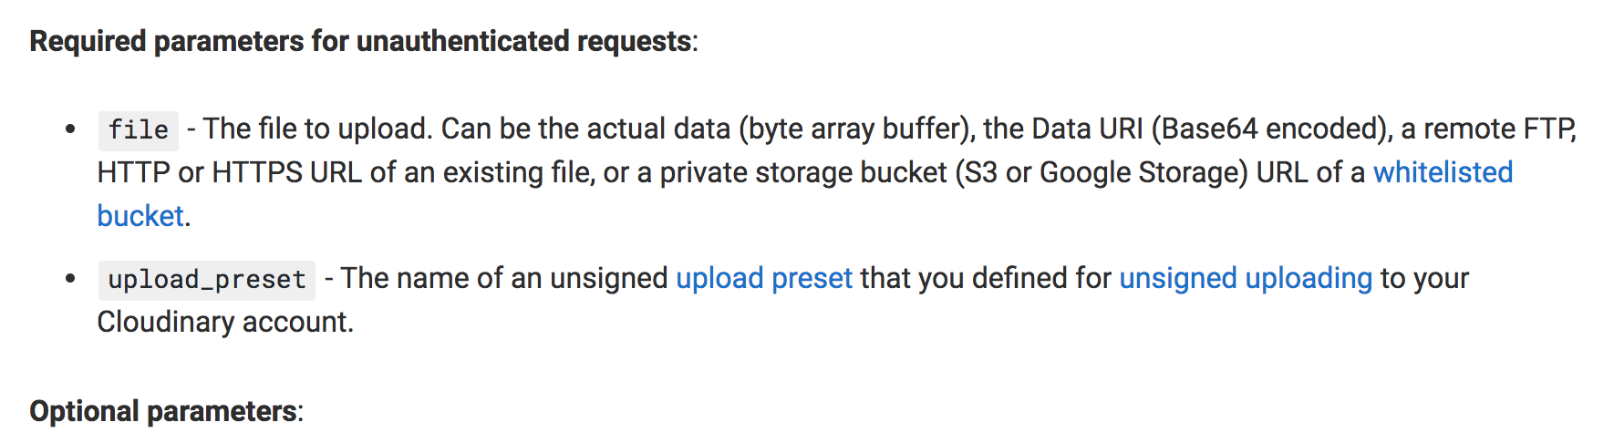
Send Ajax POST request:
The contents of the POST request you send to Cloudinary depends on whether or not you are making an authenticated request (see the documentation on Unsigned uploads for more information on unauthenticated requests).
NOTE: More easy to use the unauthenticated method:

Slide 4
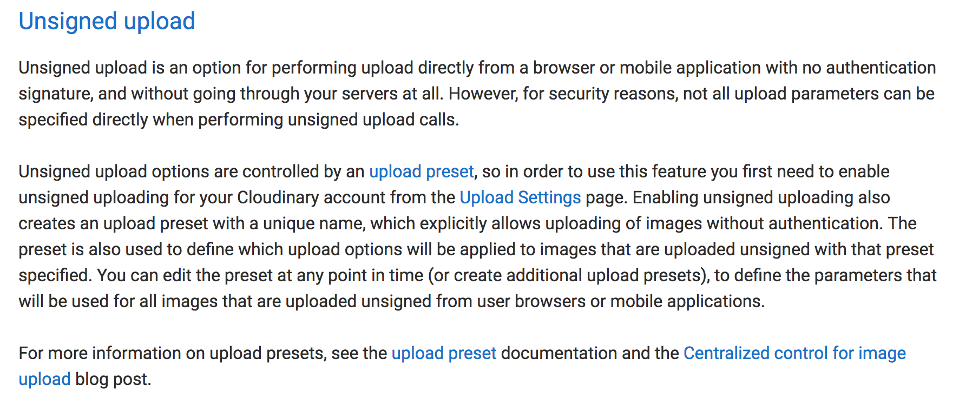
Set the “upload_preset”

Slide 5
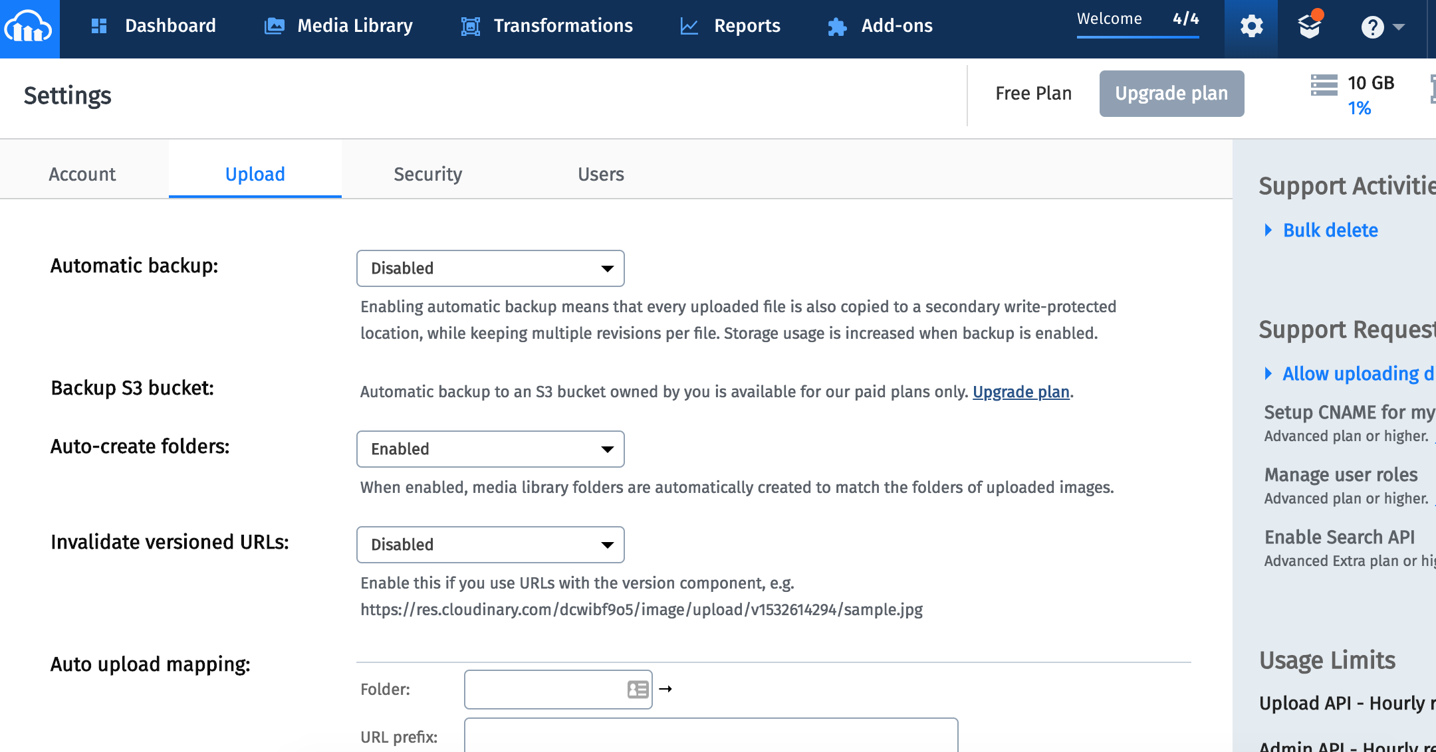
Set the “upload_preset”
Go to “settings->upload”

Slide 6
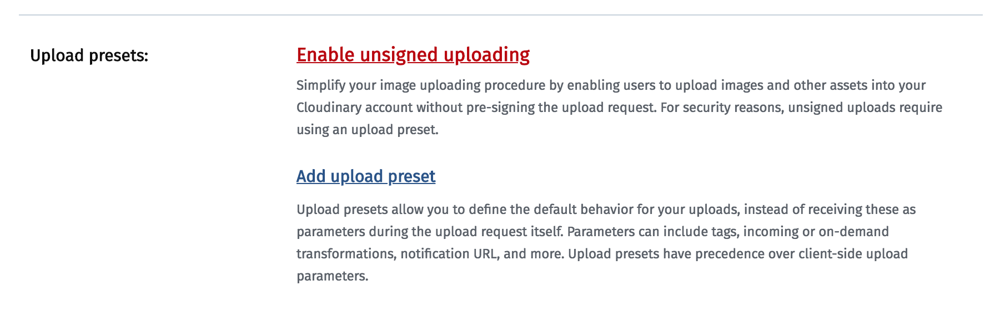
Set the “upload_preset”
Find the upload presets and click on “Enable unsigned upload”

Slide 7
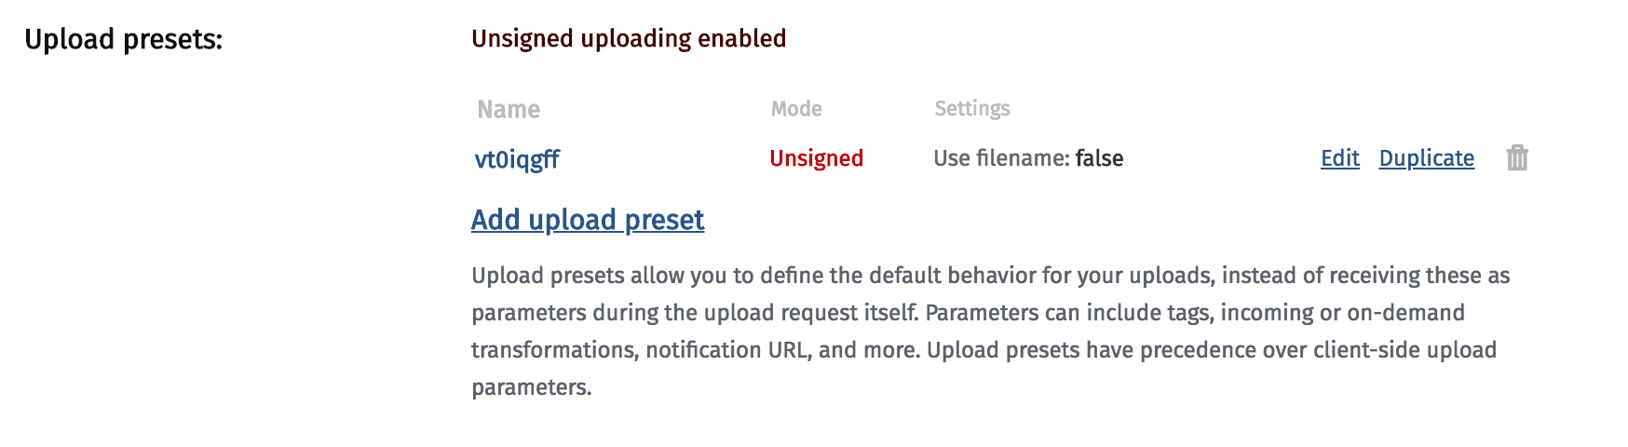
Set the “upload_preset”
Copy the name

Slide 8
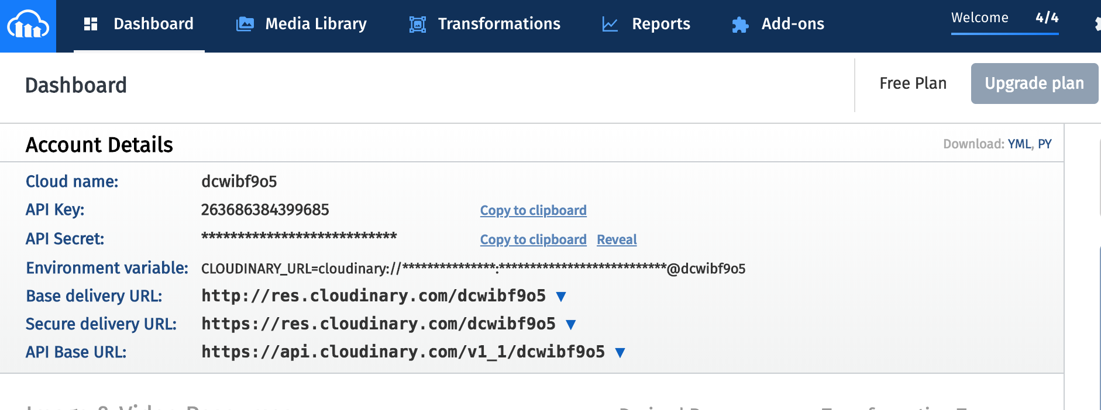
Cloud name:

Slide 9
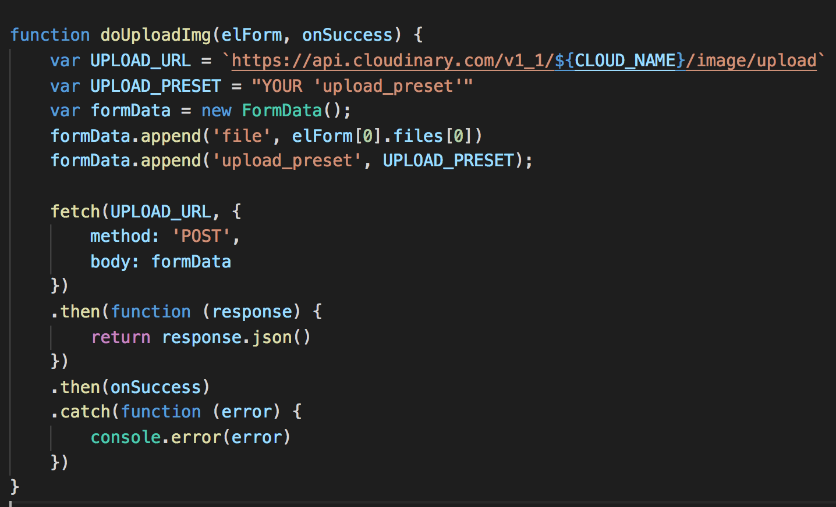
Your code:

