Slide 1
B9MG119 SME: CoinBurp
Cloud Technology for Business
Cloud Strategy and sample deployment
Student Name: Dileep kumar reddy Thathireddy
Student ID: 20003992

Slide 2
Table of Content
Procedure for deployment
Recommendations
Justification
Notes:
This slide represents the Table of Contents present in the Presentation

Slide 3
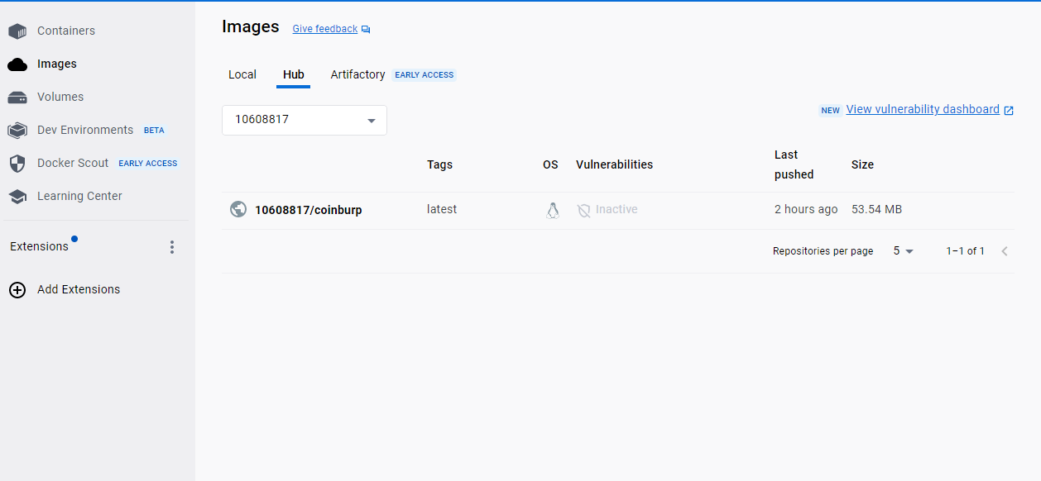
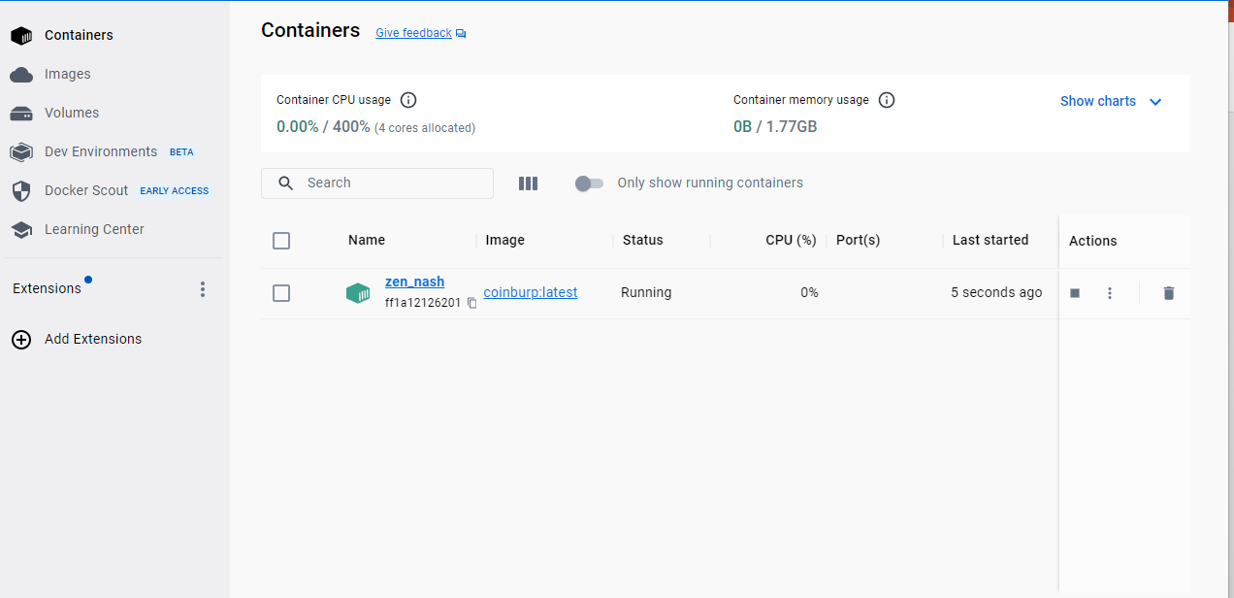
Deployment Procedure
We can offer the following cloud-based resources or services:
Visualizing the web application:
Prior to containerizing the application, we must first construct a Docker image by using the Docker instructions. The created image is visible on the Docker desktops.
Application containerization:
The application for the Web is run from the server using a container to operate on a remote server.
Notes:
This Slide represents the Overall deployment procedure of the application

Slide 4
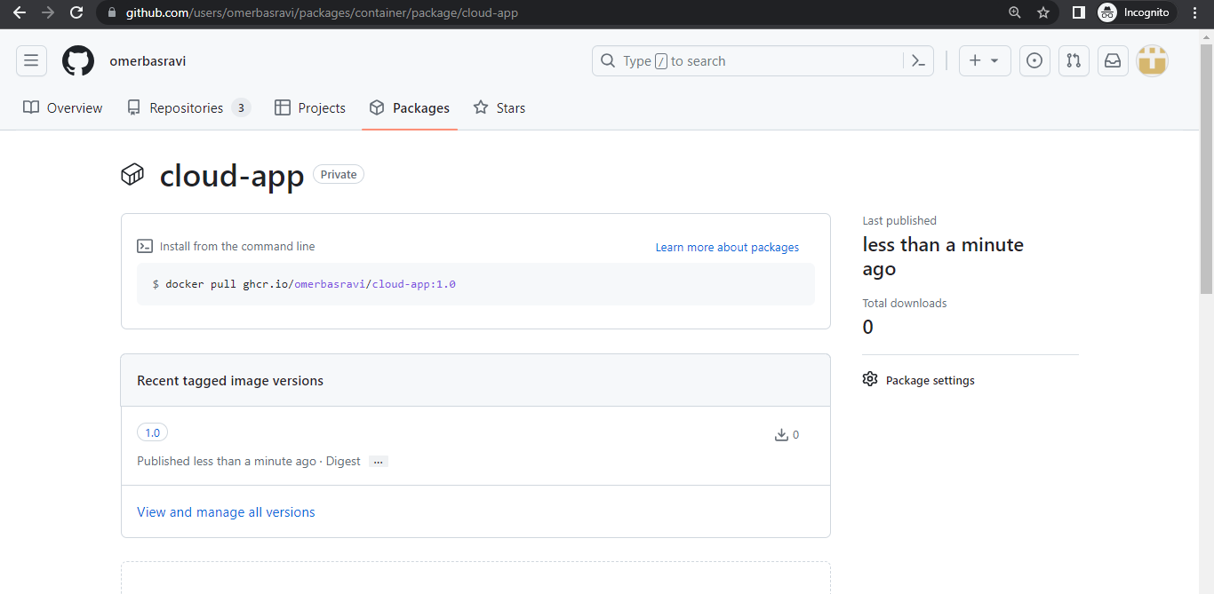
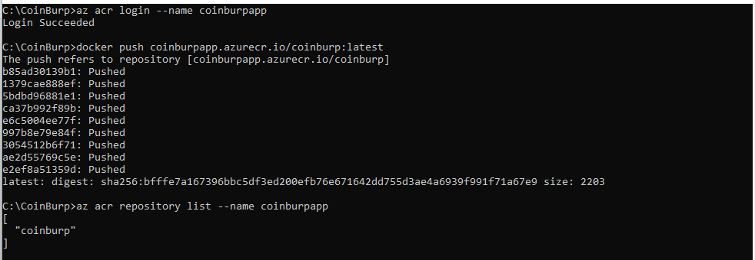
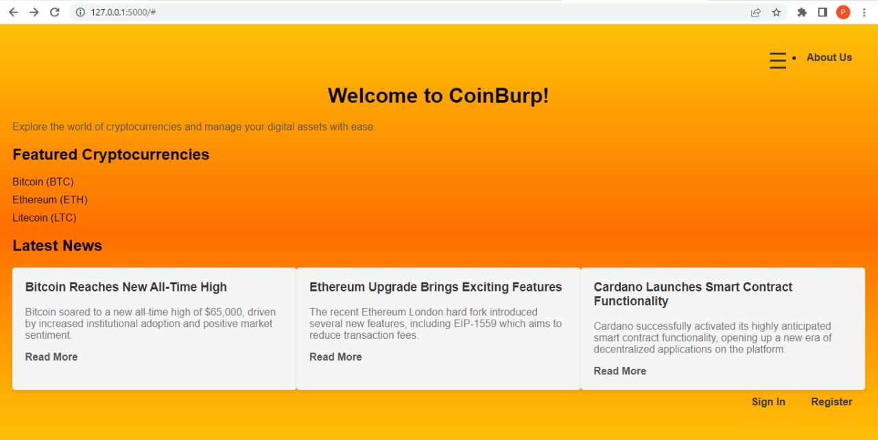
The GitHub-hosted application was containerized. GitHub is used to store images.
The pictures are retrieved from the Container registry and run on a remote machine to run the application.
using the Azure registry for hosting:
Using the Microsoft Azure container registries to store pictures that may be fetched for executing on a distant server in order to set up resources on Azure and manage these assets on the server.
Run debugging on the server running the application:
The containerized app operates upon the server.
Notes:
Continuation of the deployment procedure of the application

Slide 5
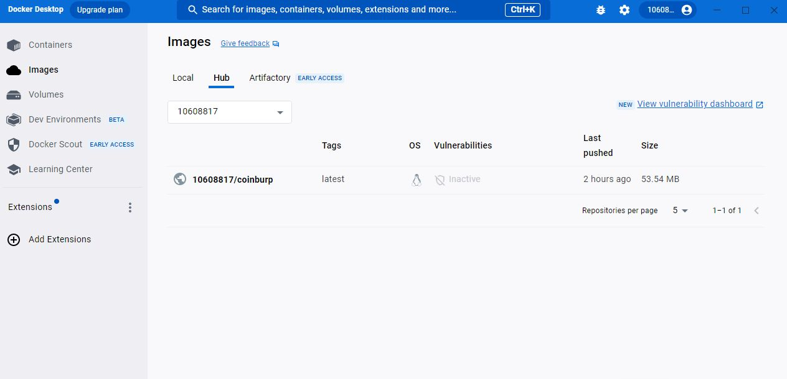
Recommendation
It is suggested that the company employ cloud solutions due to: Using an external database to store data, deploying programs on an external server, or hosting applications there are all instances of cloud solutions.
We may scale up or down apps with the aid of the cloud in accordance with our requirements to save expenses and maintain speed.
The cloud removes a lot of the responsibility from the physical facilities by enabling anyone to gain access to the server from anywhere in the world.
Notes:
This Slide represents the Recommendation for using the Cloud service for the company

Slide 6
Justification
The deployment and hosting of applications on the on-premise infrastructure are essentially what traditional on-premise infrastructure, also referred to as non-Cloud solutions, entails.
We are unable to adjust our capacity in response to changes in demand. We are not given the freedom to view the servers remotely. Additionally, the startup costs for the infrastructure are very significant.
Although somewhat automated, resource and service deployment takes longer than usual. Given all of these factors, moving from an on-premises environment to a cloud environment is necessary for an organization that needs scalability, lower infrastructure costs, and remote access to resources.
This involves moving the on-premise system to the cloud resources and using containerization to host the application on the remote server or on a virtual machine
Notes:
This Slide represents the Justification for using cloud service over non-cloud on-premise system.

Slide 7
Thank you

