Slide 1

For better operation management in restaurants
Michal Frankel | Omer Ben Simon

Slide 2
Use-case
Statistics
Main agenda:
support restaurants to achieve it proper conduct
15
8
Total faulty issues open every day (avg)
Days until issues
Being taking care of
Goals:
Reduce by 20% the amount of time faulty products is getting fixed
Reduce by 50% percent the amount of time being spent on collecting technician information and form
Reduce by 10% percent the amount of time being spent on generating monthly reports and receipts
3
3
Days until finding technician
Days until finding technician

Slide 3



// Personas
Restaurant/branch
Restaurant line
Technician
Open tasks
Managing tasks
Closes tasks

Slide 4



// Companies
Runs not as franchise restaurants

Slide 5
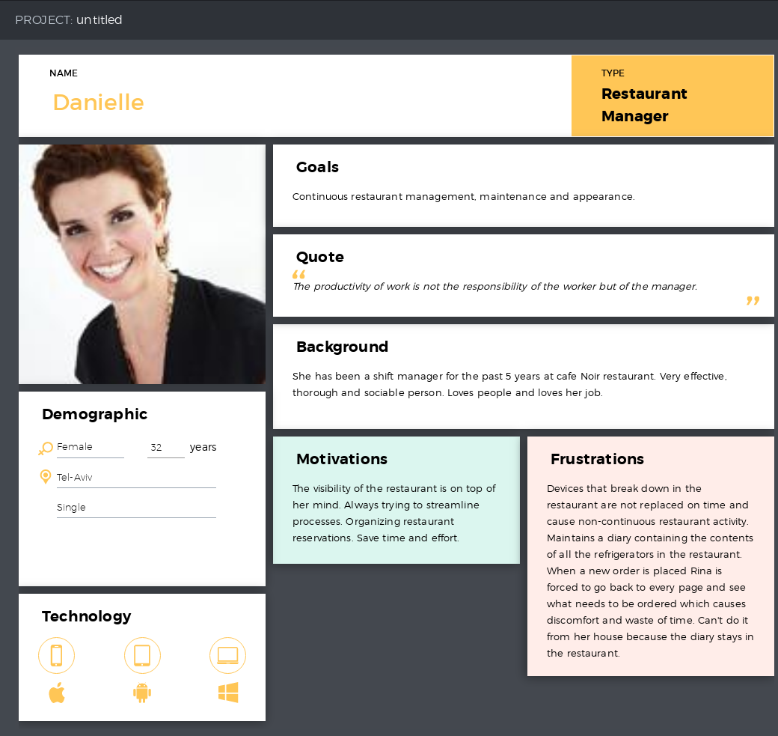

Slide 6
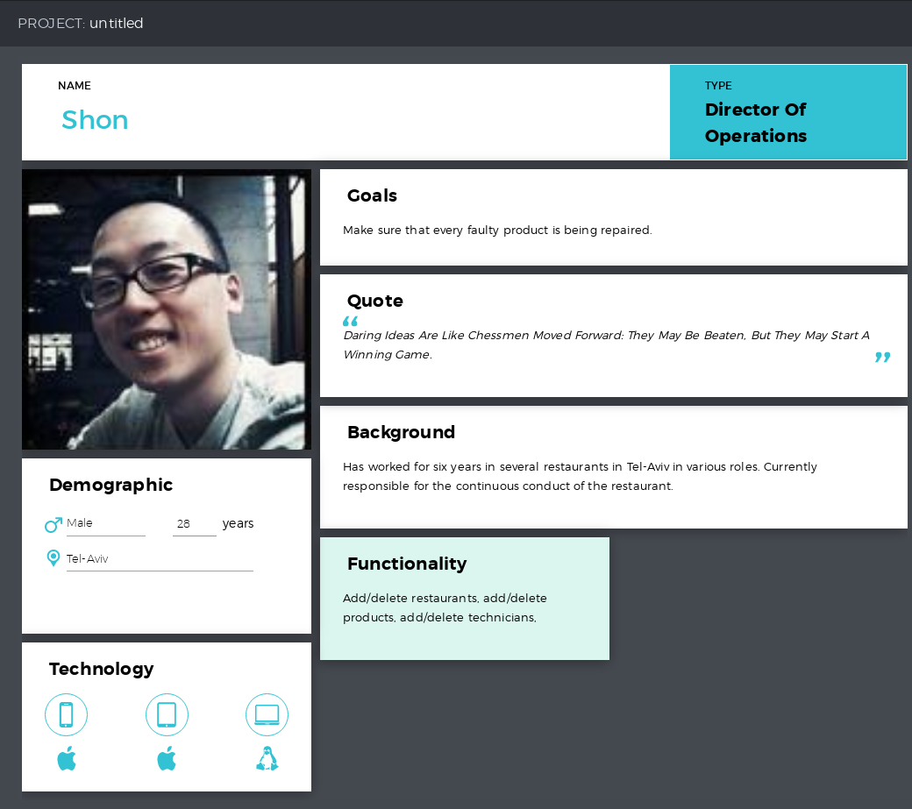

Slide 7
