Slide 1
Foreign Demand Shocks and Regional Dynamics: Evidence from Brazil

Slide 2
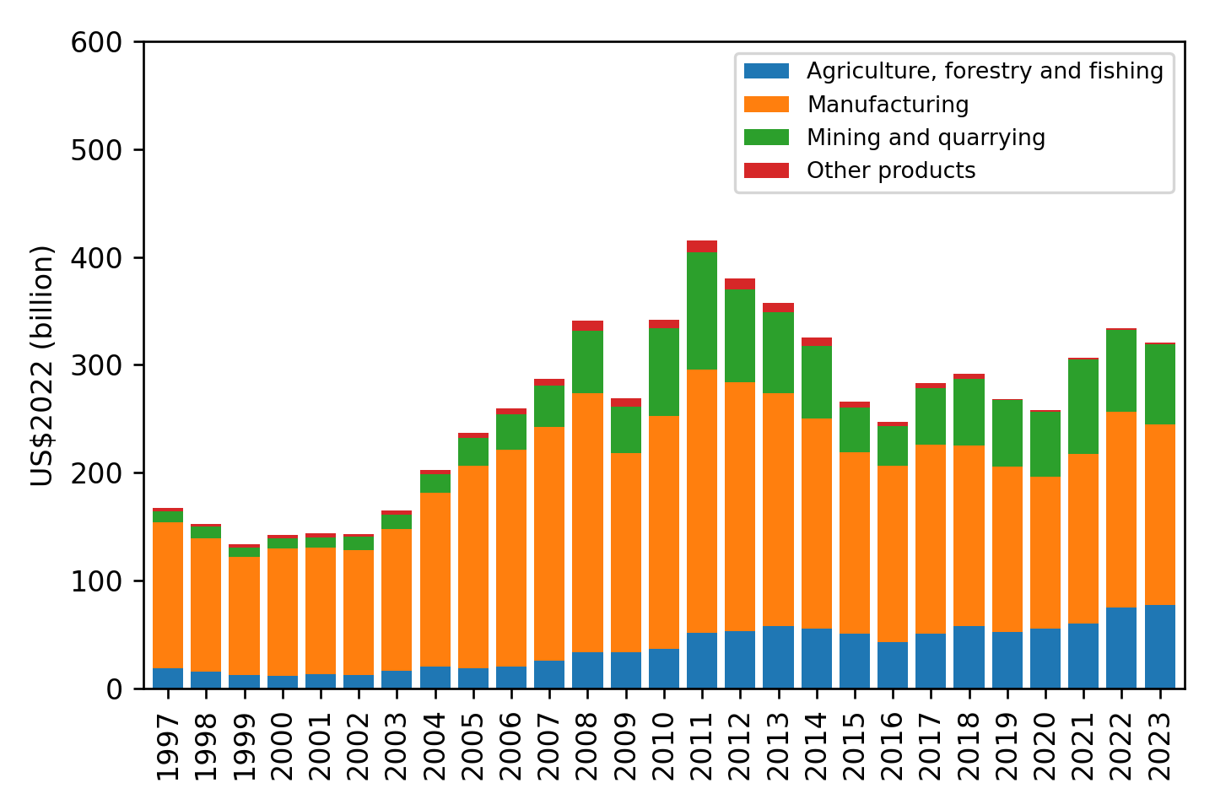
The cycle of exports in Brazil
In aggregate terms, real exports are about 3x from larger than 25 years ago but about 25% down from the 2010 peak.
At a macro-level (1-digit industry) the cycle is a combination of a continuous expansion of agro; a large cycle of oil; and a volatile manufacturing sector
Sources: Own calculations with MDIC, IBGE and Fred data.

Slide 3
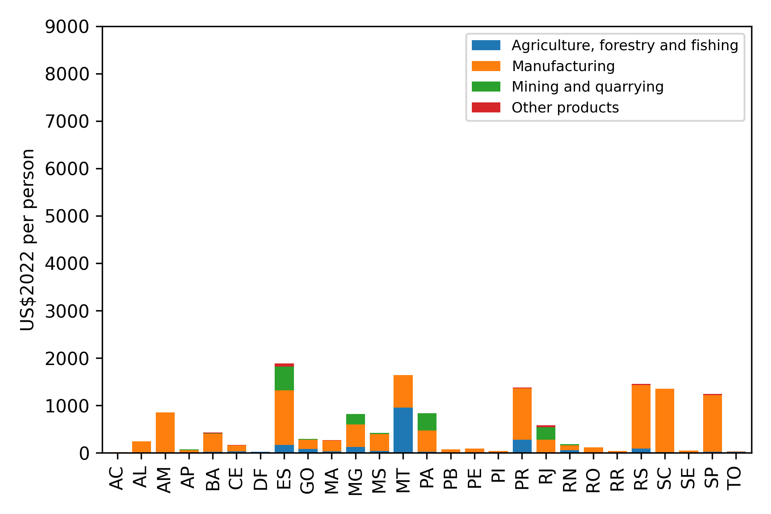
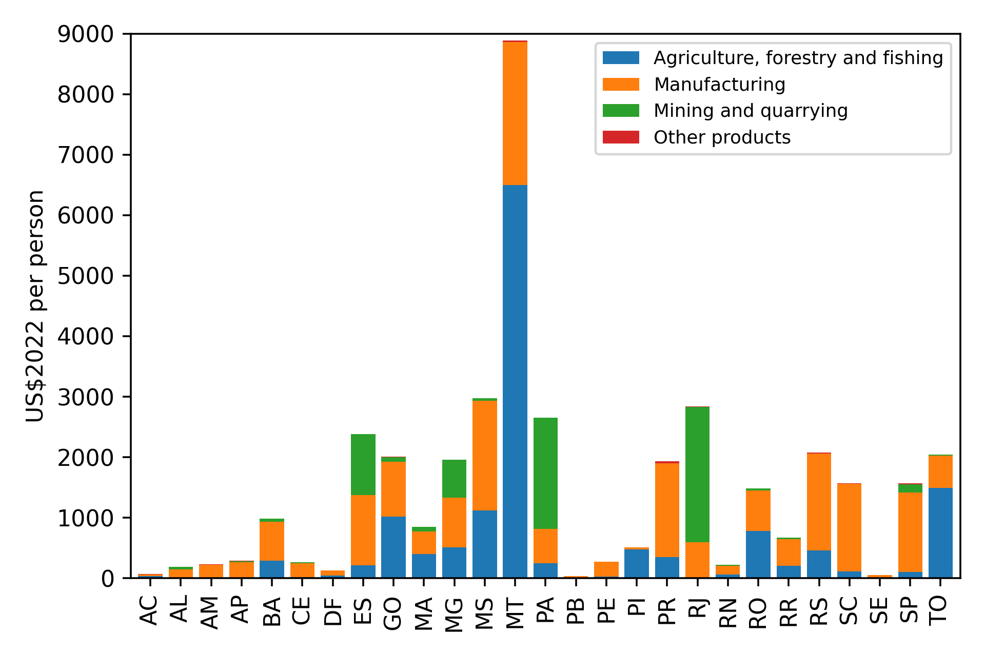
How does this look across states?
...and while the common story about agriculture does matter, there are some complementarieties between agriculture and manufacturing at play...
Average levels of exports increased for most states...
Brazilian States: Exports per Person, 2002 (In US$2022 per person; by one-digit ISIC sector)
Brazilian States: Exports per Person, 2022 (In US$2022 per person; by one-digit ISIC sector)
Sources: Own calculations with MDIC, IBGE and Fred data.
Sources: Own calculations with MDIC, IBGE and Fred data.

Slide 4
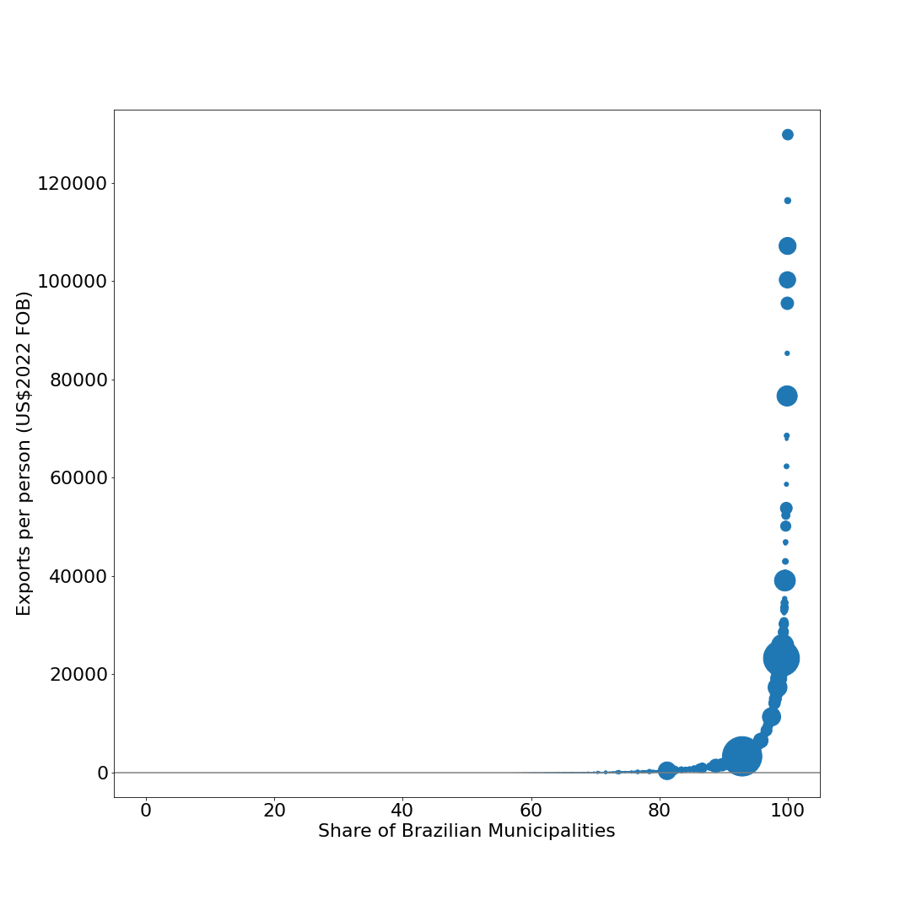
Local exposure to exports
Brazilian Municipalities: Exports per Person, 2022 (In US$2022 per person; bubbles are proportional to total municipal exports)
São Gonçalo de Rio Abaixo, MG
More than half of Brazilian municipalities did not export in 2022
Among the top 20 largest cities in Brazil, only Rio de Janeiro-RJ ($3,303), Curitiba-PR ($1,367), Guarulhos-SP ($1,591), and São Luís-MA ($1,838) have per capita exports larger than $1,000.
However, some smaller municipalities have very high exposure to exports.
Gavião Peixoto, SP
Ilhabela, SP
São Francisco do Conde, BA
Conceição do Mato Adentro, MG
Duque de Caxias, RJ
more than half of municipalities do not export
Rio de Janeiro, RJ
São Paulo, SP
Sources: Own calculations with MDIC, IBGE and Fred data.

Slide 5


Local exposure to exports
São Gonçalo de Rio Abaixo, MG
(Vale Brucutu Mining Site)
Gavião Peixoto, SP
(Embraer Production Plant)

Slide 6
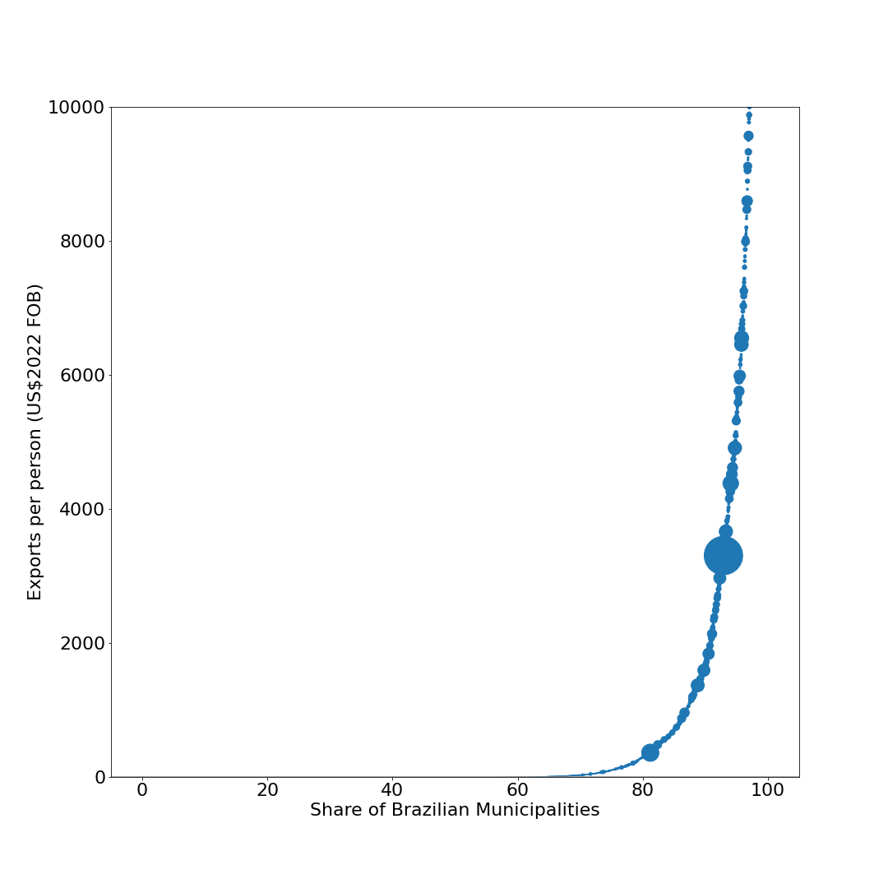
Zooming in
Brazilian Municipalities: Exports per Person, 2022 (In US$2022 per person; bubbles are proportional to total municipal exports axis truncated at US$2022 1000)
In 2022, the turning point seems to be around percentile 80...
...in other words, 20 percent of Brazilian municipalities were more exposed to exports.
Take off for higher exposure around top 20 share of municipalities
Sources: Own calculations with MDIC, IBGE and Fred data.

Slide 7
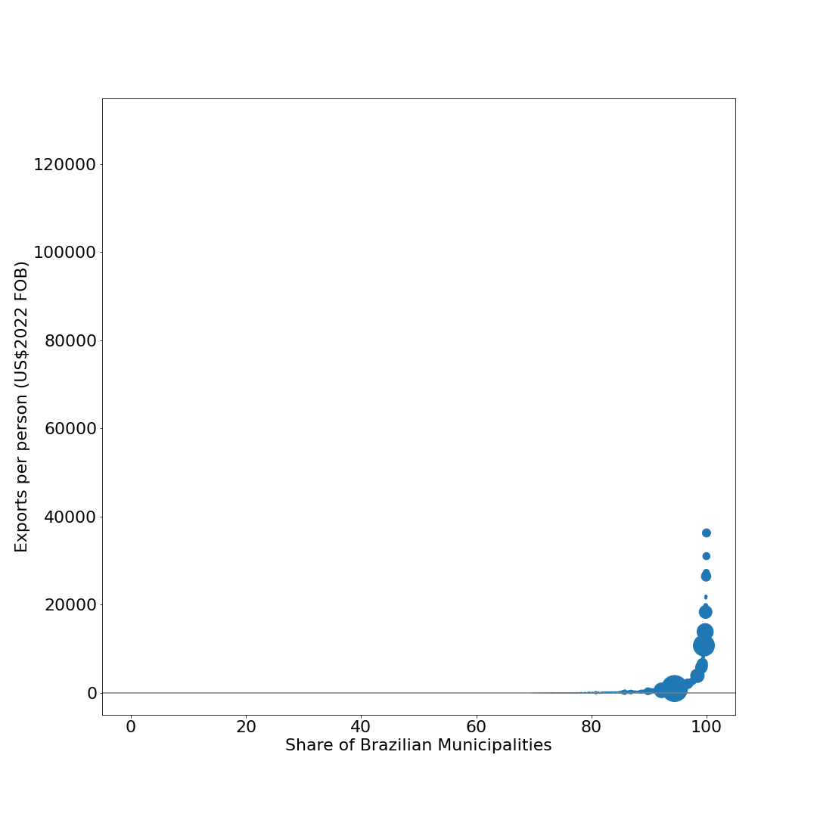
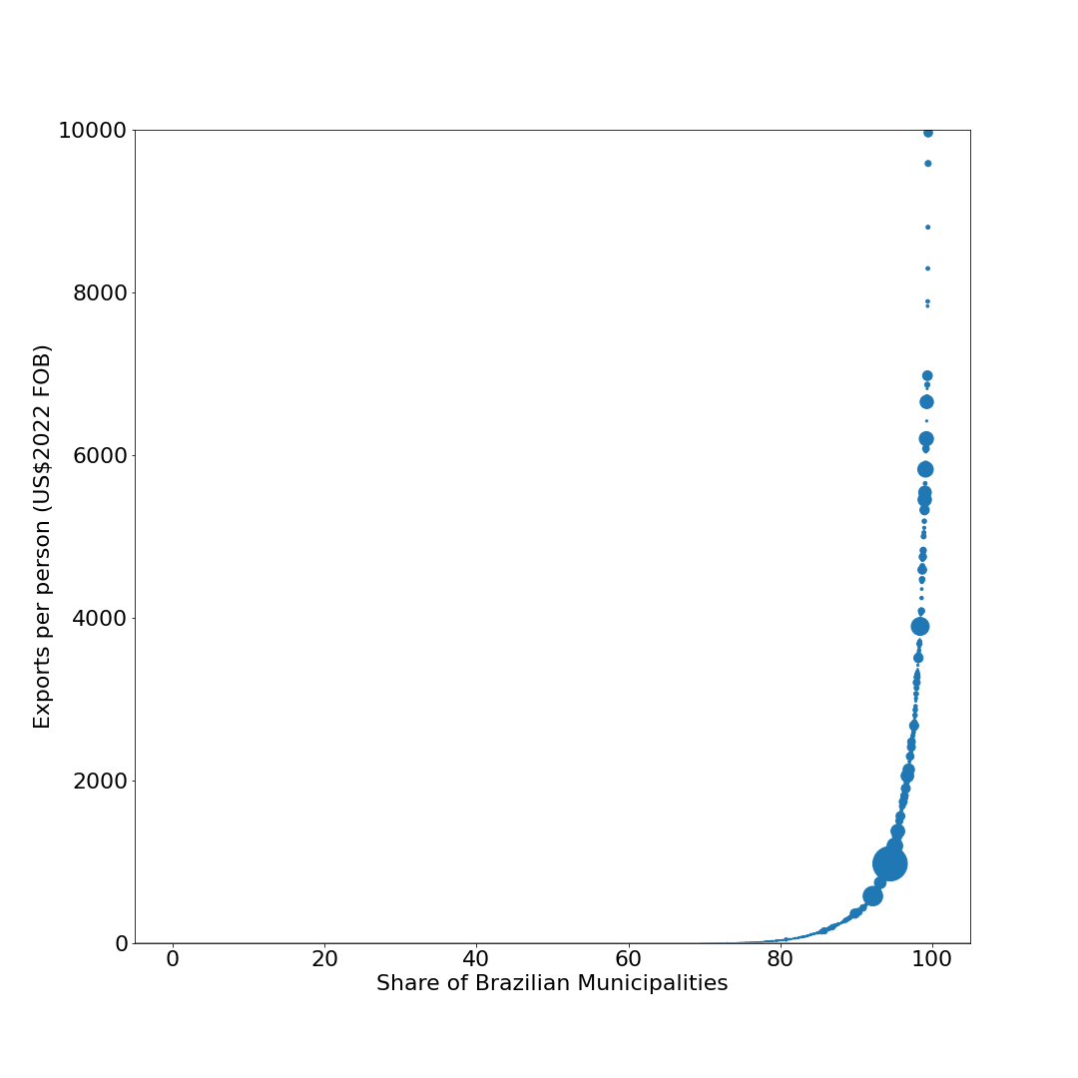
Going back 20 years, total exposure is lower and take off threshold was higher
Brazilian Municipalities: Exports per Person, 2002 (In US$2022 per person; bubbles are proportional to total municipal exports)
Brazilian Municipalities: Exports per Person, 2002 (In US$2022 per person; bubbles are proportional to total municipal exports; axis truncated at US$2022 1000)
Exports were lower across the board, both at the top and at the bottom of the distribution
Triunfo, RS
Take off for higher exposure around top 10 share of municipalities
Anchieta, ES
Belo Oriente, MG
more than two-thirds of
municipalities do not export
São Francisco do Conde, BA
Jaguariúna, SP
Vitória, ES
São José dos Campos, SP
São Paulo, SP
Rio de Janeiro, RJ
Sources: Own calculations with MDIC, IBGE and Fred data.
Sources: Own calculations with MDIC, IBGE and Fred data.

Slide 8
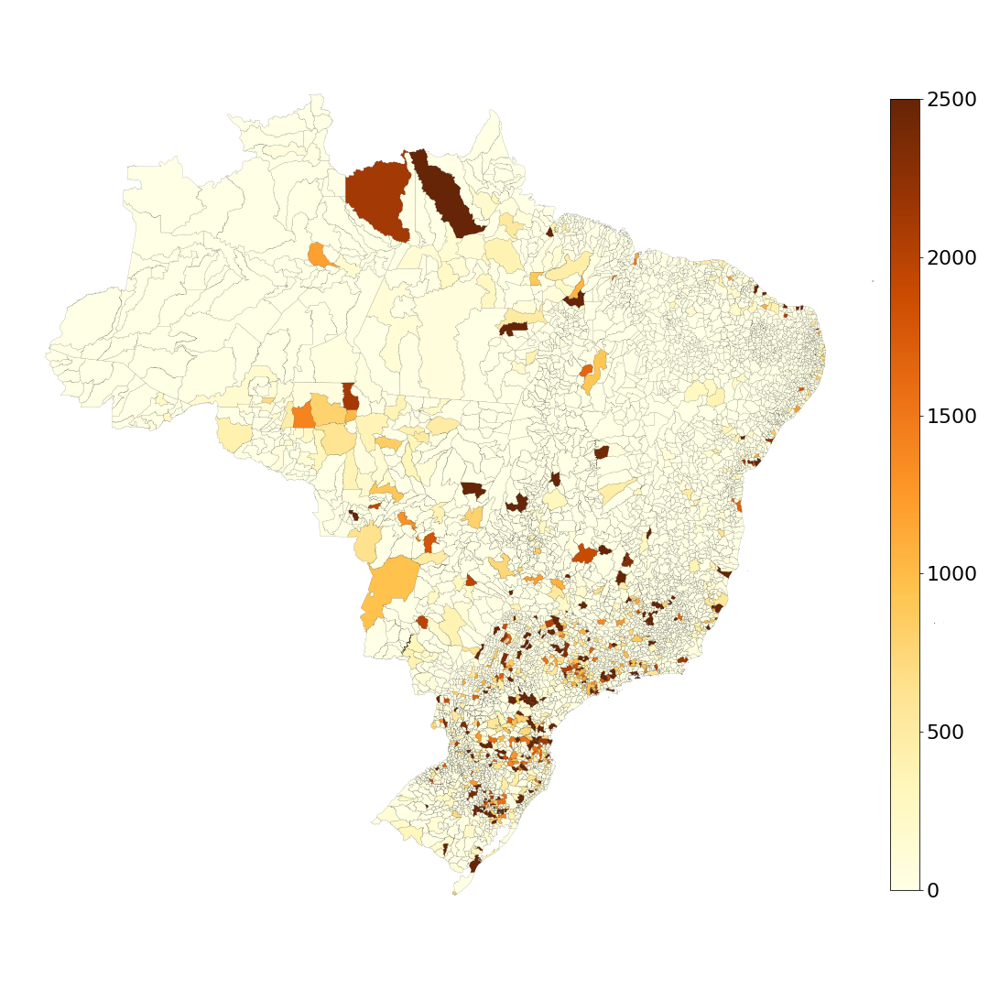
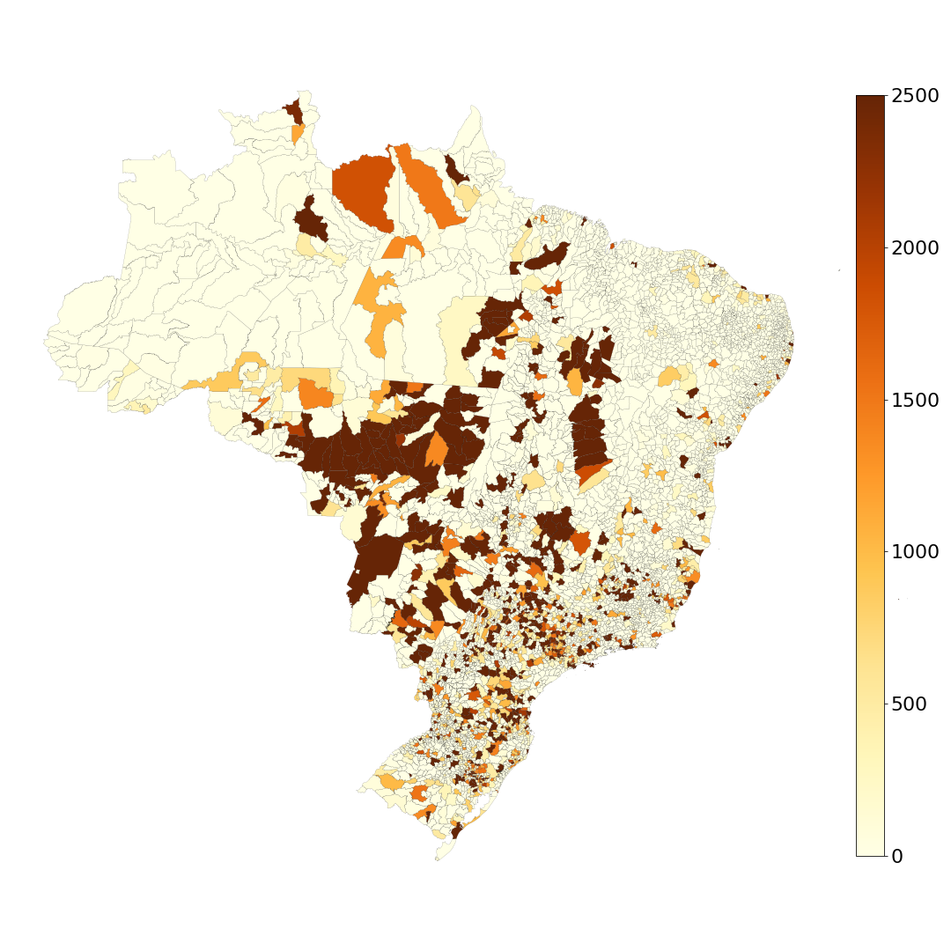
Looking at the distribution over space, one can see the takeoff of the countryside
Brazilian Municipalities: Exports per Person, 2002 (In US$2022 per person; bubbles are proportional to total municipal exports; distribution truncated at US$2022 2500+)
Brazilian Municipalities: Exports per Person, 2022 (In US$2022 per person; bubbles are proportional to total municipal exports; distribution truncated at US$2022 2500+)
Exports used to be concentrated in the old manufacturing hubs of the Southeast and South...
...while the old hubs are still important, the Midwest now has an outsized imprint.
Sources: Own calculations with MDIC, IBGE and Fred data.
Sources: Own calculations with MDIC, IBGE and Fred data.

Slide 9
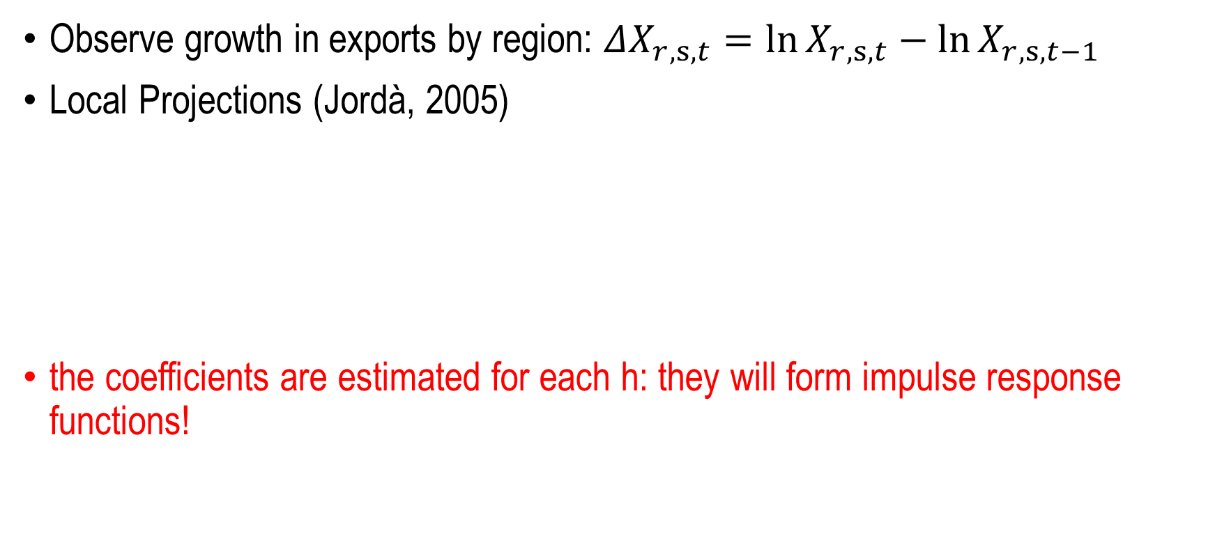
Methodology
Observe growth in exports by region: $ΔX_{r,s,t}=\ln{X_{r,s,t}}−\ln{X_{r,s,t−1}}$
Local Projections (Jordà, 2005)
the coefficients are estimated for each h: they will form impulse response functions!
$$O_{r,s,t+h}−O_{r,s,t−1}=α_{h}+β_{h}ΔX_{r,s,t}+Z_{r,s,t−1}^{′}φ_{h}+ε_{r,s,h}, for h∈ \text{\{}0,1,2,3… \text{\}}$$
cumulative change
in outcome since t-1
exports
controls

Slide 10

Since exports potentially endogenous, need IV
Instrument: weighted average of foreign GDP growth by industry exposure
$$Δ{\overline{X}}_{r,s,t}≡\sum_{i∈ℐ}{\frac{L_{r,s,i,t−1}}{L_{r,s,t−1}}}⋅\sum_{d∈C∖o}{\frac{X_{r,s,i,t−1}}{X_{r,s,t−1}}}⋅ΔY_{d,t}$$
exposure
of region r to industry i
exposure of industry i
in state s
to destination d

Slide 11
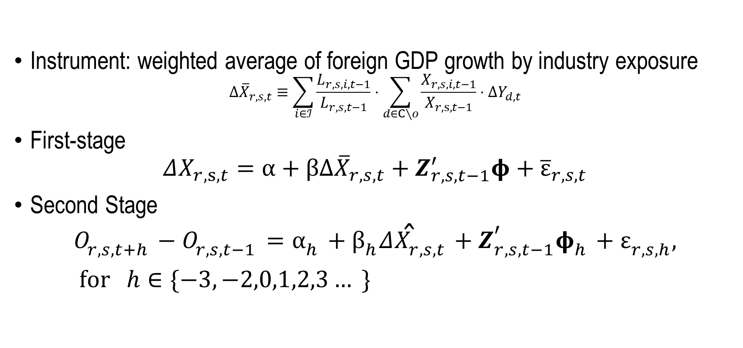
Two stage least squares with local projections
Instrument: weighted average of foreign GDP growth by industry exposure
$$Δ{\overline{X}}_{r,s,t}≡\sum_{i∈ℐ}{\frac{L_{r,s,i,t−1}}{L_{r,s,t−1}}}⋅\sum_{d∈C∖o}{\frac{X_{r,s,i,t−1}}{X_{r,s,t−1}}}⋅ΔY_{d,t}$$
First-stage
$$ΔX_{r,s,t}=α+βΔ{\overline{X}}_{r,s,t}+Z_{r,s,t−1}^{′}φ+{\overline{ε}}_{r,s,t}$$
Second Stage
$$O_{r,s,t+h}−O_{r,s,t−1}=α_{h}+β_{h}Δ{\hat{X}}_{r,s,t}+Z_{r,s,t−1}^{′}φ_{h}+ε_{r,s,h}, for h∈\{−3, −2,0,1,2,3… \}$$

Slide 12
Instrument is relevant: First Stage F-stat > 53
Note: this is a binscatter that reproduces the slope of regressing the observed growth in exports on the instrument, with region-fixed effects. The underlying regression has N=10,715, $β$=4.025 and t-stat = 7.3

Slide 13
Is the instrument valid?
We are leveraging:
differential exposure of each industry within a state to foreign demand shocks in each destination market
differential exposure of each local labor market to different industries
Critical assumption: every microregion in Brazil is small relative to global demand of a given industry
Exclusion restriction: changes in foreign demand are uncorrelated with the distribution of unobserved factors that drive changes across 558 local labor markets

Slide 14
Preliminary results: horizon-specific elasticity of formal employment to foreign demand shocks
Formal
employment
No evidence of pre-trends
Clear break in trend when the shock hits
1% exogenous increase in exports:
+0.25% increase in formal employment in SR
+0.10% increase in formal employment in LR

Slide 15
Preliminary results: heterogeneity by gender
Both male and female employment respond positively...
...but effects on female employment are subdue faster.
Male formal
employment
Female formal
employment

Slide 16
Preliminary results: horizon-specific elasticity of real average wages to foreign demand shocks
Real average
wages
Effect builds up with a lag
sticky wages?
are the gains for incumbents or entrants?
1% exogenous increase in exports:
<0.1% increase in real wages in SR
+0.2% increase in real wages in LR

Slide 17
Preliminary results: heterogeneity by gender
Effects on male wages are positive...
...but smaller than effects on female wages
Male real wages
Female real wages

