Slide 1
Exports and Regional Dynamics: Evidence from Brazil
Carlos Góes, Otávio Conceição, Gabriel Lara, and Gladys Lopez-Acevedo

Slide 2
Summary of results
Over last 25y, exports increased about 3x in Brazil
At the local level, export expansion leads to important labor market implications
Municipalities more exposed to exports see higher growth in formal emp. and wages
Effects are largely transitory, tapering out over the long-run
Adjustment is sluggish, w/ differences being significant even 10y after shock
Impact over formalization rates and high-skilled employment more persistent
Takeaways:
Export-oriented demand-side policies unlikely to increase employment over LR...
...but adjustment is slow and they may alter the formalization rate.

Slide 3
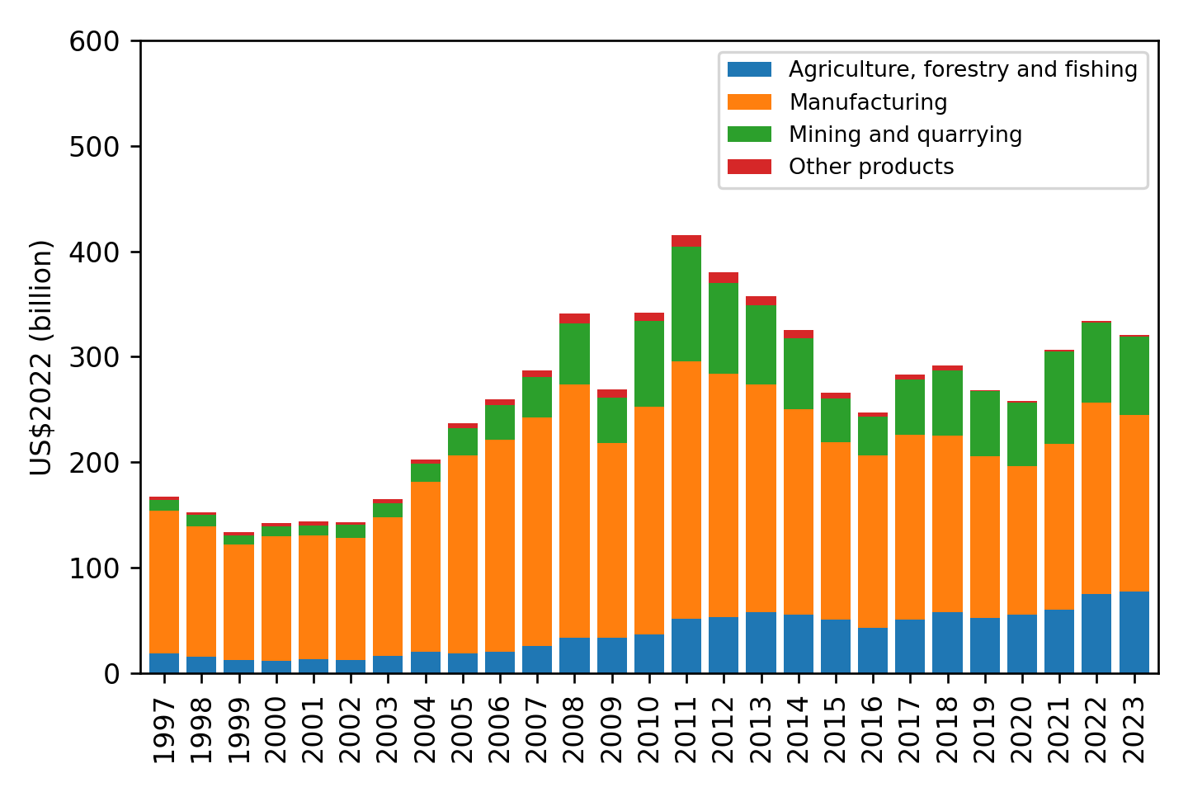
The cycle of exports in Brazil
In aggregate terms, real exports are about 3x from larger than 25 years ago but about 25% down from the 2010 peak.
At a macro-level (1-digit industry) the cycle is a combination of a continuous expansion of agro; a large cycle of oil; and a volatile manufacturing sector
Sources: Own calculations with MDIC, IBGE and Fred data.

Slide 4
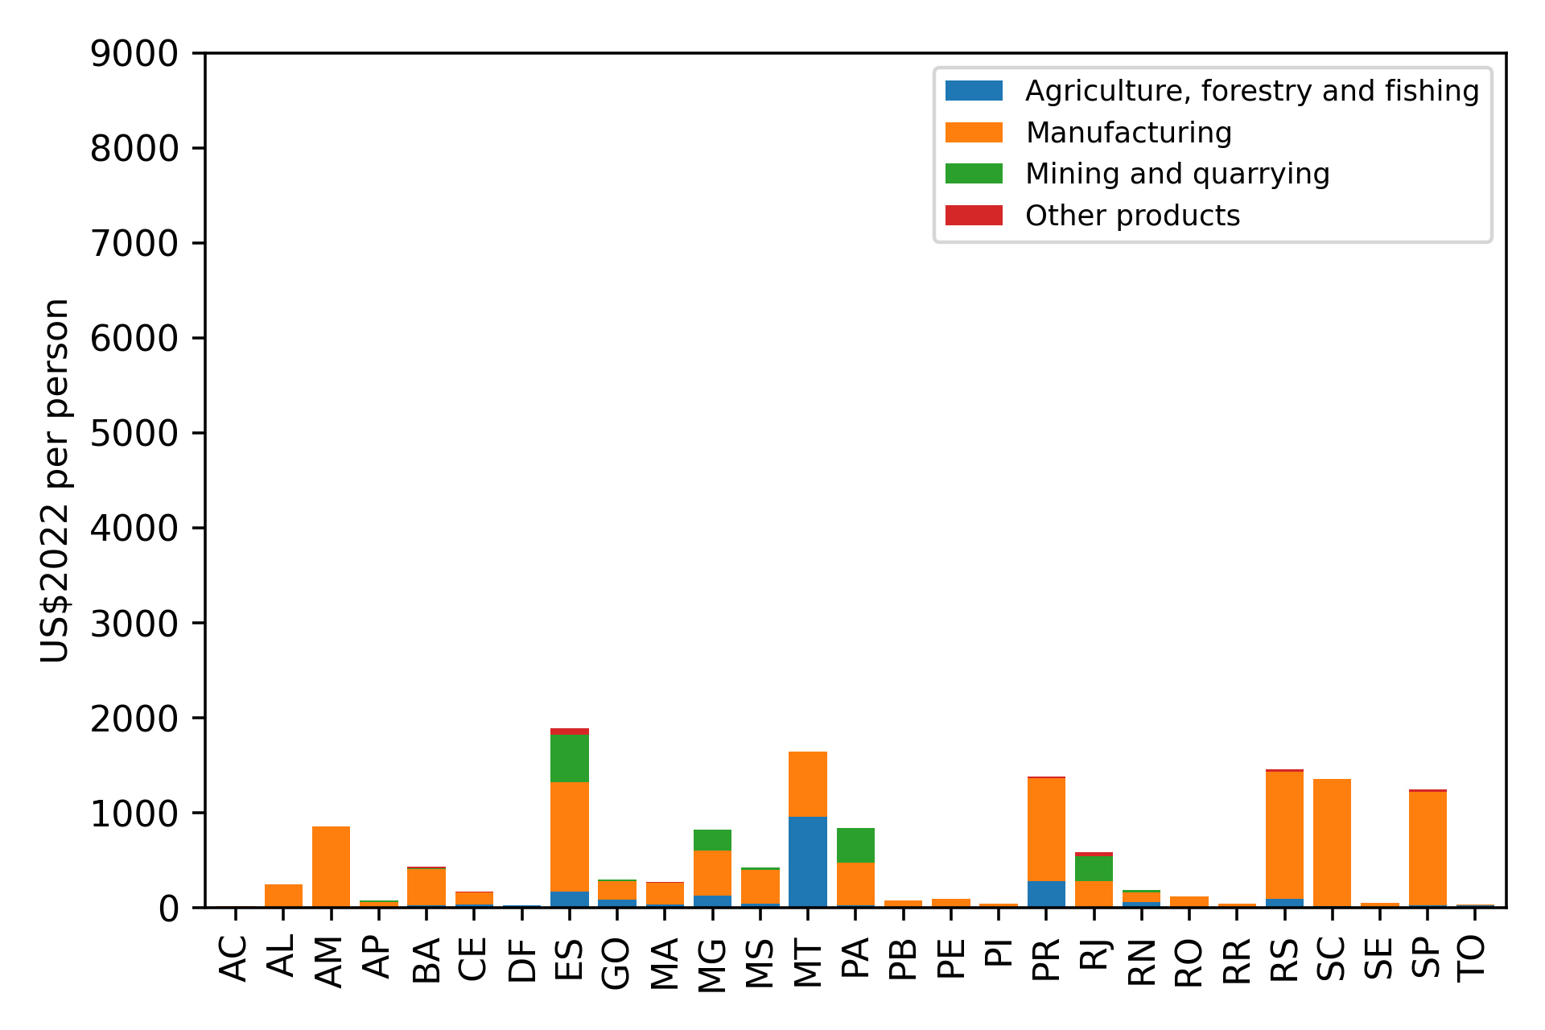
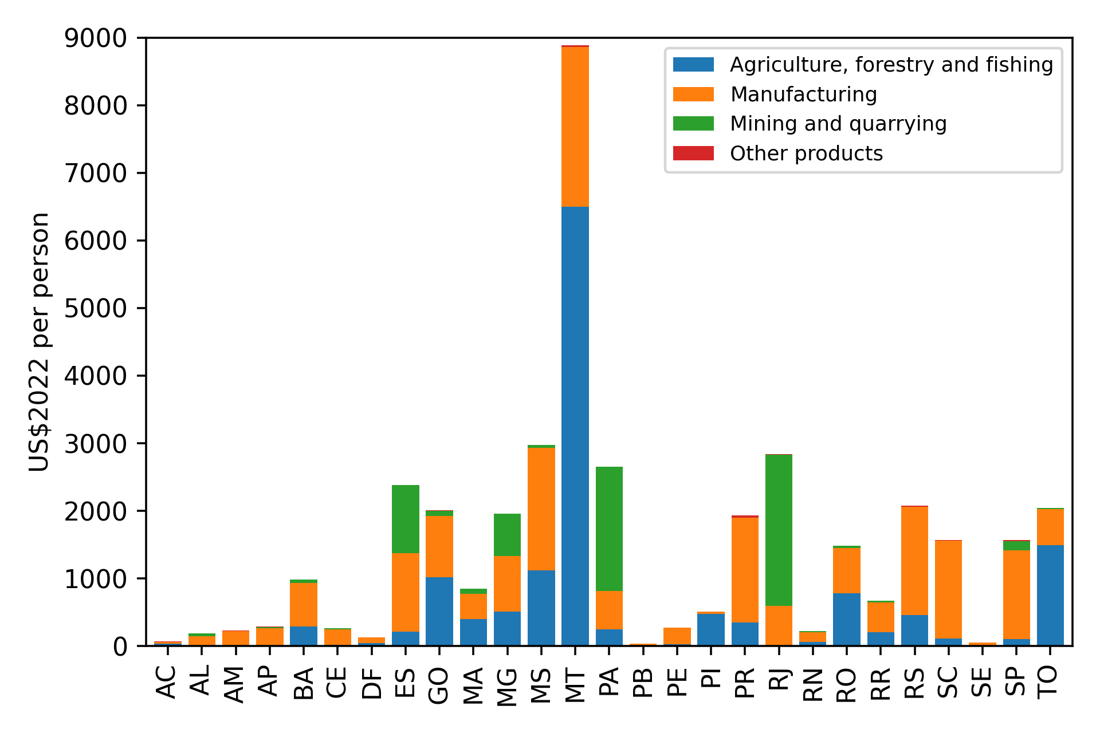
How does this look across states?
...and while the common story about agriculture does matter, there are some complementarieties between agriculture and manufacturing at play...
Average levels of exports increased for most states...
Brazilian States: Exports per Person, 2002 (In US$2022 per person; by one-digit ISIC sector)
Brazilian States: Exports per Person, 2022 (In US$2022 per person; by one-digit ISIC sector)
Sources: Own calculations with MDIC, IBGE and Fred data.
Sources: Own calculations with MDIC, IBGE and Fred data.

Slide 5
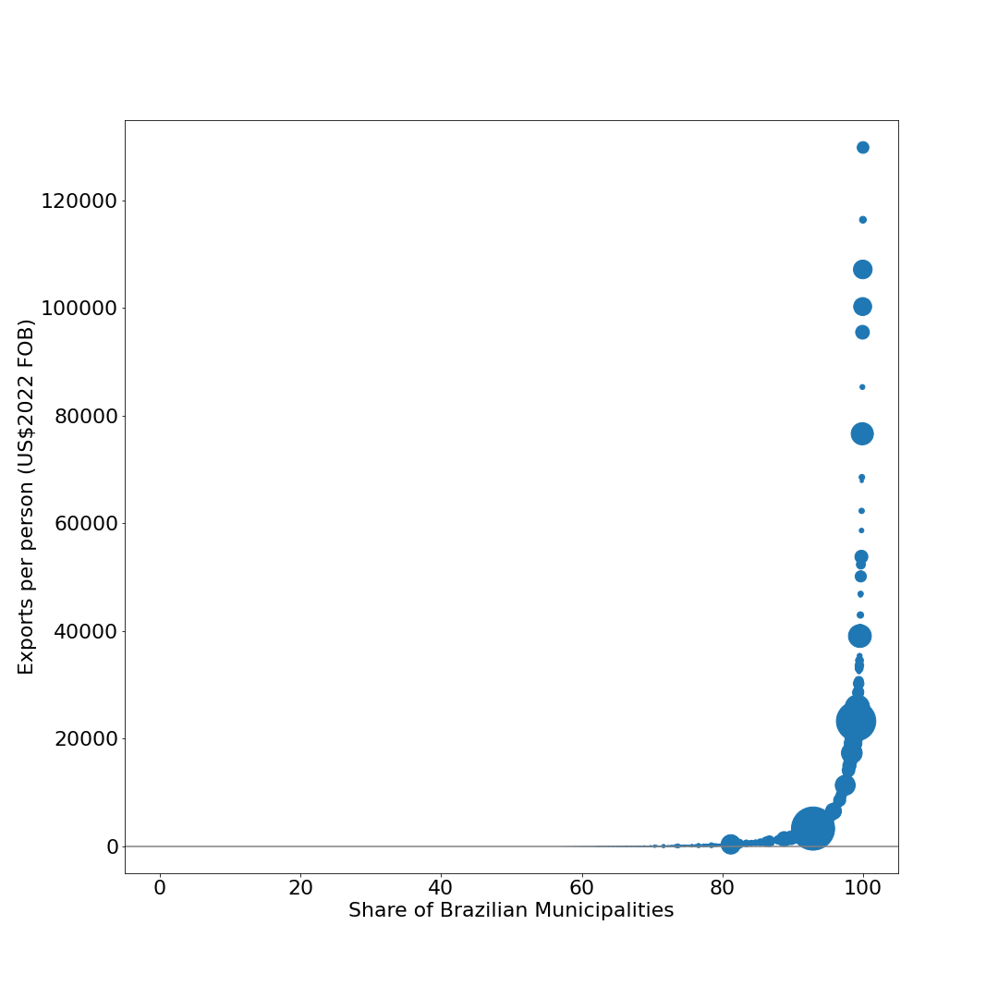
Local exposure to exports
Brazilian Municipalities: Exports per Person, 2022 (In US$2022 per person; bubbles are proportional to total municipal exports)
São Gonçalo de Rio Abaixo, MG
More than half of Brazilian municipalities did not export in 2022
Among the top 20 largest cities in Brazil, only Rio de Janeiro-RJ ($3,303), Curitiba-PR ($1,367), Guarulhos-SP ($1,591), and São Luís-MA ($1,838) have per capita exports larger than $1,000.
However, some smaller municipalities have very high exposure to exports.
Gavião Peixoto, SP
Ilhabela, SP
São Francisco do Conde, BA
Conceição do Mato Adentro, MG
Duque de Caxias, RJ
more than half of municipalities do not export
Rio de Janeiro, RJ
São Paulo, SP
Sources: Own calculations with MDIC, IBGE and Fred data.

Slide 6


Local exposure to exports
São Gonçalo de Rio Abaixo, MG
(Vale Brucutu Mining Site)
Gavião Peixoto, SP
(Embraer Production Plant)

Slide 7
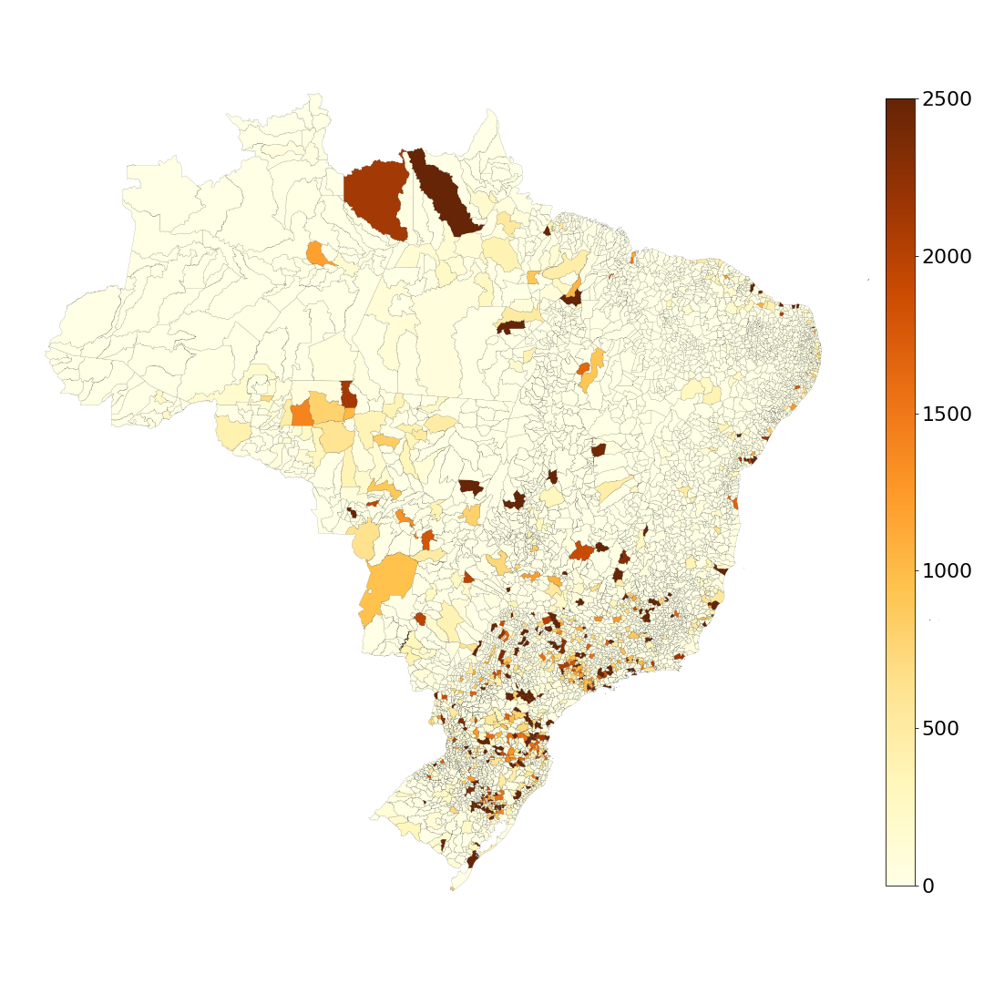
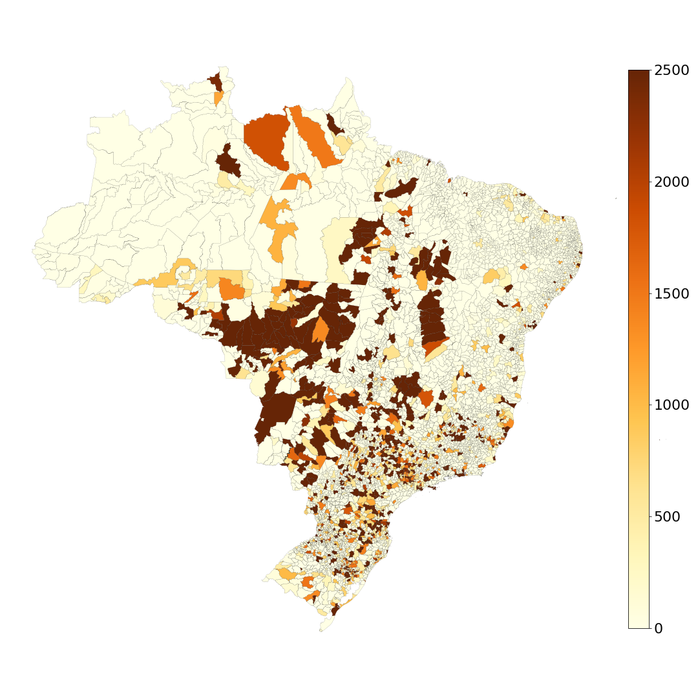
Looking at the distribution over space, one can see the takeoff of the countryside
Brazilian Municipalities: Exports per Person, 2002 (In US$2022 per person; bubbles are proportional to total municipal exports; distribution truncated at US$2022 2500+)
Brazilian Municipalities: Exports per Person, 2022 (In US$2022 per person; bubbles are proportional to total municipal exports; distribution truncated at US$2022 2500+)
Exports used to be concentrated in the old manufacturing hubs of the Southeast and South...
...while the old hubs are still important, the Midwest now has an outsized imprint.
Sources: Own calculations with MDIC, IBGE and Fred data.
Sources: Own calculations with MDIC, IBGE and Fred data.

Slide 8
Data
Administrative customs data (SISCOMEX-MDIC)
Total aggregate exports at the municipality level.
State-level exports at HS-6-digit product level.
Administrative formal labor market data (RAIS)
Employer reported formal employment, gender, education level, wages for the universe (35-45 million) of formal workers.
Two waves of Decennial Census (2000, 2010)
Captures universe of workers, both formal and informal.
Final datasets:
Panel of 3,371 exporting municipalities from 2000-2021 (N*T = ~34k).
Robustness: panel of all 558 microregions from 2000-2020.

Slide 9
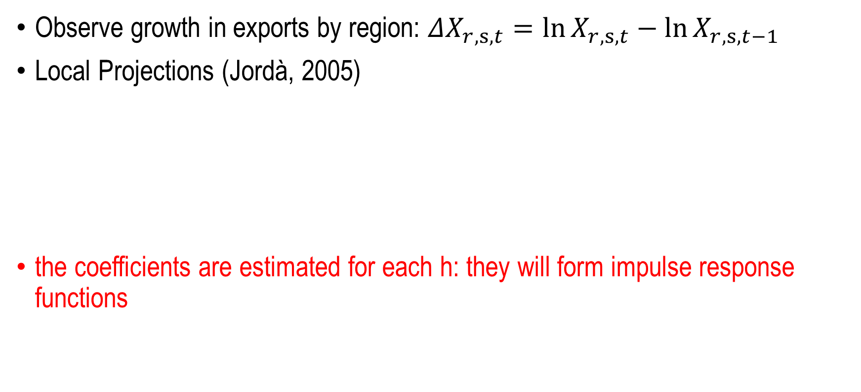
Methodology
Observe growth in exports by region: $ΔX_{r,s,t}=\ln{X_{r,s,t}}−\ln{X_{r,s,t−1}}$
Local Projections (Jordà, 2005)
the coefficients are estimated for each h: they will form impulse response functions
$$O_{r,s,t+h}−O_{r,s,t−1}=α_{h}+β_{h}ΔX_{r,s,t}+Z_{r,s,t−1}^{′}φ_{h}+ε_{r,s,h}, for h∈\{−5,…,0,…,6\}$$
cumulative change
in outcome since t-1
exports
controls

Slide 10
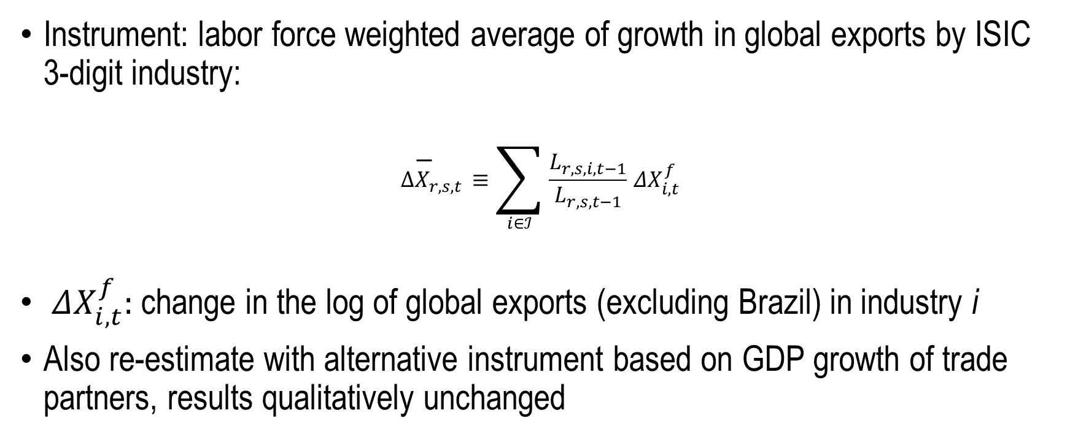
Since exports potentially endogenous, need IV
Instrument: labor force weighted average of growth in global exports by ISIC 3-digit industry:
$$Δ{\overline{X}}_{r,s,t}≡\sum_{i∈ℐ}{\frac{L_{r,s,i,t−1}}{L_{r,s,t−1}}}{ΔX}_{i,t}^{f}$$
${ΔX}_{i,t}^{f}:$change in the log of global exports (excluding Brazil) in industry i
Also re-estimate with alternative instrument based on GDP growth of trade partners, results qualitatively unchanged

Slide 11

Two stage least squares local projections
First-stage
$$ΔX_{r,s,t}=α+βΔ{\overline{X}}_{r,s,t}+Z_{r,s,t−1}^{′}φ+{\overline{ε}}_{r,s,t}$$
Second Stage
$$O_{r,s,t+h}−O_{r,s,t−1}=α_{h}+β_{h}Δ{\hat{X}}_{r,s,t}+Z_{r,s,t−1}^{′}φ_{h}+ε_{r,s,h}, for h∈\{−5,…,0,…,6\}$$

Slide 12
Instrument is relevant: First Stage F-stat > 280
Note: this is a binscatter that reproduces the slope of regressing the observed growth in exports on the instrument. The underlying regression has N=34,670, $β$=2.25 and t-stat = 16.76

Slide 13
Is the instrument valid?
We are leveraging:
differential growth in global exports (minus Brazil) in each market
differential exposure of each local labor market to different industries
Critical assumption: every municipality in Brazil is small relative to global demand of a given industry
Exclusion restriction: changes in foreign demand are uncorrelated with the distribution of unobserved factors that drive changes across 3k+ local labor markets

Slide 14
Preliminary results: horizon-specific elasticity of formal employment to foreign demand shocks
Formal
employment
Little evidence of pre-trends
Clear break in trend when the shock hits
1% exogenous increase in exports:
+0.25% increase in formal employment in SR
+0.05% increase in formal employment in MR
Effects largely transitory

Slide 15
Preliminary results: horizon-specific elasticity of average wages to foreign demand shocks
average
wages
Effect builds up with a lag
sticky wages?
are the gains for incumbents or entrants?
LR estimation (later) show differences taper down eventually
1% exogenous increase in exports:
<0.1% increase in wages in SR
~0.2% increase in wages in MR

Slide 16
Heterogeneity by education
Effects similar over SR, w/ elasticities:
~0.25-0.3 over short run
Effects on high skilled employment more persistent over mid-horizon
0.05 for below college education
~0.3 for college or higher

Slide 17
Preliminary results: heterogeneity by gender
Small differences in employment response…
… as well as on wage response.

Slide 18
The long-run
Re-estimate results with two waves of Census data (2000-2010)
Waves coincide with increase in exports
Effects on fomal employment are positive but small over LR
Regions with higher exposure to export shocks are less likely to see increase in informal employment
Differential effects on wages taper down relative to MR, small but significant for both formal and informal sectors
Baseline instruments has F-stat > 30
Baseline results in column (1)

