Slide 1
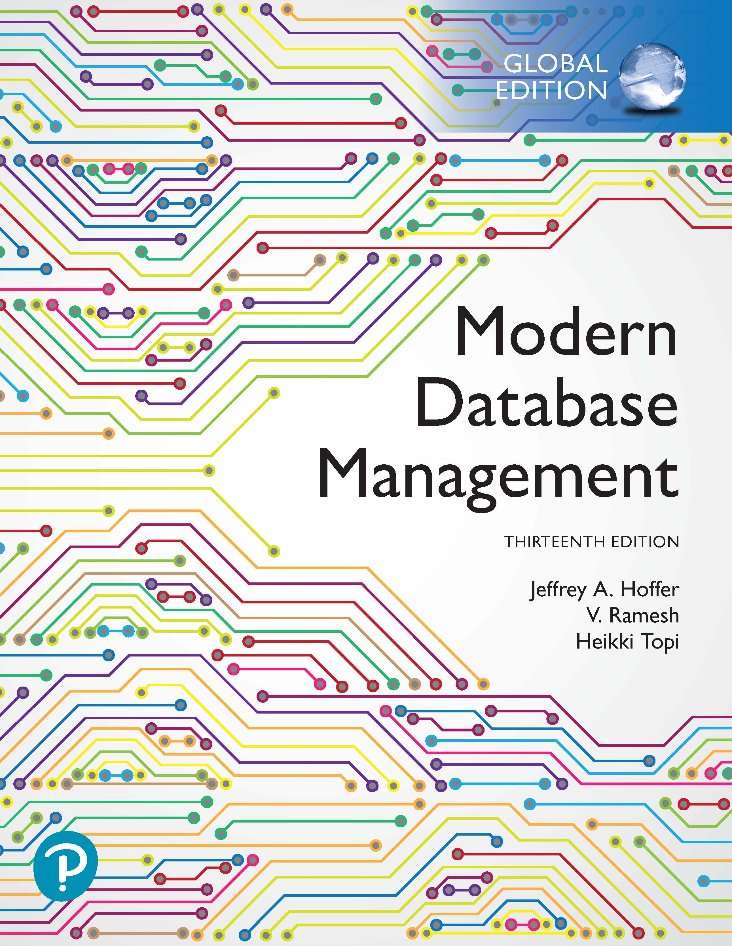
Modern Database Management
Thirteenth Edition, Global Edition
Chapter 8
Physical Database Design and Database Infrastructure
Copyright © 2020 Pearson Education Ltd. All Rights Reserved
Notes:
If this PowerPoint presentation contains mathematical equations, you may need to check that your computer has the following installed:
1) MathType Plugin
2) Math Player (free versions available)
3) NVDA Reader (free versions available)

Slide 2
Learning Objectives (1 of 2)
8.1 Define terms
8.2 Describe the physical database design process
8.3 Choose storage formats for attributes
8.4 Select appropriate file organizations
8.5 Describe three types of file organization
8.6 Describe indexes and their appropriate use
8.7 Translate a database model into efficient structures, including denormalization

Slide 3
Learning Objectives (2 of 2)
8.8 Describe problems and techniques for data security
8.9 Understand role of databases in Sarbanes-Oxley compliance
8.10 Describe problems and facilities for data recovery
8.11 Describe database tuning issues and list areas where changes can be done to tune the database
8.12 Understand impact of cloud-based database services on database infrastructure
8.13 Describe advantages and disadvantages of cloud-based database infrastructure solutions

Slide 4
Physical Database Design
Purpose – translate the logical description of data into the technical specifications for storing and retrieving data
Goal – create a design for storing data that will provide adequate performance and ensure database integrity, security, and recoverability

Slide 5
Information Needed for Physical Design
Normalized relations, including estimates for the range of the number of rows in each table
Definitions of each attribute, along with physical specifications such as maximum possible length
Descriptions of where and when data are used in various ways (entered, retrieved, deleted, and updated), including typical frequencies of these events
Expectations or requirements for response time and data security, backup, recovery, retention, and integrity
Descriptions of the technologies (database management systems) used for implementing the database
Notes:
Much of the input to the physical design comes from outputs from requirements analysis and logical design. Others stem from business security concerns and regulatory compliance, while still others stem from predictions of demand and performance analysis.

Slide 6
Critical Decisions for Physical Design
Choosing the storage format (called data type) for each attribute from the logical data model
Giving the D B M S guidance regarding how to group attributes from the logical data model into physical records
Giving the D B M S guidance on how to arrange similarly structured records in secondary memory (file organization)
Selecting structures (including indexes and the overall database architecture) for storing and connecting files to make retrieving related data more efficient
Preparing strategies for handling queries against the database that will optimize performance (query optimization)
Notes:
The primary goal of physical database design is data processing efficiency.
The organizational role that typically has the primary responsibility for physical database design is called the database administrator (DBA). More about database administration in Chapter 12.

Slide 7
Physical Design for Regulatory Compliance
Sarbanes- Oxley Act (S O X) – protect investors by improving accuracy and reliability
Committee of Sponsoring Organizations (C O S O) of the Treadway Commission
I T Infrastructure Library (I T I L)
Control Objectives for Information and Related Technology (C O B I T)
Notes:
Physical database design forms a foundation for compliance with national and international regulations on financial reporting. Without careful physical design, an organization cannot demonstrate that its data are accurate and well protected. These listed standards, guidelines, and rules focus on corporate governance, risk assessment, and security and controls of data. For full compliance, all data integrity controls must be thoroughly documented and undergo well-documented change control procedures.
The key focus of SOX audits is around three areas of control:
IT change management
Logical access to data
IT operations

Slide 8
Three Areas of S O X Audits
I T change management
Processes by which changes to operational systems and databases are authorized
Logical access to data
Security procedures to prevent unauthorized access
Personnel controls and physical access controls
I T operations
Policies and procedures for day-to-day management of infrastructure, applications, and databases

Slide 9
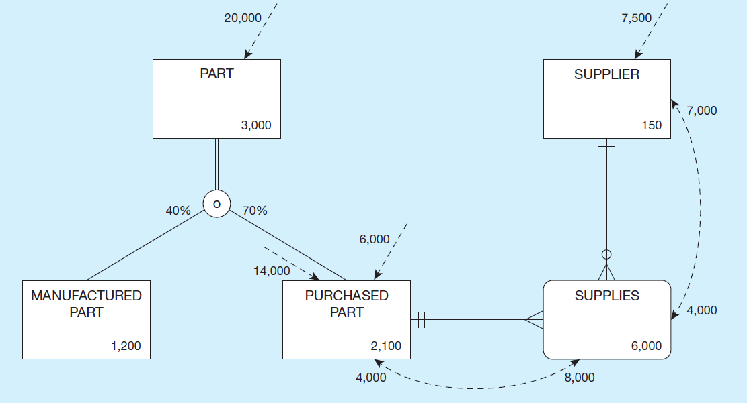
Figure 8-1 Composite Usage Map (Pine Valley Furniture Company)
Notes:
We create usage maps by modifying EER diagrams to include information regarding sizes of entities (e.g. numbers of instances) as well as frequencies of use of these entities. In this way, we come to an understanding of the storage needs, as well as the computational demand of the system. Usage analysis should be an ongoing activity.
Data volume
Here we see an expectation of 3000 parts, subdivided into manufactured and purchased. We also see 150 suppliers, and we see 6000 associations, each of which describe a particular supplier providing a particular purchased part (referred to in the next slides as a quotation). In essence, you can think of each entity as a table containing that number of rows (records).
Access Frequencies (per hour)
The volume and frequency statistics are generated during the systems analysis phase of the systems development process when systems analysts are studying current and proposed data processing and business activities. The data volume statistics represent the size of the business and should be calculated assuming business growth over a period of at least several years. The access frequencies are estimated from the timing of events, transaction volumes, the number of concurrent users, and reporting and querying activities.
Usage analysis:
14,000 purchased parts accessed per hour ➔
8000 supplies accessed from these 14,000 purchased part accesses ➔
7000 suppliers accessed from these 8000 supplies accesses
Note that the access of data from one table may trigger the need for further accesses in other tables. Usage analysis includes providing a representation of this expected flow of access requests.
Usage analysis:
7500 suppliers accessed per hour ➔
4000 supplies accessed from these 7500 supplier accesses ➔
4000 purchased parts accessed from these 4000 supplies accesses
The flow can go in different directions. In the previous slide the flow was triggered by accesses to parts and flowed through purchased part, supplies (associations), and finally suppliers. In this slide we see a flow in the opposite direction, triggered by initial access requests for suppliers.
These access requests could be queries which retrieve data or updates which manipulate the data. Each of these imposes some demand on computing resources, so this type of modeling helps to express that demand.

Slide 10
Designing Fields
Field: smallest unit of application data recognized by system software
Field design
Choosing data type
Coding, compression, encryption
Controlling data integrity
Notes:
In relational database terms, the word field is synonymous with column. Fields correspond roughly with attributes in ER and EER models.
During conceptual modeling, you identified the attributes for each entity type. During logical design, you converted the entities and attributes of the ER model to relations (tables) and columns (fields). Now, during physical design you give details of the fields. In actuality, some of these things could be part of logical design.
In some respects, logical design and physical design blend together. In other respects physical design blends with implementation. There aren’t always hard-and-fast boundaries between these phases of the SDLC.

Slide 11
Common Data Types (1 of 2)
VARCHAR2(length) max 400 characters
Variable-length character data. A string that is shorter than the maximum length will consume only the required space. N VARCHAR2 is Unicode.
CHAR(length) max 200 characters
Fixed length character data. N CHAR is Unicode.
C L O B
Character large object, capable of storing up to 4 gigabytes of one variable length character data field
NUMBER
Positive or negative number. NUMBER(5) means a 5 digit integer. NUMBER(5,2): 5 digits, two to the right of the decimal point.
Notes:
A data type is a detailed coding scheme recognized by a system software, such as a DBMS, for representing organizational data. The data type specifies the bit pattern of data stored in that coding scheme. There are many ways in which data could be physically represented. For data used in mathematical calculations, numeric fields should be used. For text displays, there are a variety of character-based representations, some of which are fixed length and some of variable length. Other data types include dates, binary representations for images or audio, and even specialized types for XML and other representations.

Slide 12
Common Data Types (2 of 2)
DATE
Can represent from Jan 1 4712 B C to Dec 31 9999 A D
Stores century, year, month, day, hour, minute, second
TIMESTAMP
Like a date. Can include fractional seconds, and time zones.
BLOB
Binary large object, can store up to 4 gigabytes
Used for photos, sound clips, etc.
Notes:
Selecting a data type involves four objectives that will have different relative levels of importance for different applications:
1. Represent all possible values.
2. Improve data integrity.
3. Support all data manipulations.
4. Minimize storage space.

Slide 13
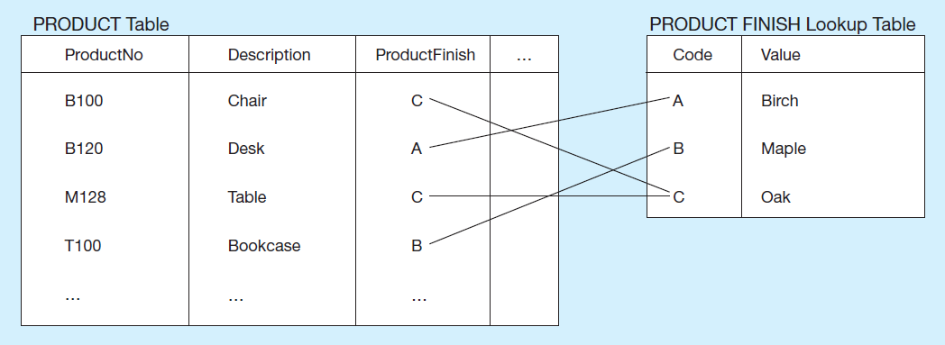
Figure 8-2 Example of a Code Look-up Table (Pine Valley Furniture Company)
Notes:
Some attributes have a sparse set of values or are so large that, given data volumes, considerable storage space will be consumed. A field with a limited number of possible values can be translated into a code that requires less space. A code table would not appear in the conceptual or logical model. The code table is a physical construct to achieve data processing performance improvements, not a set of data with business value.
So, in this case you probably would not see the PRODUCT FINISH table in either the conceptual model or the logical design.

Slide 14
Controlling Data Integrity
Default value – assumed value if no explicit value
Range control – allowable value limitations (constraints or validation rules)
Null value control – allowing or prohibiting empty fields
Referential integrity – range control (and null value allowances) for foreign-key to primary-key match-ups
Notes:
In most DBMSs, data integrity controls can be built into the physical structure of the fields and controls enforced by the DBMS on those fields. SQL has constructs to enforce these rules, as we saw Chapter 7.
The data type enforces one form of data integrity control because it may limit the type of data (numeric or character) and the length of a field value. Others include default values, allowable ranges of values, whether or not a value is required (null value controls), and enforcing relationships and their cardinality constraints via primary-to-foreign key matchups.
Sarbanes-Oxley Act (SOX) legislates importance of financial data integrity.

Slide 15
Handling Missing Data
Substitute an estimate of the missing value (e.g., using a formula)
Construct a report listing missing values
In programs, ignore missing data unless the value is significant (sensitivity testing)
Notes:
Of the three, sensitivity testing is the most complex, requiring the most sophisticated programming. This programming can be done within the capabilities of a DBMS, without requiring external applications to do the programming. Modern DBMSs have sophisticated programming capabilities, such as case expressions, user-defined functions, and triggers through which complex logic can be performed.

Slide 16
Denormalization
Transforming normalized relations into non-normalized physical record specifications
Benefits:
Can improve performance (speed) by reducing number of table lookups (i.e. reduce number of necessary join queries)
Costs (due to data duplication)
Wasted storage space
Data integrity/consistency threats
Notes:
It might seem counterintuitive that a database designer would want to denormalize a previously normalized (well structured) set of relations. After all, we spent considerable effort towards conceptual modeling (E-R/ EER) in order to ensure well-structured logical design. And, when faced with poorly structured relations, we normalized them in our logical design. Why denormalize now?
The answer is performance. When you normalize, you split data into separate tables in order to eliminate or at least reduce data duplication. This helps to ensure data integrity. But, it comes at a cost. It is much more computationally efficient to query a single table than to query multiple tables.
Therefore, it makes sense to, in a controlled way, back off from perfect normalization. In the next few slides, we’ll see some examples.

Slide 17
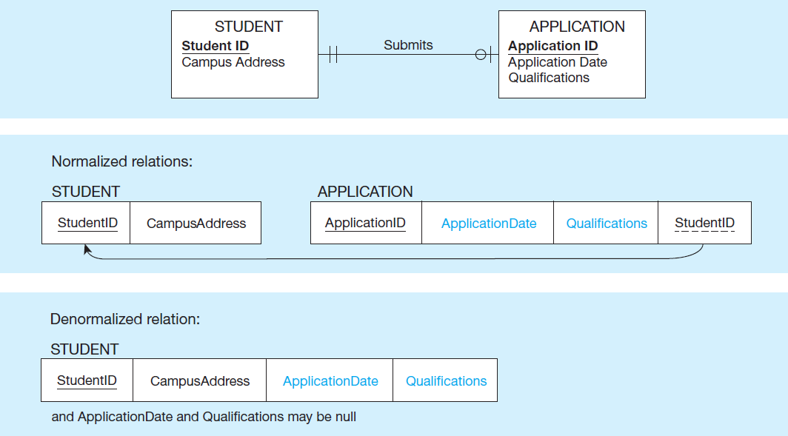
Figure 8-3 A possible Denormalization Situation
Two entities with one-to-one relationship
Notes:
One-to-one relationships are good candidates for denormalization, such as this example of students with applications.
Note that from this diagram we know that not all students have applications.
Question: How do we know this?
Answer: The optional on the application side of the Submits relationship.
Therefore, many students may not have applications, so the application date and qualifications fields of the denormalized relation may not be used. This wastes space. But, as mentioned earlier, space is cheap these days.
Denormalizing in the 1:1 case does not, however, threaten data integrity.
Question: Why?
Answer: It’s a 1:1 relationship, so there won’t be multiple records with the same student ID and campus address.

Slide 18
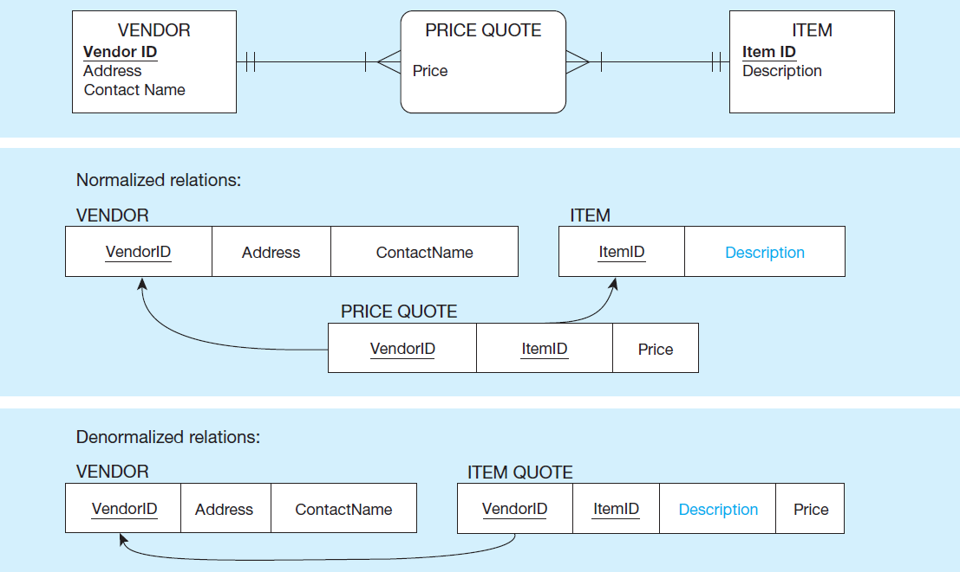
Figure 8-4 A Possible Denormalization Situation
A many-to-many relationship with non-key attributes
Notes:
Here is the case of a many-to-many relationship between vendors and items, which results in three tables (relations). Denormalizing combines the Item and Price Quote tables into a single table called Item Quote.
Question: Which attribute will wind up being duplicated in this case?
Answer: The item description. This means that any time the description changes, the change must be done to all item quotes unless you’re willing to tolerate inconsistencies in the item descriptions. So, in this case, there is some compromising of data integrity guarantees. Again, we do this for the sake of performance. A query involving two tables is more efficient than a query involving three.
Note that the composite usage map can illustrate the demand on the extra table, and therefore can be used to justify whether or not denormalization should take place.

Slide 19
Denormalize with Caution
Denormalization can
Increase chance of errors and inconsistencies
Reintroduce anomalies
Force reprogramming when business rules change
Perhaps other methods could be used to improve performance of joins
Organization of tables in the database (file organization and clustering)
Proper query design and optimization
Notes:
Note that denormalization is most beneficial and least harmful in relations where there is a minimal amount of updates that would occur to the duplicated attributes. In Chapter 9, we will discuss the concept of “data warehouses”. A data warehouse is generally for the sole purpose of performing complex queries to assist with managerial decision making. These are never updated, except at specified intervals of data integration. Therefore, data warehouses are often non-normalized.

Slide 20
Partitioning
Horizontal Partitioning: Distributing the rows of a logical relation into several separate tables
Useful for situations where different users need access to different rows
Three types: Key Range Partitioning, Hash Partitioning, or Composite Partitioning
Vertical Partitioning: Distributing the columns of a logical relation into several separate physical tables
Useful for situations where different users need access to different columns
The primary key must be repeated in each file
Notes:
You can also have combinations of Horizontal and Vertical.
The previous denormalization examples all deal with combining tables to avoid doing joins. Another form of denormalization involves the creation of more tables by partitioning a relation into multiple physical tables.
In other words, we purposely duplicate (copy) relations or portions of relations and store these copies in multiple storage locations.

Slide 21
Partitioning Pros and Cons
Advantages of Partitioning
Efficiency: records used together are grouped together
Local optimization: each partition can be optimized for performance
Security: data not relevant to users are segregated
Recovery and uptime: smaller files take less back up time
Load balancing: partitions stored on different disks, reduces contention
Disadvantages of Partitioning
Inconsistent access speed: slow retrievals across partitions
Complexity: non-transparent partitioning
Extra space or update time: duplicate data; access from multiple partitions
Notes:
As with all physical design decisions, partitioning has its advantages and disadvantages.

Slide 22
Designing Physical Database Files
Physical File
A named portion of secondary memory allocated for the purpose of storing physical records
Tablespace – named logical storage unit in which data from multiple tables/views/objects can be stored
Tablespace components
Segment – a table, index, or partition
Extent – contiguous section of disk space
Data block – smallest unit of storage
Notes:
We’ve been talking about relational database structures, involving tables, columns, and primary and foreign keys, as if this is in fact the way data is actually stored on disk. But it is not. At the operating system level, we are always talking about files. Databases are just one kind of file. The table/column/key idea is really an abstraction. At a lower implementation level, these database files (like all physical files) are actually constructed via different file formats, which will be discussed in the next few slides.
Most database management systems store many different kinds of data in one operating system file. By an operating system file, we mean a named file that would appear on a disk directory listing (e.g., a listing of the files in a folder on the C: drive of your personal computer).

Slide 23
File Organizations
Types of file organizations
Heap – no particular order
Sequential
Indexed
Hashed
Factors for selecting file organization
Fast data retrieval and throughput
Efficient storage space utilization
Protection from failure and data loss
Minimizing need for reorganization
Accommodating growth
Security from unauthorized use
Notes:
A file organization is a technique for physically arranging the records of a file on secondary storage devices. Typical file organizations include sequential, indexed, and hashed, which we will see in the next few slides. Another possibility is something called a “heap”, but this has no order and is not ideal for quick access. Imagine a telephone book where people were in no particular order. You’d potentially have to search through each and every name before finding what you need. The other file organizations are designed to bring quick access and/or optimize insertion, modification, and removal of data items.
With modern relational DBMSs, you don’t need to design file organizations, but you may be allowed to select an organization and its parameters for a table or physical file. Here are some factors to consider.

Slide 24
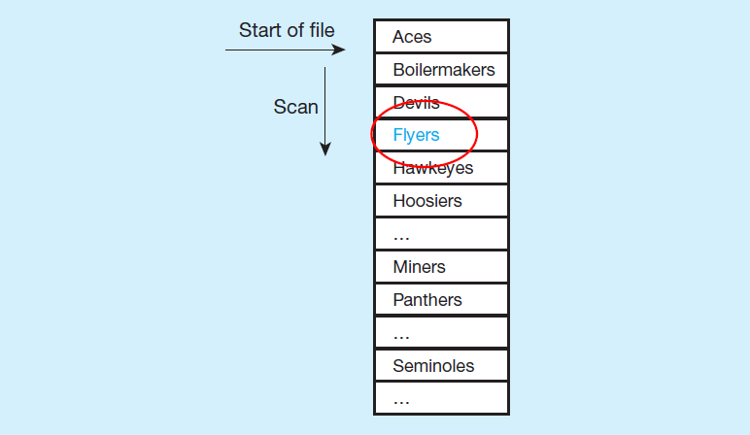
Figure 8-7 Comparison of File Organizations
a) Sequential
Notes:
In essence, when data is arranged sequentially, you can cut the search space in half each time you look. For example, suppose you wanted to find the Flyers? First, look at the middle item the list (suppose it was Hoosiers). Since Flyers come before Hoosiers, you know it has to be in the group before Hoosiers. So, then look in the middle of that group (suppose this item was Devils. At this point, you know it has to be between Devils and Hoosiers.
So, the speed of accessing a desired record (knowing the primary key) in a sequential file is much, much faster than accessing it in an unordered file (heap).
But, sequential file organization always requires data to be sorted. Therefore, such a file must be resorted every time new items are inserted, or if any existing items are changed. So, the speed of access comes with a significant maintenance cost.

Slide 25
Indexed File Organizations
Storage of records sequentially or nonsequentially with an index that allows software to locate individual records
Index: a table or other data structure used to determine in a file the location of records that satisfy some condition
Primary keys are automatically indexed
Other fields or combinations of fields can also be indexed; these are called secondary keys (or nonunique keys)
Notes:
In an indexed file organization, the records are stored either sequentially or nonsequentially, and an index is created that allows the application software to locate individual records (see Figure 8-7b). Like a card catalog in a library, an index is a table that is used to determine in a file the location of records that satisfy some condition. Each index entry matches a key value with one or more records. An index can point to unique records (a primary key index, such as on the ProductID field of a product record) or to potentially more than one record. An index that allows each entry to point to more than one record is called a secondary key index.

Slide 26
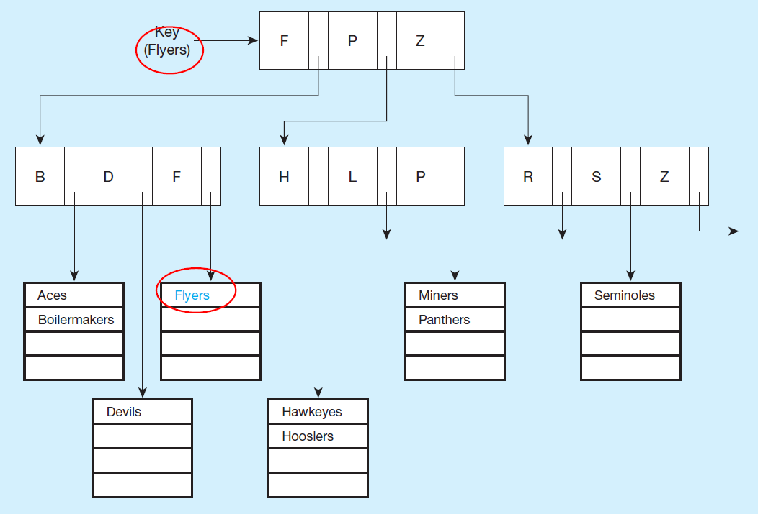
Figure 8-7 Comparison of File Organizations (1 of 2)
a) Indexed
Notes:
An advantage of the indexed file organization over the sequential is that it is easier to insert and delete data. Because the index is composed of many smaller lists of actual data items (seen in the bottom of the tree), then sorting an individual cluster is much less costly than sorting the whole file. Also, if you keep the individual lists small enough, then even if they are unsorted, the search time is not so bad.
The trick is indexing, and specifically keeping an optimal number of levels within the index. In this case we see two levels of indexing, below which are the sublists of data items.
The index organization in this figure splits at the top level into three groups. Any team name starting with A-F goes in the first group, those with G-P in the second, and those with Q-Z in the third. Within each group there is a second split into three subgroups each.
Indexed file organization is often used with attributes that are likely to be frequently used in queries. Part of the physical design process involves choosing which columns of a table to index, as we’ll see later.

Slide 27
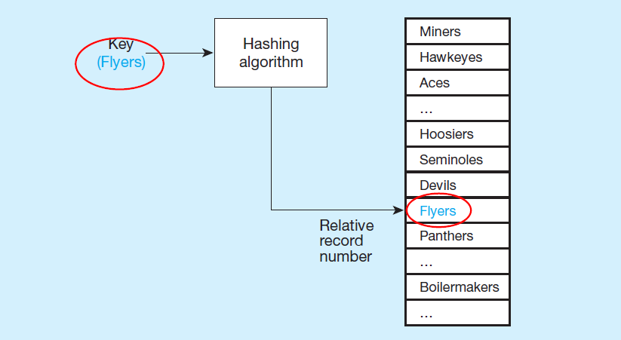
Figure 8-7 Comparison of File Organizations (2 of 2)
a) Hashed
Notes:
A hashing algorithm is a routine that converts a primary key value into a record address. Although there are several variations of hashed files, in most cases the records are located nonsequentially, as dictated by the hashing algorithm. Thus, sequential data processing is impractical.
A typical hashing algorithm uses the technique of dividing each primary key value by a suitable prime number and then using the remainder of the division as the relative storage location. For example, suppose that an organization has a set of approximately 1,000 employee records to be stored on magnetic disk. A suitable prime number would be 997, because it is close to 1,000. Now consider the record for employee ID 12396. When we divide this number by 997, the remainder is 432. Thus, this record is stored at location 432 in the file.
Hashing algorithms could potentially map two different primary keys to the same location. If that happens, there will be a list at that location, similar to the lists in the indexed file organization described earlier.

Slide 28
Clustering Files
In some relational D B M S s, related records from different tables can be stored together in the same disk area
Useful for improving performance of join operations
Primary key records of the main table are stored adjacent to associated foreign key records of the dependent table
e.g. Oracle has a CREATE CLUSTER command
Notes:
Clustering records is best used when the records are fairly static, as in a data warehouse. When records are frequently added, deleted, and changed, wasted space can arise; it may be difficult to locate related records close to one another after the initial loading of records, which defines the clusters. Clustering is, however, one option a file designer has to improve the performance of tables that are frequently used together in the same queries and reports.
So, clustering and join indexes are both done for the purpose of optimizing join queries.

Slide 29


Unique and Non unique Indexes
Unique (primary) Index
Typically done for primary keys, but could also apply to other unique fields
,
Non unique (secondary) index
Done for fields that are often used to group individual entities (e.g., zip code, product category)
,
Notes:
Part of the physical design process is to decide which fields need indexing. Primary keys are normally indexed by default. The database designer typically chooses which other fields to index, based on expected usage of those fields in queries and inserts. If the fields are used a lot as conditions in queries, this increases the importance of indexing. But indexing comes at a cost, which involves maintaining the index. Indexes are costly for fields that get updated a lot.

Slide 30
When to Use Indexes (1 of 2)
Use on larger tables
Index the primary key of each table
Index search fields (fields frequently in WHERE clause)
Fields in S Q L ORDER BY and GROUP BY commands
When there are >100 values but not when there are <30 values

Slide 31
When to Use Indexes (2 of 2)
Avoid use of indexes for fields with long values; perhaps compress values first
If key to index is used to determine location of record, use surrogate (like sequence number) to allow even spread in storage area
D B M S may have limit on number of indexes per table and number of bytes per indexed field(s)
Be careful of indexing attributes with null values; many D B M S s will not recognize null values in an index search
Use a query optimizer

Slide 32
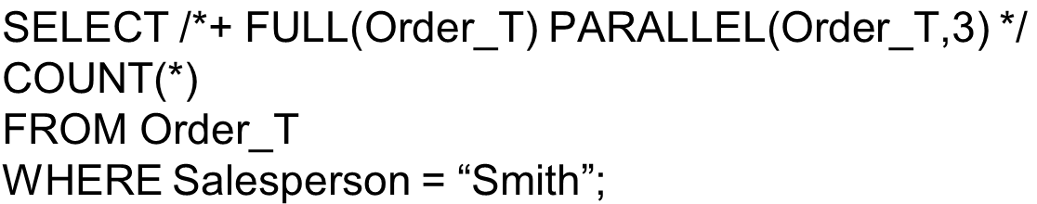

Query Optimization
Parallel query processing – possible when working in multiprocessor systems
Overriding automatic query optimization allows for query writers to preempt the automated optimization
Oracle example:
clause is a hint to override Oracle’s default query plan

Slide 33
Data Dictionaries and Repositories
Data dictionary
Documents data elements of a database
System catalog
System-created database that describes all database objects
Information Repository
Stores metadata describing data and data processing resources

Slide 34
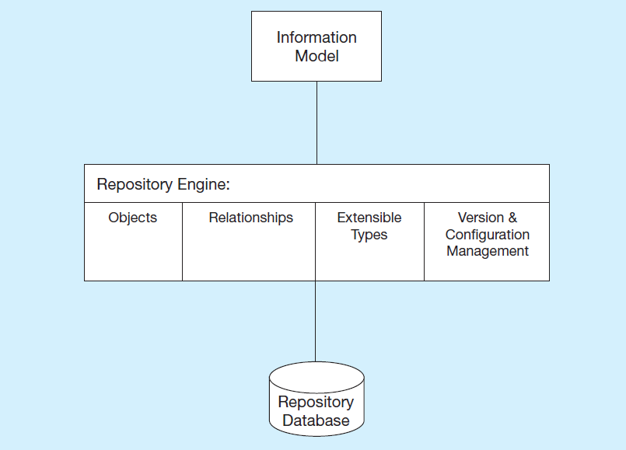
Figure 8-8 Three Components of the Repository System Architecture
Based on Bernstein, 1996
Notes:
Information model is a schema of the repository information.
Repository engine is software that manages the repository objects.
Repository database is where repository objects are stored.
Everything has an architecture, including metadata management. Database administrators and data warehouse repositories use Repository Engine tools to administer the organization’s metadata.

Slide 35
Database Software Security Features
Views or subschemas
Integrity controls
Authorization rules
User-defined procedures
Encryption
Authentication schemes
Backup, journalizing, and checkpointing
Notes:
All of these are DBMS features that enable a DBA to implement data security in an organization’s database. We’ll discuss these in the next few slides.

Slide 36
Views and Integrity Controls
Views
Subset of the database that is presented to one or more users
User can be given access privilege to view without allowing access privilege to underlying tables
Integrity Controls
Protect data from unauthorized use
Domains – set allowable values
Assertions – enforce database conditions
Triggers – prevent inappropriate actions, invoke special handling procedures, write to log files
Notes:
We discussed Views in Chapter 6. We can set access privileges on these views to control which users get to see which aspects of the database.
As you can see, the integrity controls discussed in Chapter 4 also serve a security purpose.

Slide 37
Authorization Rules
Controls incorporated in the data management system
Restrict:
access to data
actions that people can take on data
Authorization matrix for:
Subjects
Objects
Actions
Constraints
Subject | Object | Action | Constraint
Sales Dept. | Customer record | Insert | Credit limit L E $5000
Order trans. | Customer record | Read | None
Terminal 12 | Customer record | Modify | Balance due only
Acctg. Dept. | Order record | Delete | None
Ann Walker | Order record | Insert | Order a m l L T $2000
Program A R4 | Order record | Modify | None
Notes:
Authorization rules grant subjects access to objects, specifying which actions and constraints govern the subjects’ access.
Subjects are users or groups of users. Objects are entities in the database. Actions are the types of DML commands permitted for a given subject on a given object (SELECT, INSERT, UPDATE, DELETE). And these actions can be further constrained, based on the authorization rule.
All of these are available to the DBA to control via the DBMS software.
Here we see these rules expressed as an authorization matrix (figure 8-9).

Slide 38
Figure 8-10 Implementing Authorization Rules
a) Authorization table for subjects (salespersons)
Blank | Customer records | Order records
Read | Y | Y
Insert | Y | Y
Modify | Y | N
Delete | N | N
b) Authorization table for objects (orders)
Blank | Salespersons (password BATMAN) | Order entry (password JOKER) | Accounting (password TRACY)
Read | Y | Y | Y
Insert | N | Y | N
Modify | N | Y | Y
Delete | N | N | Y
Notes:
These authorization tables are simplified representations of authorization rules. One is for subjects and the other is for objects.
The key idea in both authorization matrices and authorization tables is that you are controlling who gets what kind of access to which data elements.
Privileges are granted for different database activities: select, insert, update, delete, alter, index, references, and procedure/function execution.

Slide 39
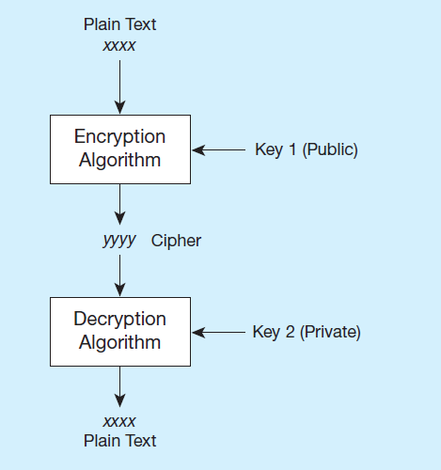
Figure 8-12 Basic Two-Key Encryption
Encryption – the coding or scrambling of data so that humans cannot read them
Secure Sockets Layer (S S L) is a popular encryption scheme for T C P/I P connections.
Notes:
Some DBMS products include encryption routines that automatically encode sensitive data when they are stored or transmitted over communications channels. For example, encryption is commonly used in electronic funds transfer (EFT) systems. Other DBMS products provide exits that allow users to code their own encryption routines.

Slide 40
Authentication Schemes (1 of 2)
Goal – obtain a positive identification of the user
Passwords: First line of defense
Should be at least 8 characters long
Should combine alphabetic and numeric data
Should not be complete words or personal information
Should be changed frequently
Notes:
Authentication is not the same as authorization. Authorization rules specify who has what access rights to what data elements. Authentication schemes are means of ensuring that a user is who he or she claims to be.
Obviously passwords are the first line of defense, but these are imperfect. It’s hard to remember multiple complex passwords, so people tend to simplify them, or worse, write them down.

Slide 41
Authentication Schemes (2 of 2)
Strong Authentication
Passwords are flawed:
Users share them with each other
They get written down, could be copied
Automatic logon scripts remove need to explicitly type them in
Unencrypted passwords travel the Internet
Possible solutions:
Two factor – e.g., smart card plus P I N
Three factor – e.g., smart card, biometric, P I N
Notes:
Smart cards, biometric, and combinations are some current means of improving authentication.

Slide 42
Database Recovery
Mechanism for restoring a database quickly and accurately after loss or damage
Recovery facilities:
Backup Facilities
Journalizing Facilities
Checkpoint Facility
Recovery Manager
Notes:
Sometimes data is lost or damaged, so DBMSs include facilities for recovering from this lost. Generally this involves backing data up and allowing it to be restored.

Slide 43
Back-up Facilities
D B M S copy utility that produces backup copy of the entire database or subset
Periodic backup (e.g. nightly, weekly)
Cold backup – database is shut down during backup
Hot backup – selected portion is shut down and backed up at a given time
Backups stored in secure, off-site location
Notes:
We’ll talk more about the mechanics of backup-and-recovery shortly.

Slide 44
Journalizing Facilities
Audit trail of transactions and database updates
Transaction log – record of essential data for each transaction processed against the database
Database change log – images of updated data
Before-image – copy before modification
After-image – copy after modification
Notes:
Actually, the recovery process requires both the backup snapshot and the change log, as we’ll see shortly.

Slide 45
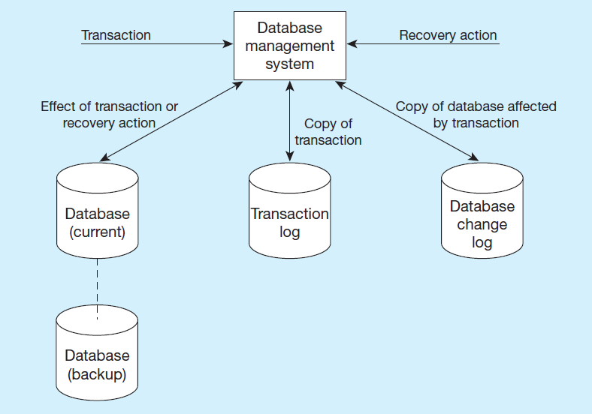
Figure 8-13 Database Audit Trail
From the backup and logs, databases can be restored in case of damage or loss
Notes:
Imagine that the database was last backed up on Sunday at midnight. This means that we need all transaction/change log entries since Sunday at midnight in order to bring it up to date. We start with the backup and then repeat the database changes.
Note the difference between the transaction log and the database change log. Transaction logs are used for one form of recovery (restore/rerun) and database change logs are used for another (forward recovery).

Slide 46
Checkpoint Facilities
D B M S periodically refuses to accept new transactions
Therefore, the system is in a quiet state
Database and transaction logs are synchronized
This allows recovery manager to resume processing from short period, instead of repeating entire day
Notes:
The database needs to be in a quiet state in order for backup to occur.
A DBMS may perform checkpoints automatically (which is preferred) or in response to commands in user application programs. Checkpoints should be taken frequently (say, several times an hour).

Slide 47
Recovery Manager
Recovery Manager – D B M S module that restores the database to a correct condition when a failure occurs and then resumes processing user requests
Recovery and Restart Procedures
Disk Mirroring – switch between identical copies of databases
Restore/Rerun – reprocess transactions against the backup (only done as a last resort)
Backward Recovery (Rollback) – apply before images
Forward Recovery (Roll Forward) – apply after images (preferable to restore/rerun)

Slide 48
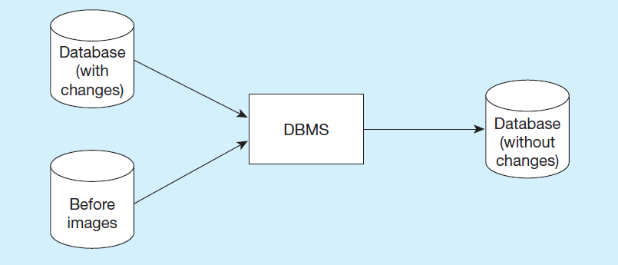
Figure 8-14 Basic Recovery Techniques (1 of 2)
a) Rollback
Notes:
Rollback is the backout, or undo, of unwanted changes to a database. Before images of the records that have been changed are applied to the database, and the database is returned to an earlier state. Rollback is used to reverse the changes made by transactions that have been aborted, or terminated abnormally.
Rollback is a typical means of cancelling transactions when there is an error in the insert/update/deletes.

Slide 49
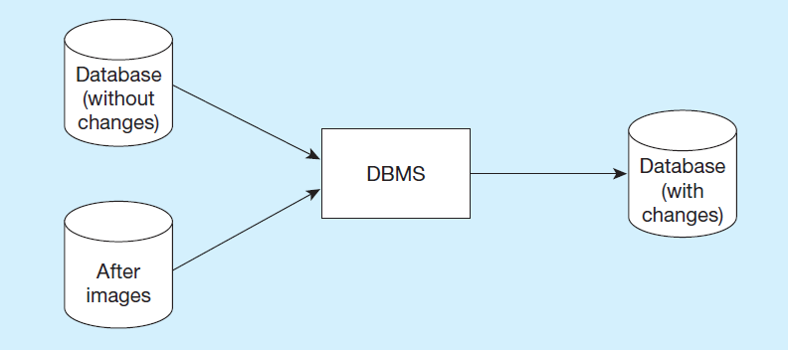
Figure 8-14 Basic Recovery Techniques (2 of 2)
b) Rollforward
Notes:
Rollforward is a technique that starts with an earlier copy of a database. After images (the results of good transactions) are applied to the database, and the database is quickly moved forward to a later state.
This approach is an alternative to restore/rerun. It is much faster and doesn’t require the use of the transaction log and repetition of transactions. Instead, it makes use of database change log. Of course, this requires more up-front activity (maintaining the database change log in addition to the transaction log). But the actual recovery itself, if needed, runs much faster and with more accuracy.

Slide 50
Responses to Database Failures (1 of 2)
Aborted transaction
Rollback (preferred)
Rollforward/return transactions to state just prior to abort
Incorrect data (update inaccurate)
Rollback (preferred)
Reprocess transactions without inaccurate data updates
Compensating transactions
Notes:
In this and the next slide, we see some types of failures and the best recovery techniques to use. Notice that reprocessing transactions is never a preferred option. Notice also that all these are possible because of disk mirroring, backups, and the maintenance of transaction and database change logs. All of these are techniques to make the database “fault tolerant”.

Slide 51
Responses to Database Failures (2 of 2)
System failure (database intact)
Switch to duplicate database (preferred)
Rollback
Restart from checkpoint (rollforward)
Database destruction
Switch to duplicate database (preferred)
Rollforward
Reprocess transactions

Slide 52
Disaster Recovery
Develop a detailed written disaster recovery plan, and test this regularly
Choose and train a multidisciplinary team to carry out the plan
Establish a backup data center at an off-site location, located a sufficient distance from the primary site
Send backup copies of databases to the backup data center on a scheduled basis

Slide 53
Cloud-based Data Management Services (1 of 2)
Cloud computing
Provisioning/acquiring computing services on demand using centralized resources accessed through public Internet or private networks
Infrastructure-as-a-Service (I a a S)
Cloud service involving hardware and various types of systems software resources
Platform-as-a-Service (P a a S)
Cloud service involving hardware and various types of systems software resources

Slide 54
Cloud-based Data Management Services (2 of 2)
Software-as-a-Service (S a a S)
Cloud service involving software solutions/applications intended to directly address the needs of a noncomputing activity
Database-as-a-Service (D B a a S)
Cloud service involving data management cloud platform service

Slide 55
Benefits of Cloud-based Data Management Services
No need for initial investments in hardware, physical facilities, and systems software
Significantly lower need for internal expertise in the management of the database infrastructure
Better visibility of overall costs of data management
Increased level of flexibility (elasticity) in situations when capacity needs to fluctuate significantly
Allows organizations to explore new data management technologies more easily
Mature cloud service providers have expertise to provide a high level of availability, reliability, and security

Slide 56
Downside of Cloud-based Data Management Services
Existing systems do not yet provide capacity using a model that would automatically adapt to the changing requirements targeting the system
Current systems are not yet providing full consistency guarantees in a highly distributed environment
Live migration is still a challenging task that requires manual planning, initiation, and management
It is challenging to be able to monitor the extent to which cloud providers are maintaining their Service Level Agreement (S L A) commitments
D B a a S solutions are still struggling to find fully scalable models for providing A C I D support for transactions

Slide 57

Copyright

