Slide 1

Modern Database Management
Thirteenth Edition, Global Edition
Chapter 4
+ Normalization
Copyright © 2020 Pearson Education Ltd. All Rights Reserved
Notes:
If this PowerPoint presentation contains mathematical equations, you may need to check that your computer has the following installed:
1) MathType Plugin
2) Math Player (free versions available)
3) NVDA Reader (free versions available)

Slide 2
Data Normalization
Primarily a tool to validate and improve a logical design so that it satisfies certain constraints that avoid unnecessary duplication of data
The process of decomposing relations with anomalies to produce smaller, well-structured relations
Notes:
The previous slides showed how to map an E-R model to a relational database design. If you follow these mappings, then your result will be a well-structured database. But if you just start by creating tables without considering the E-R rules, then you will likely get a database that is not well-structured. These databases could cause anomalies because of data duplication. In the next several slides we’ll see how to correct these anomalies through a process called “normalization”.

Slide 3
Well-Structured Relations
Relations that contain minimal data redundancy and allow users to insert, delete, and update rows without causing data inconsistencies
Goal is to avoid anomalies
Insertion Anomaly – adding new rows forces user to create duplicate data
Deletion Anomaly – deleting rows may cause a loss of data that would be needed for other future rows
Modification Anomaly – changing data in a row forces changes to other rows because of duplication
Notes:
A general rule of thumb: A table should not pertain to more than one entity type.

Slide 4
Example–Figure 4-2b
EMPLOYEE2
Emp I D | Name | Dept Name | Salary | Course Title | Date Completed
100 | Margaret Simpson | Marketing | 48,000 | S P S S | 6/19/2018
100 | Margaret Simpson | Marketing | 48,000 | Surveys | 10/7/2018
140 | Alan Beeton | Accounting | 52,000 | Tax Acc | 12/8/2018
110 | Chris Lucero | Info Systems | 43,000 | Visual Basic | 1/12/2018
110 | Chris Lucero | Info Systems | 43,000 | C++ | 4/22/2018
190 | Lorenzo Davis | Finance | 55,000 | Blank | Blank
150 | Susan Martin | Marketing | 42,000 | S P S S | 6/19/2018
150 | Susan Martin | Marketing | 42,000 | Java | 8/12/2018
Question: Is this a relation? Answer: Yes; unique rows and no multivalued attributes
Question: What’s the primary key? Answer: Composite — Emp I D, CourseTitle
Notes:
This is a relation. But it is not a well-structured relation.

Slide 5
Anomalies in This Relation (1 of 2)
Insertion – can’t enter a new employee without having the employee take a class (or at least empty fields of class information)
Deletion – if we remove employee 140, we lose information about the existence of a Tax Acc class
Modification – giving a salary increase to employee 100 forces us to update multiple records
Notes:
Why do these anomalies exist? Because there are two themes (entity types) in this one relation. There are employees and there are courses. This results in data duplication and an unnecessary dependency between the entities.

Slide 6
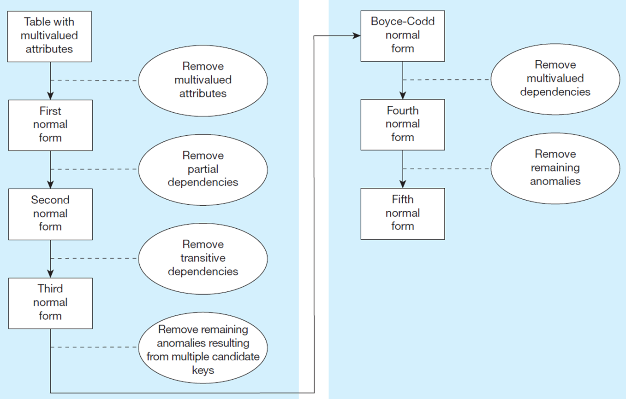
Figure 4.22 Steps in Normalization
Notes:
It is important that a database reach third normal form. Boyce-Codd, fourth, and fifth are of theoretical interest, but not generally considered vital for qualifying as a set of well-structured relations.

Slide 7
Functional Dependencies and Keys
Functional Dependency: The value of one attribute (the determinant) determines the value of another attribute
Candidate Key:
A unique identifier. One of the candidate keys will become the primary key
E.g., perhaps there is both credit card number and S S# in a table…in this case both are candidate keys.
Each non-key field is functionally dependent on every candidate key.

Slide 8
First Normal Form
No multivalued attributes
Every attribute value is atomic
Fig. 4-25 is not in 1st Normal Form (multivalued attributes) → it is not a relation.
Fig. 4-26 is in 1st Normal form.
All relations are in 1st Normal Form.

Slide 9
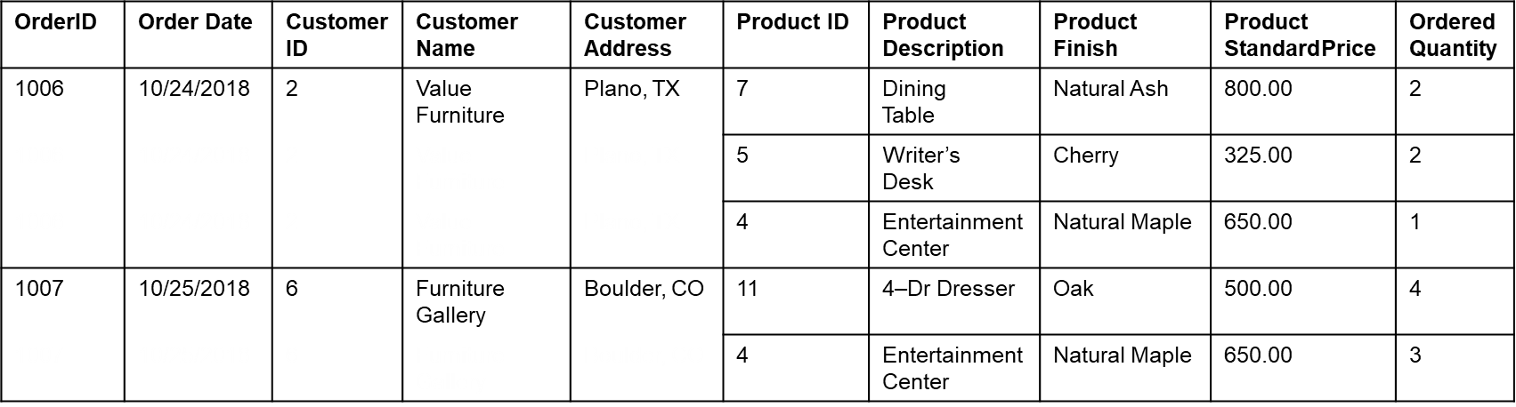
Figure 4.25 Invoice Data (Pine Valley Furniture Company)
Table with multivalued attributes, not in 1st normal form.
This is not a relation.
Notes:
This table is not a relation. Note the blank OrderID field. Also, we don’t explicitly see the customer or order date for the second, third, and fifth rows. You can imagine seeing something like this in a spreadsheet and inferring that the second and third rows correspond with order 1006. But this is not sufficient for a database.

Slide 10
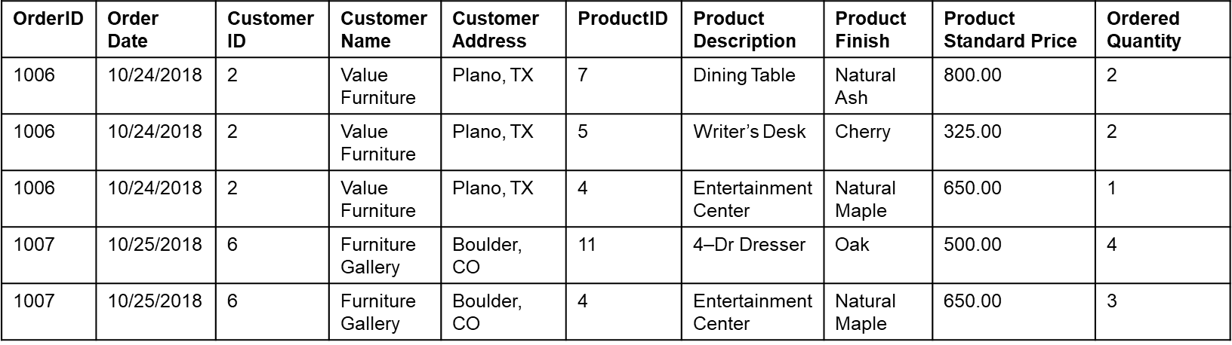
Figure 4.26 INVOICE Relation (1N F) (Pine Valley Furniture Company)
This is a relation, but not a well-structured one.

Slide 11
Anomalies in This Relation (2 of 2)
Insertion – if new product is ordered for order 1007 of existing customer, customer data must be re-entered, causing duplication
Deletion – if we delete the Dining Table from Order 1006, we lose information concerning this item’s finish and price
Update – changing the price of product I D 4 requires update in multiple records
Notes:
Why do these anomalies exist?
Because there are multiple themes (entity types) in one relation. This results in duplication and an unnecessary dependency between the entities.

Slide 12
Second Normal Form
1N F plus every non-key attribute is fully functionally dependent on the ENTIRE primary key
Every non-key attribute must be defined by the entire key, not by only part of the key
No partial functional dependencies

Slide 13
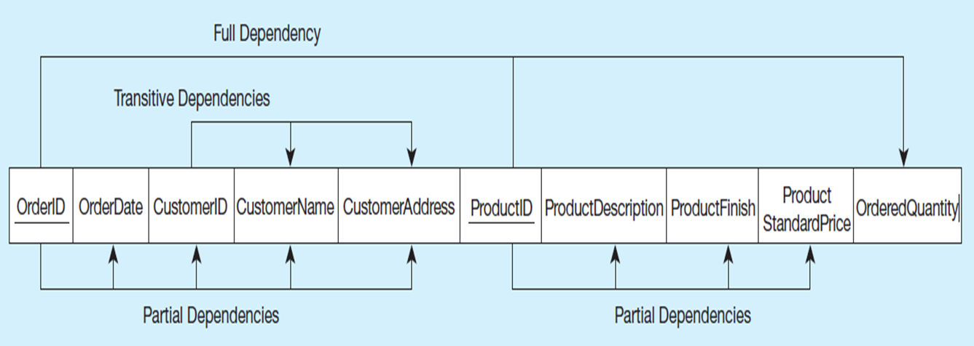
Figure 4-27 Functional Dependency Diagram for Invoice
OrderID → OrderDate, CustomerID, CustomerName, CustomerAddress CustomerID → CustomerName, CustomerAddress ProductID → ProductDescription, ProductFinish, ProductStandardPrice OrderID, ProductID → OrderQuantity
Therefore, not in 2nd Normal Form
Notes:
In this one relation, there are both partial and transitive dependencies. Because of partial dependencies, the relation is not in 2nd normal form. So, our first step is to remove the partial dependencies by splitting the table into three, one for orders, one for products, and one for order line.

Slide 14
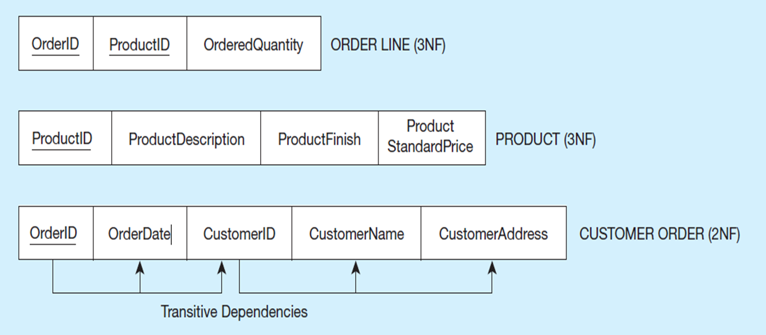
Figure 4-28 Removing Partial Dependencies
Getting it into Second Normal Form
Partial dependencies are removed, but there are still transitive dependencies
Notes:
So, now we have three separate relations. There is no partial dependency. But we still have a transitive dependency. We will fix this next by splitting customers from orders.

Slide 15
Third Normal Form
2N F PLUS no transitive dependencies (functional dependencies on non-primary-key attributes)
Note: This is called transitive, because the primary key is a determinant for another attribute, which in turn is a determinant for a third
Solution: Non-key determinant with transitive dependencies go into a new table; non-key determinant becomes primary key in the new table and stays as foreign key in the old table

Slide 16
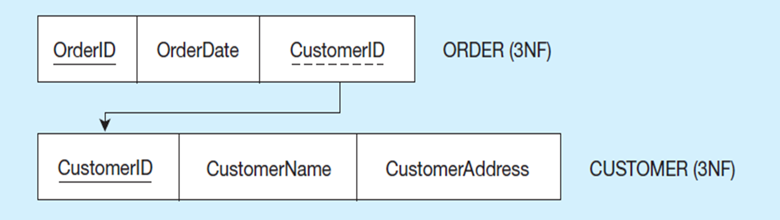
Figure 4-29 Removing Transitive Dependencies
Getting it into Third Normal Form
Transitive dependencies are removed.
Notes:
Finally we are at third normal form. At this point we have a well-structured database.

Slide 17
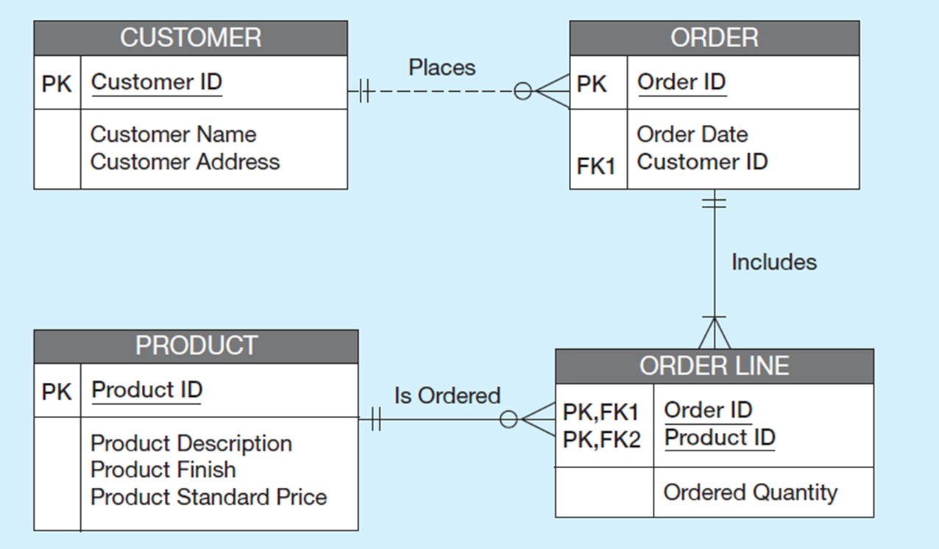
Figure 4-30 Relational Schema for INVOICE Data (Microsoft Visio Notation)
Notes:
Note that if we had started with a thorough E-R model, we would not have wound up with one big table containing multiple themes. The original table basically had three separate entities all wrapped into a single relation (customer, product, and order). Furthermore, it hid the fact of a many-to-many relationship between orders and products.
This illustrates the danger of going straight to the logical database design without first performing the conceptual model analysis. But this sort of thing happens all too often.

Slide 18
Merging Relations
View Integration – Combining entities from multiple E-R models into common relations
Issues to watch out for when merging entities from different E-R models:
Synonyms – two or more attributes with different names but same meaning
Homonyms – attributes with same name but different meanings
Transitive dependencies – even if relations are in 3N F prior to merging, they may not be after merging
Supertype/subtype relationships – may be hidden prior to merging

Slide 19
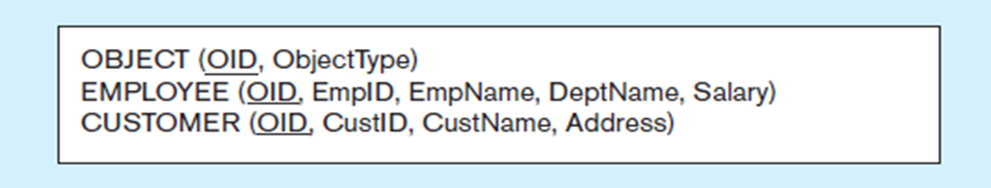
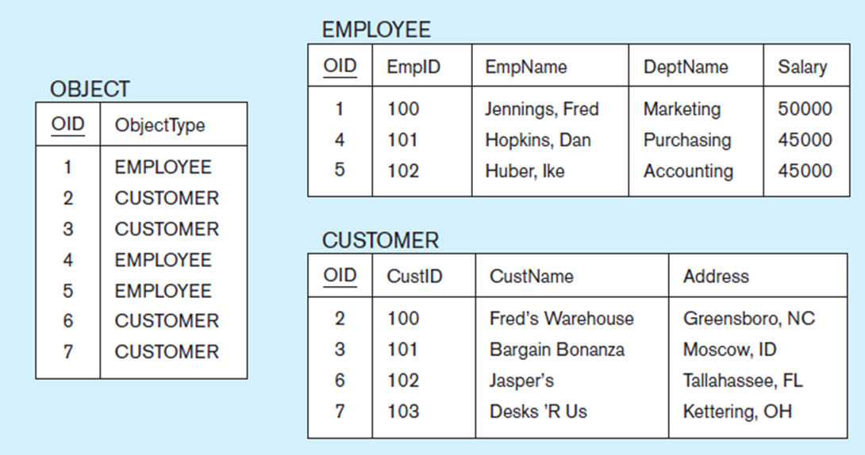
Figure 4-31 Enterprise Keys
a) Relations with enterprise key
b) Sample data with enterprise key
Notes:
Enterprise keys are primary keys that are unique in the whole database, not just within a single relation. This corresponds with the concept of an object ID in object-oriented systems.

Slide 20

Copyright

