Slide 1

Streamlining Delivery Routes: A Comprehensive Approach
Team members:
Ömercan Göktaş
M. Yusuf Şahin Berkan Korkmaz
Advisor:
Dr. Öğr. Üyesi Fatma Corut Ergin

Slide 2
Agenda
Definition of the Problem and Brief Description of the Project
Project Aims
Related Work
Project Scope
Methodology and Technical Approach
Tasks Accomplished
Difficulties Encountered
Tasks to be Completed in the 2nd Semester
B-Plan for Challenges
References
Questions and Answers

Slide 3
DefInItIon of the Problem AND BrIef DescrIptIon of the Project
Project is developing a system to optimize truck routes for the Single-Depot Vehicle Routing Problem, ensuring efficient deliveries from a warehouse by considering pallet limitations for each truck.
The project is motivated by the need to reduce logistical costs, address environmental concerns, and improve efficiency in delivery routes amid rising fuel prices and increasing road congestion. The goal is to save time, decrease fuel consumption, and reduce carbon emissions.
The problem is vital due to its impact on economic and environmental health, affecting operational costs, customer service, traffic, and pollution. Solving it is key to a sustainable, cost-efficient transportation future.

Slide 4
PROJECT AIMS
Aim 1: Optimize Route Efficiency: Significantly improve the efficiency of delivery routes. By using Ant Colony Optimization algorithms, we plan to minimize the distance traveled by each vehicle, ensuring timely deliveries within the specified time windows.
Aim 2: Reduce Operational Costs: Reduce the operational costs associated with logistics. By optimizing routes, we can decrease fuel consumption, reduce wear and tear on vehicles, and save valuable working hours, thus directly impacting the bottom line of businesses."
Aim 3: Enhance Environmental Sustainability: Project is committed to sustainability. By optimizing routes, we not only reduce fuel consumption but also contribute to decreasing the overall carbon footprint of transportation, aligning with global efforts to combat climate change."

Slide 5
reLATED WORK
Multi-depot vehicle routing problem with time windows considering delivery and installation vehicles [1]
This study targets route optimization in MDVRPTW to cut labor and transport costs, focusing on vehicles returning to the same depot. While not directly applicable, its strategies for complex routing and cost issues in multi-depot environments can inform our project.
An efficient improvement of ant colony system algorithm for handling capacity vehicle routing problem [2]
This study enhances the Ant Colony System algorithm to better address the Capacitated Vehicle Routing Problem, focusing on optimizing logistics, reducing journey times, and overcoming vehicle capacity and routing challenges. It also integrates external research to refine strategies and meet its research objectives efficiently.
Overview of Similar Projects
Many projects address the Multi-Depot Vehicle Routing using algorithms such as heuristics, focusing on improving route efficiency, lowering environmental impact, and incorporating real-time data.

Slide 6
Connection to Our Project: Project acknowledges these past efforts but pushes the boundary further with advanced Ant Colony Optimization algorithms. We've adopted and adapted these techniques specifically for routing problem, focusing on real-world applicability and scalability.
Novelties of Our Project: The novelty of our approach lies in its hybridization of algorithms, real-time adaptability, and specific focus on environmental sustainability. Unlike many projects that treat routing in static terms, ours dynamically adjusts to real-time traffic and weather conditions, providing unprecedented adaptability and accuracy in logistics planning.

Slide 7
Scope
Limits of our project and the basic ideas that guide our strategy.
Assumptions:
Known customer demand patterns for pre-planning and optimization on the Anatolian side of Istanbul, allowing us to leverage local insights for more precise forecasting.
Project Constraints:
Computational limits for real-time optimization, dependency on traffic/data accuracy, and variability in delivery and vehicle availability.

Slide 8
Methodology and Technical Approach
Our project employs a unique methodology, focusing on solving single-depot vehicle routing challenges in logistics by integrating various pallet combinations for optimized deliveries, primarily utilizing established techniques like Ant Colony Optimization (ACO) for route efficiency.
Data Collection, Generation, and Preprocessing: Our goal is to collect essential datasets, including depot specifics, store locations, vehicle capacities, historical route information, and potential pallet combinations for each delivery. This process involves transforming the raw data into a format conducive to comprehensive analysis and optimization, considering a variety of pallet combinations.

Slide 9
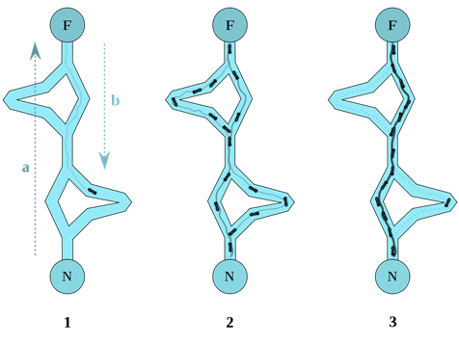
Ant Colony Optimization: Ant Colony Optimization (ACO) is a method that efficiently optimizes delivery routes by determining the most effective pallet combinations for each vehicle. The algorithm involves customizing parameters such as update rates, evaporation rates, ant count, and exploration preferences. The ACO algorithm efficiently optimizes delivery routes by determining the most effective pallet combinations for each vehicle.
[3] Behavior of ants searching for food.

Slide 10
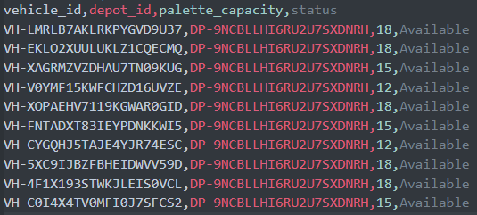
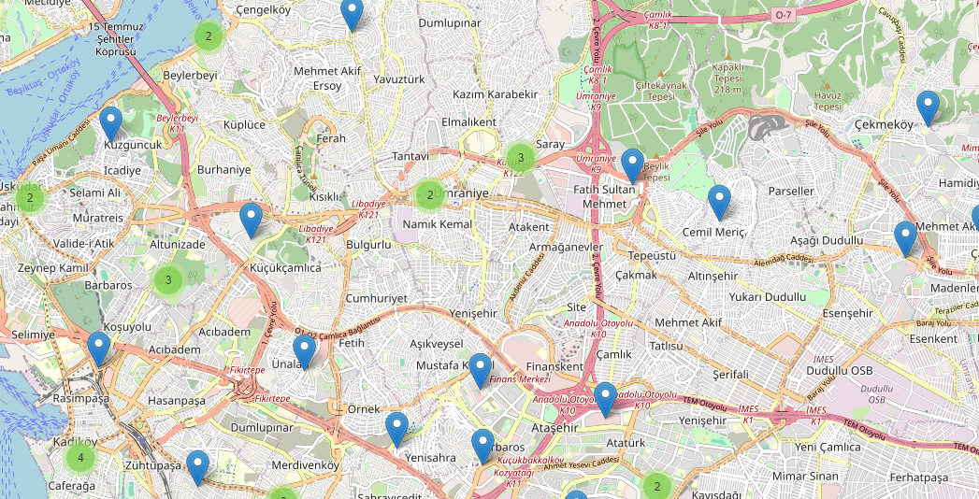
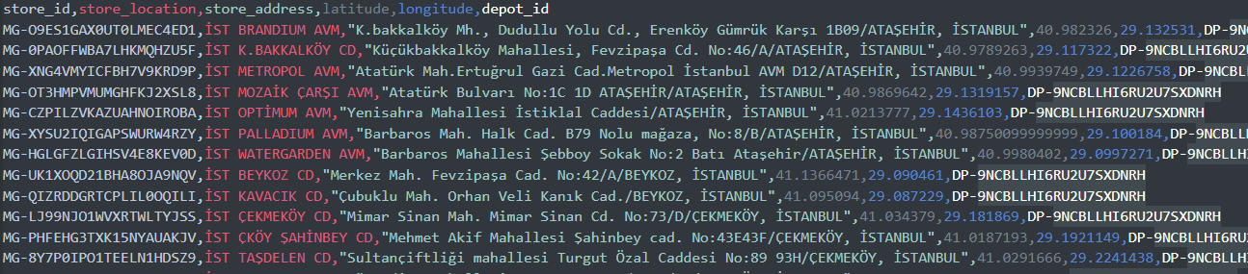
Tasks Accomplished
Dataset Generation and Data Preprocessing: Contributed significantly to synthetic logistics dataset creation, closely simulating real-world conditions for optimal relevance. Played a key role in data preprocessing, transforming raw data by identifying errors, integrating diverse sources, and ensuring dataset integrity.

Slide 11
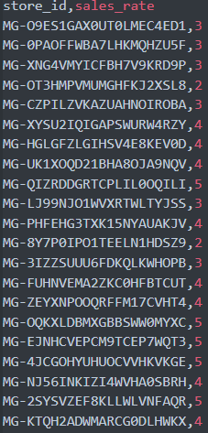
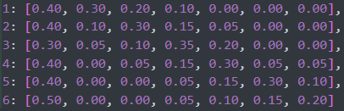
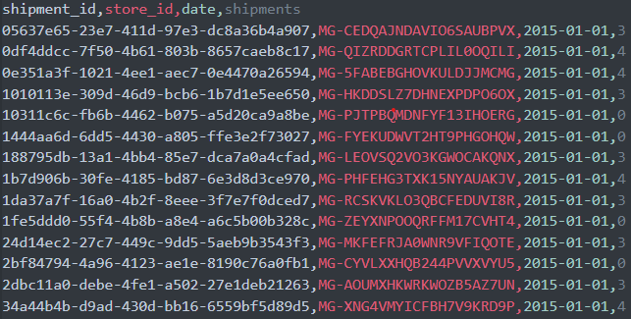

Slide 12
Difficulties encountered
Data Quality and Availability: The challenges we encountered were associated with the significance of our problem in the real-world context, emphasizing the critical importance of data quality and accessibility for us. Consequently, we initiated data generation and processing processes, taking into consideration the real-world conditions.

Slide 13
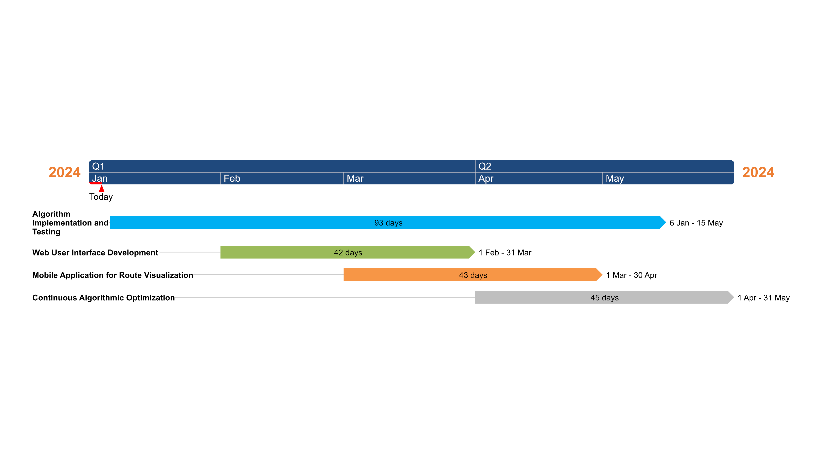
Tasks to be Completed in the 2nd Semester
Algorithm Implementation and Testing (January - May)
Web User Interface Development (February - March)
Mobile Application for Route Visualization (March - April)
Continuous Algorithmic Optimization (April - May)

Slide 14
B-plan for challenges
Alternative Algorithms: If the current algorithms, especially ACO, struggle with large datasets, we are prepared to try alternative optimization methods. This flexibility ensures we can adapt to evolving project needs, effectively tackle challenges, and ensure successful task completion and project advancement.

Slide 15
references
[1] Bae, H., & Moon, I. (2016). Multi-depot vehicle routing problem with time windows considering delivery and installation vehicles. Applied Mathematical Modelling, 40(13–14), 6536-6549. https://doi.org/10.1016/j.apm.2016.01.059
[2] Mutar, M., Modhi, B., Burhanuddin, M. A., Hameed, A., Yusof, N., & Mutashar, H. (2020). An efficient improvement of ant colony system algorithm for handling capacity vehicle routing problem. International Journal of Industrial Engineering Computations, 11, 549-564. DOI: 10.5267/j.ijiec.2020.4.006
[3] Mutar, M., Modhi, B., Burhanuddin, M. A., Hameed, A., Yusof, N., & Mutashar, H. (2020). An efficient improvement of ant colony system algorithm for handling capacity vehicle routing problem. International Journal of Industrial Engineering Computations, 11, 549-564. [https://archive.conscientiabeam.com/index.php/79/article/view/2684/4829]

Slide 16
Questıons?

