Slide 1


Introducing xeet: A Generic Testing Platform
xeet is a new testing platform that breaks the mold of traditional, technology-specific testing frameworks. It provides a unified platform for orchestrating diverse types of tests, including API, UI, performance, and more.
by Omer Caspi

Slide 2
Testing and QA Eco-Systems
The tests themselves
Libraries (Selenium)
Suits (testim.io)
Some are commercials and some not
Orchestration tools
Some use the CI/CD as orchestration tool (Omer Z.)
Test Management (TestRail, Testing, Qase.io)
Couldn’t find generic orchestration tool
Apparently, cases where internal orchestration tools are developed in house are not rare
CI/CD integration
QA Management
Development support

Slide 3
Existing Companies and solutions
There are many solutions out there for tests
Almost all the solutions are around E2E and API tests
Commercial: (testim.io, Katalon, Rainforest QA, Cypress) seem to try to provide for all-in-one solution, but have some limits
Recording is fragile
Must be used in cloud
AI testing seems to be problematic
Many open-source tools for testing
Pretty much all of them are libraries (Selenium, Playwright, Pupeteer) requiring other supporting tools (orchestration, management)
Usually require coding
Test management suits (commercial) are also available to manage QA tests (TestRail, Testiny, Qase.io, etc.)
Don’t run tests
Require integration with existing suite/framework

Slide 4
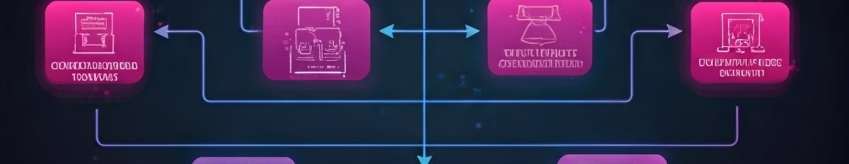
Limitations of Existing Testing Frameworks
1
Limited Scope
2
Fragmented Ecosystem
3
Lack of Orchestration
Existing frameworks are often tied to specific technologies or test types, limiting their applicability and flexibility.
Tests across different frameworks require separate setup, execution, and reporting, leading to a fragmented testing landscape.
Traditional frameworks lack the ability to seamlessly coordinate and orchestrate tests across different stages of the development lifecycle.

Slide 5
Key Benefits of xeet
Genericity
Unified Platform
Extensibility
xeet is technology agnostic and can be used to test any software application, regardless of its underlying technology.
xeet provides a single platform for managing all types of tests, simplifying the testing process and reducing complexity.
xeet is easily extensible to support new technologies and test types, ensuring its relevance in a rapidly evolving tech landscape.

Slide 6
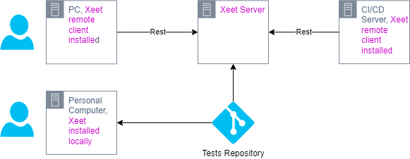
Simple Xeet deployments

Slide 7
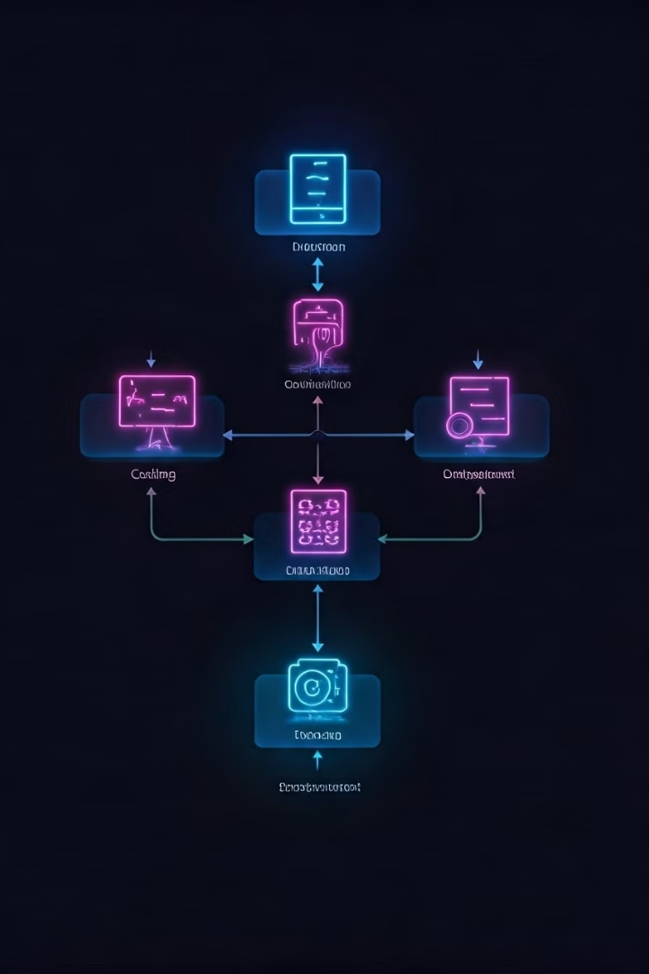
Shift Left with xeet's Orchestration Capabilities
1
Early Testing
xeet enables early testing during development, catching issues before they propagate to later stages, improving code quality and reducing risks.
2
Automated Execution
xeet can automatically execute tests as part of the CI/CD pipeline, ensuring that every code change is thoroughly tested and validated.
3
Feedback Loop
xeet provides immediate feedback on test results, allowing developers to identify and fix issues quickly and efficiently.

Slide 8




Deployment and Integration with CI/CD Pipelines
Seamless Integration
Automated Testing
Real-Time Feedback
xeet integrates seamlessly with popular CI/CD tools, allowing for easy deployment and integration into existing workflows.
xeet automates the execution of tests as part of the CI/CD pipeline, ensuring comprehensive testing and continuous quality assurance.
xeet provides real-time feedback on test results, allowing for immediate identification and resolution of issues, reducing delays and bottlenecks.

Slide 9
Where Xeet can benefit users
When there is no good option for writing tests
No supporting suit, framework etc.
Xeet plugin can be used
With Xeet you can always defer to binaries with
When there are tests, but no orchestration
If multiple technologies should be tested in the same test flow
When there’s no unified way to run tests between the developers, QA and automated testing

