Slide 1
BOOK STORE MANAGING DATABASE
Ömer Duran
Mikhail Serga
Danylo Bazalinskyi
Taha Buğra Tağ
A. (G.) V.

Slide 2
Table of Contents
1.
REQUIREMENTS
2.
ER-DIAGRAM
3.
REPOSITORY
4.
TEST QUERIES

Slide 3
REQUIREMENTS
A book can have one author (including folklore/unknown), one publisher, and one category. An author, a publisher, and a category can each have many books.
A customer has an optional address, managed one-to-one. A customer can write many reviews and can place many orders. Reviews are written by customers for specific books.
An order contains many order details (>=1) and one payment. Order details include books and their quantity.

Slide 4
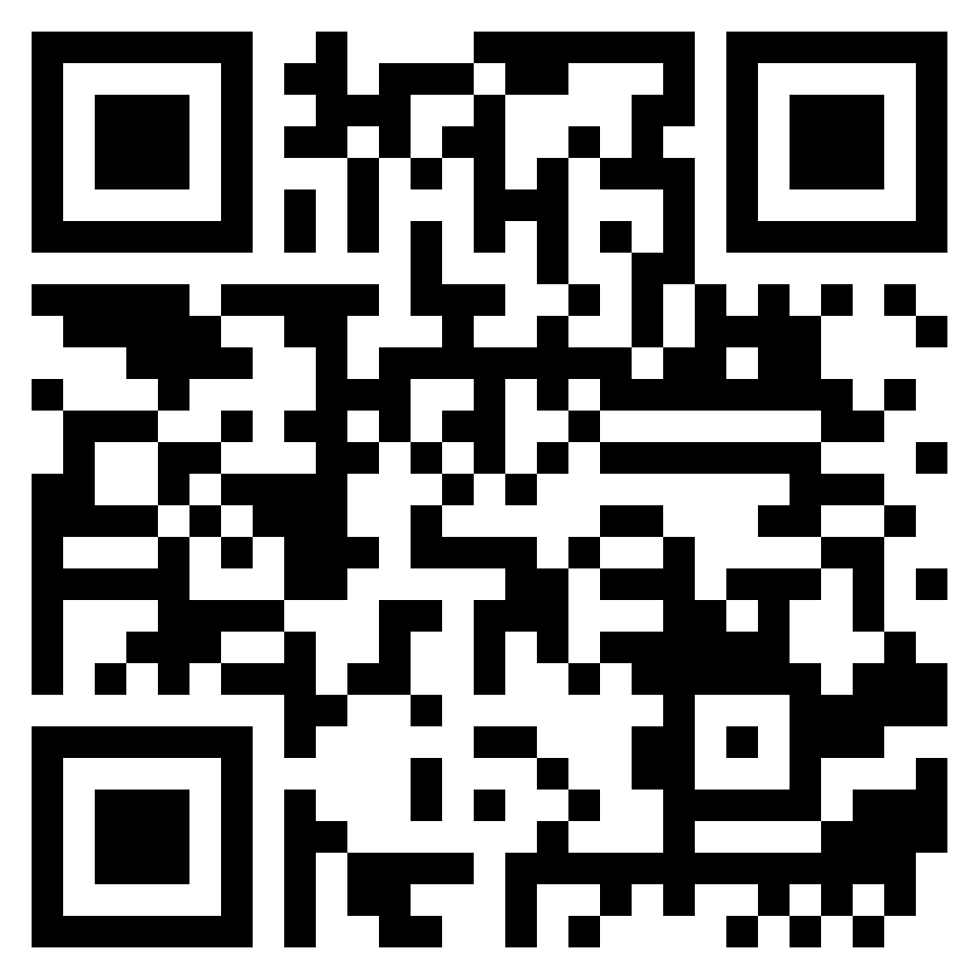
Let’s move to the Repository!

