Slide 1
BLG 632E · NEXT-GEN WIRELESS NETWORKS · SPRING 2025–2026
5G RRC Signaling Storm Mitigation
via a Proactive Digital Twin Architecture
with Continuous Calibration
Ömer Dikyol
Department of Computer Engineering
Istanbul Technical University

Slide 2
AGENDA
Outline
01
Problem Definition & Research Gap
Why availability matters; the storm; control-loop latency
02
System Model
MMPP/M/c/K queue and gNB RACH parameters
03
Proposed Method
Calibrated Digital Twin with EMA + asymmetric step rule
04
Results & Evaluation
Mirroring error, queue stability, delay CDF, ε-sensitivity
05
Conclusion
Findings, O-RAN deployment, future work
5G RRC Storm Mitigation · Calibrated Digital Twin
2 / 21

Slide 3

MOTIVATION
Why 5G availability matters
5G NR underpins mission-critical services — every device starts with an RRC connection request through the gNB RACH.
<10 ms
5×9
100s–1000s
Round-trip latency required by autonomous vehicles
Reliability target for remote surgery and industrial IoT
UEs sharing a single gNB simultaneously
gNB RACH at a glance
c = 54
K = 200
Q ≥ K
preamble channels
buffer capacity
requests dropped immediately
The RACH is a shared, limited resource with no built-in overload anticipation. RACH failure ⇒ no data plane, all services blocked.
5G RRC Storm Mitigation · Calibrated Digital Twin
3 / 21

Slide 4
BACKGROUND
What is an RRC signaling storm?
RRC and the RACH
RACH procedure (Msg1–Msg4)
RRC is the 3GPP Layer-3 protocol that manages connection setup. No data flows without a completed RRC connection.
UE
gNB
Msg1 — Preamble
How a storm forms
Botnet floods Msg1 simultaneously, overwhelming c = 54 preamble slots
Preamble collision ⇒ both UEs fail ⇒ retry
gNB buffers pending Msg3 (RRC Requests) up to K = 200
At λ_high = 500 req/s, buffer fills in 0.4 s
Dropped devices retry — load never subsides
Msg2 — RAR
Msg3 — RRC Request
Msg4 — RRC Setup
Net effect: RACH becomes a denial-of-service point — legitimate UEs cannot complete connection setup.
connected
5G RRC Storm Mitigation · Calibrated Digital Twin
4 / 21

Slide 5

THREAT MODEL
The RRC signaling storm attack
Attack mechanism
Attack flow
Botnet
500 req/s
Adversary coordinates a botnet of compromised devices
Each device sends RRC connection requests at high rate
Combined rate: λ_high = 500 req/s vs. normal λ_low = 10 req/s (50×)
RACH buffer saturates within seconds
Access requests are dropped — QoS failure
flood
⚠ buffer overflow
gNB RACH
K = 200, c = 54
blocked
Termed “RRC Signaling Storm” in the literature [b1].
Legitimate UEs
Impact: All connected services lose access until the attack subsides.
5G RRC Storm Mitigation · Calibrated Digital Twin
5 / 21

Slide 6
PROBLEM
Control-loop latency in ACB/UAC
Current defence: Access Class Barring (ACB) — 3GPP TS 38.331 UAC framework.
Control-loop latency — damage already done
Attack starts
Queue fills up
ACB detects Q > 0.8K
Dropping starts
Fundamental causality constraint
Empirical evidence
ACB throttles only after observing Q_real > 0.8K. During the build-up, requests are silently dropped.
Kotuliak et al. (2021): RACH exceeded delay budget under high load in commercial 5G NR deployments [b6].
5G RRC Storm Mitigation · Calibrated Digital Twin
6 / 21

Slide 7




RESEARCH GAP
Why existing approaches fall short
Reactive ACB / UAC
ML / DNN predictors
Standard Digital Twin
Strength
Strength
Strength
Simple, standards-compliant
High accuracy on stationary traffic
Proactive control possible
Limitation
Limitation
Limitation
Reacts after saturation; inherent control-loop latency
O(W) inference, W ~ 10⁵–10⁷; ms latency — impractical on gNB hardware
Model drift under non-stationary traffic; mirroring error grows unbounded
Gap: no DT approach suppresses model drift via an online calibration loop during the attack interval. This work closes that gap.
5G RRC Storm Mitigation · Calibrated Digital Twin
7 / 21

Slide 8

SYSTEM MODEL
MMPP/M/c/K queue
Two-state CTMC: Markov-Modulated Poisson Process
Physical gNB RACH
Parameter | Value
Preamble channels | c = 54
Buffer capacity | K = 200
Service time | Exp(1)
S₀ — Normal
λ = 10 req/s
α = 0.1
S₁ — Burst
λ = 500 req/s
β = 0.5
Generator matrix
Q = [ −α α ; β −β ] ; sojourn ~ Exp(|Q_ii|)
Stationary blocking governed by classical M/c/K formulas; non-stationarity comes from MMPP modulation.
Exact CTMC dynamics in DES — no matrix exponential needed.
5G RRC Storm Mitigation · Calibrated Digital Twin
8 / 21

Slide 9




PROPOSED METHOD
Calibrated Digital Twin architecture
Digital Twin (xApp on Near-RT RIC)
Every Δ = 1 s
Physical gNB RACH
① Observe & Predict
② Control Decision
③ Calibrate
Q_real
queue length
observe
n_win
arrivals per Δ
EMA → λ̂
p_acb from Q_real
α ← f(E)
Count arrivals in Δ; EMA predicts λ̂.
Min. barring probability to keep Q_real < K.
Adjust α via asymmetric step rule when E > ε.
p_acb → SIB1
uac-BarringInfo
p_acb feedback into SIB1
5G RRC Storm Mitigation · Calibrated Digital Twin
9 / 21

Slide 10

PROPOSED METHOD
EMA predictor and ACB control policy
EMA arrival-rate predictor
Stochastic barring probability
EMA_t = α · λ_cur + (1 − α) · EMA_{t−1}
λ_cur = n_win / Δ
p_acb = max(0, min(1, 1 − (K − Q_real) / max(EMA_t · Δ, 1e−9)))
Initial weight α₀ = 0.20
α is dynamic — updated by the calibration loop (Stage 3)
Minimum probability to prevent Q_real ≥ K next step
Applied as a Bernoulli trial per request
Maps to uac-BarringInfo in SIB1 (3GPP TS 38.331)
Key insight: p_acb rises before Q_real reaches K — proactive throttling, not reactive.
5G RRC Storm Mitigation · Calibrated Digital Twin
10 / 21

Slide 11
PROPOSED METHOD
Continuous calibration loop
State-mirroring error
E(t) = | Q_real(t) − Q_virtual(t) |
Asymmetric step rule
Attack onset: δ⁺ = 0.05 (fast)
if E > ε :
α ← min(α_max, α + δ⁺)
else:
α ← max(α_min, α − δ⁻)
EMA becomes high-frequency
Outdated observations discarded quickly
Normal traffic: δ⁻ = 0.01 (slow)
ε
δ⁺
δ⁻
Statistical stability preserved
Avoids oscillation around ε
10
0.05
0.01
calibration threshold
fast attack response
slow decay (stability)
5G RRC Storm Mitigation · Calibrated Digital Twin
11 / 21

Slide 12

ALGORITHM 1
Calibrated DT control loop
Every Δ control step
Complexity
1. λ_cur ← n_win / Δ
2. EMA_t ← α · λ_cur + (1 − α) · EMA_{t−1}
3. d ← max(EMA_t · Δ, 1e−9)
4. p_acb ← max(0, min(1, 1 − (K − Q_real) / d))
5. Q_virtual ← clip(Q_virtual + EMA_t · (1 − p_acb) · Δ − c · Δ, 0, K)
6. E ← | Q_real − Q_virtual |
7. if E > ε : α ← min(α_max, α + δ⁺)
8. else : α ← max(α_min, α − δ⁻)
9. drop_rate ← p_acb
Calibrated DT
O(1)
Fixed arithmetic · 4 state variables · μs control budget
DNN predictors
O(W)
W ~ 10⁵–10⁷ · ms latency · impractical on gNB
State: { EMA_t, Q_virtual, α, n_win }
5G RRC Storm Mitigation · Calibrated Digital Twin
12 / 21

Slide 13

EVALUATION
Simulation setup
Experimental configuration
Key parameters
Discrete-event simulation: SimPy, Python 3.10
T_sim = 1000 s per run
N = 10 independent seeds (Monte Carlo)
95 % CI: x̄ ± 1.96 · σ̂ / √N
Parameter | Symbol | Value
Preamble channels | c | 54
Buffer capacity | K | 200
Normal arrival rate | λ_low | 10 req/s
Burst arrival rate | λ_high | 500 req/s
Control interval | Δ | 1 s
Calibration threshold | ε | 10
Initial EMA weight | α₀ | 0.20
Three methods compared
Reactive Baseline
threshold 0.8 K, drop 0.5
DT no-calibration
α fixed
Calibrated DT
asymmetric step rule
5G RRC Storm Mitigation · Calibrated Digital Twin
13 / 21

Slide 14
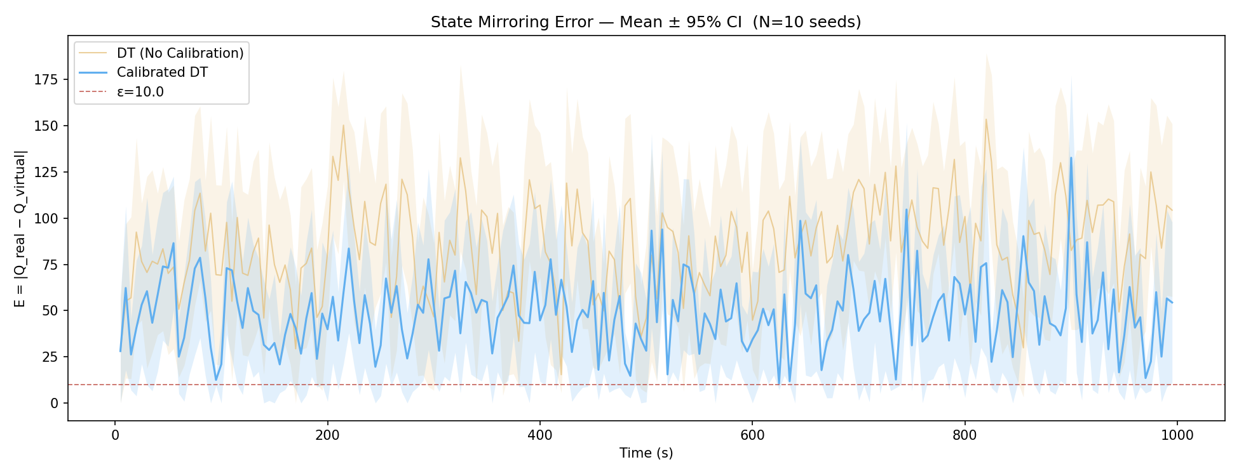
RESULT 1
State-mirroring error — 42% reduction
42 %
E_mean (N = 10, 95 % CI)
Takeaway
DT (no calib.)
Calibrated DT
85.03 ± 4.40
49.14 ± 3.09
Calibration suppresses model drift continuously during the burst — CIs do not overlap.
reduction in E_mean
5G RRC Storm Mitigation · Calibrated Digital Twin
14 / 21

Slide 15
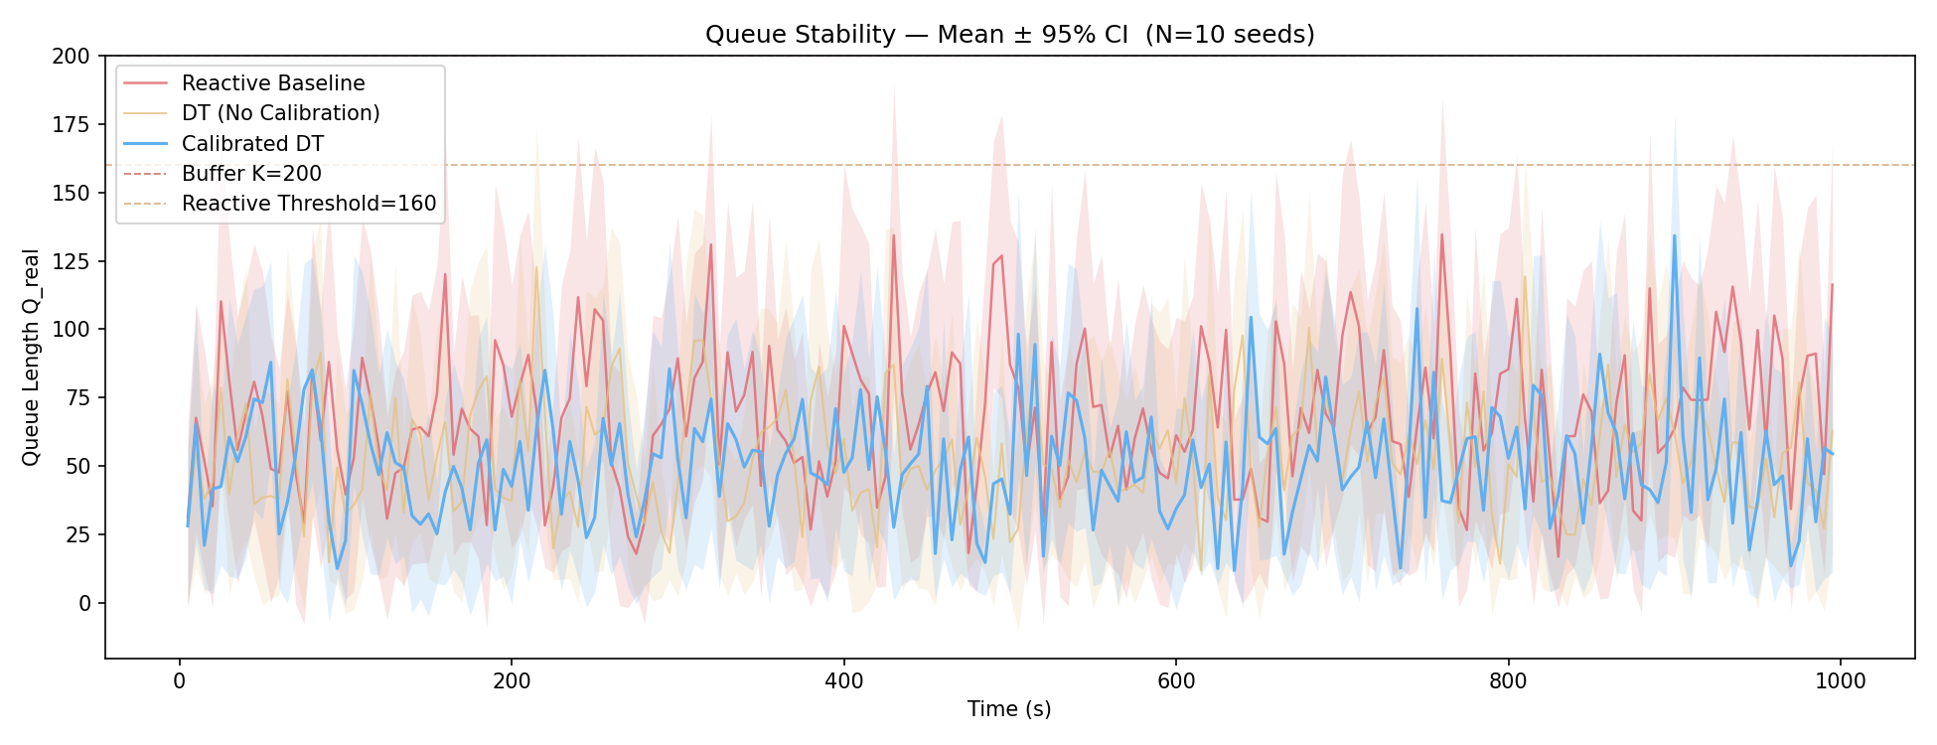
RESULT 2
Queue stability
P_success (N = 10, 95 % CI)
≈
Interpretation
Reactive
DT (no calib.)
Calibrated DT
0.310 ± 0.015
0.301 ± 0.011
0.309 ± 0.019
Reactive only acts after Q > 0.8 K
Calibrated DT raises p_acb before saturation
statistically equivalent to baseline; no throughput penalty
5G RRC Storm Mitigation · Calibrated Digital Twin
15 / 21

Slide 16
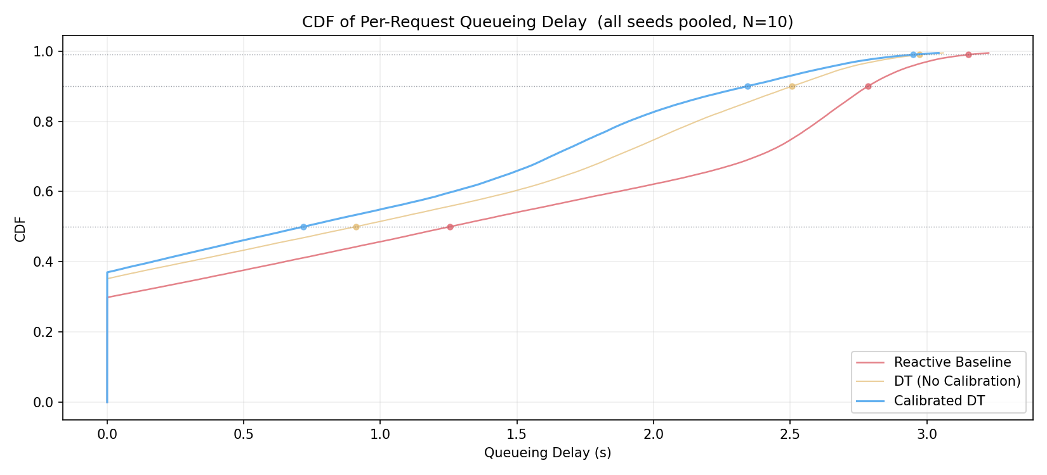
RESULT 3
Queueing delay — CDF
CDF left-shift
Tail suppressed
Mechanism
Calibrated DT curve sits left of the others — lower delay across all reported percentiles.
P90 / P99 queueing delay roughly halved — critical for URLLC latency budgets.
Reactive admits requests into a deeply loaded queue
Calibrated DT keeps Q_real low → short waits
5G RRC Storm Mitigation · Calibrated Digital Twin
16 / 21

Slide 17
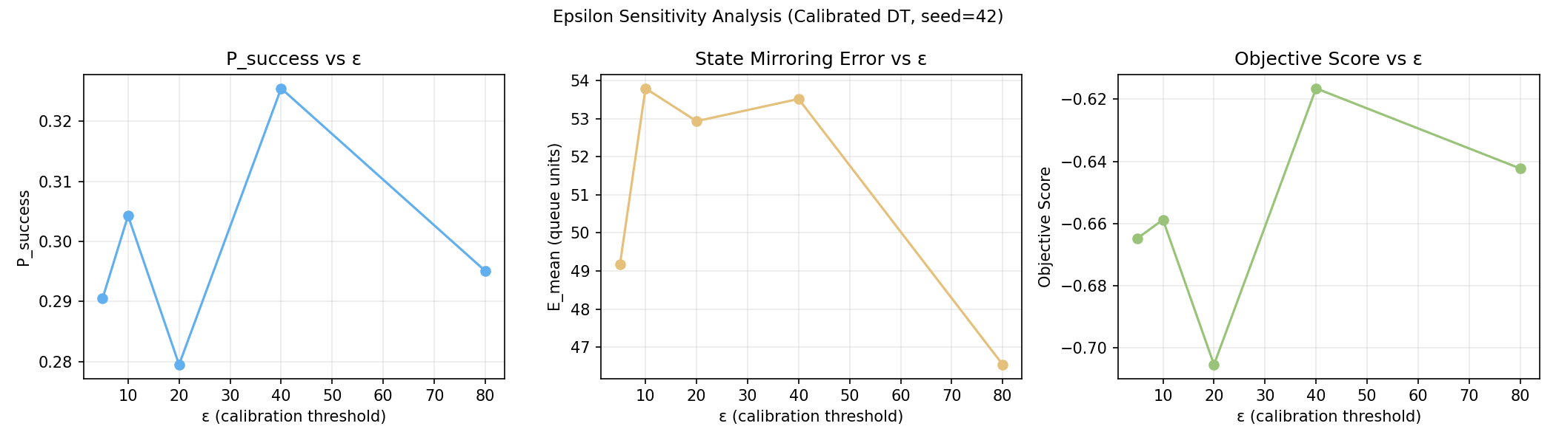
RESULT 4
ε-sensitivity analysis
Tested values
Interpretation
Adopted default
ε ∈ { 5, 10, 20, 40, 80 }
ε = 5 → over-calibrates on normal traffic
ε = 80 → calibration rarely triggers
ε = 40 → best composite in this sweep
ε = 10
Single-seed sweep (seed = 42)
conservative — just above the normal-traffic noise floor
5G RRC Storm Mitigation · Calibrated Digital Twin
17 / 21

Slide 18

DEPLOYMENT
O(1) complexity and O-RAN integration
O-RAN integration
Deployment notes
Non-RT RIC
policy: ε, δ⁺, δ⁻
Δ = 1 s fits Near-RT RIC range (10 ms – 1 s)
No protocol modifications required
Vendor-independent xApp — standard E2 service models
O(1) per step — fixed-cost arithmetic, suitable for tight gNB control budgets after hardware benchmarking
A1
Near-RT RIC
xApp running Algorithm 1
E2SM-RC
E2SM-KPM
gNB CU-CP
SIB1 uac-BarringInfo
Calibrated DT runs in μs vs. ms-class DNN inference — practical for commercial gNB software.
5G RRC Storm Mitigation · Calibrated Digital Twin
18 / 21

Slide 19

CONCLUSION
Findings and future work
42 %
≈
O(1)
reduction in state-mirroring error vs. uncalibrated DT
P_success statistically equivalent to baseline; P90/P99 delay reduced
deployable in commercial gNB software via O-RAN xApp
Proactive control in non-stationary 5G environments requires both a sound control policy and tight virtual-physical alignment.
Multi-cell extension
RL-based calibration
Current model treats one gNB cell independently. Real deployments involve handover correlations and inter-cell interference — a distributed DT with inter-cell state sharing is required.
Fixed δ⁺ and δ⁻ are vulnerable to slow ramp-up attacks. An RL agent can learn step sizes dynamically using state-mirroring error E as a reward signal.
5G RRC Storm Mitigation · Calibrated Digital Twin
19 / 21

Slide 20
?
Questions?
5G RRC Signaling Storm Mitigation via a Proactive Digital Twin Architecture with Continuous Calibration
Ömer Dikyol
dikyol25@itu.edu.tr
BLG 632E · ITU

Slide 21
REFERENCES
Selected references
[b1]
D. Rupprecht et al., "Breaking LTE on Layer Two," Proc. IEEE S&P, May 2019, pp. 1121–1136.
[b7]
S. K. Sharma and X. Wang, "Toward Massive MTC in Ultra-Dense Cellular IoT Networks," IEEE COMST, 2020.
[b2]
B. H. Lee et al., "Enhanced Random Access for Massive-MTC," IEEE IoT J., vol. 8, no. 8, 2021.
[b8]
R. Dong et al., "Deep Learning for Radio Resource Allocation in 5G," IEEE TWC, vol. 20, no. 4, 2021.
[b3]
M. Grieves and J. Vickers, "Digital Twin: Mitigating Unpredictable Emergent Behavior," Springer, 2017.
[b9]
C. Zhang et al., "Deep Learning in Mobile and Wireless Networking: A Survey," IEEE COMST, 2019.
[b4]
3GPP, "NR; RRC Protocol Specification," TS 38.331, Rel. 17.3.0, 2022.
[b10]
H. X. Nguyen et al., "Digital Twin for 5G and Beyond," IEEE Commun. Mag., vol. 59, no. 2, 2021.
[b5]
L. Miuccio et al., "Joint Control of Random Access for Massive MTC in 5G NR," IEEE IoT J., vol. 7, no. 6, 2020.
[b14]
M. Polese et al., "Understanding O-RAN," IEEE COMST, vol. 25, no. 2, 2023.
[b6]
M. Kotuliak et al., "Performance Evaluation of 5G NR Non-Standalone Network," IEEE Access, vol. 9, 2021.
5G RRC Storm Mitigation · Calibrated Digital Twin
21 / 21

