Slide 1
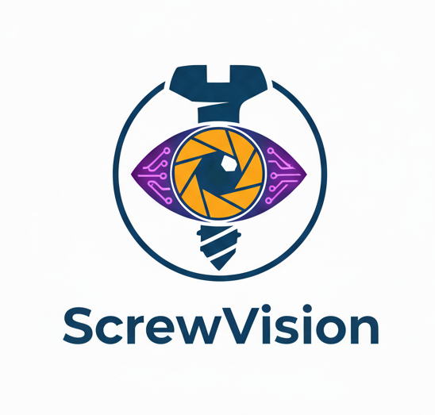

BIM 439 DATA MINING PROJECT Project Name: ScrewVision: Intelligent Screw Classification using YOLOv8 Team Members: Ömer EDEBALI - 030721030 Abdullah Kerem YAVUZ - 030722098

Slide 2
Abstract
In our study, an AI-powered mobile system based on YOLOv8 has been developed to automatically identify different screw drives (Phillips, Torx, Allen, etc.) commonly encountered in assembly and maintenance processes.
The system analyzes images from the mobile device camera in real-time, detecting the screw type with high accuracy and providing instant visual feedback. Through ONNX Runtime optimization, the models achieve high efficiency and minimum latency on mobile devices.

Slide 3
Introduction
Problem Statement:
Incorrect identification of fasteners during assembly or maintenance leads to mechanical failures, stripped screws, and significant time loss.
Why It Matters:
Accurate screw identification ensures structural integrity and operational efficiency. However, manual identification is often slow and prone to human error, especially with similar drive types.
Objectives:
To develop an AI system capable of automatically recognizing various screw head types.
To provide a real-time, mobile-compatible solution for industrial and DIY use.
To achieve high classification accuracy with low latency on edge devices.

Slide 4
Literature Review
Object Detection: Traditional methods (Edge detection) vs. Deep Learning (CNNs).
YOLO (You Only Look Once): Selected for its high speed and real-time detection capabilities.
YOLOv8: The latest iteration offering better accuracy and smaller model size compared to previous versions (v5, v7), making it ideal for mobile use.
STUDY | METHOD | OBJECT TYPE & CLASS COUNT | REAL TIME
Qian et al. (2020) | Faster R-CNN | Aerospace Fasteners (4 Classes) | ❌
Li et al. (2021) | YOLOv5 | 5 (plastik, kağıt, ekmek, organik, yemek) | ✅
Chen & Wang (2023) | YOLOv7 | Small Screw Parts (6 Classes) | ✅
ScrewVision | YOLOv8 + ONNX | Standard Screw Drives (6 Classes) | ✅

Slide 5
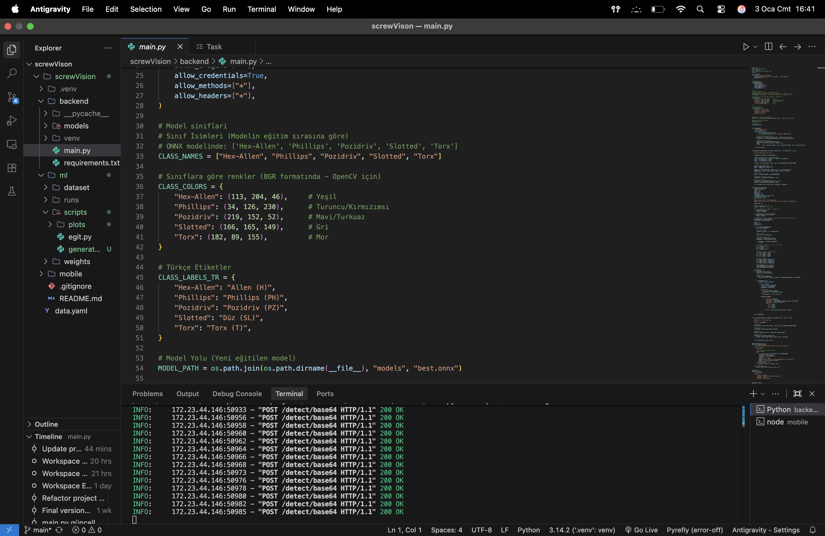
Methodology
Algorithms & Tech Stack
Core Technologies:
YOLOv8m: Object Detection (57 Epochs on VSCode).
FastAPI: High-performance Backend.
React Native: Cross-platform Mobile App.
System Flow:
Camera → Preprocessing → ONNX Model → Result

Slide 6
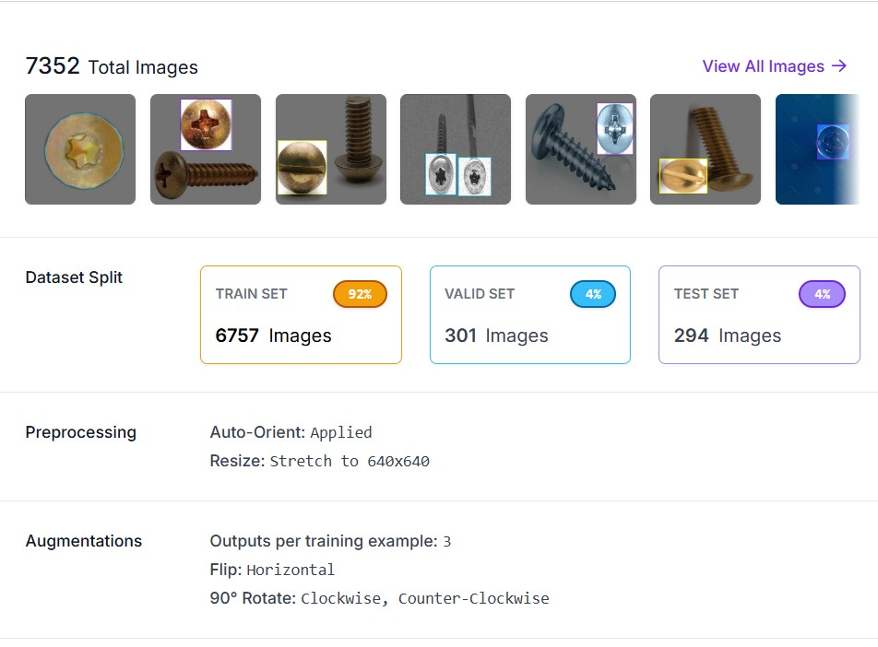
Methodology
Custom Dataset:
We personally collected and manually labeled 500+ photo.
We have 7352 total photo(inclde data agumentation)
Preprocessing:
All images resized to 640x640 pixels.
Augmentation:
Applied Flip, Rotation (±15°).

Slide 7
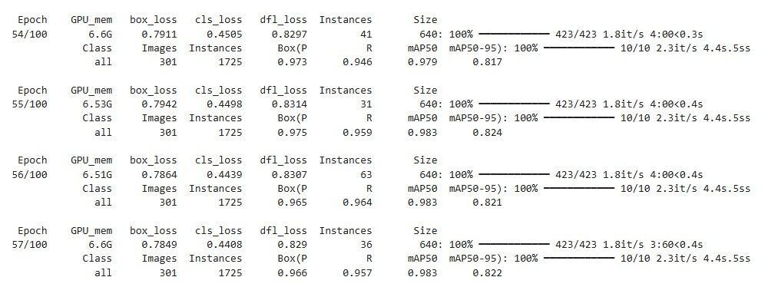
Experimental Results
Model Performance
METRIC | VALUE
Total Epochs | 57
Best Epoch | 55
Precision | 0.99
Recall | 0.99
mAP@0.5 | 0.983
mAP@0.5:0.95 | 0.824
Class Count | 6
Model Size | YOLOv8m (ONNX) (~98MB)
Parameters | ≈25.9M

Slide 8
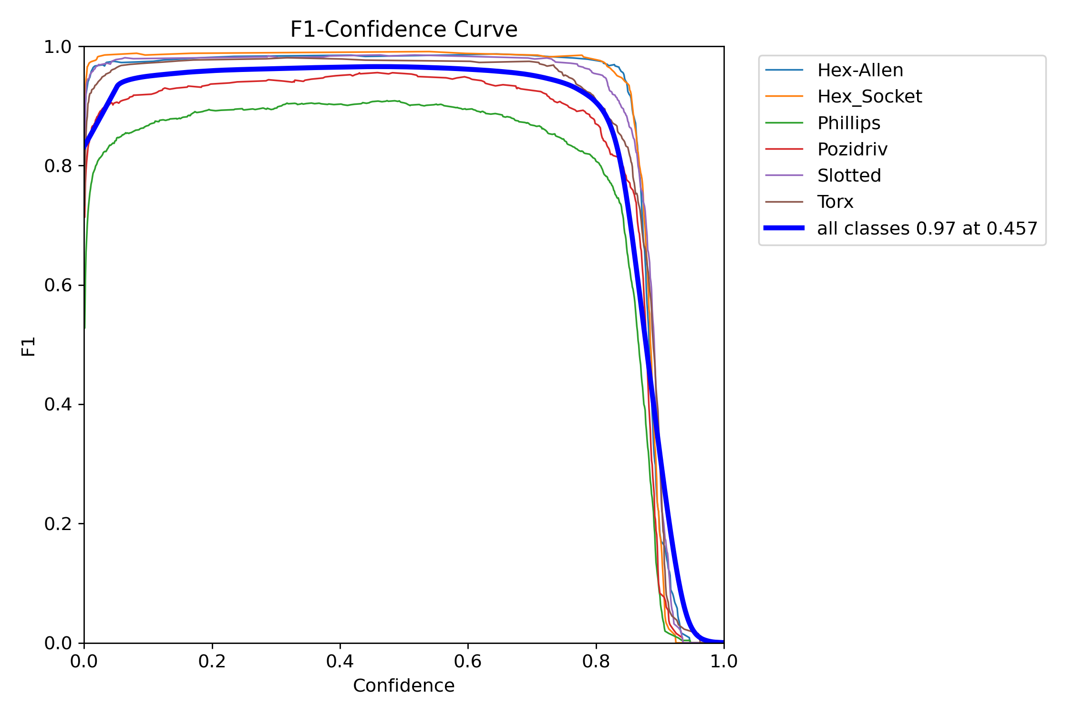
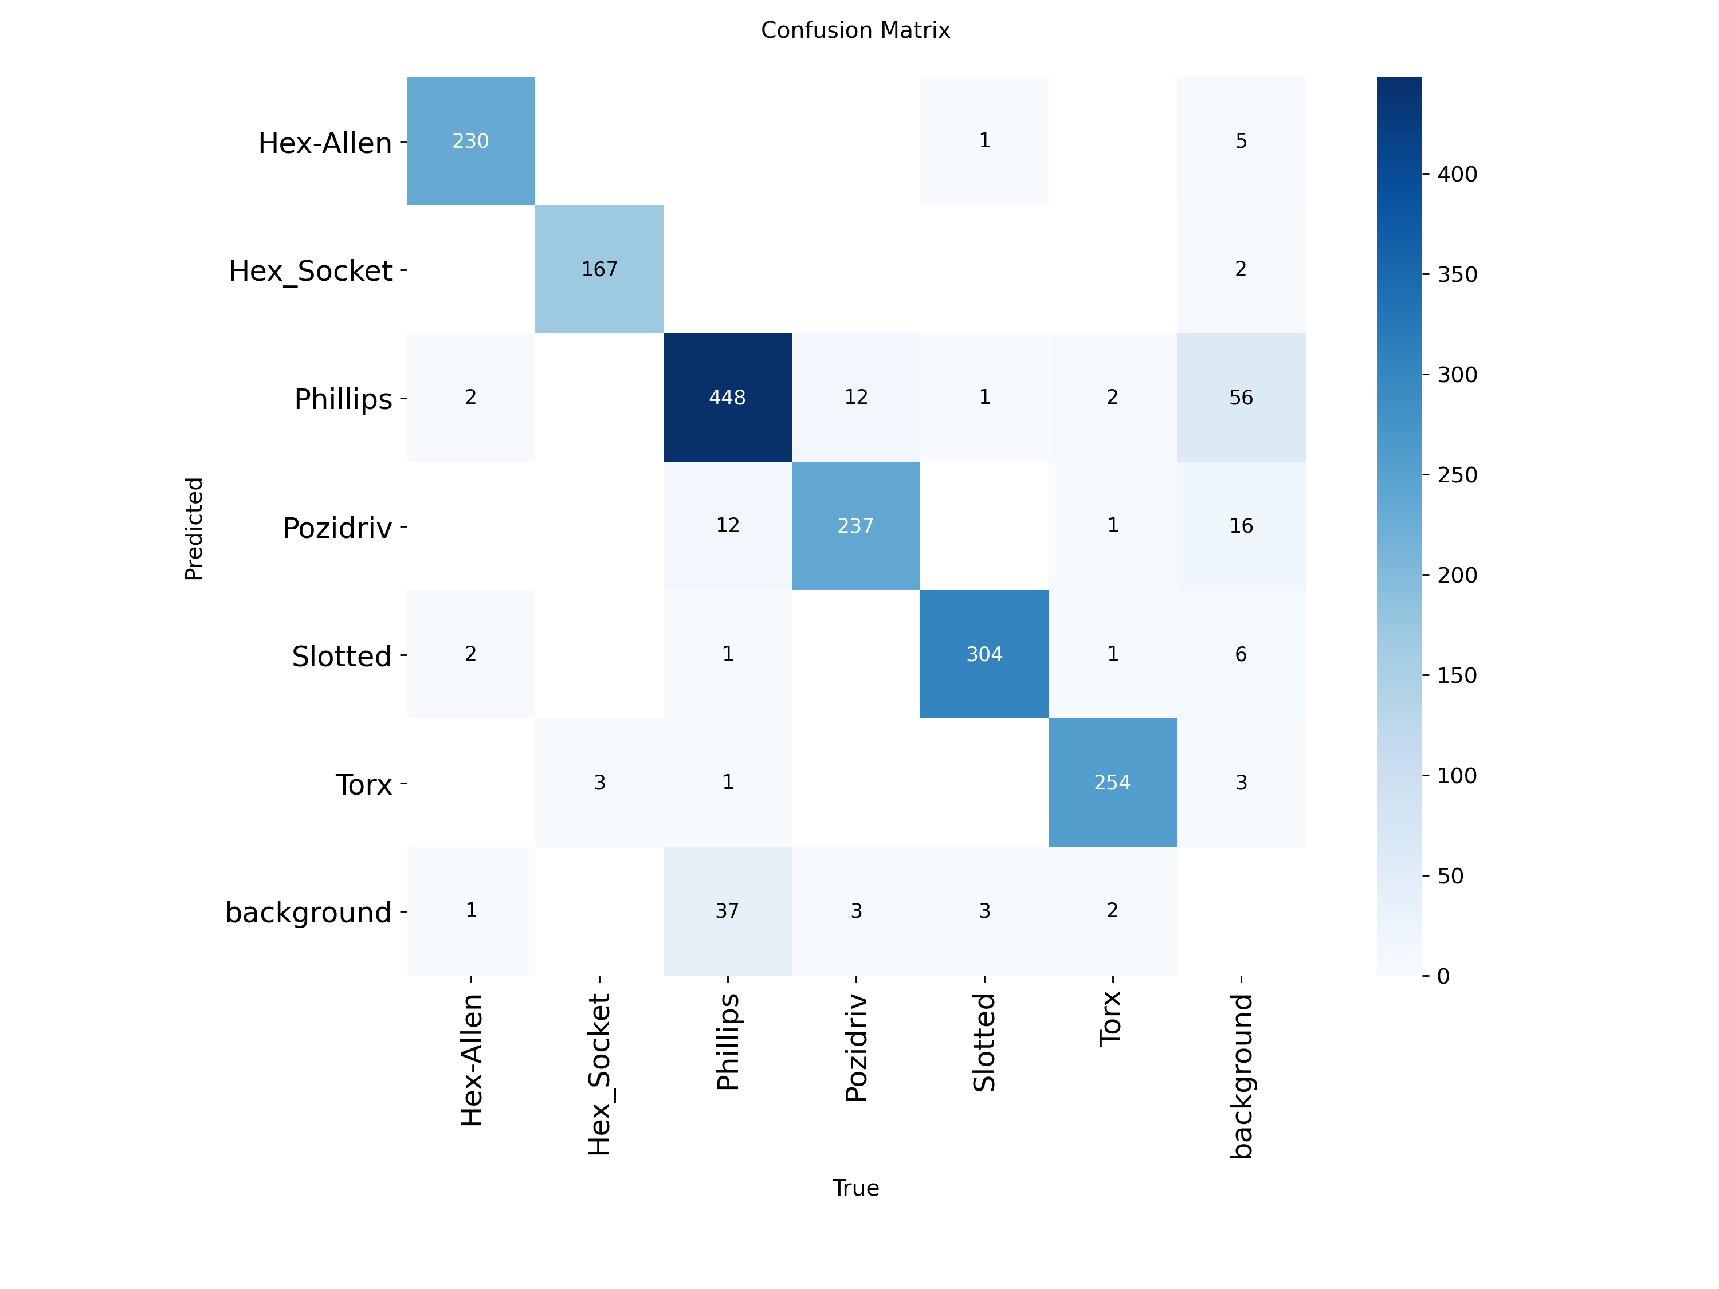
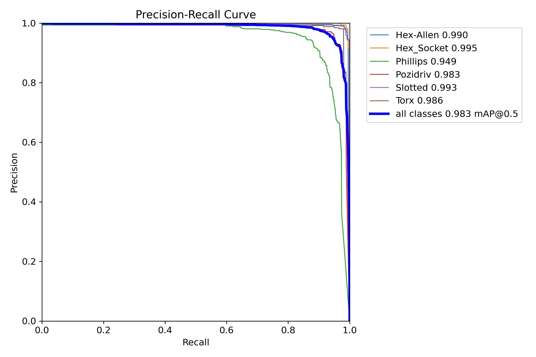
Experimental Results

Slide 9
Mobile App Features
Real-Time Object Detection: Instant analysis of fasteners directly from the camera feed.
Gallery Image Classification: Capability to process and classify pre-existing photos from the device gallery.
Visual Feedback: Detected screws are highlighted with color-coded bounding boxes for easy identification.
Confidence Scoring: Displays the AI's certainty percentage for each prediction to ensure reliability.
High-Performance Inference: Powered by ONNX Runtime for low-latency detection on mobile hardware.
Professional UI/UX: A clean, intuitive, and modern interface designed for ease of use.

Slide 10
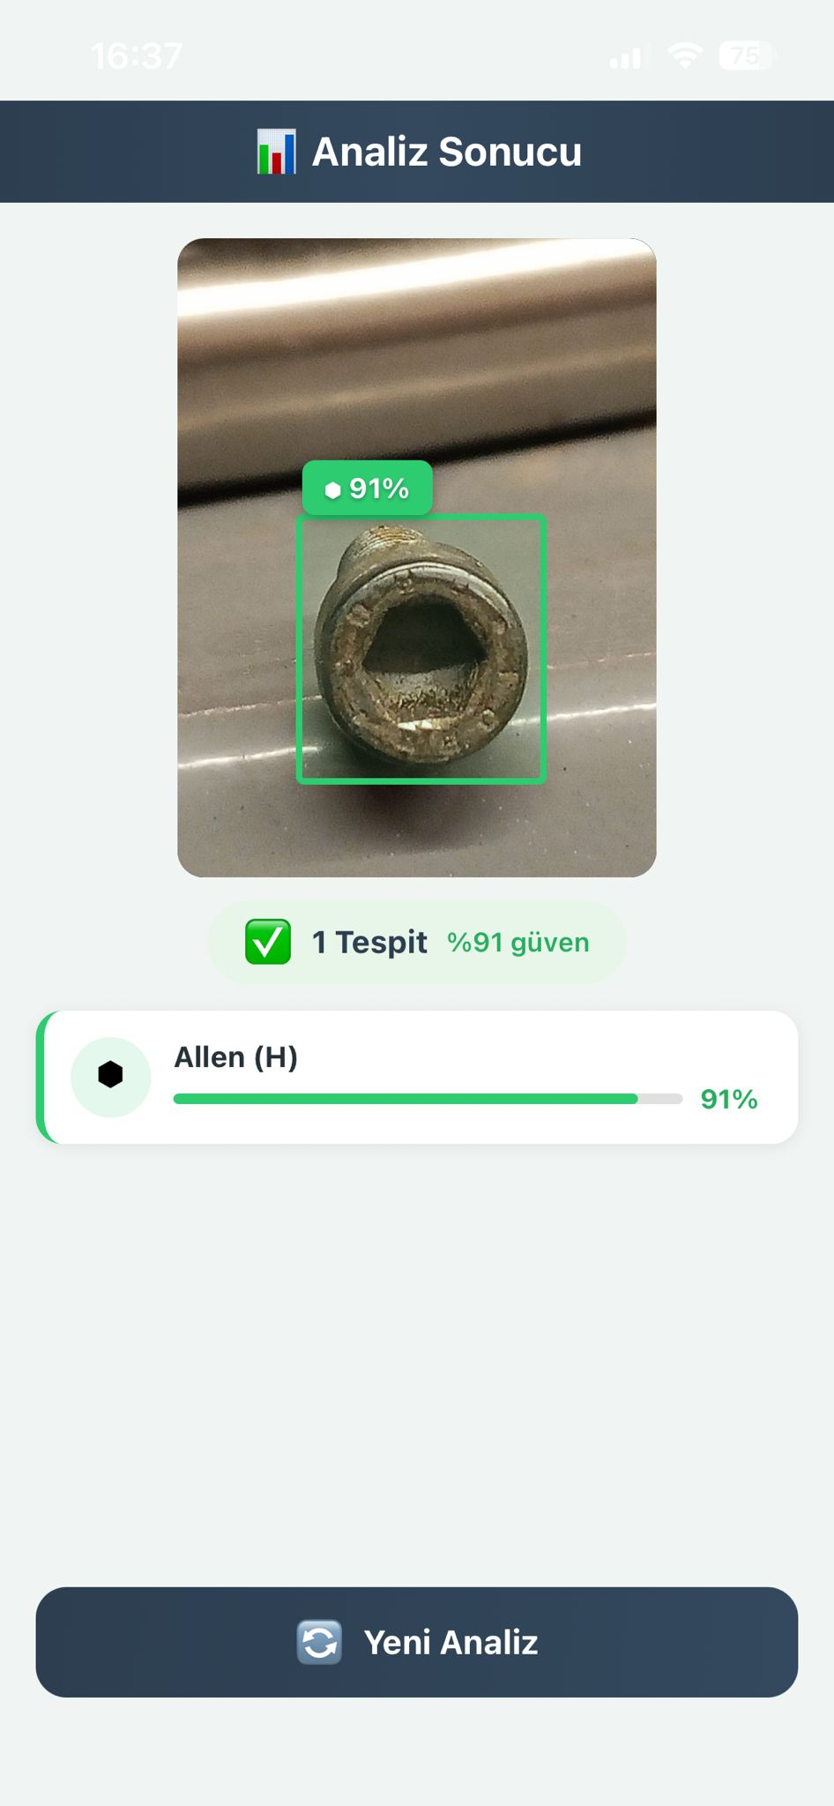
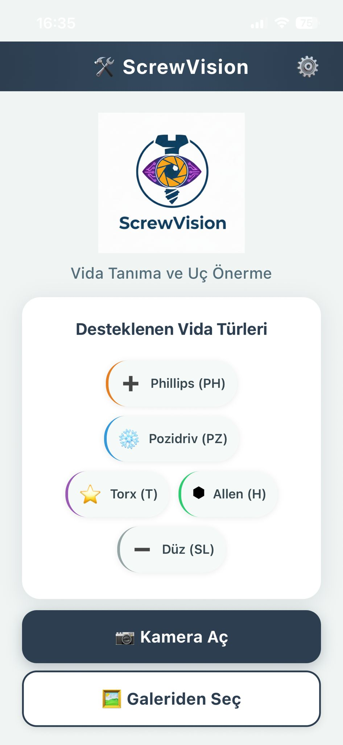
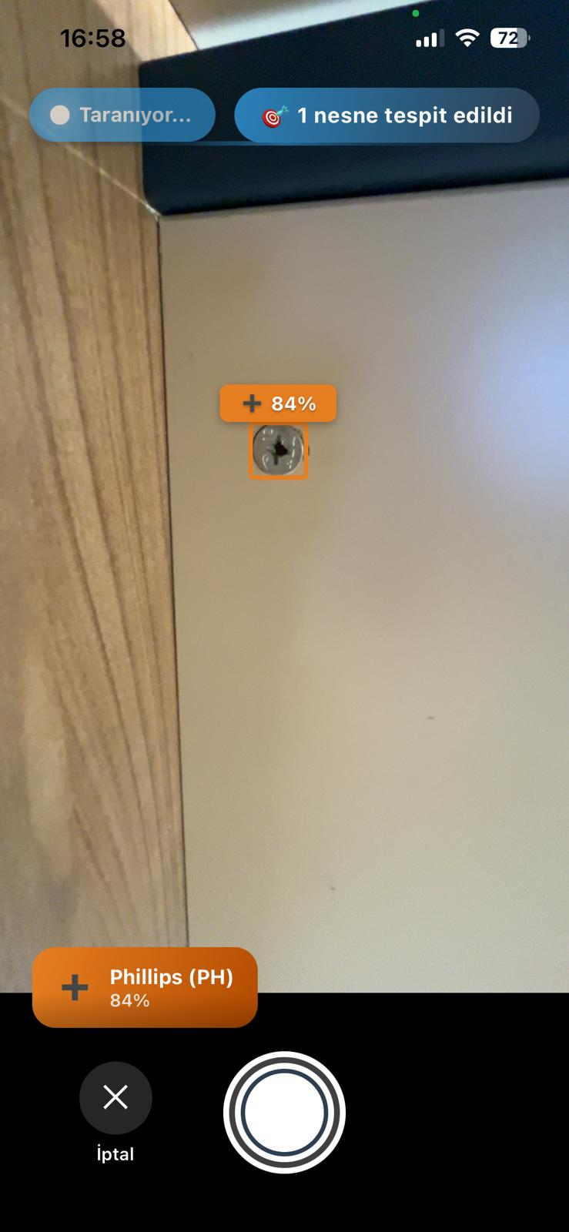
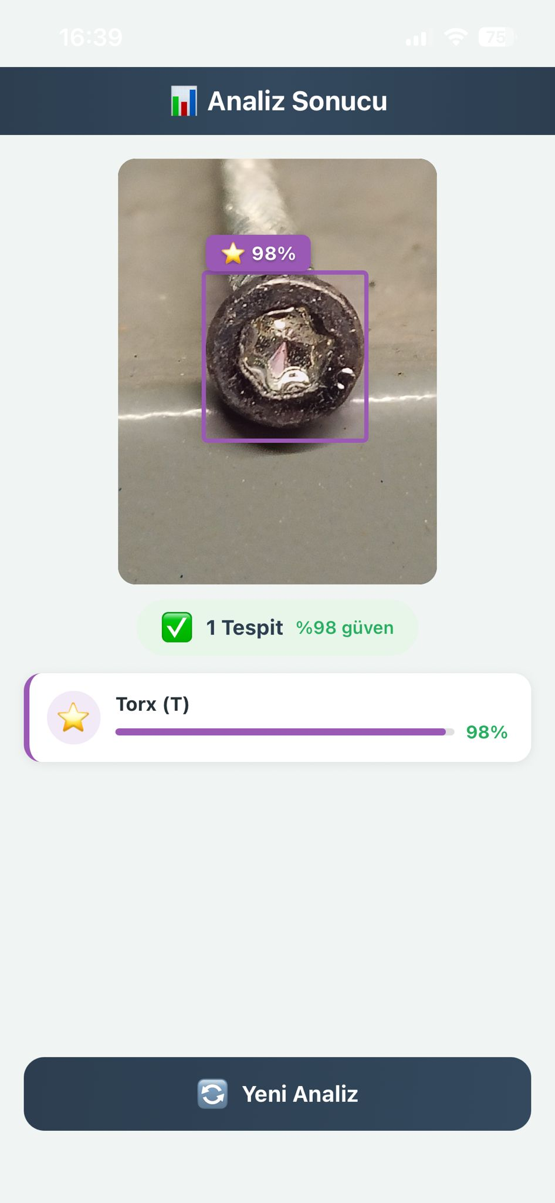
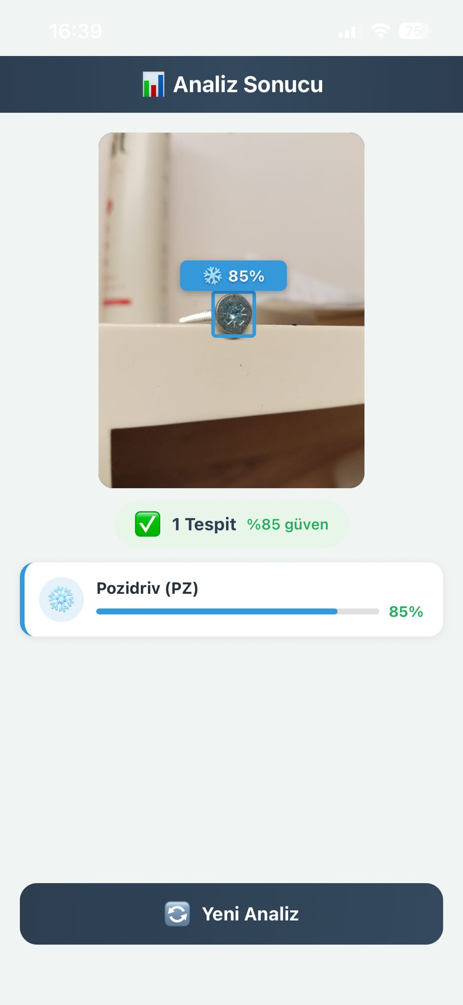
Mobile App UI & Tests

Slide 11
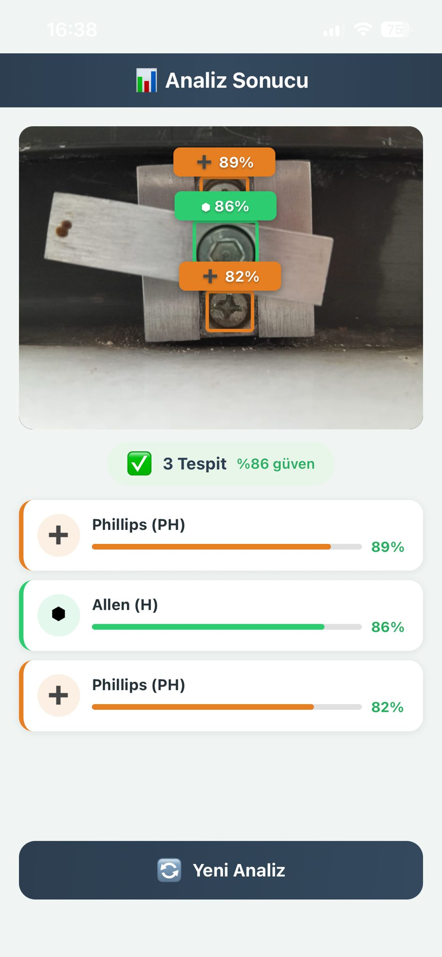
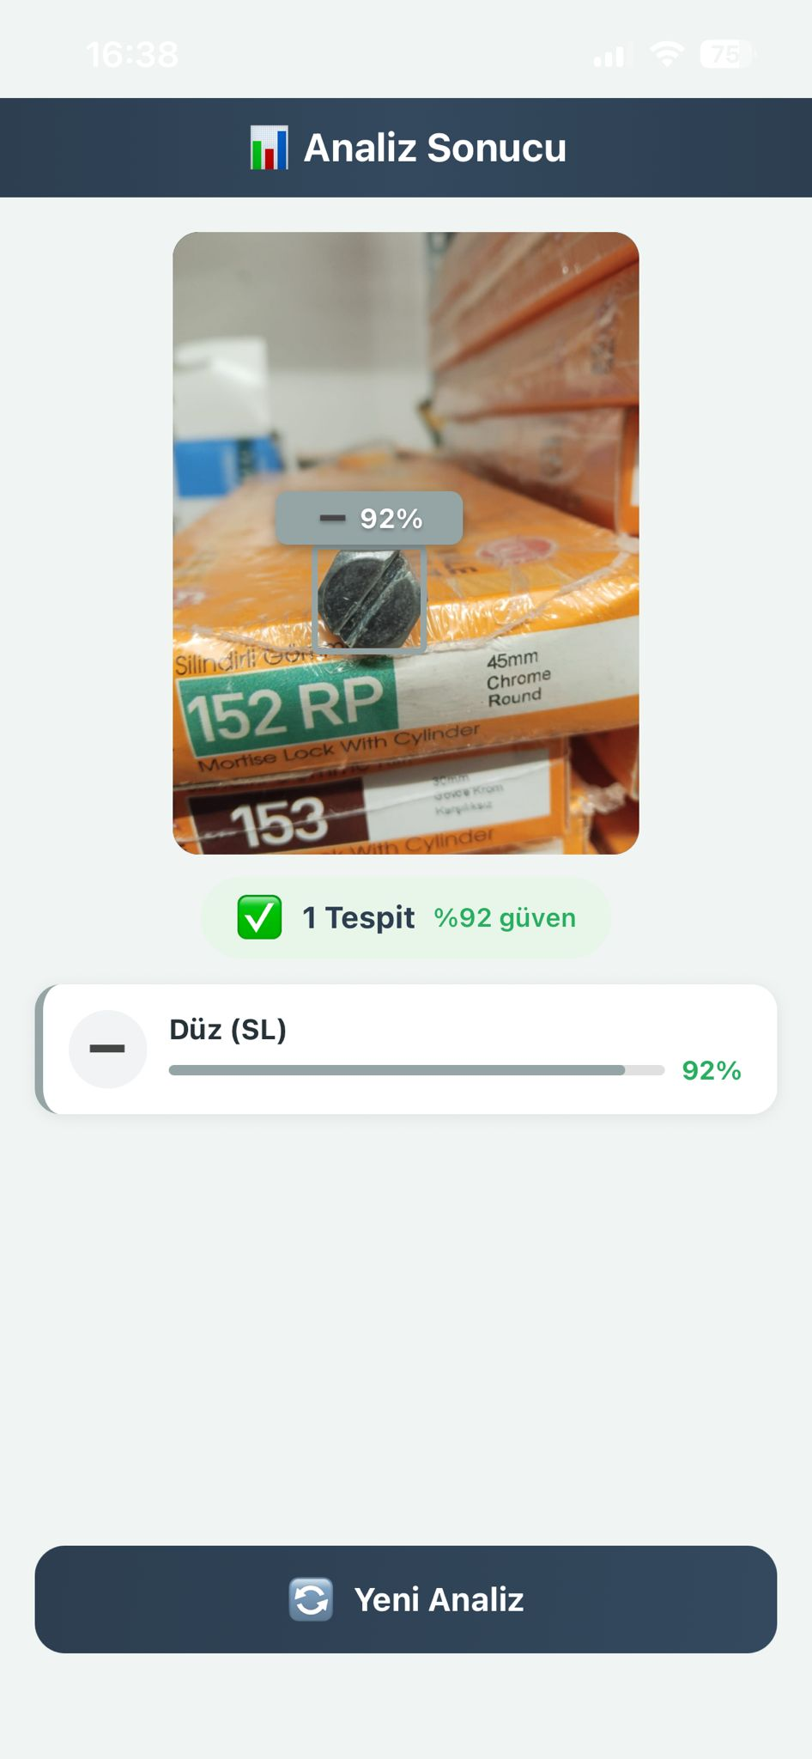
Results and Discussion
The developed ScrewVision system provides a highly accurate and functional mobile solution for automatic screw drive classification.
By combining YOLOv8 and ONNX Runtime, the application achieves both high detection speed and real-time performance on mobile devices.
While the model successfully generalizes to unseen data, occasional misclassification may occur between visually similar types due to dataset limitations.

Slide 12
Future Work
Expanded Dataset: Retraining with a larger, more diverse dataset to include specialized screw types (e.g., Robertson, Security Torx).
Offline Capability: Deploying the model directly on-device (Edge AI) to enable functionality without an internet connection.
AR Assistance: Integration of Augmented Reality to provide real-time screwdriver size matching and torque recommendations.
Smart Inventory: Developing a feature to count and track screw inventory for workshops and hardware stores.

Slide 13
References
Li, Y., Wang, H., & Zhao, L.
Automatic Screw Detection and Classification Based on YOLOv5,
Journal of Physics: Conference Series, 2021.
Jocher, G., et al.
Ultralytics YOLOv8 Documentation,
https://docs.ultralytics.com, 2023.
Bai, J., et al.
ONNX Runtime: Cross-Platform, High Performance ML Inferencing,
https://onnxruntime.ai, Microsoft, 2020.
Roboflow Inc.
Roboflow: Computer Vision Datasets and Annotation Tools,
https://roboflow.com.

