Slide 1

MARMARA UNIVERSITY FACULTY OF ENGINEERING
EE4069 Fall 2023
Artificial Intelligence in Health Sciences
PROJECT
A Deep Learning Detection Model for Scoliosis and Spondylolisthesis from X-Ray Images

Slide 2
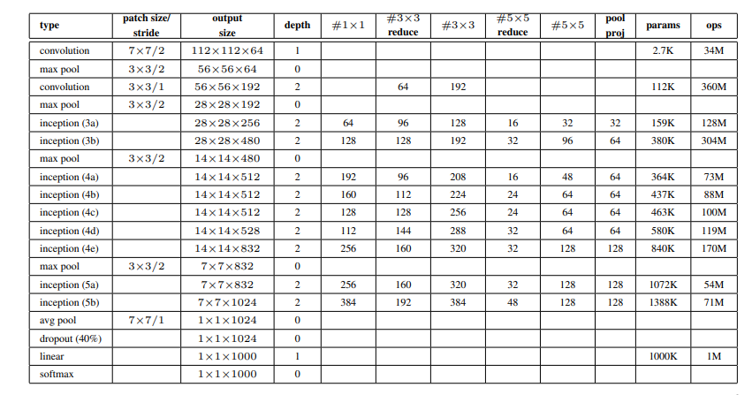
System Model
GoogLeNet Model:
22 layers deep.
18,278,353 total number of parameters.
Architecture uses 1x1 convolution to increase the depth by decreasing number of parameters.
Freezing pre-trained layers.
Adding output dense layer.
Data normalization applied.

Slide 3
System Model
CustomNet Model:
6 layers deep.
896,579 total number of parameters.
Data augmention applied.

Slide 4
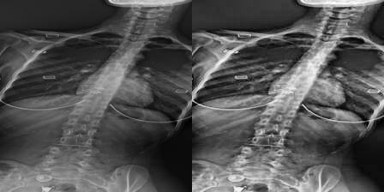
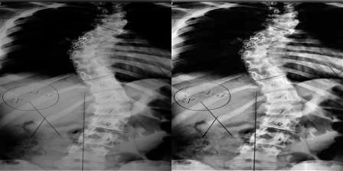
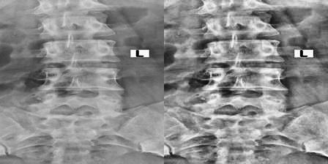
Pre-Processing
Contrast enhancement and normalization.
Normal
Spond
Scol

Slide 5
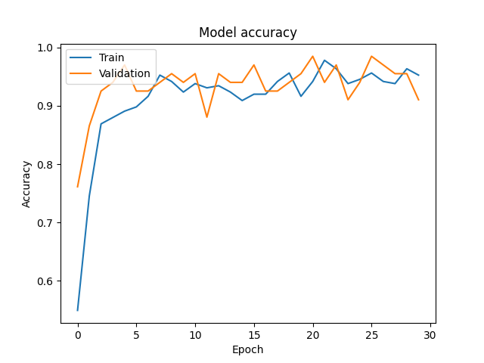
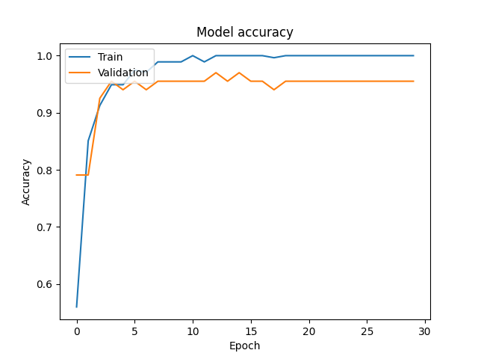
Normalization Performance Analysis
GoogLeNet without normalization
GoogLeNet with normalization

Slide 6
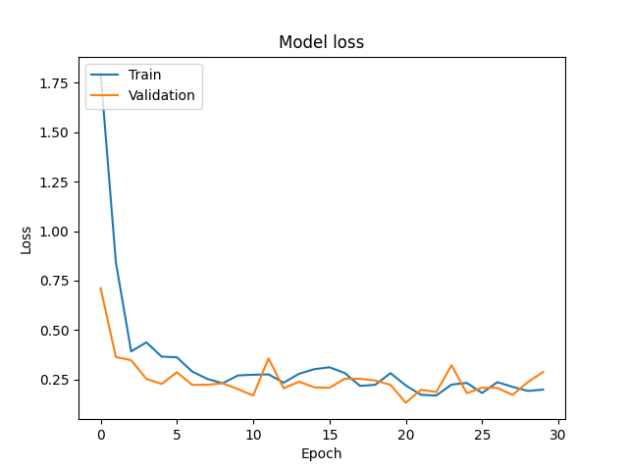
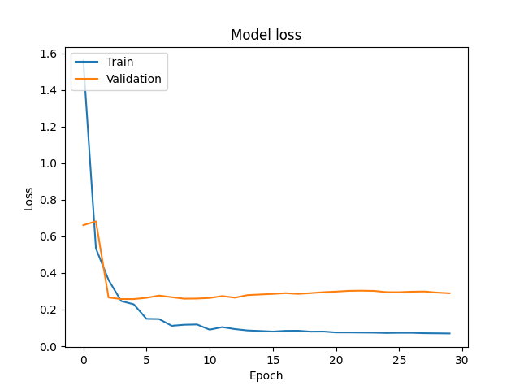
Normalization Performance Analysis
GoogLeNet without normalization
GoogLeNet with normalization

Slide 7
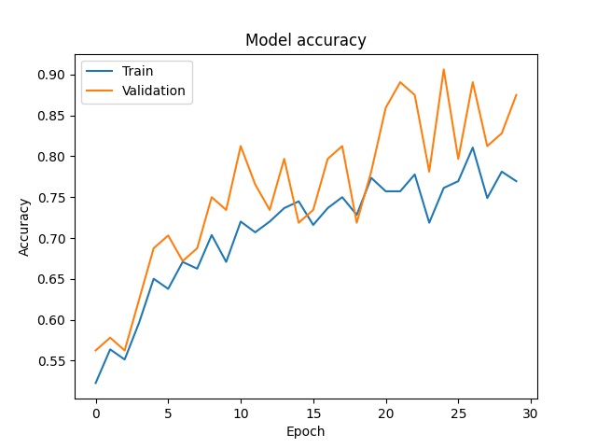
GoogLeNet vs CustomNet Performance Analysis
GoogLeNet
CustomNet

Slide 8
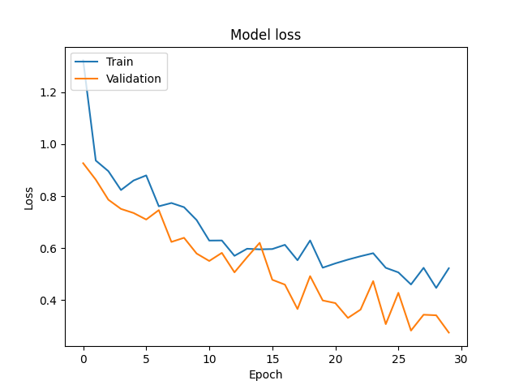
GoogLeNet vs CustomNet Performance Analysis
GoogLeNet
CustomNet

Slide 9
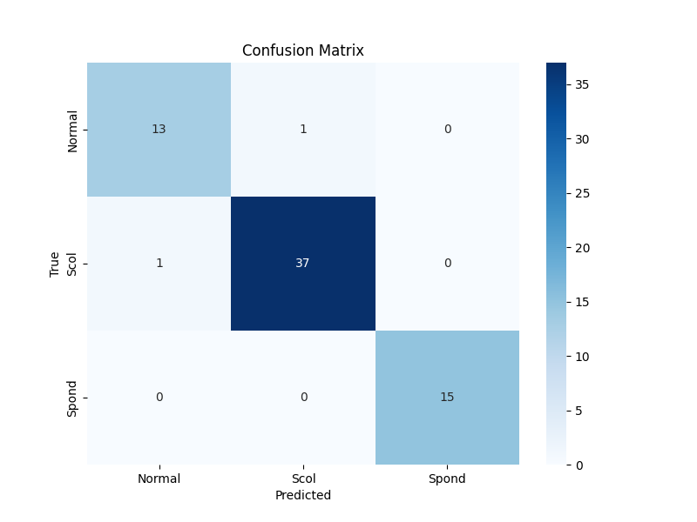
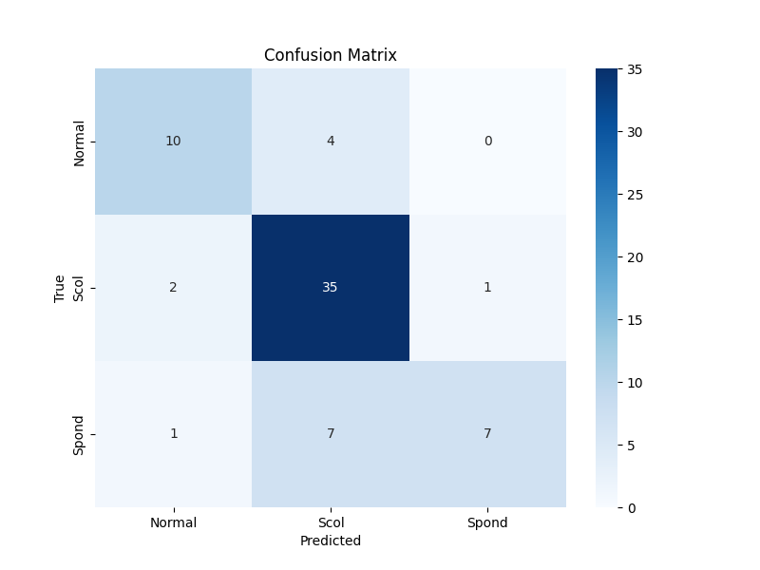
GoogLeNet vs CustomNet Performance Analysis
GoogLeNet
CustomNet

Slide 10
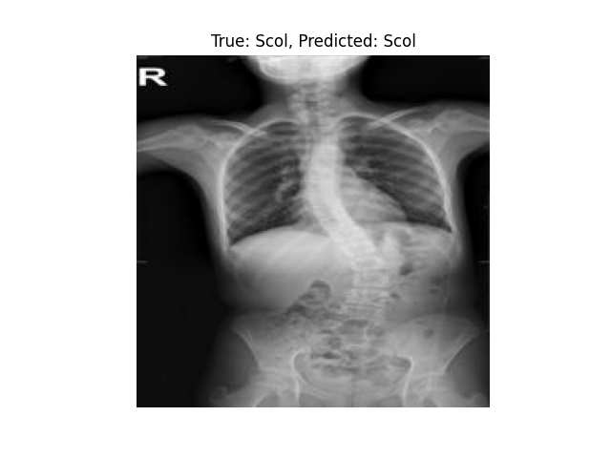
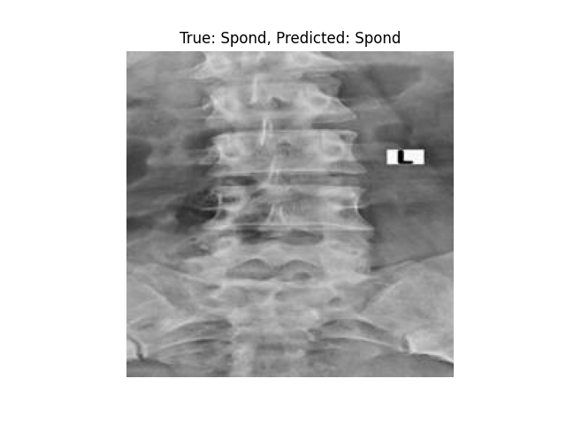
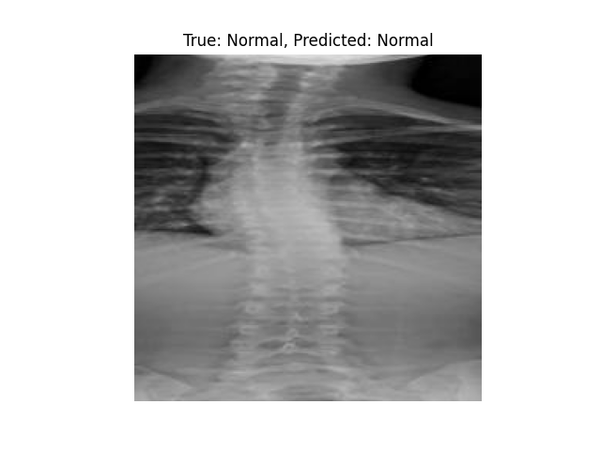
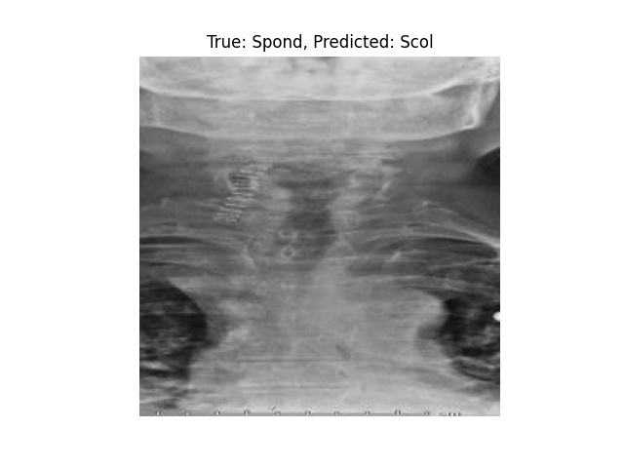

Prediction Results
GoogLeNet:
CustomNet:

Slide 11
Thank you

