Slide 1
Electricity Consumption Forecasting in Portugal
Group 7
Ömer Faruk MERCAN – 150114018
Taylan SABIR – 150714017
Akif TAŞCI – 150716840
Emre YILDIZ- 150316505

Slide 2
Outline
Aim of Project
Introduction to Dataset
Dataset Features
Graphs describing Dataset
K-Means Clustering
Autoregression prediction
Conclusion

Slide 3
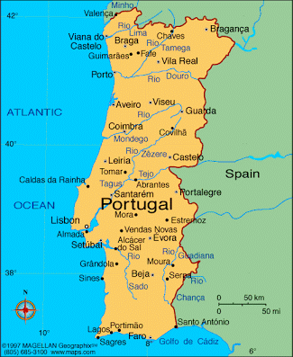
Aim of the Project
Content of Dataset
Electricity consumption in 370 different location in Portugal.
Measurements in kWh with 15 minute intervals.
Between years 2012 and end of the 2014.
Our aim is that predict electricty consumption in next year.

Slide 4
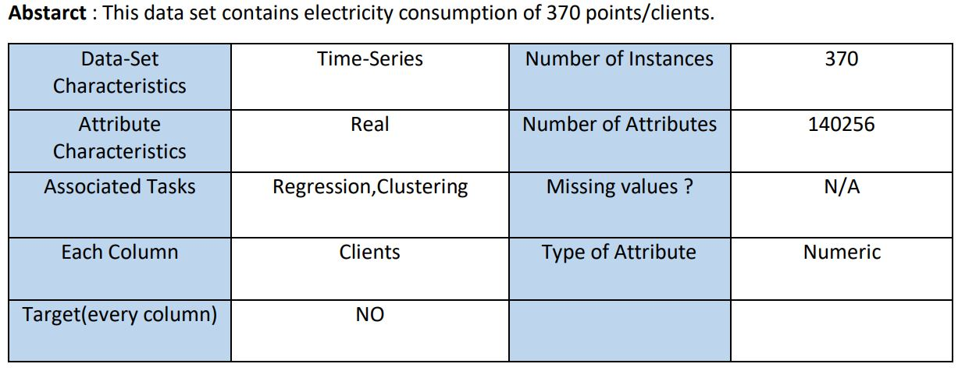
Introduction to dataset

Slide 5
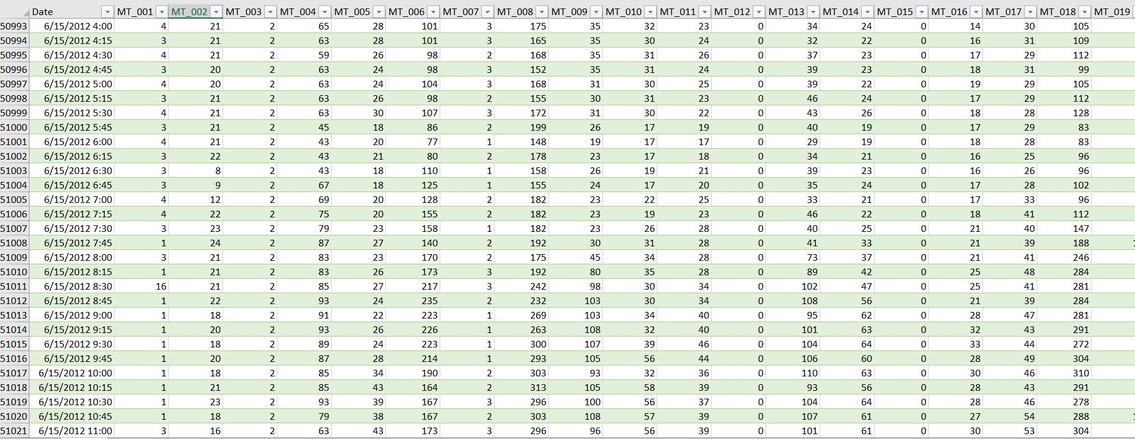
Dataset

Slide 6
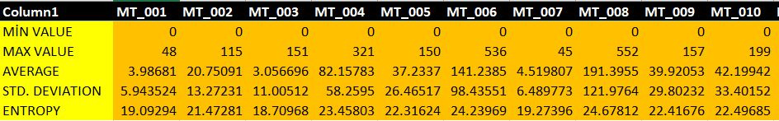
Statistical Description of Dataset

Slide 7
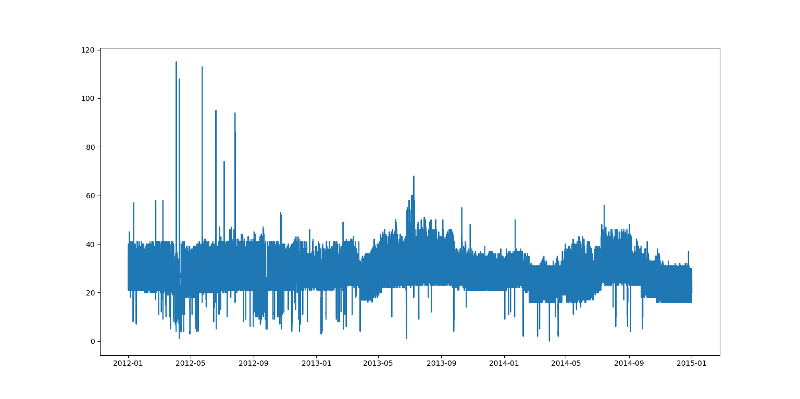
One Point Visualization

Slide 8
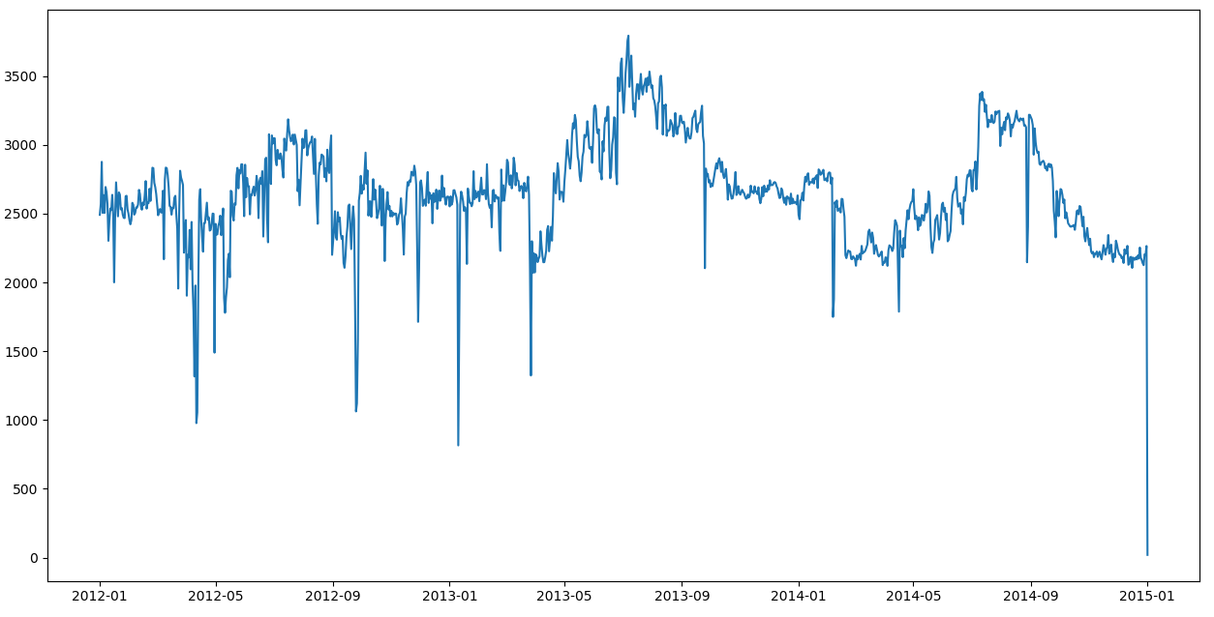
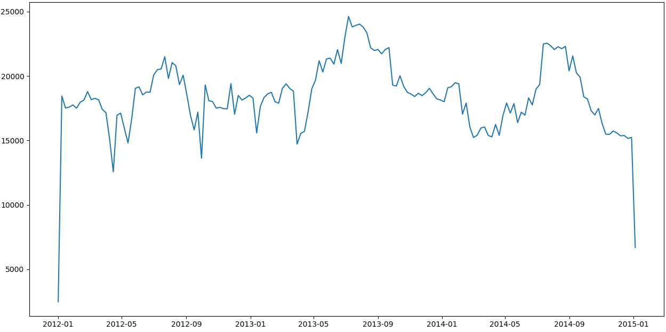
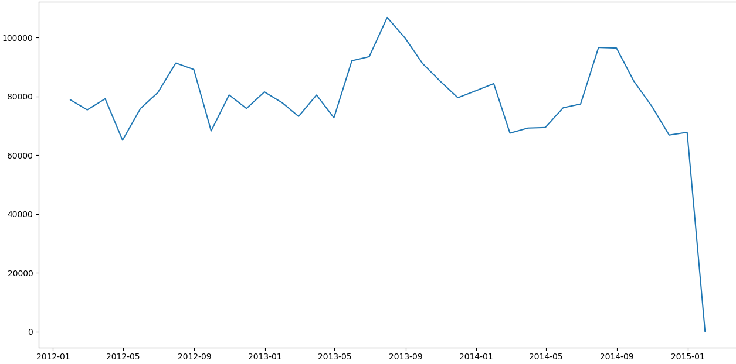

Slide 9
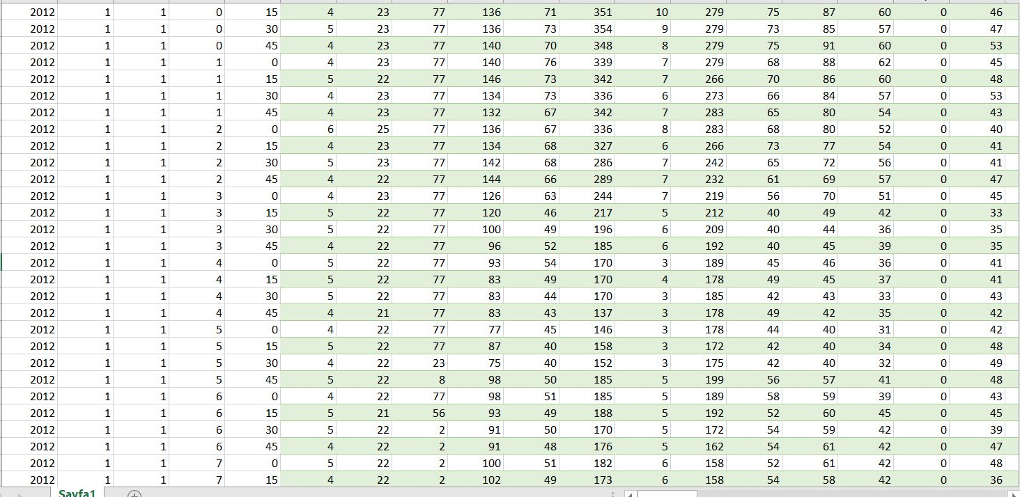

Slide 10
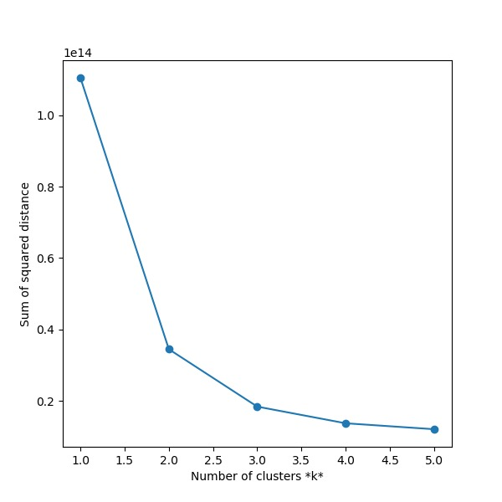
Choosing of k by using Elbow Method

Slide 11
Silhouette Score
For 2 , 0.616126
For 3, 0.507959
For 4, 0.47467
Error Sum of Squares (SSE) = 65981553677.2014

Slide 12
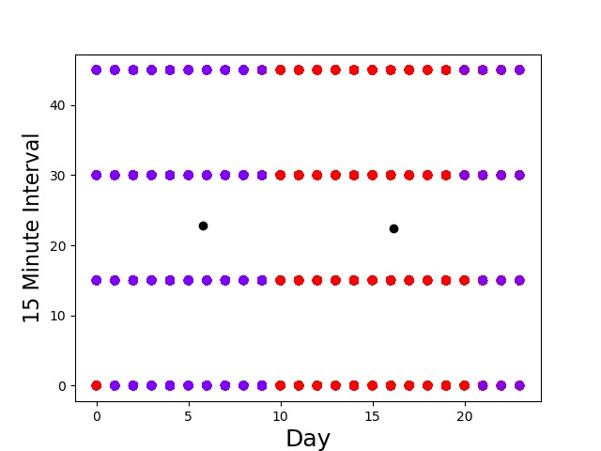
k-Means Clustering (2 Cluster)

Slide 13
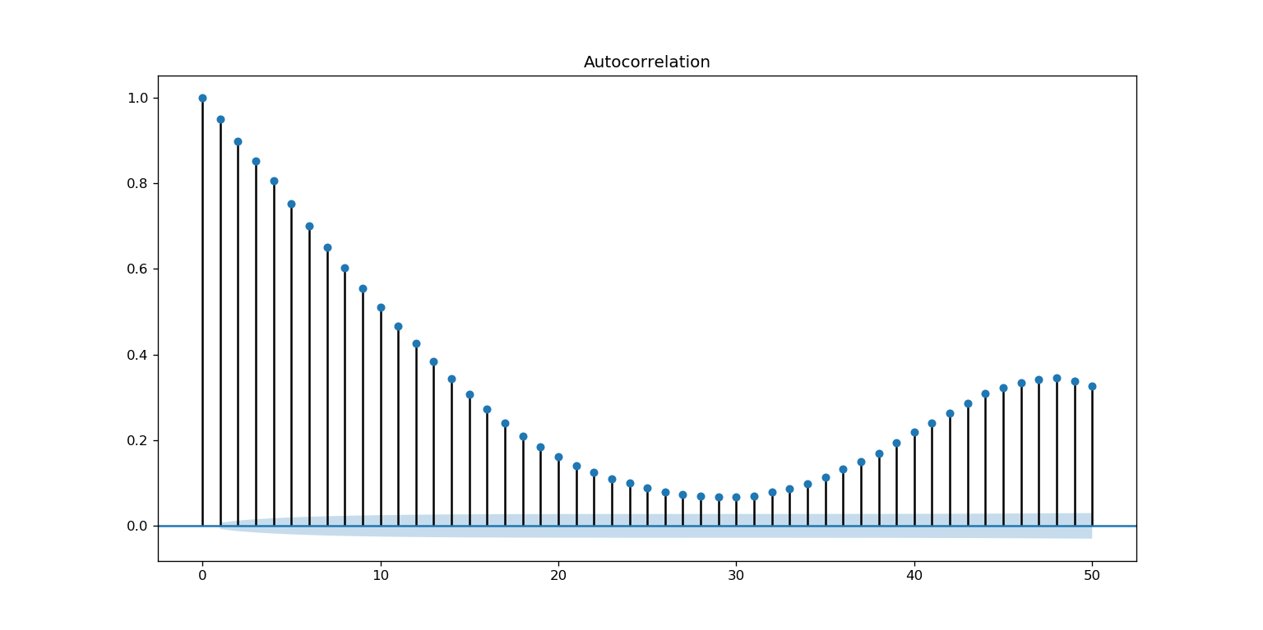

Slide 14
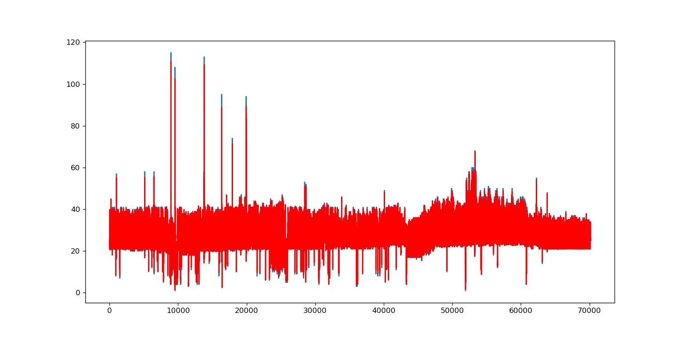
Auto Regression Results

Slide 15
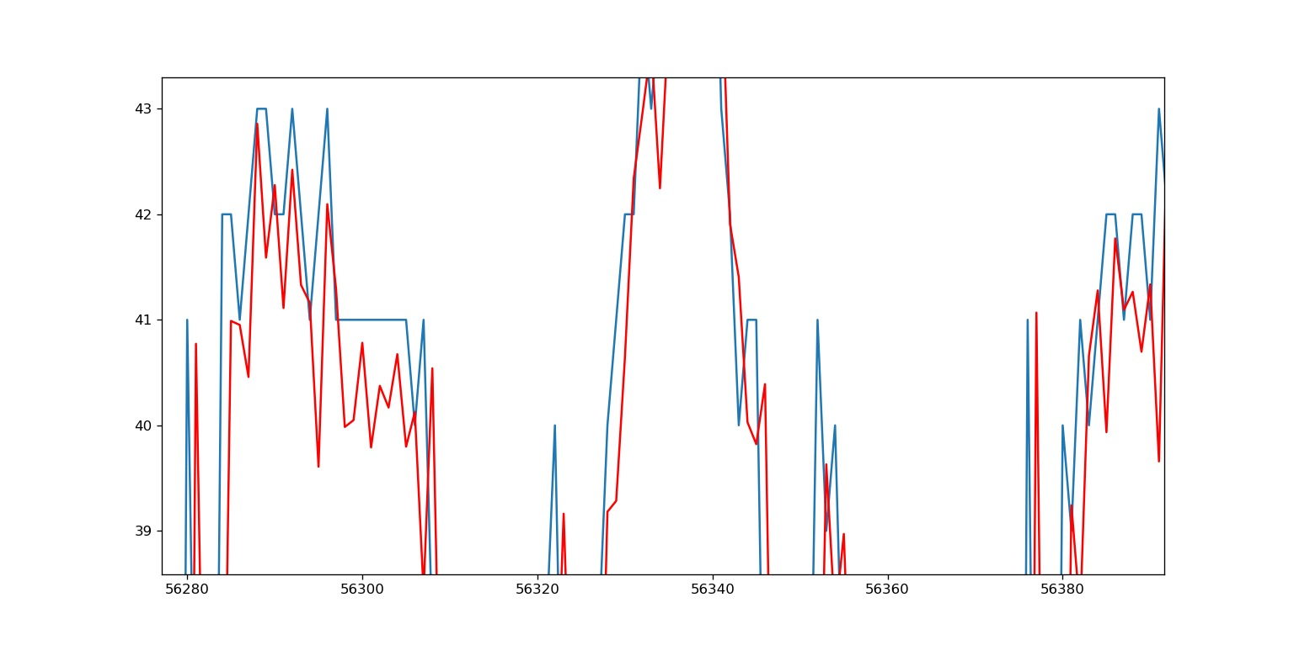
Specific Results

Slide 16

Error Results of AutoRegression

Slide 17
THANKS FOR LISTENING

