Slide 1
AI/RAG-Based Live GTU Q&A System
CSE 496
First Presentation
Ömer Fehmi Çakıcı
Advisor: Mehmet Göktürk
March 2026

Slide 2
Contents
• Project Definition
• Project Design
• Project Requirements
• Success Criteria
• Project Timeline (with monthly granularity)
• References

Slide 3
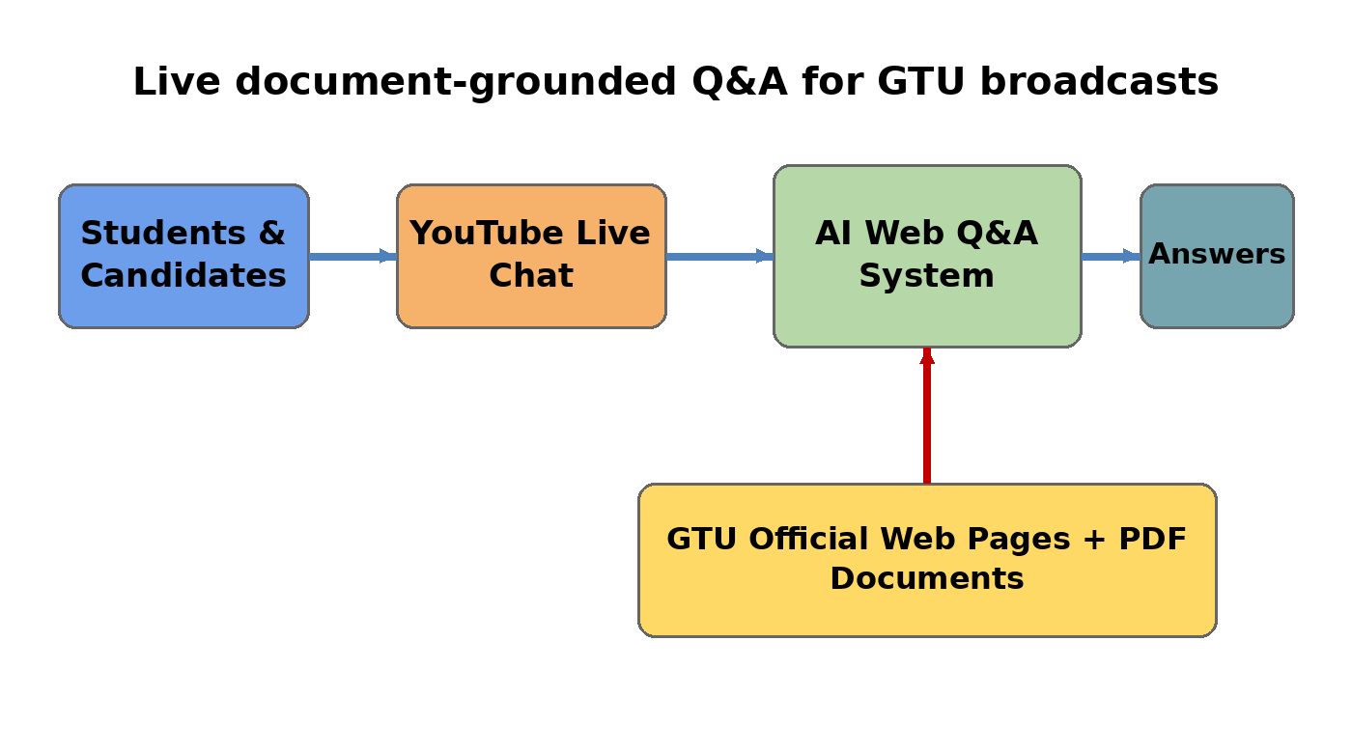
Project Definition
• Receives questions from YouTube live chat
• Searches GTU official web pages and PDF documents
• Produces Turkish answers
• This project builds a live question-answering assistant for GTU candidates and students. It focuses on reliable, document-grounded answers.

Slide 4
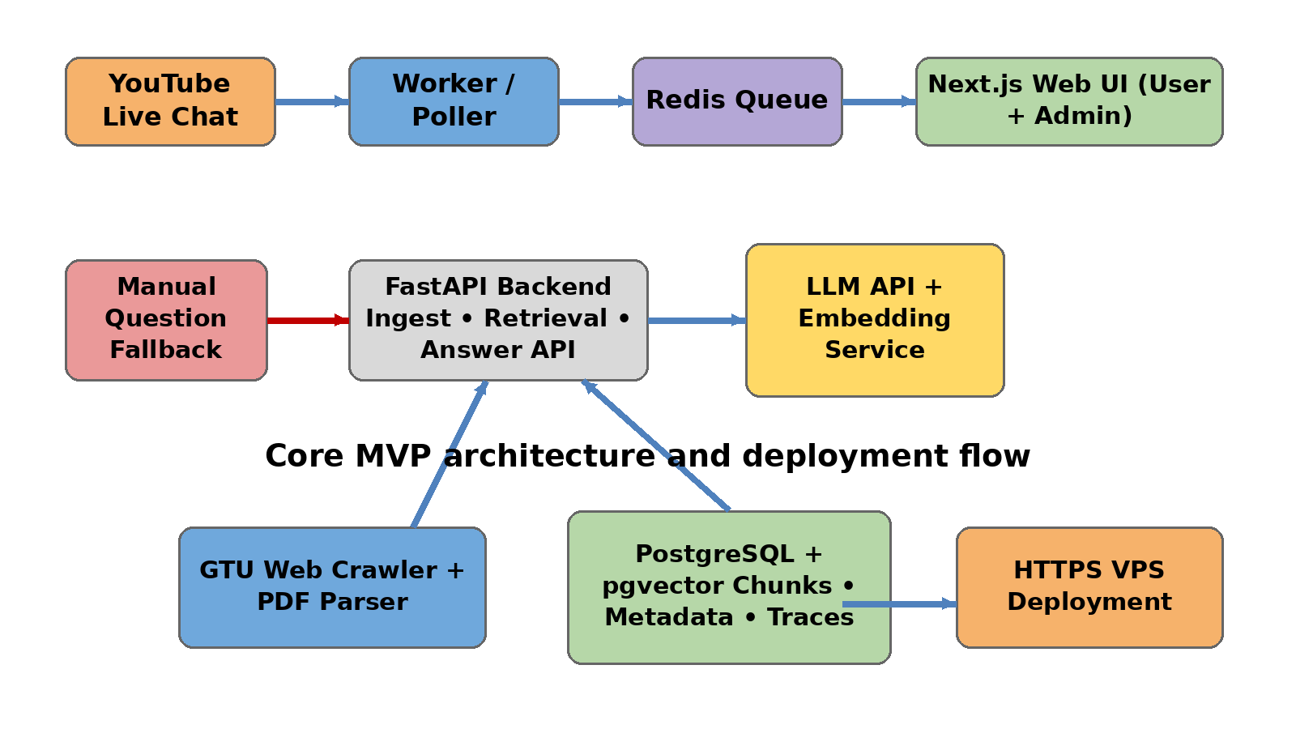


Project Design
• Next.js frontend shows live Q&A and admin pages
• FastAPI provides ingest, retrieval and answer APIs
• A worker polls YouTube live chat and removes duplicates
• PostgreSQL + pgvector stores chunks and answer traces
• Redis supports queueing/cache and improves reliability
• The system is deployed on a VPS with Docker Compose and HTTPS

Slide 5
Project Requirements
• Software: FastAPI, Next.js, PostgreSQL + pgvector, Redis, Docker Compose, LLM API, embedding service
• Hardware / Infrastructure: Linux VPS for deployment
• Data: GTU official web pages, GTU PDF documents, evaluation question set, crawl seed URLs and metadata
• Other resources: YouTube live stream access, admin credentials, logging/monitoring tools, documentation tools

Slide 6
Success Criteria
1. GTU official web pages and PDF documents shall be ingested and indexed into a searchable chunk store.
2. In a live session, a new YouTube question shall appear in the queue within 5 seconds, and duplicate messages shall not be processed twice.
3. On a 50-question GTU evaluation set, a relevant source shall appear in the top-5 retrieval results for at least 80% of the questions.
4. End-to-end answer latency on the VPS shall be P50 ≤ 8 seconds and P95 ≤ 15 seconds under demo load.
5. For low-confidence or off-topic questions, the system shall return a clear limitation message instead of fabricating an answer.
6. The final product shall be reachable through YouTube Live Chat, not from an IDE.

Slide 7
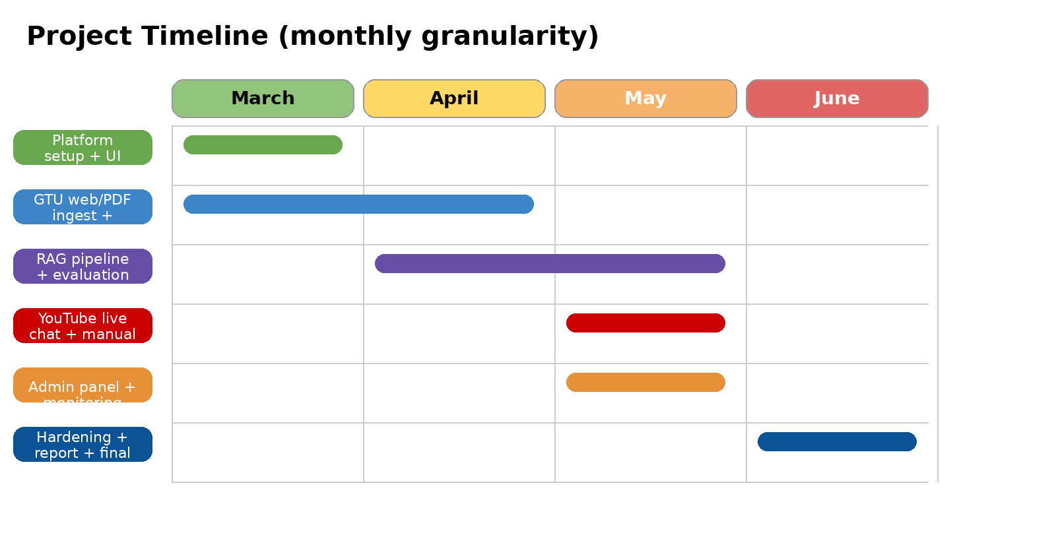
Project Timeline
Admin panel

Slide 8
References
1. Lewis, P. et al., “Retrieval-Augmented Generation for Knowledge-Intensive NLP Tasks,” NeurIPS 2020.
2. Karpukhin, V. et al., “Dense Passage Retrieval for Open-Domain Question Answering,” EMNLP 2020.
3. FastAPI Documentation, official website, 2026.
4. Next.js Documentation, official website, 2026.
5. pgvector Documentation, official website, 2026.
6. YouTube Data API, Live Chat Messages Documentation, Google Developers, 2026.

