Slide 1
AI/RAG-Based Live GTU Q&A System
CSE 496
Second Presentation
Ömer Fehmi Çakıcı
Advisor: Mehmet Göktürk
April 2026

Slide 2
Contents
Progress since the first meeting
Current backend and RAG implementation
Broadcast UI, avatar, TTS and lip-sync work
Next steps
References

Slide 3
Progress Since the First Meeting
Backend RAG pipeline was implemented: ingest, archive, chunking, embeddings, retrieval and answer traces.
Admin panel was extended for GTU source management, YouTube stream connection and runtime TTS control.
Live broadcast screen was designed around a presenter avatar, active question and current answer.
3D avatar loading, camera framing, mouth animation and TTS synchronization were prototyped.
Worker/service flow developed so queued questions are processed continuously.

Slide 4
Current System Architecture

Slide 5
Backend and RAG Implementation
GTU web/PDF ingest supports seed URLs, PDF URLs, sitemap discovery and cached source archives.
Documents are converted into chunks and indexed with embeddings for semantic retrieval.
Retrieval combines vector similarity with keyword/string relevance and document quality penalties.
Answer generation uses a GTU-specific system prompt and keeps source traces internally.
Fallback behavior is implemented for missing API keys or weak context instead of fabricating details.

Slide 6
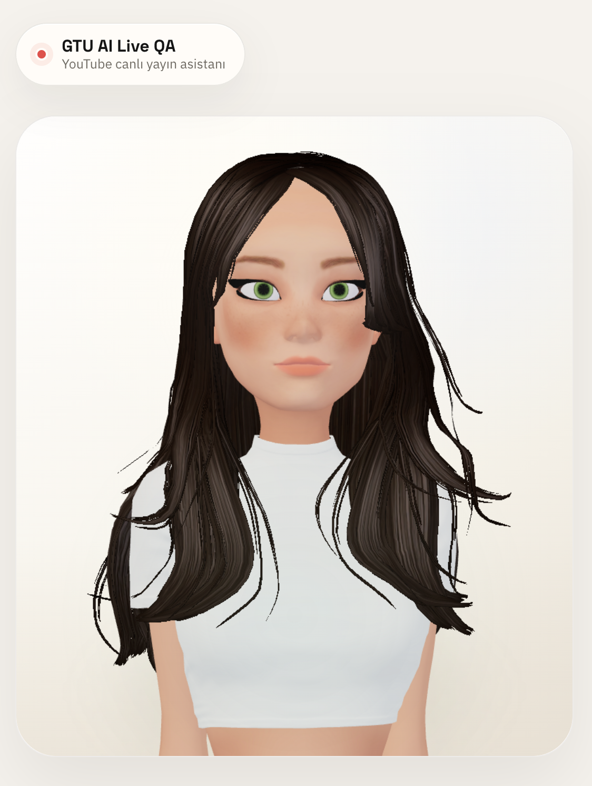
Live Broadcast UI, Avatar and TTS
The live page was designed as a 16:9 broadcast scene: avatar presenter on the left, question and answer on the right.
A rigged 3D avatar is loaded in the browser and framed as a presenter portrait.
TTS generation was integrated through OpenRouter using an OpenAI-compatible speech endpoint.
Avatar mouth movement now follows audio timing and volume meter data instead of a fixed short animation.
The answer remains visible until speech ends, waits briefly, then moves to the next question.
Admin panel can enable/disable TTS for new answers.

Slide 7
Next Steps
Improve retrieval ranking with broader official GTU source coverage and better page filtering.
Optimize latency by caching common answers, tuning model choice and separating TTS timing from answer generation.
Complete YouTube live end-to-end demo with real chat messages and duplicate protection.
Polish avatar delivery: more natural idle motion, stable hair/material settings and better lip-sync calibration.
Finalize documentation, deployment steps and final presentation demo flow.

Slide 8
REFERENCES USED IN CONTINUED WORK
1. Lewis et al., Retrieval-Augmented Generation, NeurIPS 2020.
2. Karpukhin et al., Dense Passage Retrieval, EMNLP 2020.
3. FastAPI, Next.js, pgvector and YouTube Data API documentation.
4. OpenRouter / OpenAI-compatible API documentation.
5. GTU official web pages and PDF documents used as system data.

Slide 9
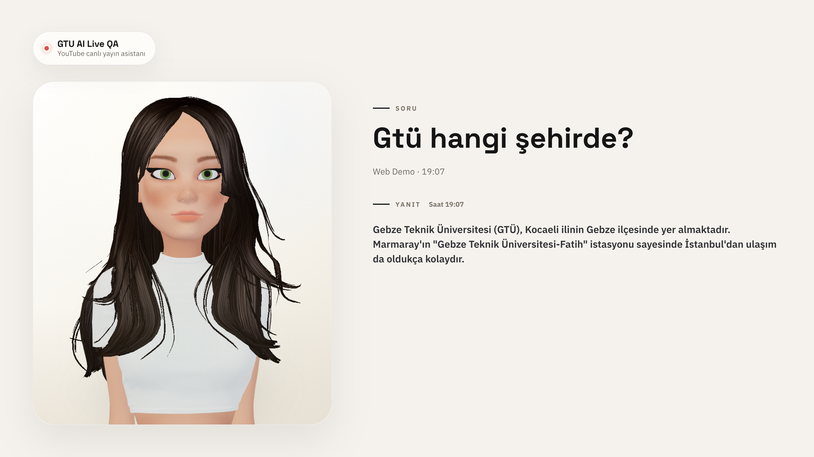
Live Screen

Slide 10
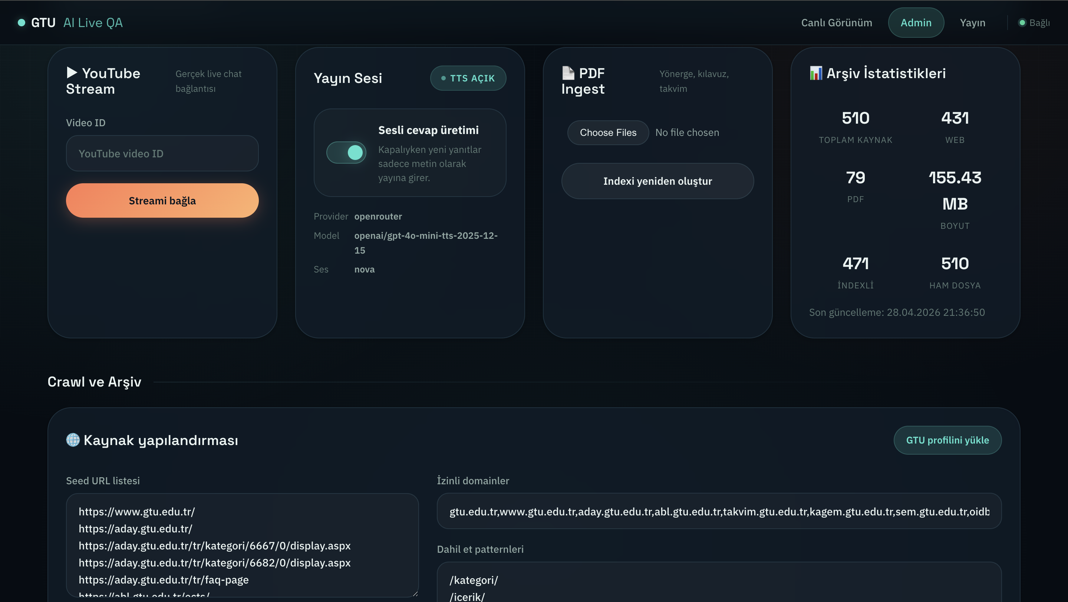
Admin Panel

