Slide 1
Canada and Immigration

Slide 2
Main
Canada is among the world's most generous nations for immigrants and has one of the highest per capita admission rates. It has, on average, offered residency to about 200,000 immigrants and refugees a year over the past decade, earning a global reputation for an "open arms" attitude. The problem am trying to solve is how to send those people to right states in Canada and how to builds malls and market places in Canada in places that have low population rates in order to avoid overcrowding certain states with all the people while leaving some empty. In this project I will study the best hot spots in Canada for new small businesses such as : restaurants , coffee shops and supermarkets. In away that fights overcrowdedness and maximize profits.

Slide 3
Data and Cleaning
I scraped the data from wiki and then did data cleanig and data manipulation
this is the url : ' https://en.wikipedia.org/wiki/List_of_postal_codes_of_Canada:_M
I used pandas data frames to make it easy for me to remove rows and columns for example : I removed the Canada row because it was redundant and there was no use for it

Slide 4
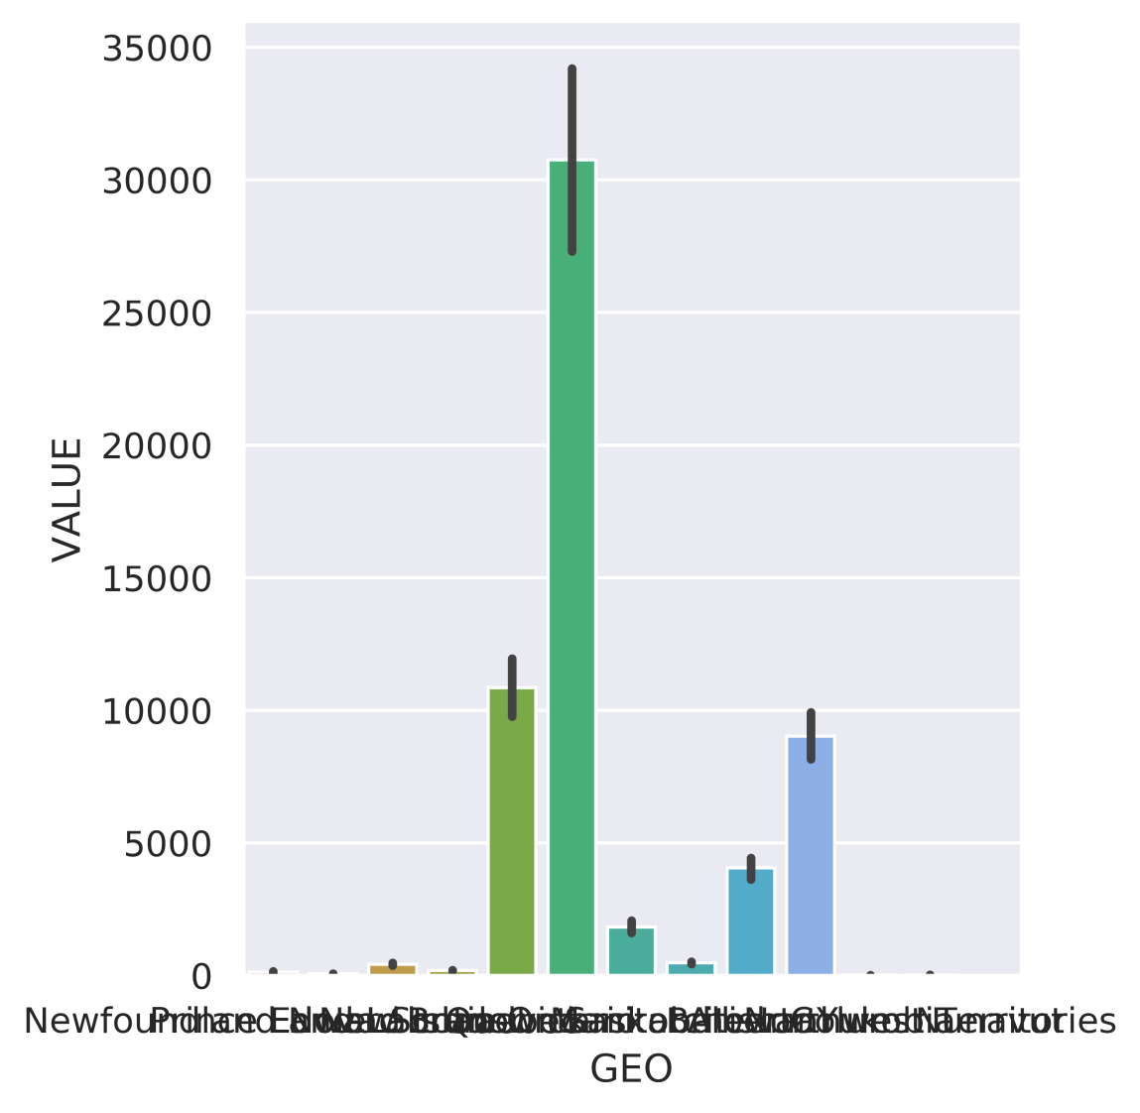
The distribution is not equal .a clearer graph is provided in the next slide

Slide 5
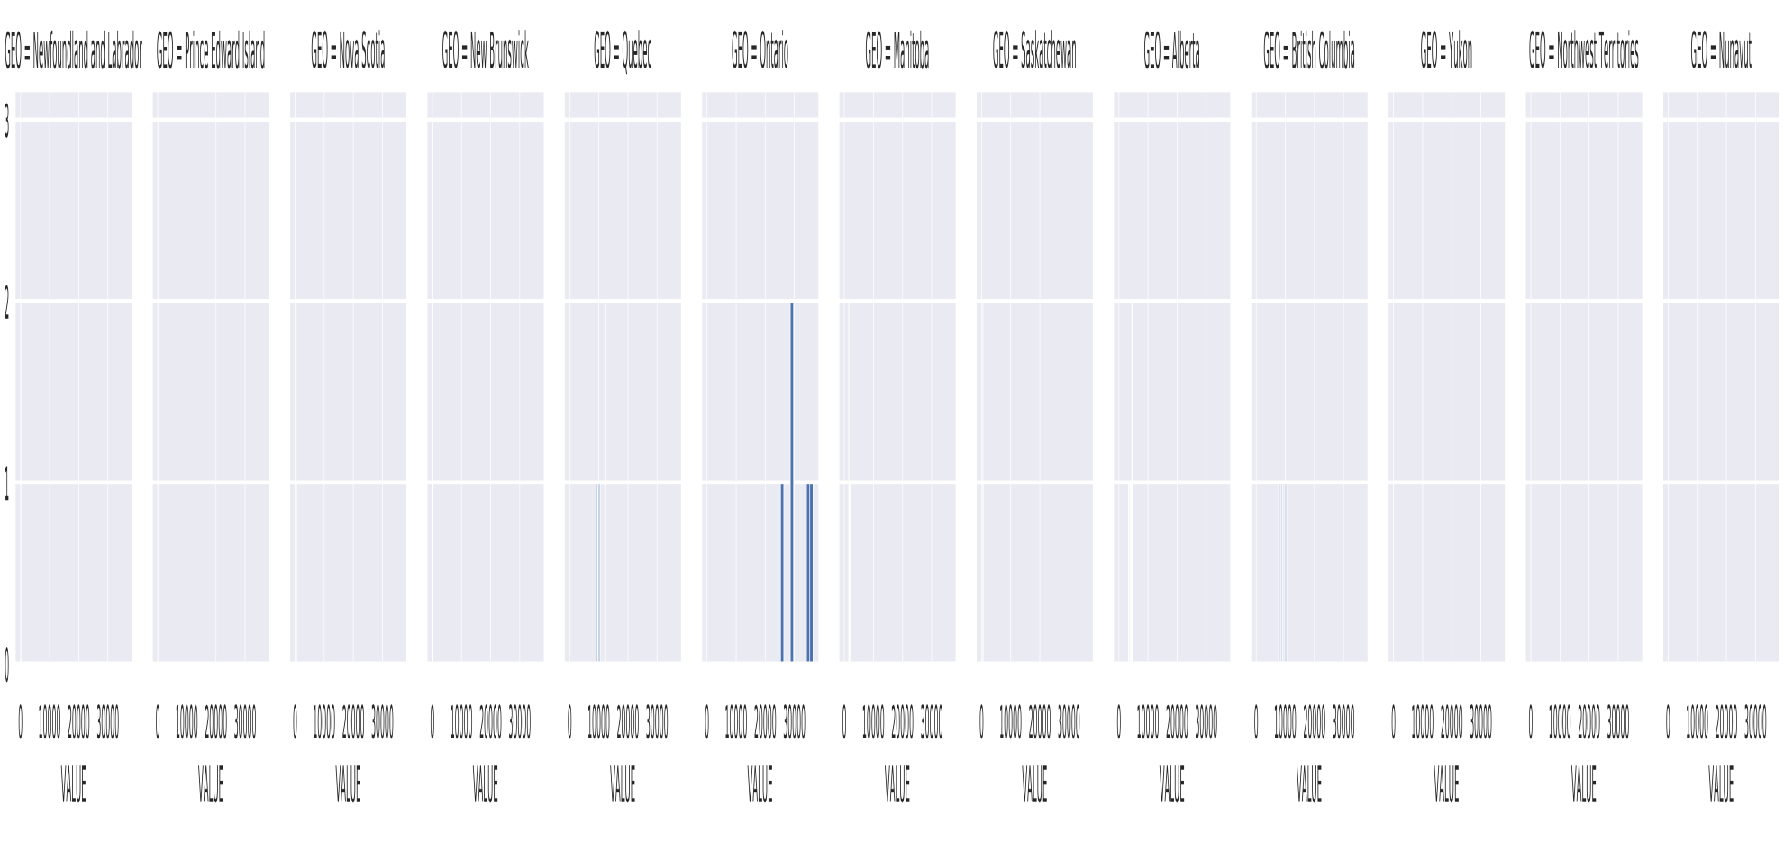

Slide 6
Conclusion
From the graphs above there is clearly an unequal distribution of the immigrants between the different provinces of Canada and that
is not an issue right now due to the small person per km squared ratio in Canada , but as the number of immigrants increases, It is
recommended to have a more linear distribution between different provinces in Canada to ensure low congestion rates , low crowdedness complaints and the healthy environment Canada is famous for.

