Slide 1
Link prediction with Node2Vec
Group No:1
Ömer Işıldak 21809831 – Abdullah Atahan Türk 21827943

Slide 2
Evaluating Node Embeddings of Complex Networks
It is our paper that we use in this project. You can find it in here

Slide 3
Index
Introduction Part
What problem is the paper trying to solve?
Why is the problem interesting?
Explaining Node Embedding
Explaining Node2Vec
Application Part
A Brief Summary of Steps of Code
The Result
Comparing the Results
Take Aways
References
Q&A Session

Slide 4

Code And Papers
https://github.com/omerisildak/bbm462-Link-Prediction

Slide 5
What problem is the paper trying to solve?
extract useful structural information from graphs
In the case of link prediction, a good embedding should have the property that most of the network’s edges can be predicted from the coordinates of the nodes

Slide 6

Why is the problem interesting?
It is about predicting the possible future link It feels like digital fortune-telling.
In this application, we have used the citations dataset, but you can apply it to other fields. In the beginning, we tried to apply a co-purchase system but we didn’t accomplish it because of some technical challenges.

Slide 7

What is Link Prediction?
The objective of link prediction is to identify pairs of nodes that will either form a link or not in the future.

Slide 8

Summary of Node Embedding

Slide 9
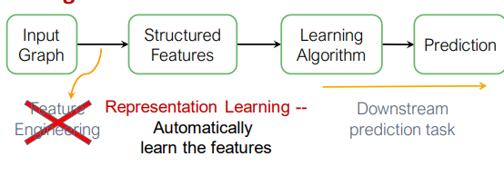
Why does node embedding matter?
We can get the more effective model and with using feature vectors we can predict possible link

Slide 10
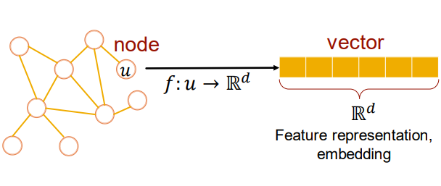
What is Node Embedding?
Node embeddings are a way of representing nodes as vectors.
To be clear by “Embedding” I mean mapping each node in a network into a low-dimensional space, which will give us insight into nodes’ similarity and network structure.

Slide 11
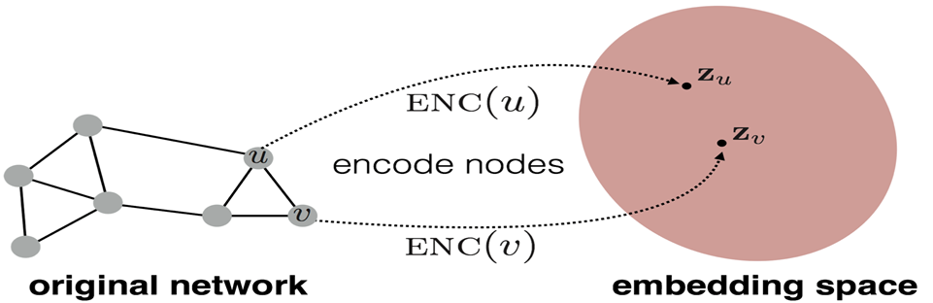
4 Stage of Node Embedding
Define an encoder
Define a node similarity function
Define Decoder
Optimize the parameters of the encoder

Slide 12

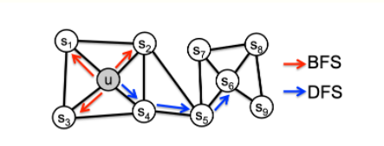
Encoding Types
“Shallow” Encoding
Random Walk
Biased Random Walk (Node2Vec)

Slide 13
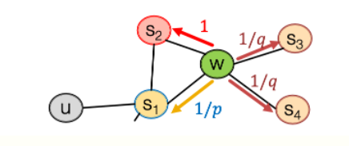

Node2Vec Algorithm and Biased Random Walk
Compute random walk probabilities
Simulate r Random Walks of length starting from each node u
Optimize the node2vec objective using “Stochastic Gradient Descent”

Slide 14
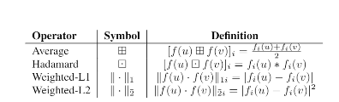
Binary Operators for Learning edge Features
We also show how feature representations of individual nodes
can be extended to pairs of nodes (i.e., edges). In order to generate
feature representations of edges, we compose the learned feature
representations of the individual nodes using simple binary operators.
This compositionality lends node2vec to prediction tasks
involving nodes as well as edges

Slide 15
A Brief Summary of Steps of Code
The Cora dataset consists of 2708 scientific publications classified into one of seven classes. " "The citation network consists of 5429 links. Each publication in the dataset is described by a 0/1-valued word vector "
Split dataset and run node2vec algorithm
Plot with PCA(Principal Component Analysis) algorithm
PCA helps us to plot vectors in 2 d
Evaluate and compare train and test sets
F1 scores, MCC, Confusion Matrix

Slide 16
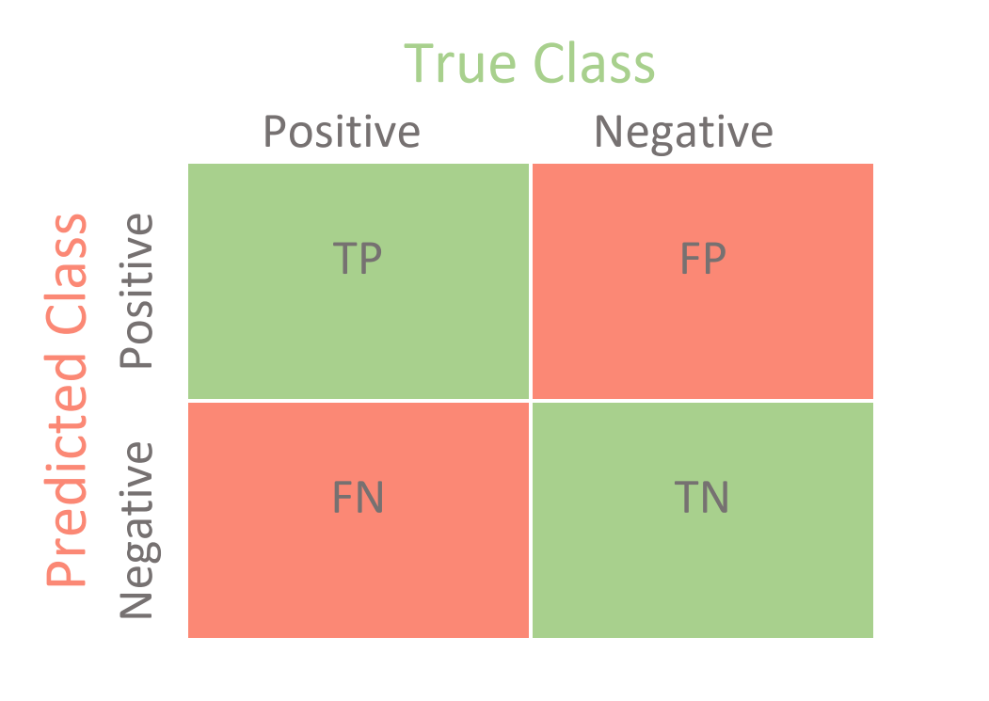
Confusion Matrix

Slide 17
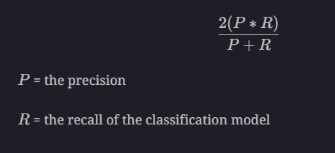
F1 Score
The F1-score combines the precision and recall of a classifier into a single metric by taking their harmonic mean.

Slide 18
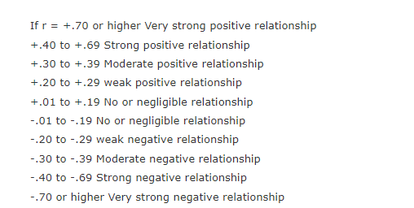
Matthews correlation coefficient (MCC)
The Matthews correlation coefficient (MCC), instead, is a more reliable statistical rate that produces a high score only if the prediction obtained good results in all of the four confusion matrix categories (true positives, false negatives, true negatives, and false positives), proportionally both to the size of positive elements and the size of negative elements in the dataset.
r is correlation coefficient

Slide 19
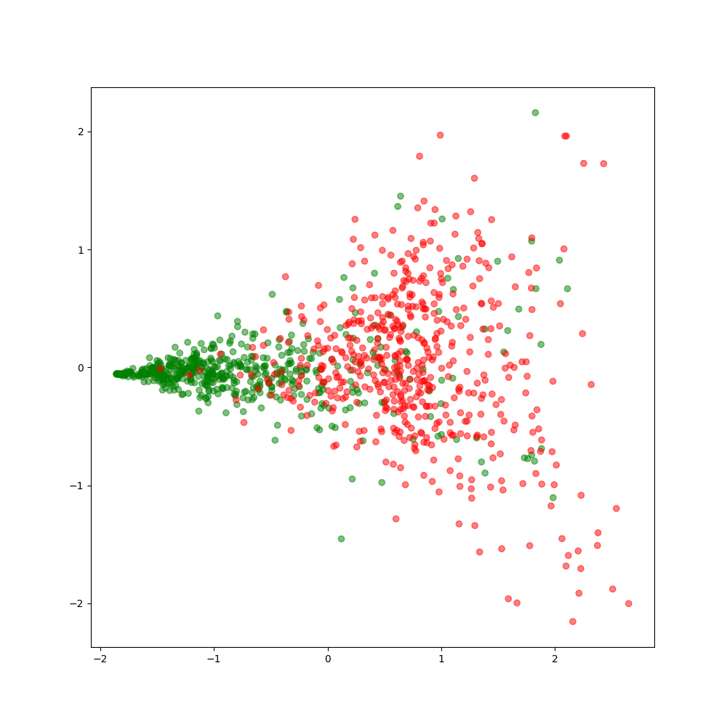
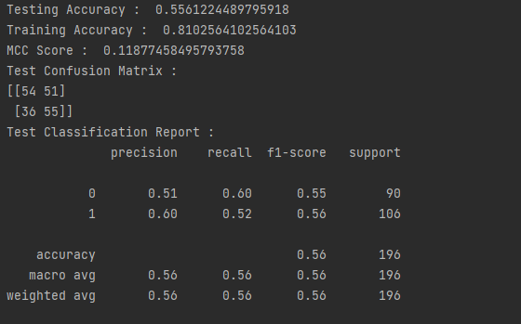
Result
Our parameters are:
q=2.0(discover) , p=2.0(return back the previous node), dimension=16 , number of walk=10
Other parameters will be constant.
Green means it is true and red one is the edge shouldn’t exit

Slide 20
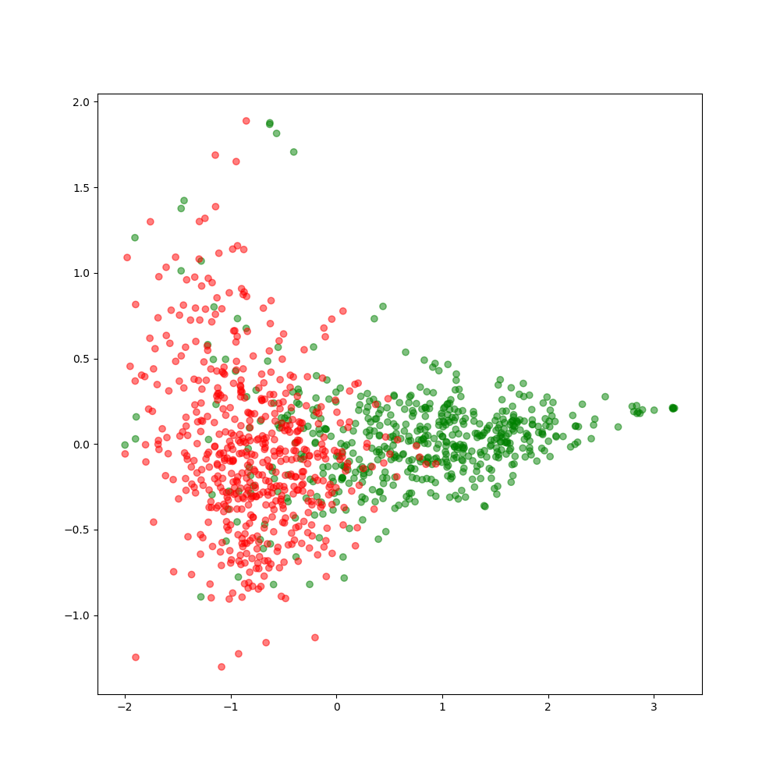
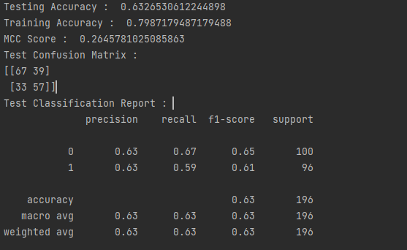
Same parameters but dimension is 128

Slide 21
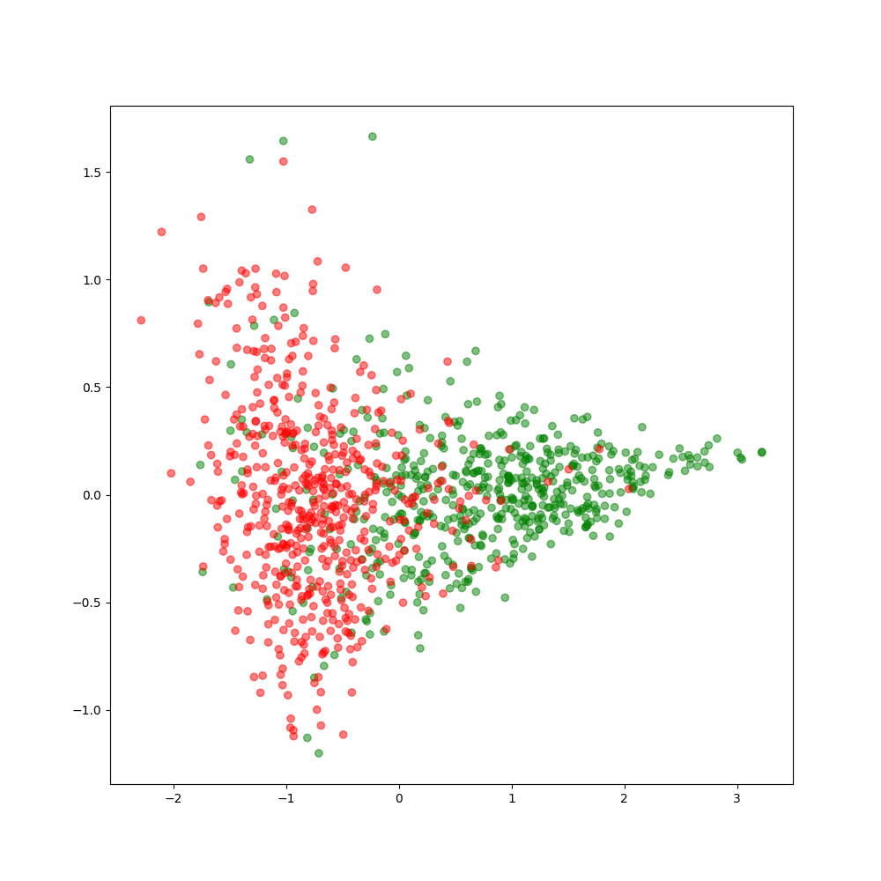
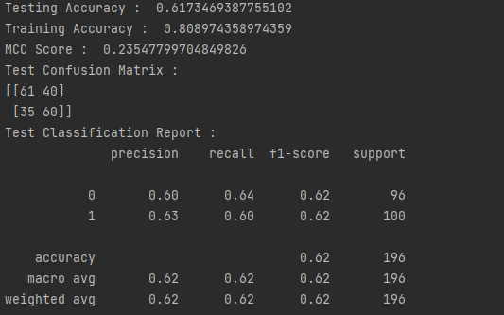
Same parameters but dimension is 256

Slide 22
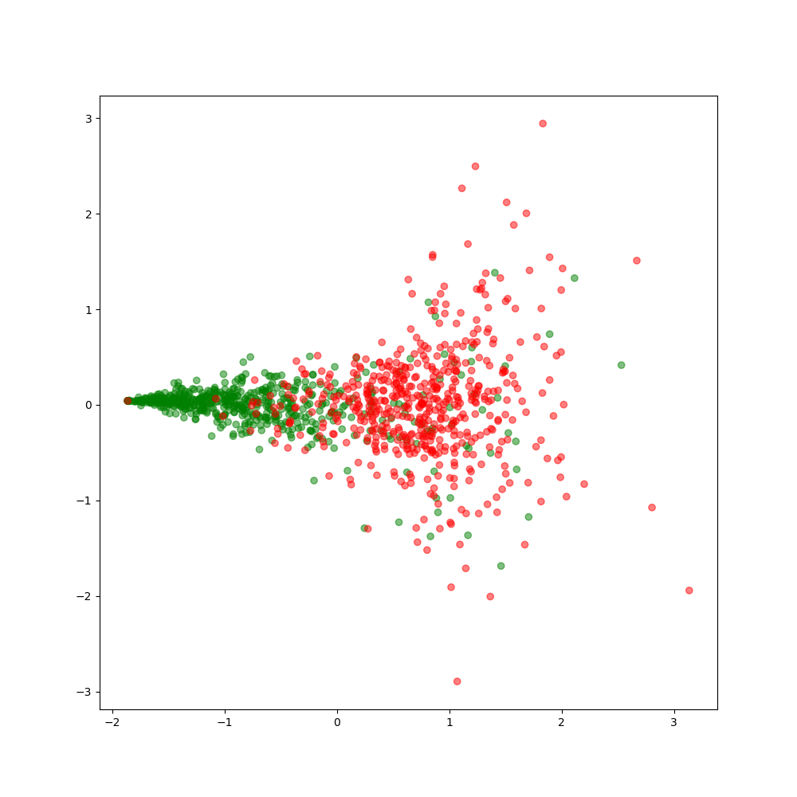
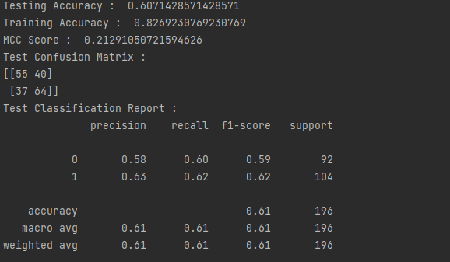
Our parameters are: q=3.0 , p=2.0, dimension=16

Slide 23
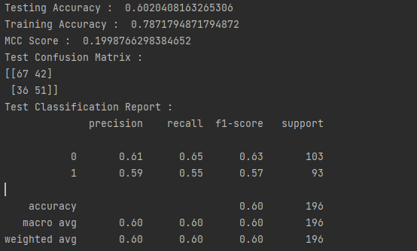
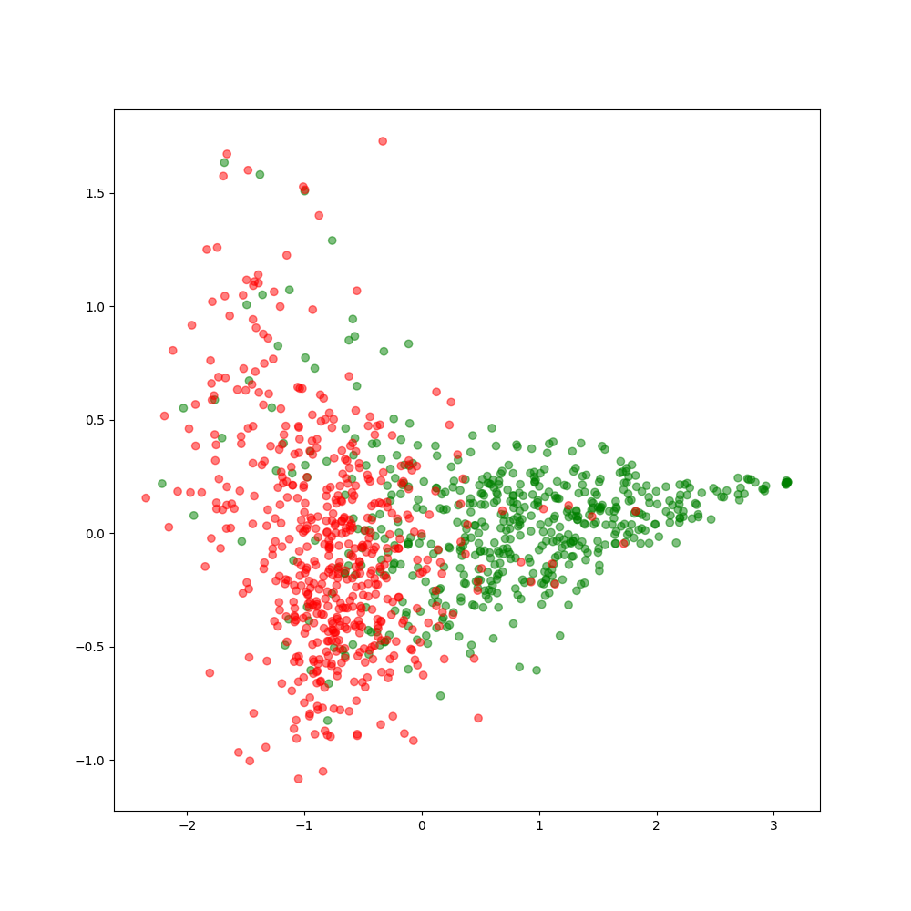
Our parameters are: q=2.0 , p=3.0, dimension=16

Slide 24
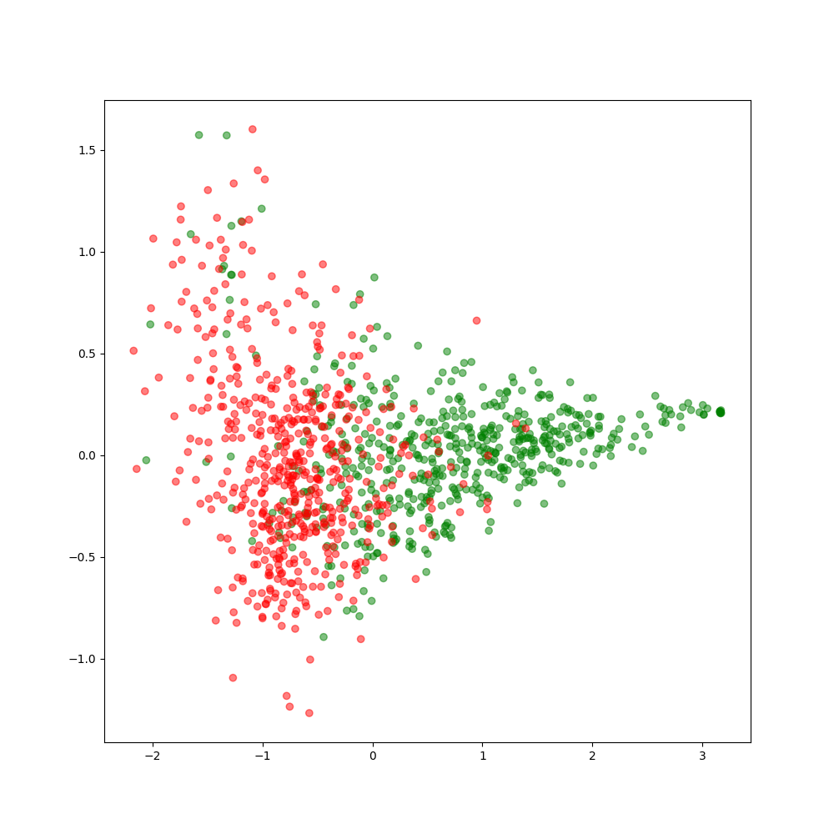
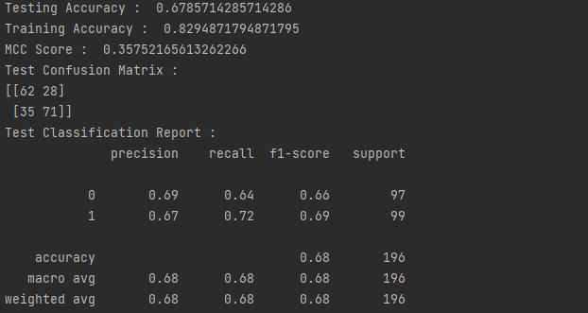
Our parameters are: q=2.0 , p=2.0, dimension=512

Slide 25
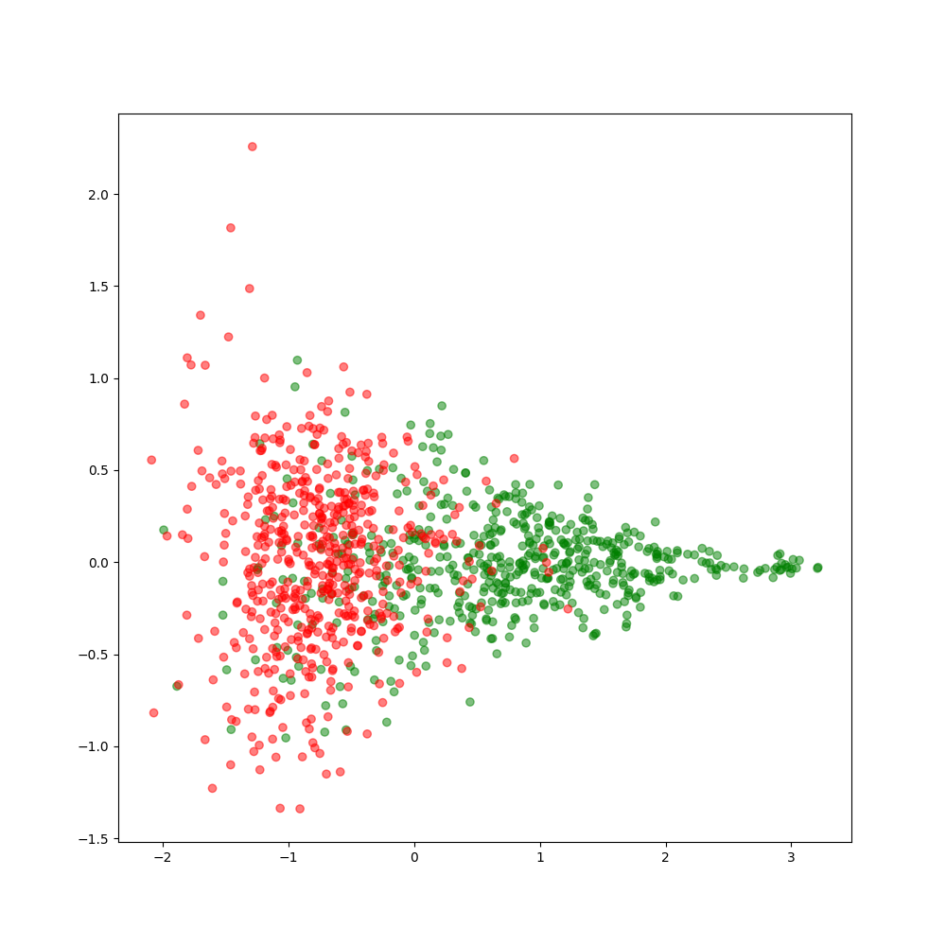
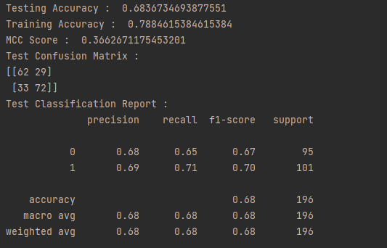
Our parameters are: q=1.0 , p=1.0, dimension=16

Slide 26
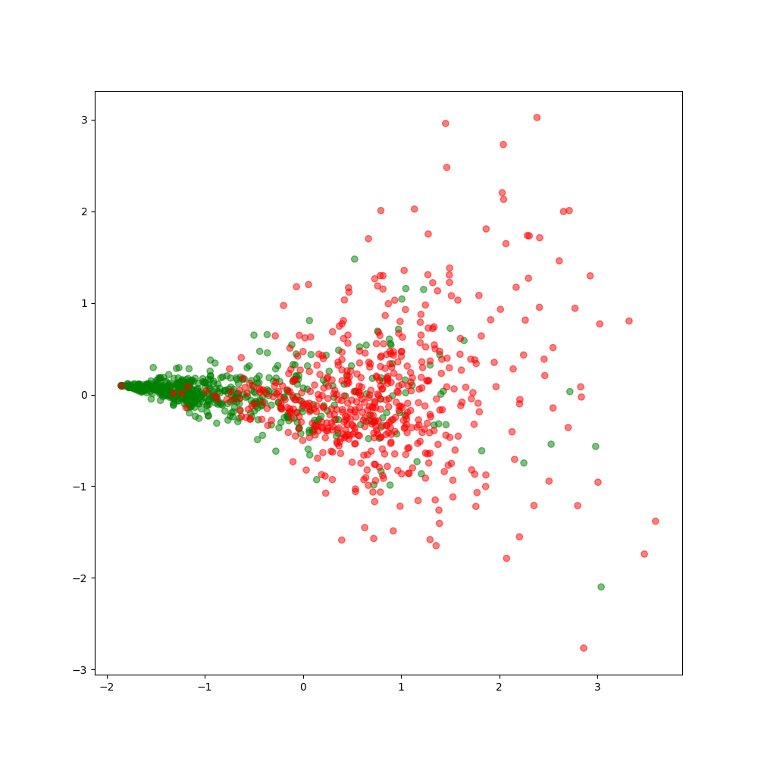
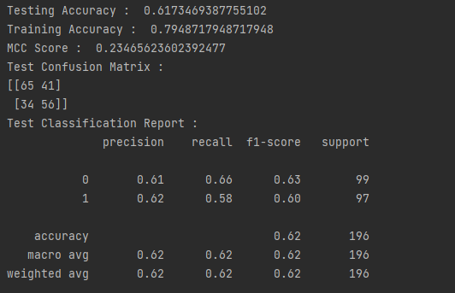
Our parameters are: q=1.0 , p=1.0, dimension=16, number of walk 100

Slide 27
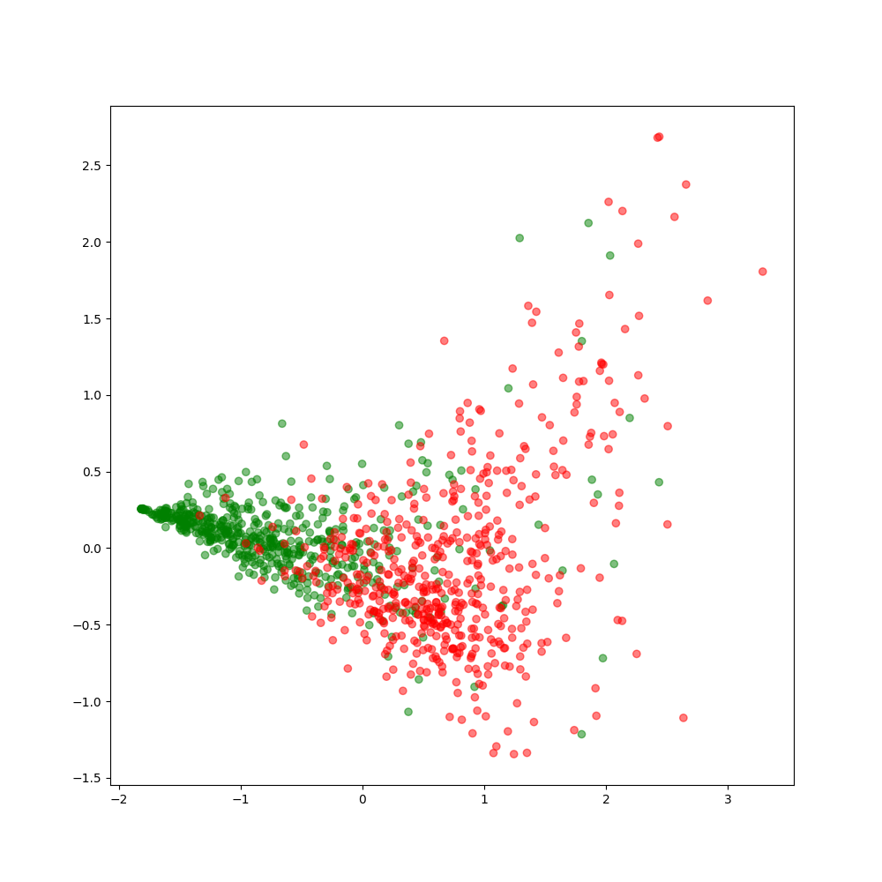
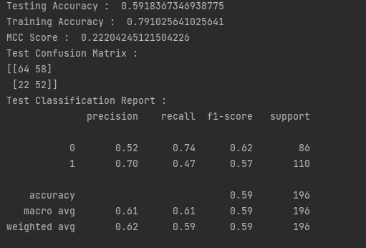
Our parameters are: q=1.0 , p=1.0, dimension=200

Slide 28

What are the key take-aways

Slide 29
References
https://doi.org/10.48550/arXiv.1607.00653
https://doi.org/10.48550/arXiv.2102.08275
https://doi.org/10.1186/s12864-019-6413-7
https://stellargraph.readthedocs.io/en/stable/demos/link-prediction/node2vec-link-prediction.html
Snap Lecture Notes
Our Lecture notes
https://www.educative.io/edpresso/what-is-the-f1-score
https://towardsdatascience.com/confusion-matrix-for-your-multi-class-machine-learning-model-ff9aa3bf7826
http://faculty.quinnipiac.edu/libarts/polsci/Statistics.html

Slide 30

Q&A Session

