Slide 1
CallForHelp Manual
November 2016

Slide 2
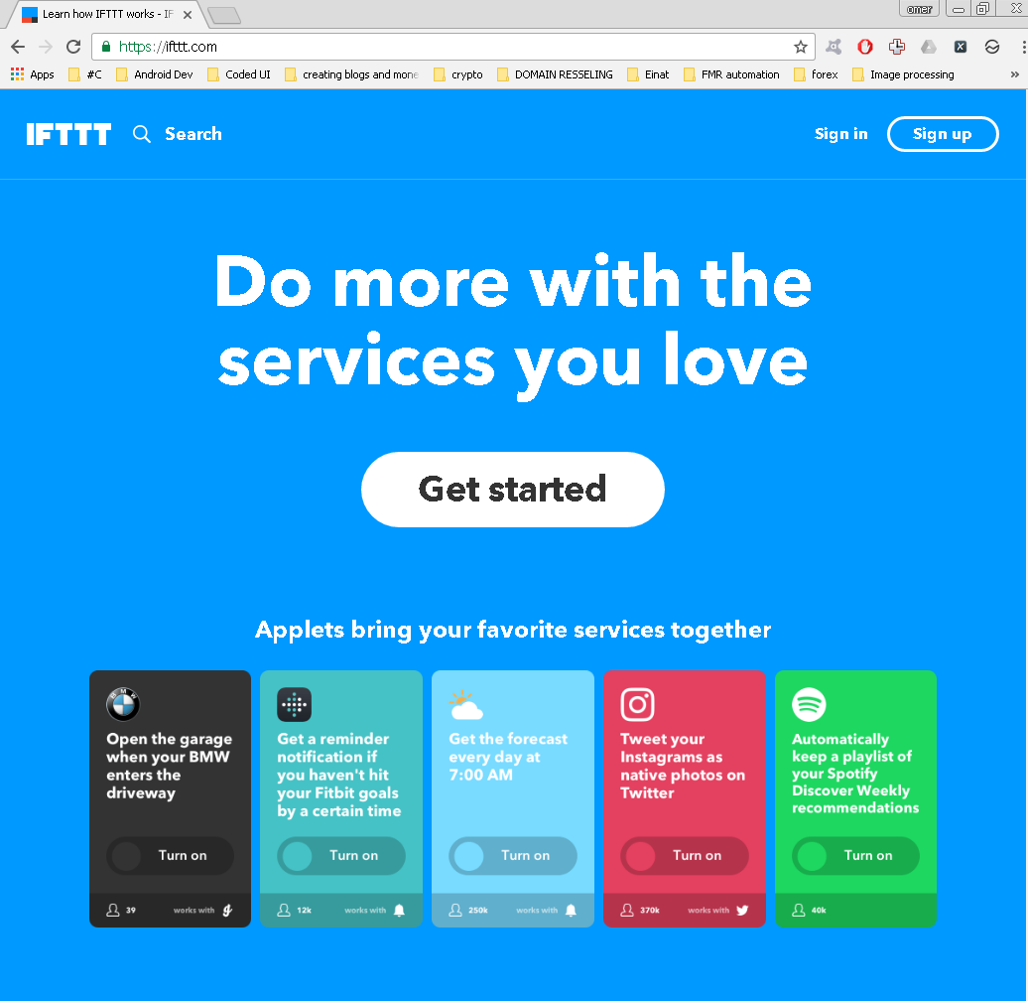
Create an IFTTT account
Go to https://ifttt.com/ and Sign up.

Slide 3
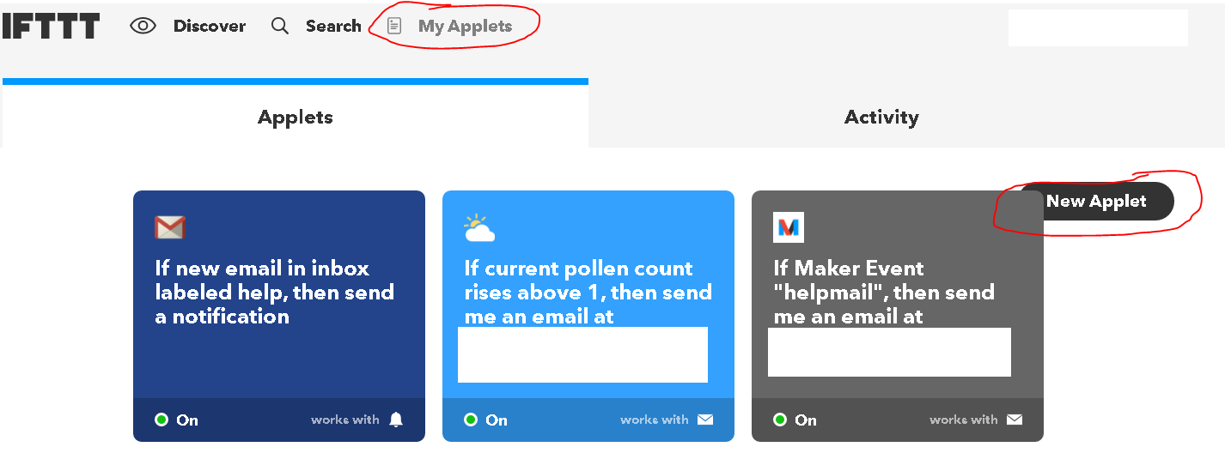
Create the SMS Applet
Click on My Applets
Click on New Applet

Slide 4
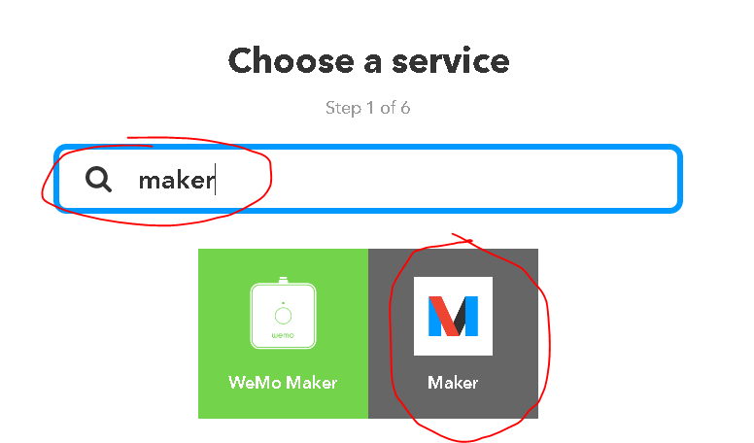
Create the SMS Applet
Search For “maker”

Slide 5
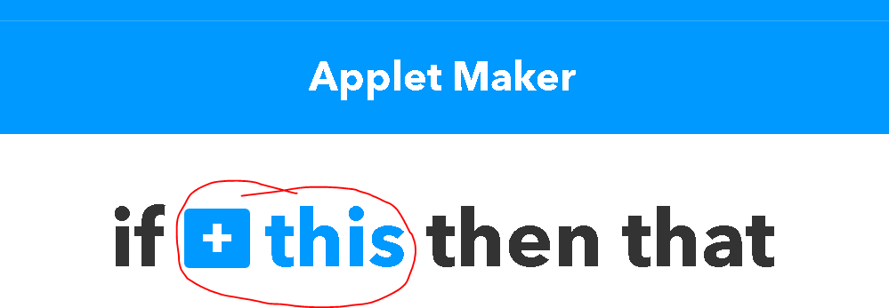
Create the SMS Applet
Click on “+This”

Slide 6
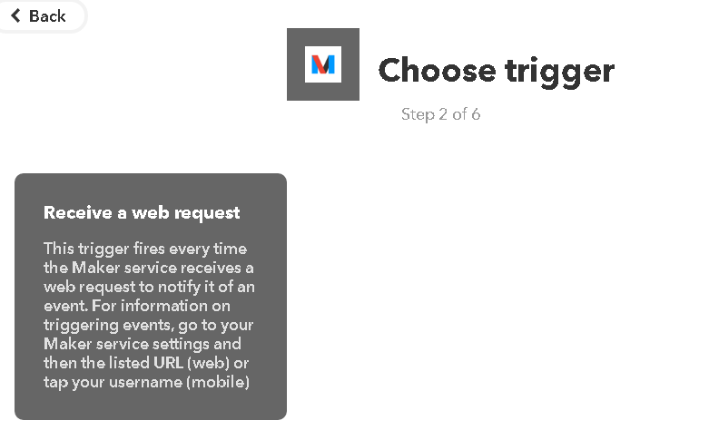
Create the SMS Applet
Select “Receive a web request”

Slide 7
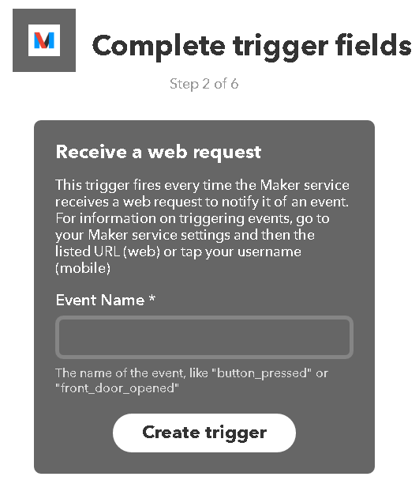
Create the SMS Applet
Put any event name but with logic.
E.g (HelpSendSms)

Slide 8
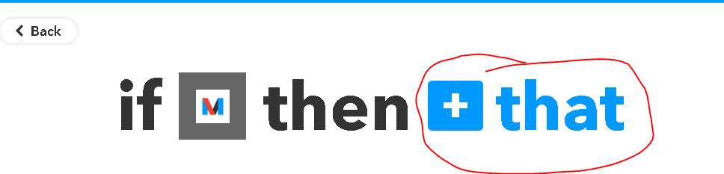
Create the SMS Applet
Click on “+that”

Slide 9
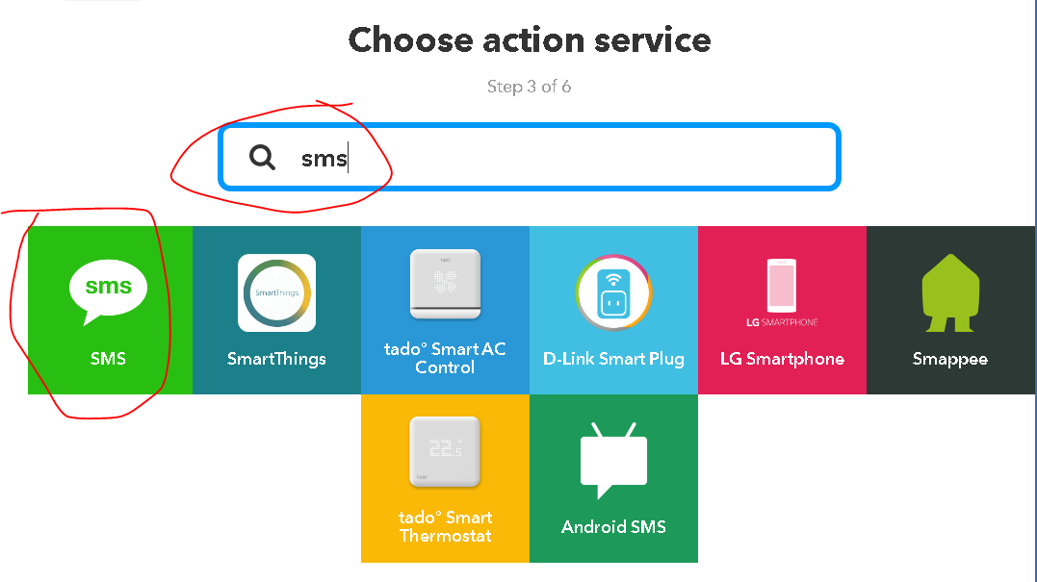
Create the SMS Applet
Search for SMS
Click on SMS

Slide 10
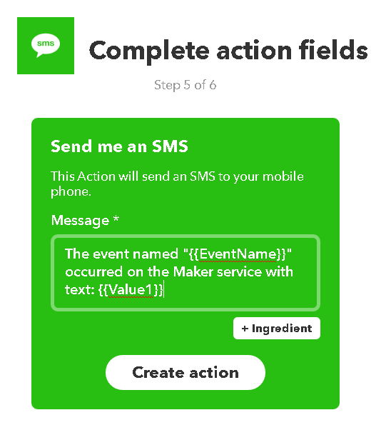
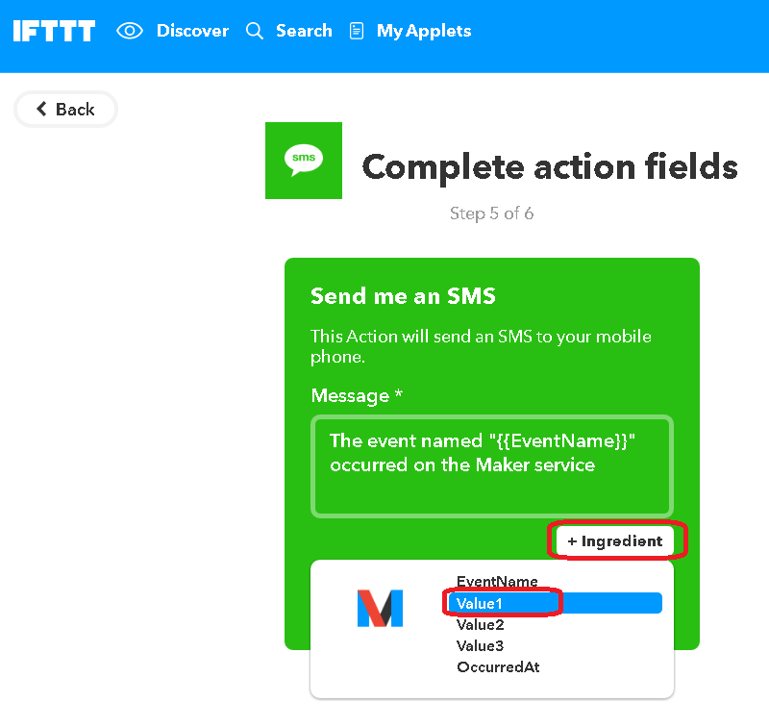
Create the SMS Applet
Update the message text to add “with text:”.
Click on “+ingredient” and select “Value1”

Slide 11
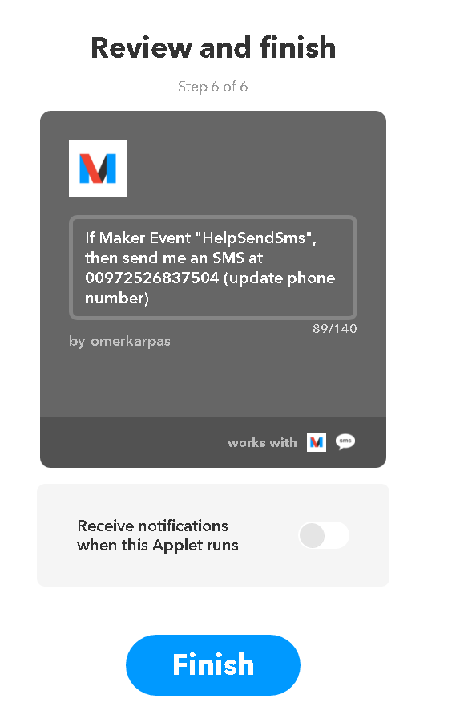
Create the SMS Applet
Click On Finish

Slide 12
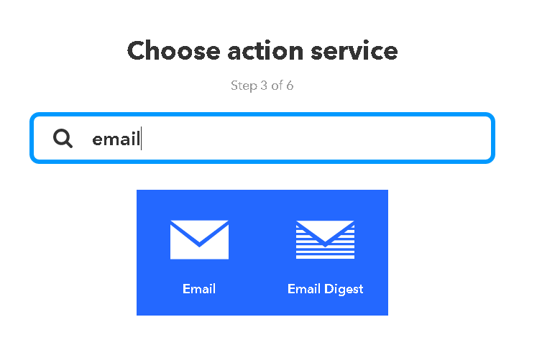
Create the Email Applet
Repeat the exact same process just in step 3 select Email.

Slide 13
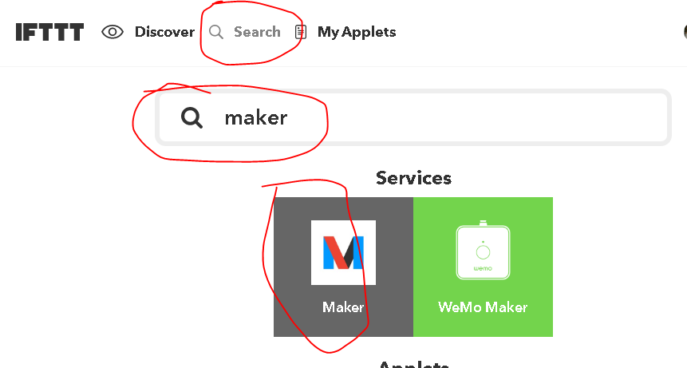
Getting the maker UID
Click on Search
Search for Maker
Select Maker

Slide 14
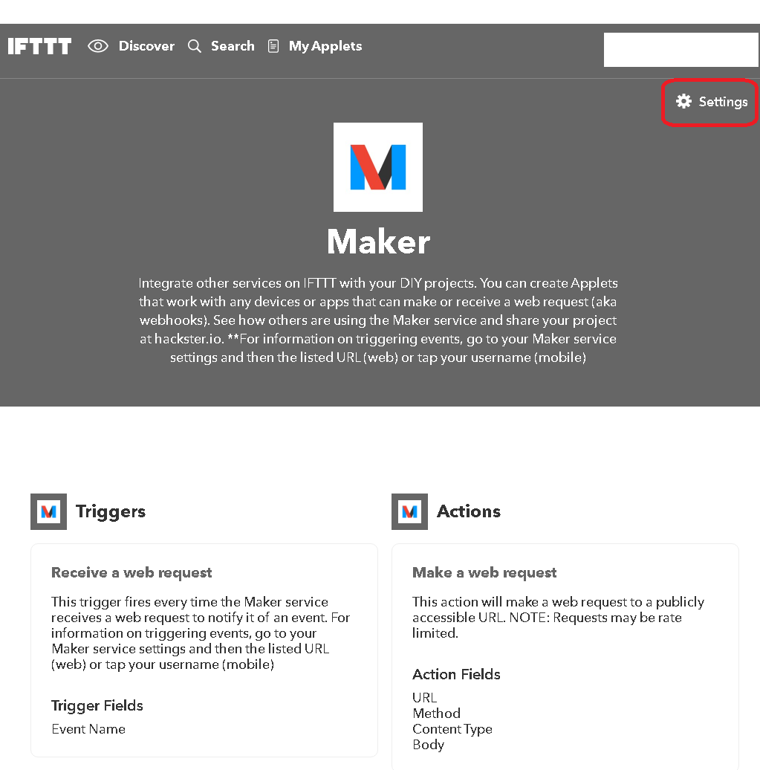
Getting the maker UID
Click on Settings

Slide 15
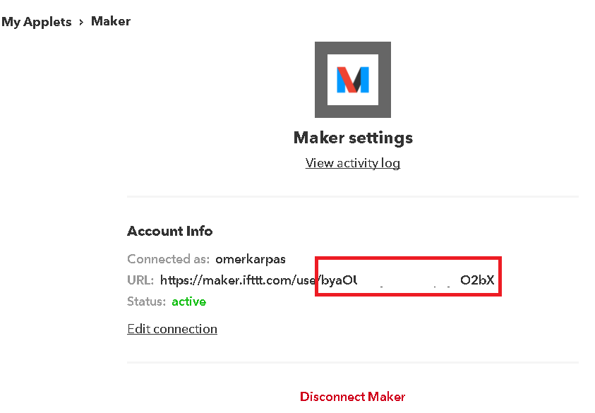
Getting the maker UID
The string at the end of the URL is your unique identification maker number.

Slide 16
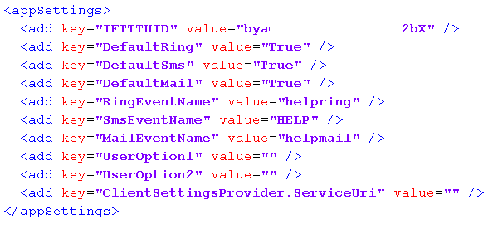
Config File
The application comes with a config file called: “CallForHelp.exe.config”

Slide 17
Config File
Change IFTTTUID value to your UID.
Change RingEventName, SmsEventName, MailEventName values to the names you entered for your Events. Important Event name is CASE sensitive.

Slide 18
Config File
You can add 2 more default user options at UserOption1 and UserOption2.
You can set the default send values from True to False by changing: DefaultRing, DefaultSms and DefaultMail values.

