Slide 1
T.C. MARMARA UNIVERSITY FACULTY of ENGINEERING COMPUTER ENGINEERING DEPARTMENT
CSE4095.1
Special Topics in Computer Engineering
“Twitter Sentiment Analysis”
Akif ÇETİN
Filiz DALIP
Ömer Yasin KOLKANAT

Slide 2
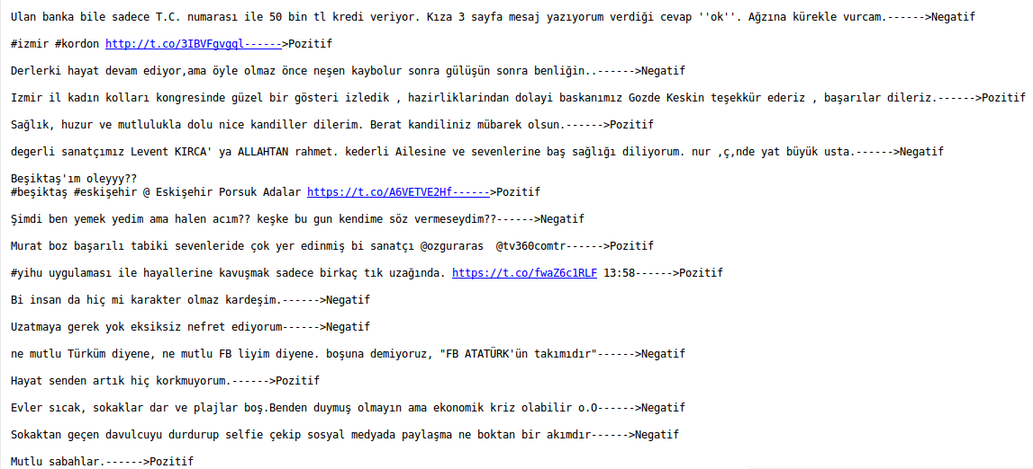
Tweets
Notes:
1076 tane tweet üzerinden işlem yaptık

Slide 3
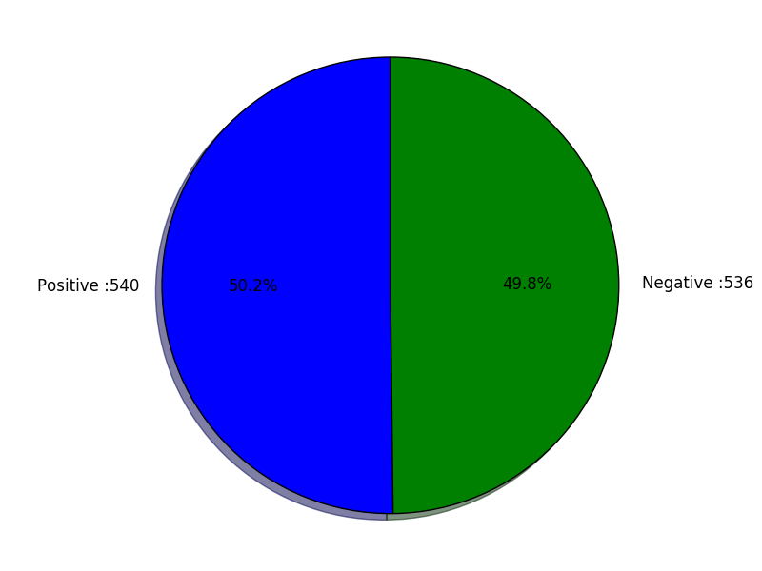
Positive and Negative Tweets

Slide 4
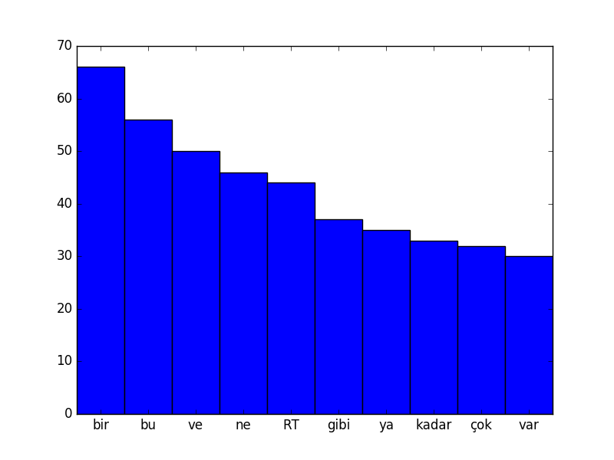
Dirty Negative Data

Slide 5
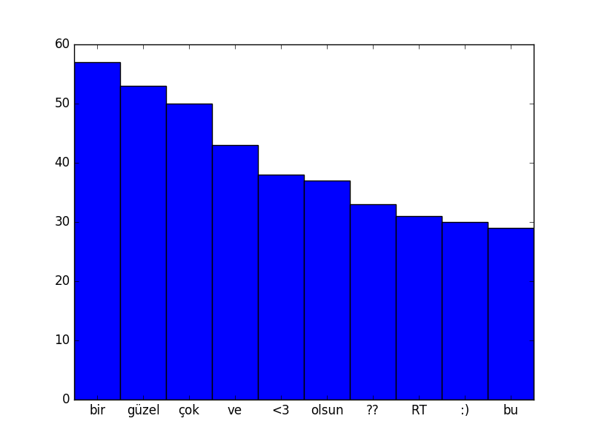
Dirty Positive Data

Slide 6
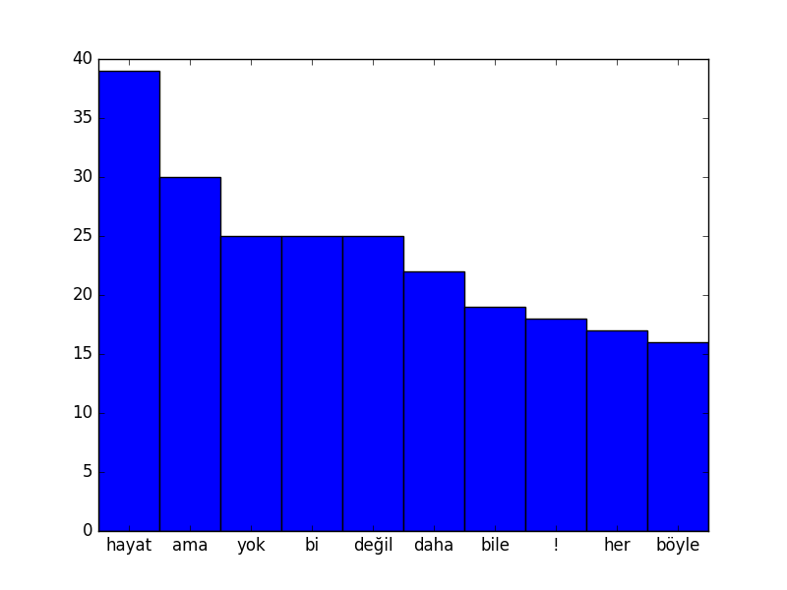
Clean Data for Negative Tweets

Slide 7
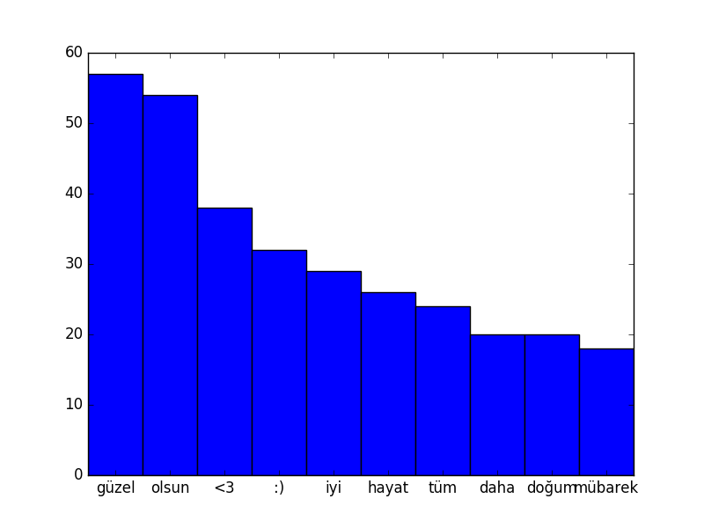
Clean Data for Positive Tweets

Slide 8
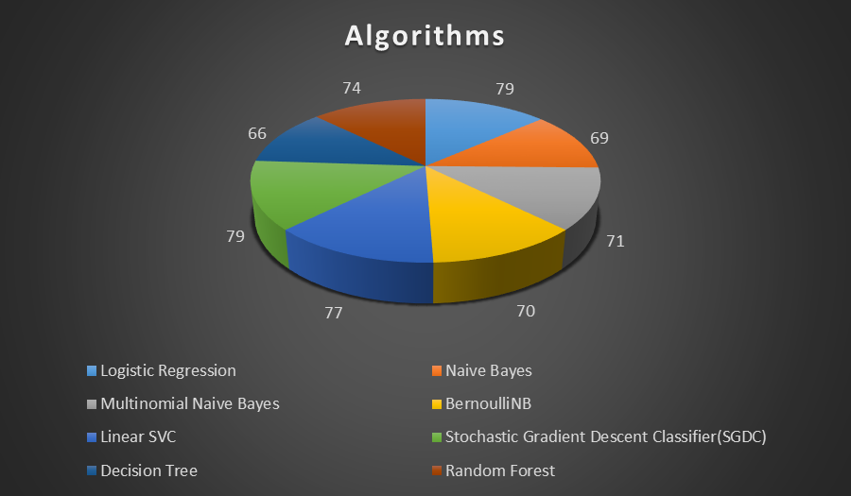
Algorithms

Slide 9
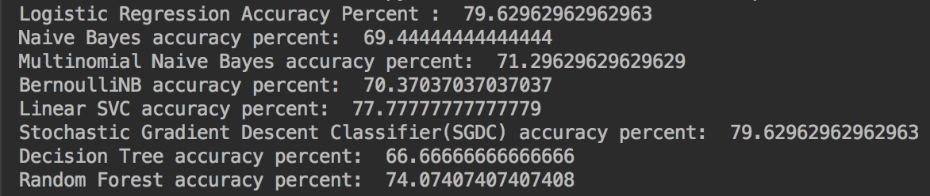

Slide 10
Thank you for listening…

