Slide 1

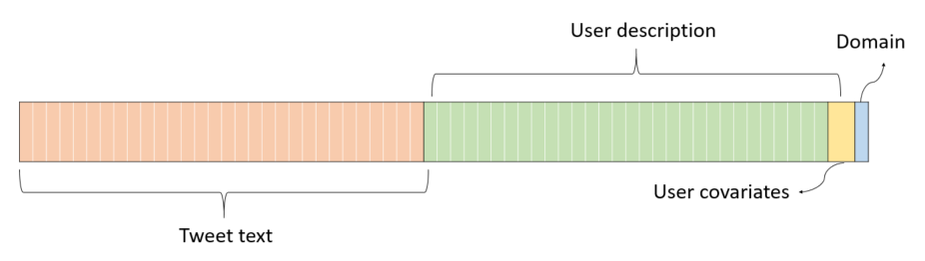
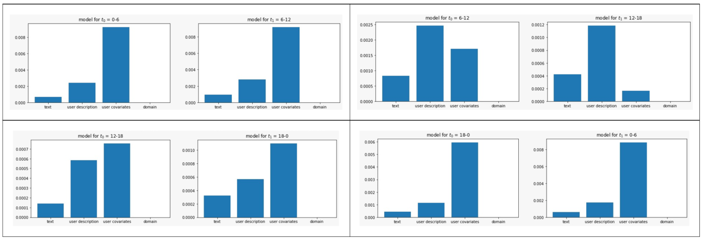
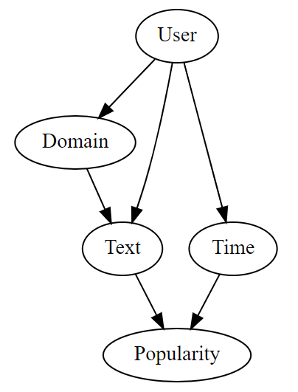


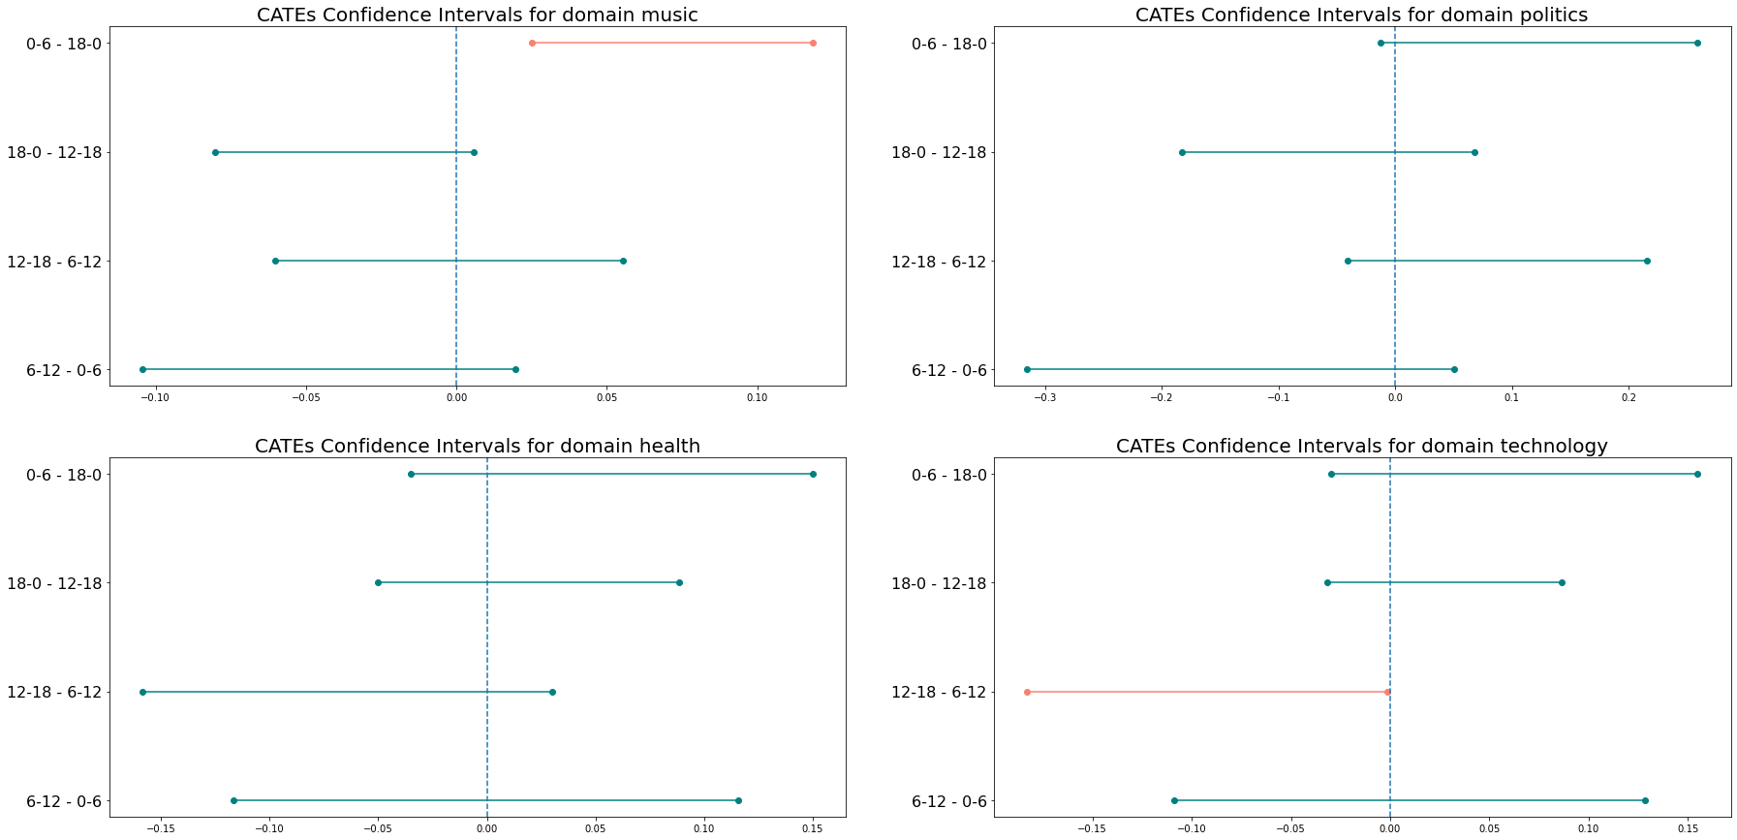
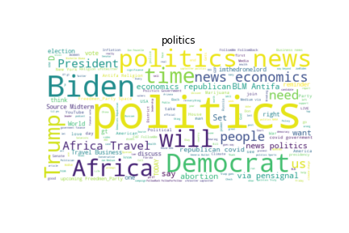

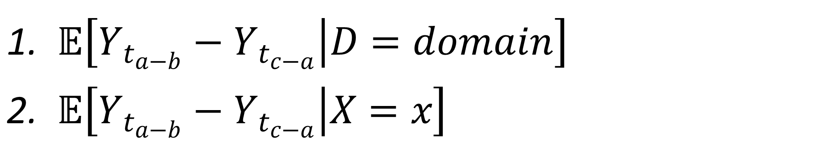
When should I tweet?
Estimating the causal effect of tweets’ publication hour on their popularity
Omer Madmon, Gal Sasson
Introduction
Data representation:
High dimensional CATE
Social networks became a major part of our day-to-day life, and besides their use for socializing social networks are also used for advertising purposes. As such, optimizing social networks engagement became a point of interest for many users, both individuals and business companies.
In this project we aim to identify the conditional average treatment effect (CATE) of tweets publication time on tweet popularity, in two levels of granularity:
Identification
SUTVA
Consistency
Ignorability
Overlap
Conclusions
Methods
There is no significant causal effect of the publication hour of a tweet on its relative popularity within each domain.
The groups related to the user (both the user covariates and the user description) are the most important in determining the causal effect.
S-Learner (linear regression model)
T-Learner (Lasso linear regression models)
X-Learner (Lasso linear regression models for both pseudo-CATE labels generation and predictions)
$𝔼\left[Y_{t_{a−b}}−Y_{t_{c−a}} | D=domain\right]$
$𝔼\left[Y_{t_{a−b}}−Y_{t_{c−a}} | X=x\right]$
The data
Results
Domain conditioned CATE
Discussion
Determining the hour interval length introduces an identification-estimation tradeoff.
More complex models might capture more accurately the relationships between the covariates, the treatments and the potential outcomes.
A causal effect might exist in more specific sub-domains.

