Slide 1
Lyrics-Based Semantic Networks
Ariel Nitzav, Omer Madmon
Notes:
Google Colab notebook: https://colab.research.google.com/drive/1d9ra1QAZOZx-ykpxDohTzpg4BX7SDYe3?usp=sharing

Slide 2
Agenda
Introduction
Method & Results
Raw Data
Network Estimation
Network Analysis & Statistical Testing
Themes Representation in Genres
Discussion

Slide 3
Introduction
Topic of the project: Characterizing the lyrical structure of music genres
Aim of the project: Examining the lyrical traits (structure, themes) of three popular music genres: Pop, Hip-Hop and Rock using networks science
Questions asked:
Which genres are more structured, which are more flexible?
Which lyrical themes are more associated with each genre?

Slide 4
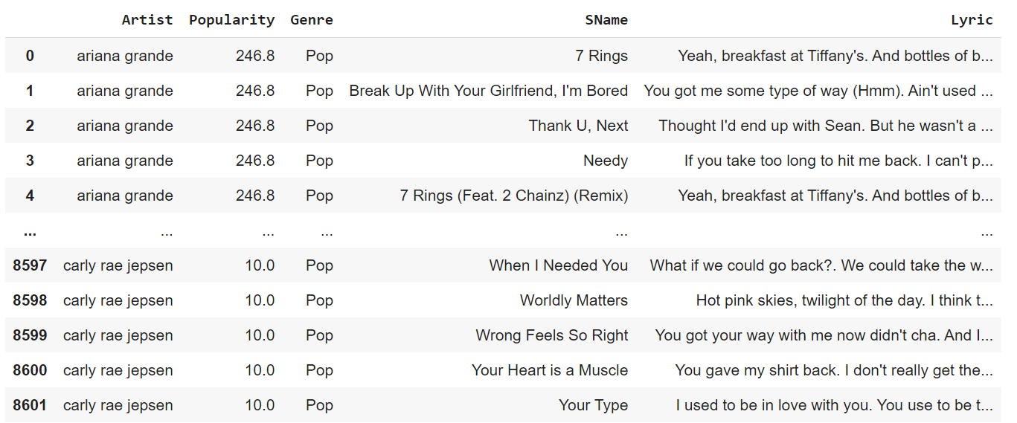
Raw Data
Notes:
Raw Data source: https://www.kaggle.com/neisse/scrapped-lyrics-from-6-genres
We have applied some simple transformations and joined the artists table with the genres table to create the above table.

Slide 5
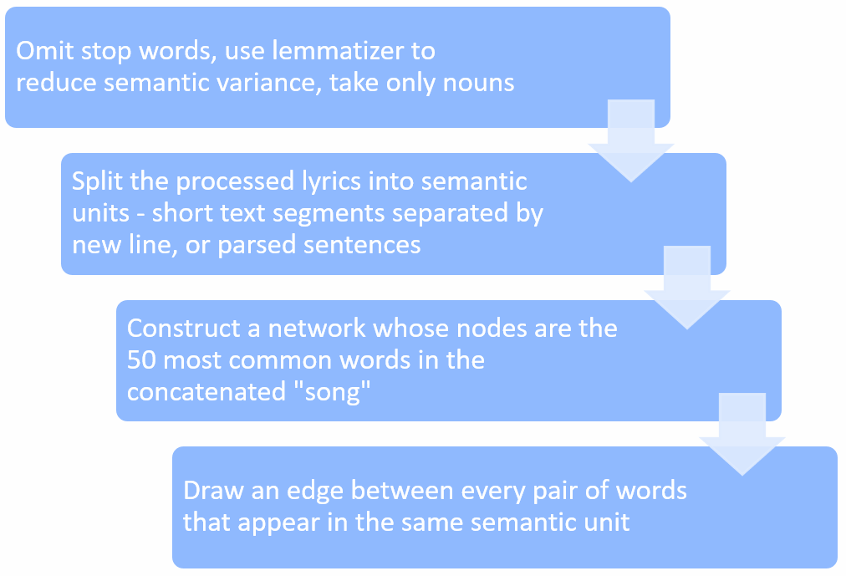
Network Estimation

Slide 6
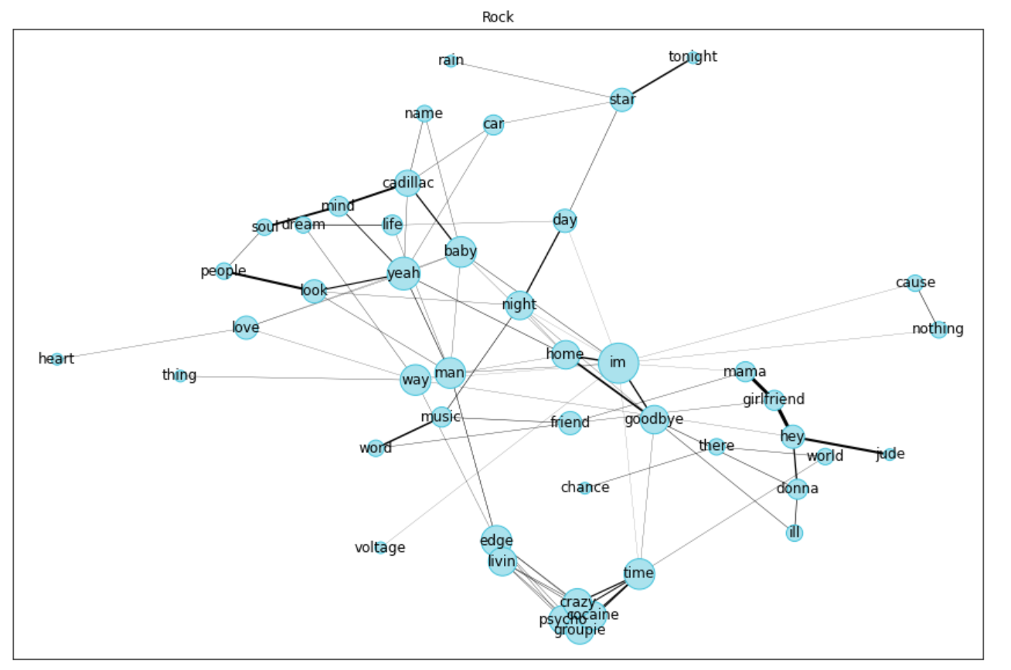
Network Estimation - contd.

Slide 7
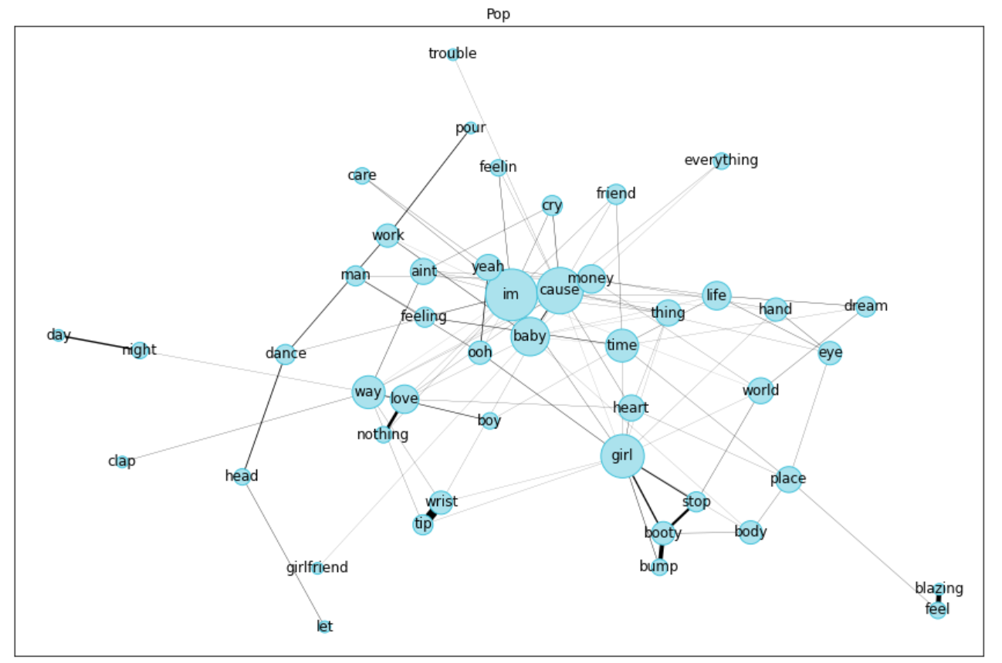
Network Estimation - contd.

Slide 8
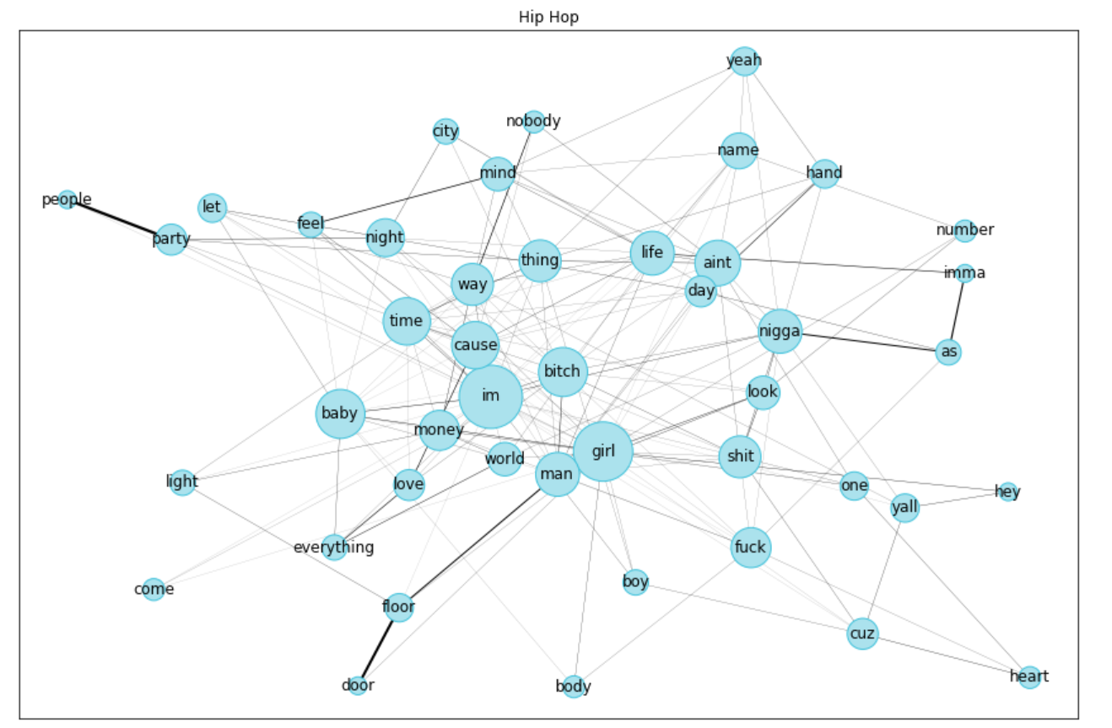
Network Estimation - contd.

Slide 9
Bootstrap Sampling
For each genre, we have created 50 networks, each based on 200 lyrics sampled randomly and concatenated into a one big “song”.
For each of the networks, we have calculated:
Average degree
Average shortest-path length
Clustering coefficient

Slide 10
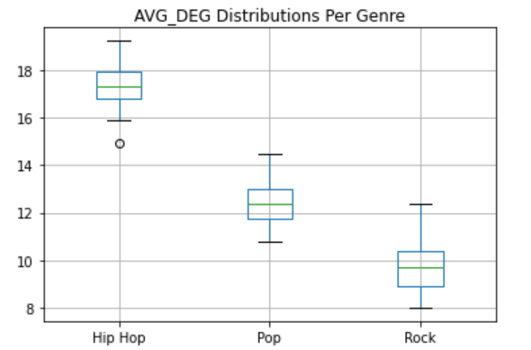
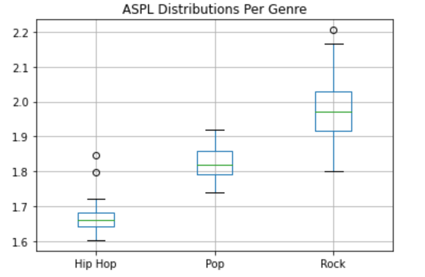
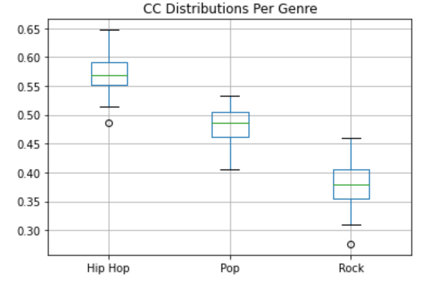
Bootstrap Sampling - contd.

Slide 11
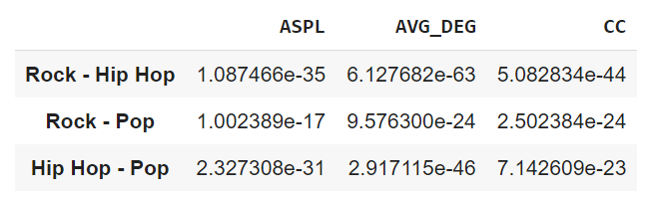
Statistical Testing
All pairwise hypothesis cross all three measures: 3*3=9 hypotheses
Used Bonferroni procedure for multiple-comparison correction
Adjusted p-values:
<< 0.05

Slide 12
Themes Representation in Genres
Each theme (topic) was represented as a hard-coded list of words
Topic-genre score was defined as:

Slide 13
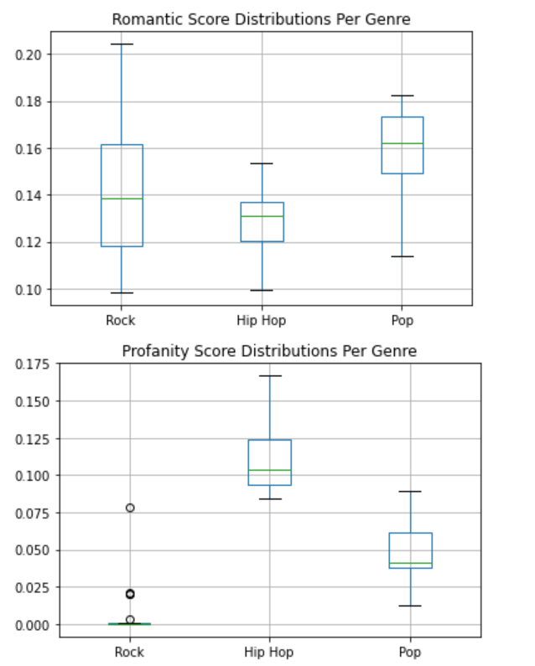
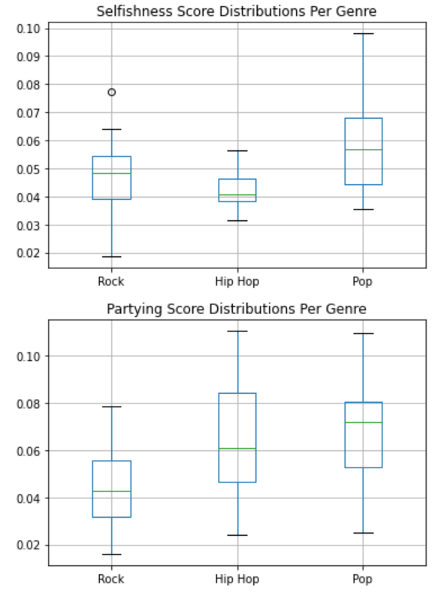
Themes Representation in Genres - contd.

Slide 14
Discussion
What we have learned?
Hip-Hop tends to be less structured, more flexible and more thematicaly diverse
Pop is always in the middle of the scale (combines elements from both other genres)
Topics are not necessarily represented in genres as we have expected
Network estimation is the most critical phase
How did network analysis contributed to our work?
Networks capture structure!

Slide 15
Discussion - contd.
Analysis Limitations
Selective bias in network estimation (used top 50 words)
Topic representation method was heuristic
Future Directions
Similar analysis on musical features per genre
Lyrics generation

Slide 16
Thank you!
Notes:
Google Colab notebook: https://colab.research.google.com/drive/1d9ra1QAZOZx-ykpxDohTzpg4BX7SDYe3?usp=sharing

