Slide 1
KUBEVIRT

Slide 2
KubeVirt is a Kubernetes extension that lets users natively run traditional Virtual Machine (VM) workloads alongside container workloads in their Kubernetes clusters
This technology allows Kubernetes to manage, deploy, and schedule virtual machines using the same tools as containerized workloads. This removes the need for a separate environment with management tools and specialized monitoring.
KubeVirt is NOT an hypervisor. The virtual machines are created and managed via KVM / libvirt. The virtual machines are NOT running inside a pod. All virtual machines are real KVM virtual machines running on the Linux nodes

Slide 3
Why Kubevirt?
Seamless Integration: With KubeVirt, the lines between virtual machines and containers blur as both coexist within the same Kubernetes platform. You no longer need separate management tools or disjointed workflows.
Live Migration: One of KubeVirt’s standout features is live migration. This allows you to move running virtual machines between hosts without service disruption. With KubeVirt, you can seamlessly migrate VMs to optimize performance, balance workloads, or perform maintenance tasks while maintaining business continuity.
High Security: Kubervirt inherits the security features of Kubernetes. This ensures that your VMs have a robust and secure environment. You can also leverage Kubernetes’ RBAC (Role-Based Access Control) and network policies to enforce granular access control. This will help isolate your virtualized workloads and secure communication within the cluster.
Centralized Management: Centralizing container and VM management streamlines your infrastructure stack while providing several less apparent benefits. By eliminating the need for separate container and VM pipelines, KubeVirt minimizes the stress on your DevOps teams, speeding up daily procedures. You also get to save money on utilities and software as you migrate more VMs to Kubernetes.
Zero Hypervisor Tax: KuberVirt protects you from hypervisor tax. You get to eliminate the need to license and use a hypervisor to run the VMs associated with your application. By exploiting Kubernetes’ ability to schedule and package virtual apps, you may reduce your infrastructure footprint in the long run.

Slide 4
Use Cases
Management of Traditional Workloads
KuberVirt is an efficient application orchestration engine that reduces the complexity of distributed computing. You don’t need to keep separate environments, personnel, or skill sets for either application when you combine VM Based and Containerized workloads. As a result, it is easier to bring VM-based workloads closer to your DevOps workflows, thanks to the fact that you can create VM declaratively and manage them with Kubernetes commands and virtctl. Instead of building separate DevOps pipelines for your containerized and VM-based workloads, you can combine and manage them from one place.
Working with Legacy Applications
You can’t simply relocate some applications to cloud-native environments. With KubeVirt, you can move any app you run on a physical or virtual server to a VM managed using a virt-launcher in a Kubernetes pod. This means you can use Kubernetes in cloud-native environments to manage applications made up of a patchwork of different technologies or older applications you can’t rearchitect. These applications can communicate more easily with containerized applications when you manage them in Kubernetes. In a containerized VM, not all legacy applications are easy to run. In KubeVirt, running mainframe software or applications requiring hardware connections with sensors or additional infrastructure may become more complex. But any hardware that connects over the network should work with a KubeVirt VM because KubeVirt is leveraging the pod’s network connectivity. This means that by using the container environment to connect current VMs with legacy hardware and software, KubeVirt can integrate legacy applications in today’s architectures and development pipelines.

Slide 5
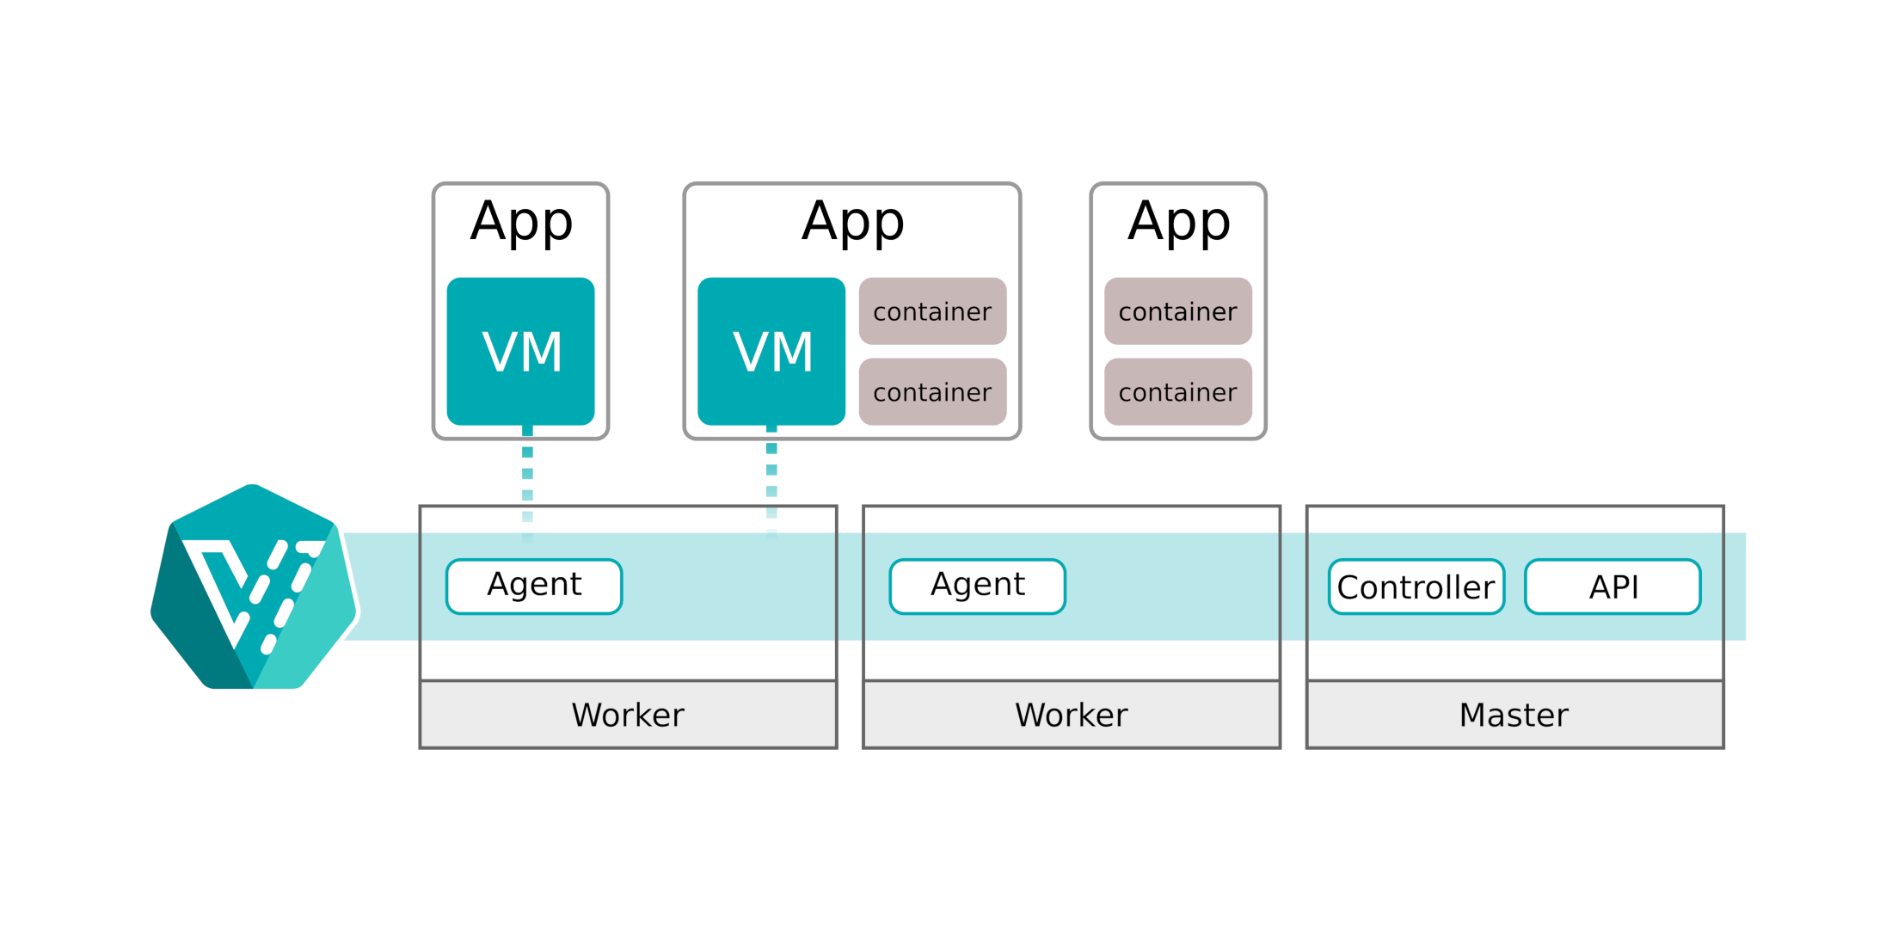
KubeVirt Architecture
API: The KubeVirt api component runs as a Deployment in Kubernetes and is responsible for the communication with KubeVirt via webhooks, triggered via CRDs and the validation of the triggered objects.
Controller: The KubeVirt controller is the heart of KubeVirt. The controller is responsible for the CRUD (lifecycle) operations of the KubeVirt objects running in Kubernetes. The controller continuously monitors all KubeVirt objects.
Agent: The KubeVirt agent (also known as virt-handler) is a DaemonSet, running on each Kubernetes worker, and it is the glue between Kubernetes and the underlaying Linux Kernel. The agent is responsible for keep the defined virtual machine (configuration) in sync with the running virtual machine on this node.

Slide 6
virt-launcher
For every VMI object one pod is created. This pod's primary container runs the virt-launcher KubeVirt component.
Kubernetes or the kubelet is not running the VMIs itself. Instead a daemon on every host in the cluster will take care to launch a VMI process for every pod which is associated to a VMI object whenever it is getting scheduled on a host.
The main purpose of the virt-launcher Pod is to provide the cgroups and namespaces, which will be used to host the VMI process.
virt-handler signals virt-launcher to start a VMI by passing the VMI's CRD object to virt-launcher. virt-launcher then uses a local libvirtd instance within its container to start the VMI. From there virt-launcher monitors the VMI process and terminates once the VMI has exited.
If the Kubernetes runtime attempts to shutdown the virt-launcher pod before the VMI has exited, virt-launcher forwards signals from Kubernetes to the VMI process and attempts to hold off the termination of the pod until the VMI has shutdown successfully.

Slide 7
Example Flow
VMI’s pod = virt-launcher pod
A client posts a new VMI definition to the K8s API Server.
The K8s API Server validates the input and creates a VMI custom resource.
The virt-controller observes the creation of the new VMI object and creates a corresponding pod.
Kubernetes is scheduling the pod on a host.
The virt-controller observes that a pod for the VMI got started and updates the nodeName field in theVMI object. Now that the nodeName is set, the responsibility transitions to the virt-handler for any further action.
The virt-handler (DaemonSet) observes that a VMI got assigned to the host where it is running on.
The virt-handler is using the VMI Specification and signals the creation of the corresponding domain using a libvirtd instance in the VMI's pod.
A client deletes the VMI object through the virt-api-server.
The virt-handler observes the deletion and turns off the domain.

Slide 8
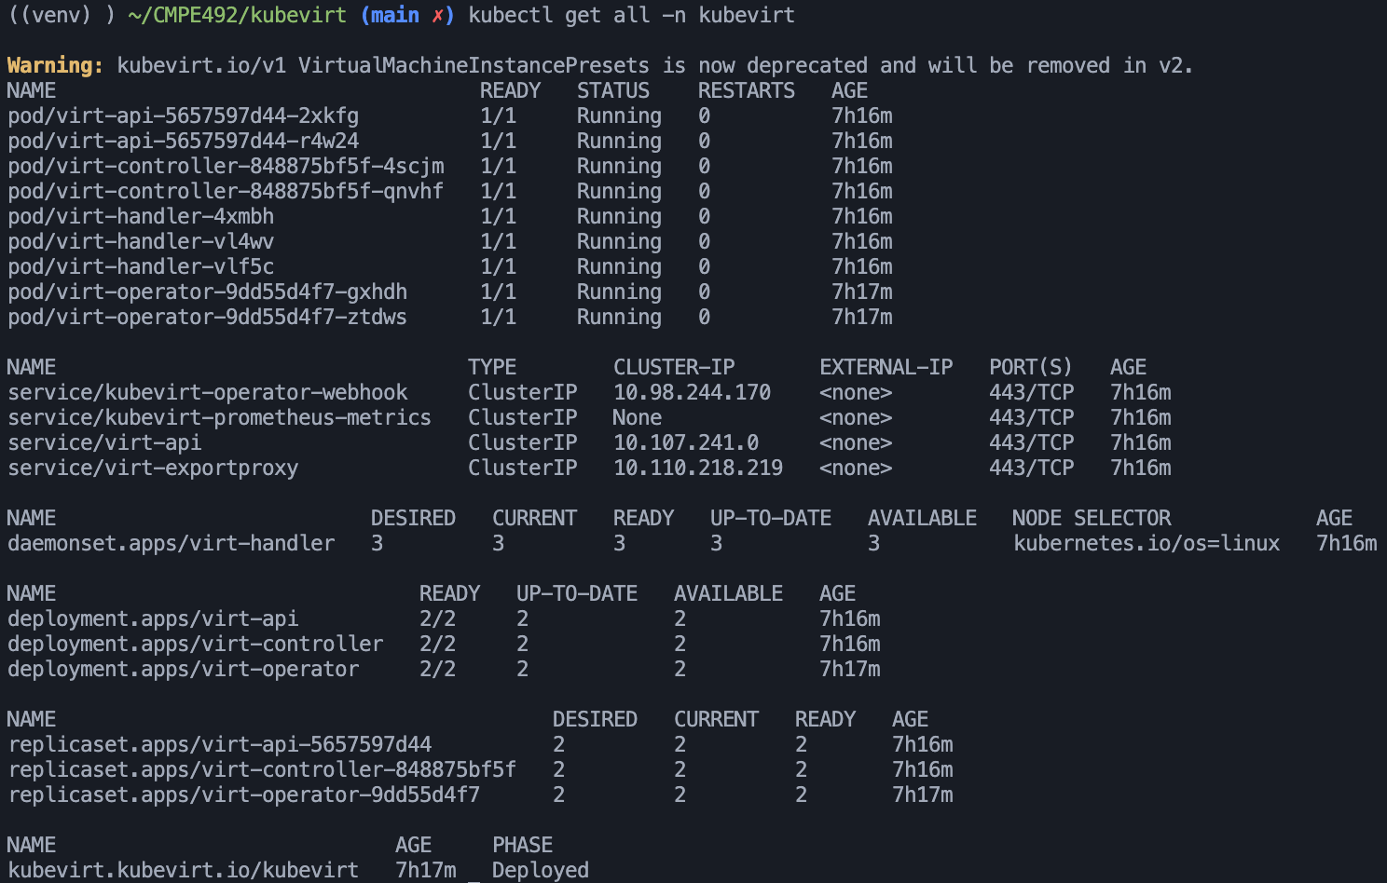
How to install kubevirt?
Nested virtualization for the nodes should be enabled
Deploy kubevirt operator (manages the lifecycle of all the KubeVirt core components.)
Deploy Kubevirt Custom Resource Definitions (Deploy core kubevirt components)
Install virtctl (for quick access to the serial and graphical ports of a VM and also handle start/stop operations.)

Slide 9
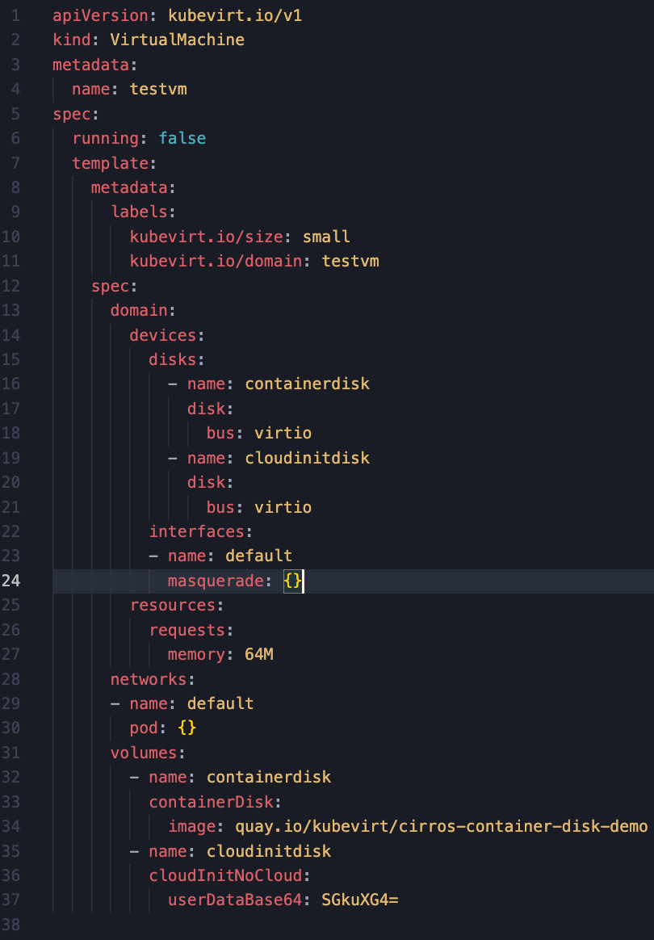
How to Create a VM?
Create a manifest file for the definition of VM
Apply the manifest
Start the vm via virtctl

Slide 10
Kubevirt Horizontal Scaling

Slide 11
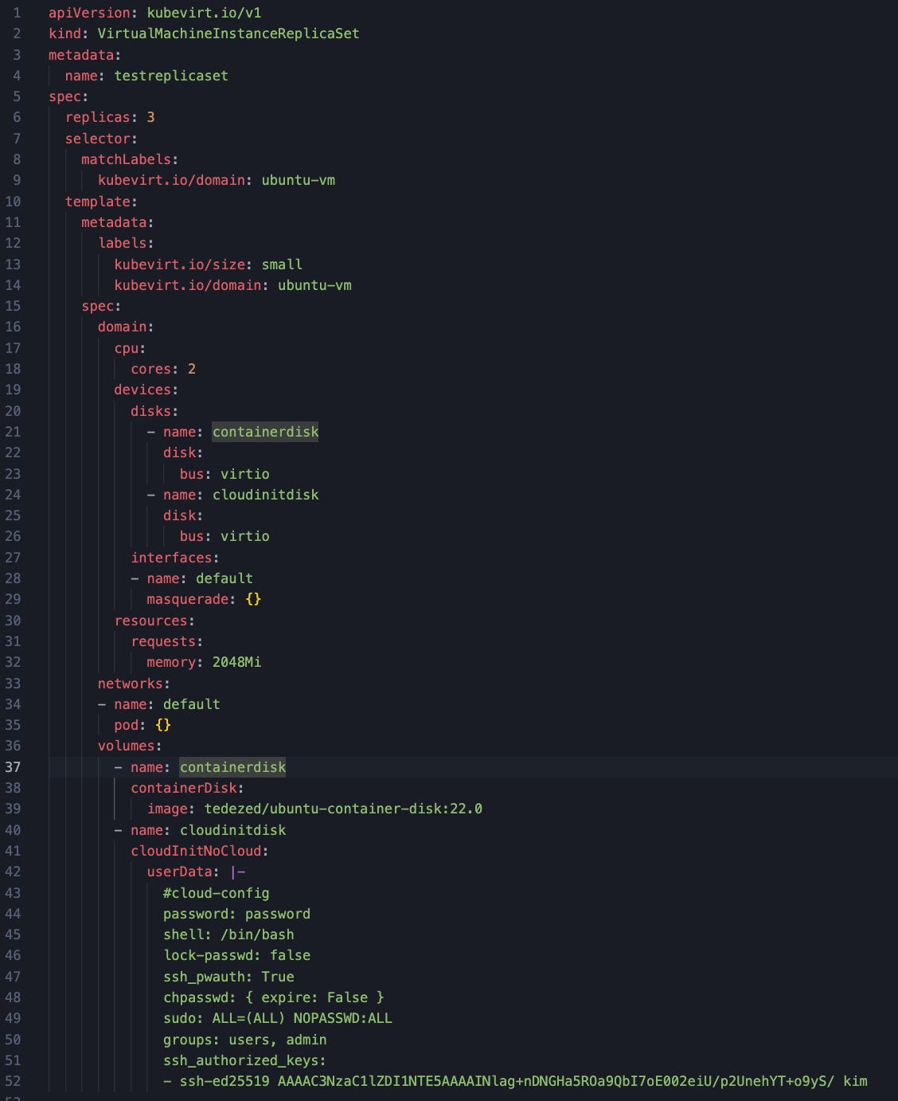

Slide 12
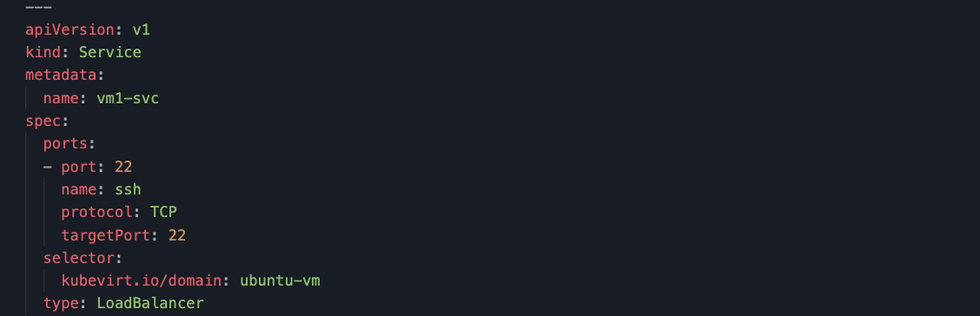

Slide 13
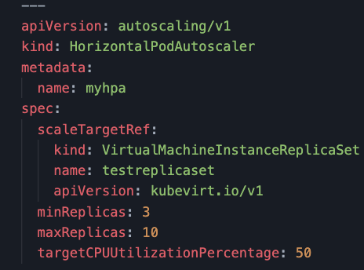

Slide 14
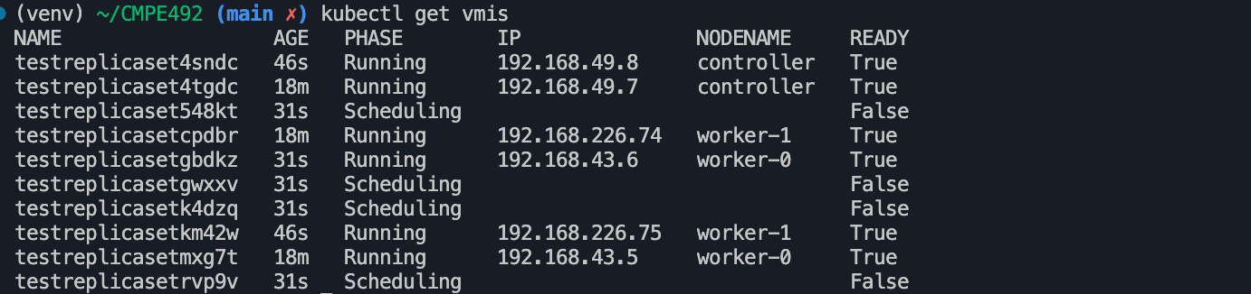

Slide 15
Live Vm Migration

Slide 16
Live Migration is a common virtualization feature supported by KubeVirt where virtual machines running on one cluster node move to another cluster node without shutting down the guest OS or its applications.

Slide 17
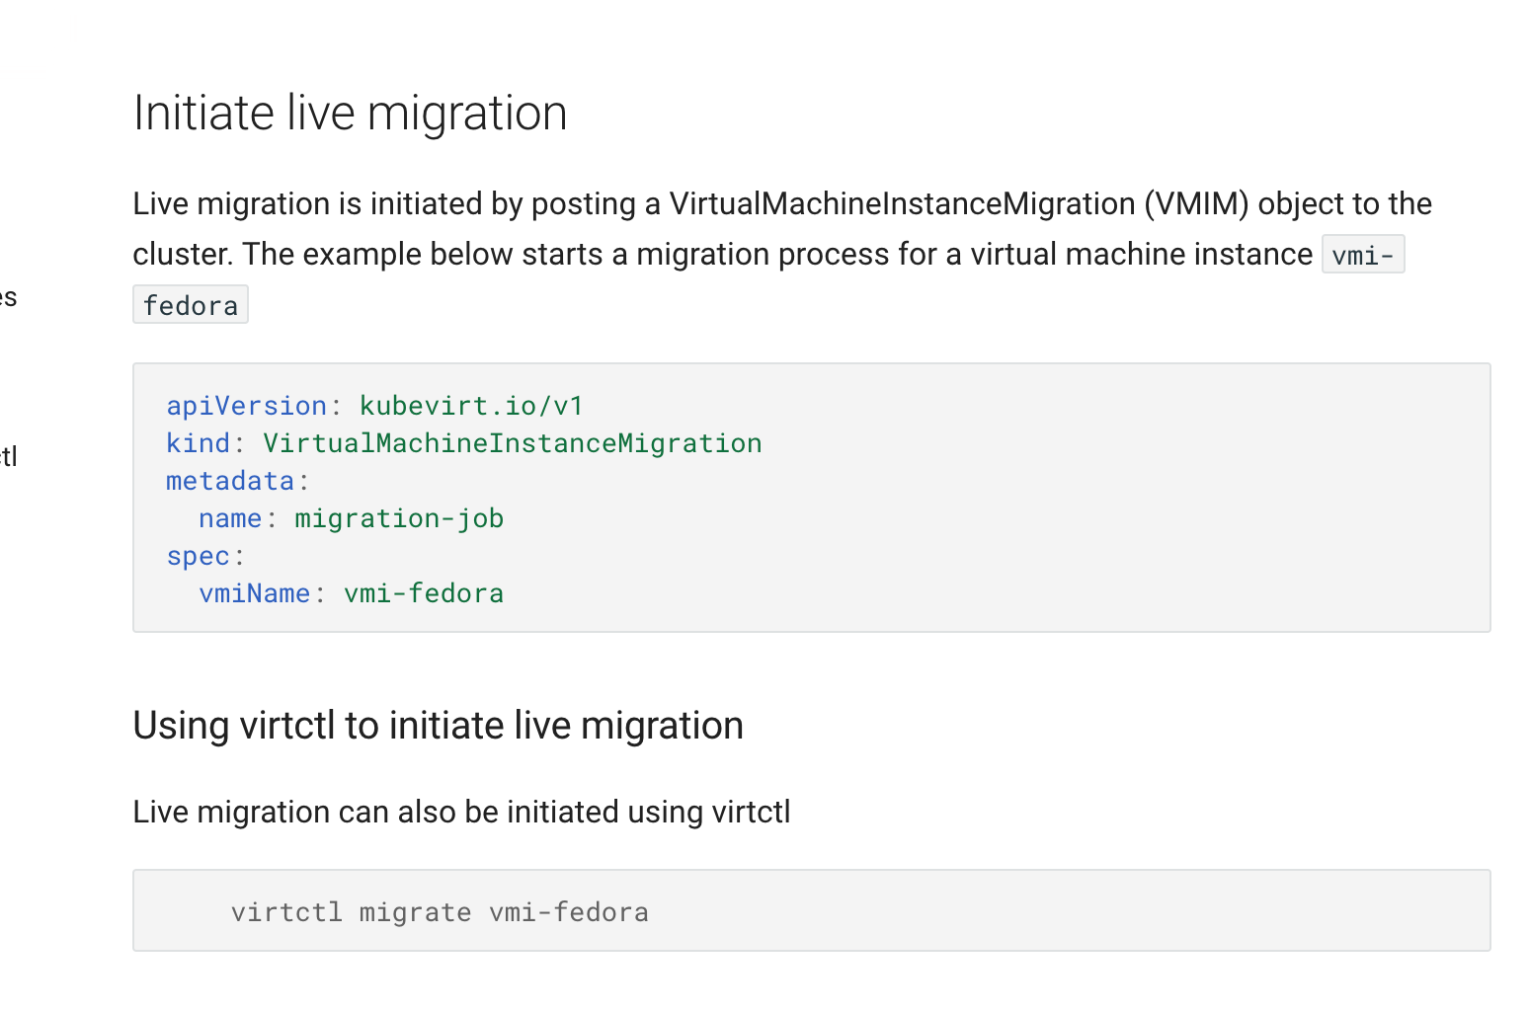

Slide 18
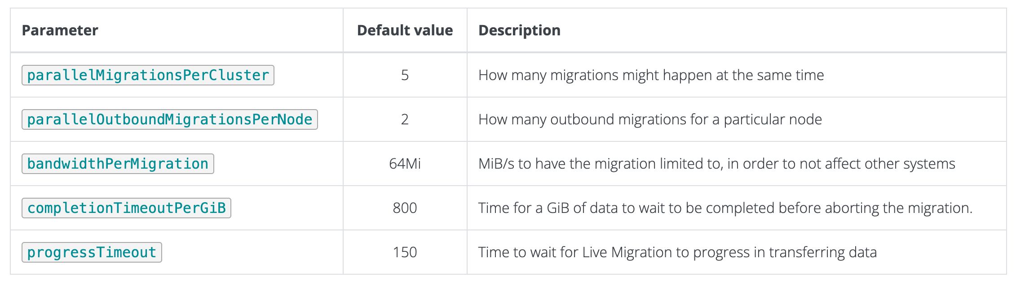
Paramaters

Slide 19
Container Migration
Intra and Inter Cluster Stateful Container/Pod Migration
The simplest way to migrate a running pod in Kubernetes is to stop it and deploy a new pod to a different server. This approach respects the “cattle” principle, but has two major drawbacks:
Unless the application immediately dumps its runtime state to disk upon receiving the SIGTERM signal, any state is lost after the migration.
Any open TCP connections will stop working, which may create inconsistencies between clients and the server.
DMTCP and CRIU

Slide 20
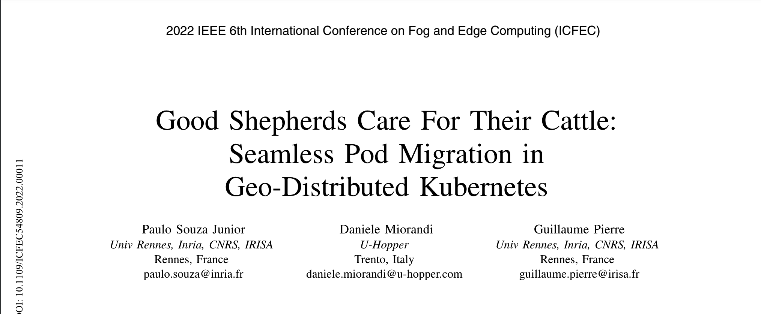
https://ieeexplore.ieee.org/stamp/stamp.jsp?tp=&arnumber=9799256

Slide 21
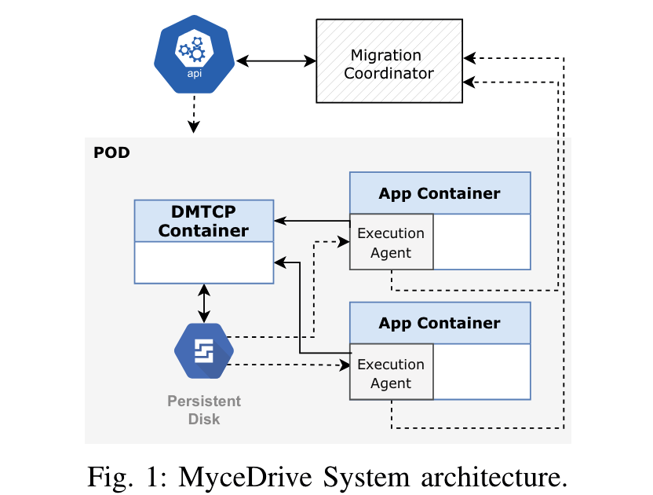
This paper presents MyceDrive, a pod migration technique integrated within the Kubernetes container orchestration system. Following the pet/cattle analogy, MyceDrive avoids killing a healthy running pod and waiting for Kubernetes to restart a new one when it is, instead, possible to migrate it to a different server. Migration is totally transparent to the application running inside the pod as well as the clients having open TCP connections to the migrated pod. MyceDrive relies on DMTCP [5] to checkpoint the container’s memory state and open network connections at the migration time, and to resume this saved state in the new pod. MyceDrive integrates in regular Kubernetes deployments with no need for any specific CPU architecture, OS, kernel modules or hypervisor
DMTCP: Distributed MultiThreaded Checkpointing

Slide 22
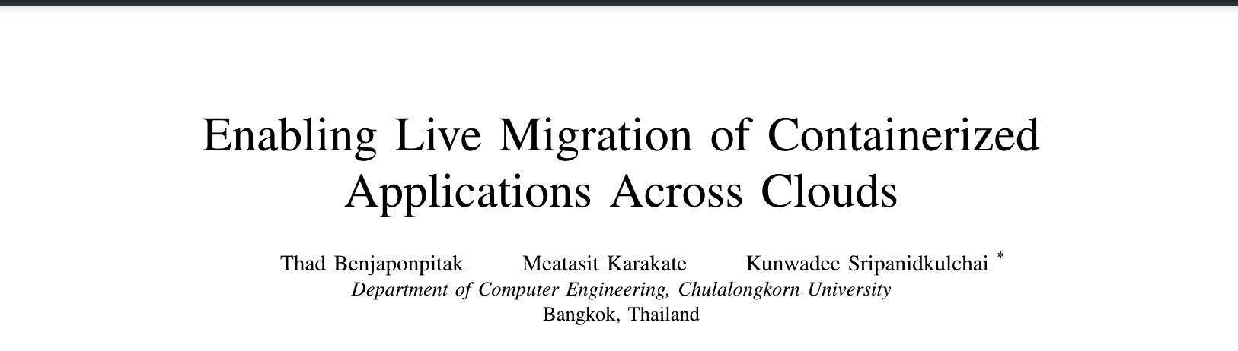
https://ieeexplore.ieee.org/stamp/stamp.jsp?tp=&arnumber=9155403

Slide 23
In this paper, we focus on live migration of applications running within multiple containers. Our contributions are a fully automated live migration solution, CloudHopper that enables containerized applications to hop around different clouds with no client-perceived downtime. We have successfully migrated applications between three of the most popular cloud providers (Amazon Web Services, Google Cloud Platform, and Microsoft Azure) across the wide area. For realistic application workloads, using pre-migration and migration optimizations, migrated containers may be down for under half a minute. However, during that period, CloudHopper maintains connectivity such that clients only perceive a delayed response, instead of actual downtime

Slide 24
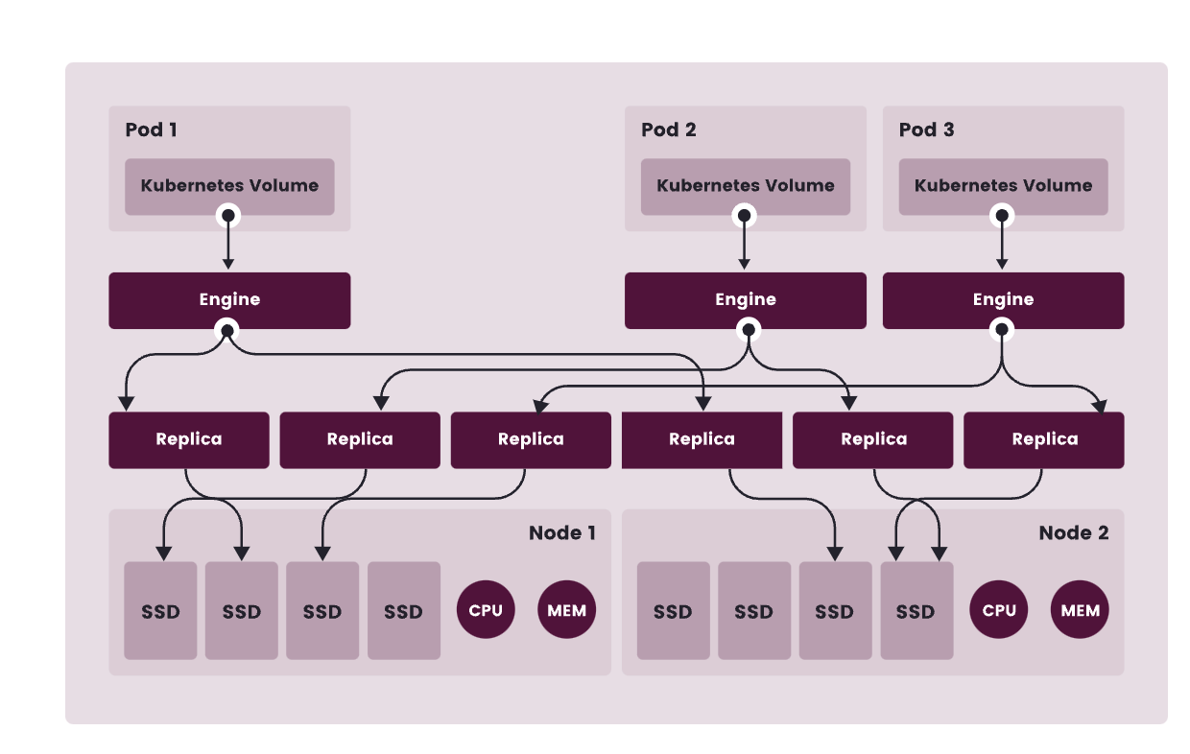
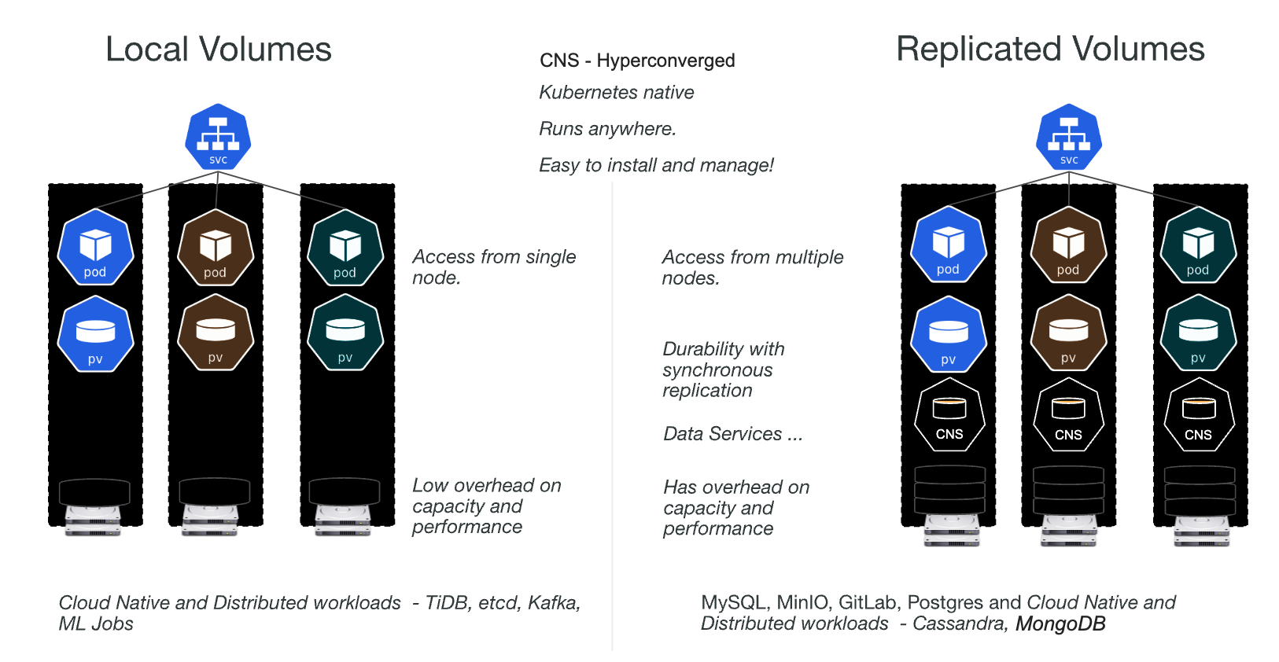
Persistent Storage Options
Ceph & Rook
Longhorn
OpenEBS
Longhorn
OpenEBS

