Slide 1
KUBEVIRT

Slide 2
KubeVirt is a Kubernetes extension that lets users natively run traditional Virtual Machine (VM) workloads alongside container workloads in their Kubernetes clusters.
This technology allows Kubernetes to manage, deploy, and schedule virtual machines using the same tools as containerized workloads. This removes the need for a separate environment with management tools and specialized monitoring.
KubeVirt is NOT an hypervisor. The virtual machines are created and managed via KVM / libvirt. The virtual machines are NOT running inside a pod. All virtual machines are real KVM virtual machines running on the Linux nodes

Slide 3
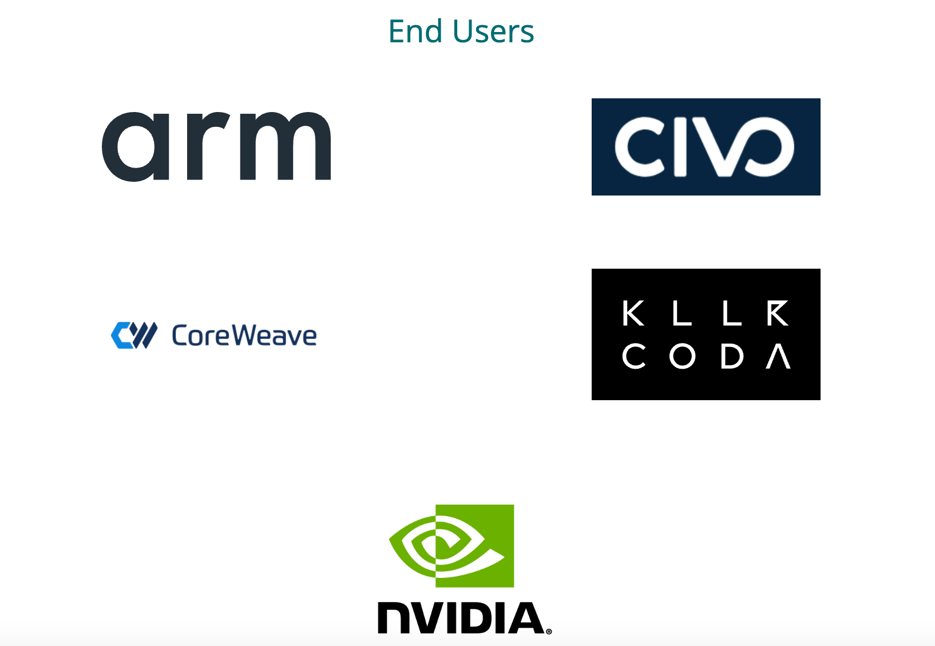

Fact Sheet
Open source https://github.com/kubevirt/kubevirt
5.1K Stars
CNCF Incubating Project
Weekly Commits for the last year

Slide 4
Why Kubevirt?
Seamless Integration: Lines between virtual machines and containers blur as both coexist within the same Kubernetes platform. No longer need separate management tools or disjointed workflows.
Live Migration: Allows you to move running virtual machines between hosts without service disruption. Seamlessly migrate VMs to optimize performance, balance workloads, or perform maintenance tasks while maintaining business continuity.
High Security: Kubervirt inherits the security features of Kubernetes. This ensures that your VMs have a robust and secure environment. You can also leverage Kubernetes’ RBAC (Role-Based Access Control) and network policies to enforce granular access control. This will help isolate your virtualized workloads and secure communication within the cluster.

Slide 5
Why Kubevirt?
Centralized Management: Centralizing container and VM management Eliminating the need for separate container and VM pipelines. Much easier DevOps cycles.

Slide 6
Use Cases
Management of Traditional Workloads
Working with Legacy Applications

Slide 7
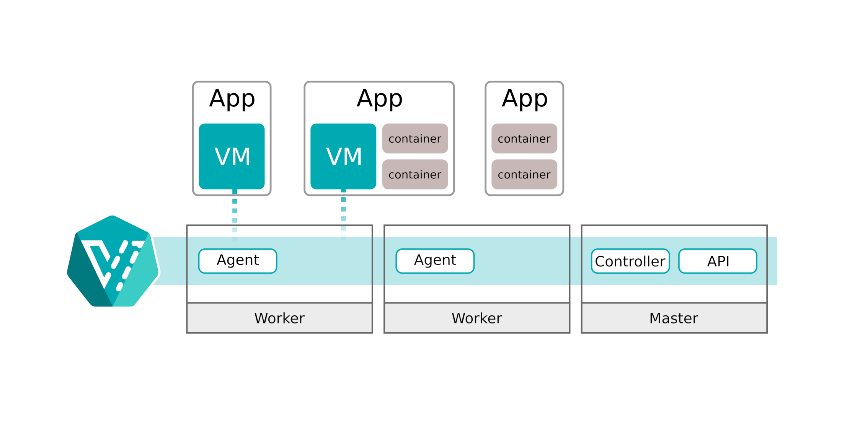
KubeVirt Architecture

Slide 8
KubeVirt Architecture
API: The KubeVirt api component runs as a Deployment in Kubernetes and is responsible for the communication with KubeVirt via webhooks, triggered via CRDs and the validation of the triggered objects.
Controller: The KubeVirt controller is the heart of KubeVirt. The controller is responsible for the CRUD (lifecycle) operations of the KubeVirt objects running in Kubernetes. The controller continuously monitors all KubeVirt objects.
Agent: The KubeVirt agent (also known as virt-handler) is a DaemonSet, running on each Kubernetes worker, and it is the glue between Kubernetes and the underlaying Linux Kernel. The agent is responsible for keep the defined virtual machine (configuration) in sync with the running virtual machine on this node.

Slide 9
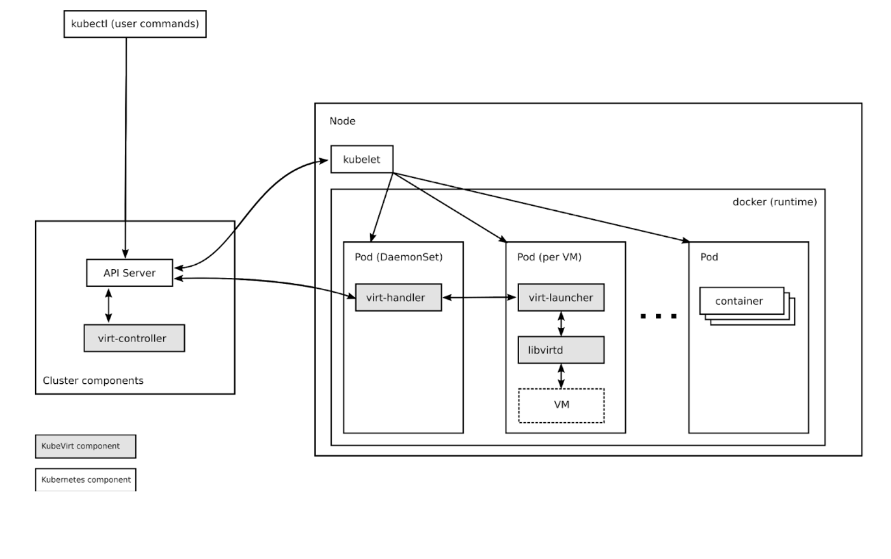
virt-launcher
For every VMI object one pod is created. This pod's primary container runs the virt-launcher KubeVirt component.
Kubernetes or the kubelet is not running the VMIs itself. Instead a daemon on every host in the cluster will take care to launch a VMI process for every pod which is associated to a VMI object whenever it is getting scheduled on a host.
The main purpose of the virt-launcher Pod is to provide the cgroups and namespaces, which will be used to host the VMI process.
virt-handler signals virt-launcher to start a VMI by passing the VMI's CRD object to virt-launcher. virt-launcher then uses a local libvirtd instance within its container to start the VMI. From there virt-launcher monitors the VMI process and terminates once the VMI has exited.
If the Kubernetes runtime attempts to shutdown the virt-launcher pod before the VMI has exited, virt-launcher forwards signals from Kubernetes to the VMI process and attempts to hold off the termination of the pod until the VMI has shutdown successfully.

Slide 10
Example Flow
A client posts a new VMI definition to the K8s API Server.(Creation is started)
The K8s API Server validates the input and creates a VMI custom resource.
The virt-controller observes the creation of the new VMI object and creates a corresponding pod.
Kubernetes is scheduling the pod on a host.
The virt-controller observes that a pod for the VMI got started and updates the nodeName field in theVMI object. Now that the nodeName is set, the responsibility transitions to the virt-handler for any further action.
The virt-handler (DaemonSet) observes that a VMI got assigned to the host where it is running on.
The virt-handler is using the VMI Specification and signals the creation of the corresponding domain (VM) using a libvirtd instance in the VMI's pod. (Creation is completed)
A client deletes the VMI object through the virt-api-server.(Deletion is started)
The virt-handler observes the deletion and turns off the domain. (Deletion is completed)
VMI’s pod = virt-launcher pod
https://github.com/kubevirt/kubevirt/blob/main/docs/components.md

Slide 11
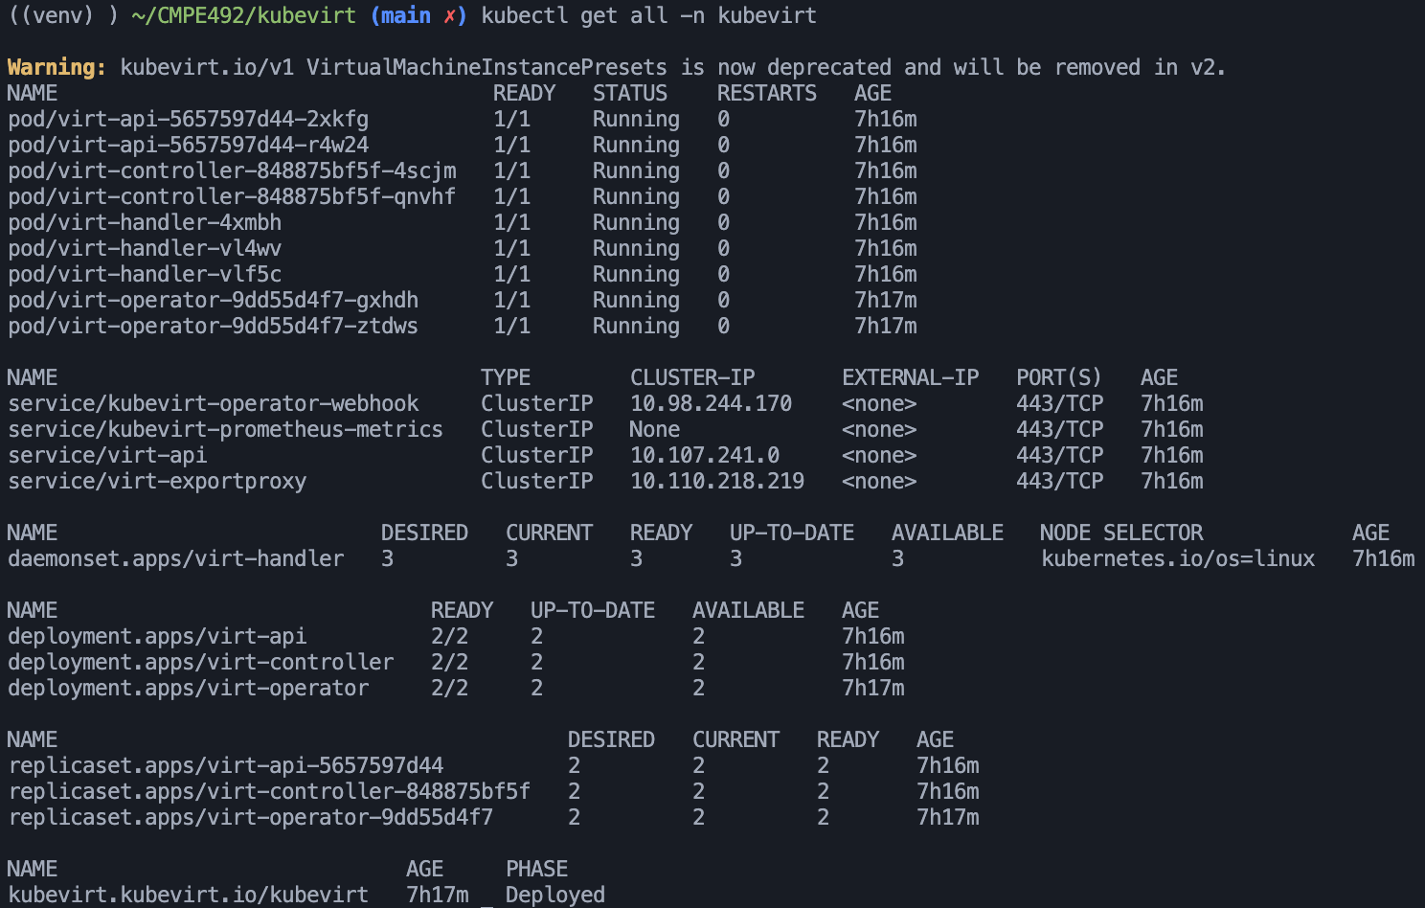
How to install kubevirt?
Nested virtualization for the nodes(if a vm) should be enabled
Deploy kubevirt operator (manages the lifecycle of all the KubeVirt core components.)
Deploy Kubevirt Custom Resource Definitions (Deploy core kubevirt components)
Install virtctl (for quick access to the serial and graphical ports of a VM and also handle start/stop operations.)

Slide 12
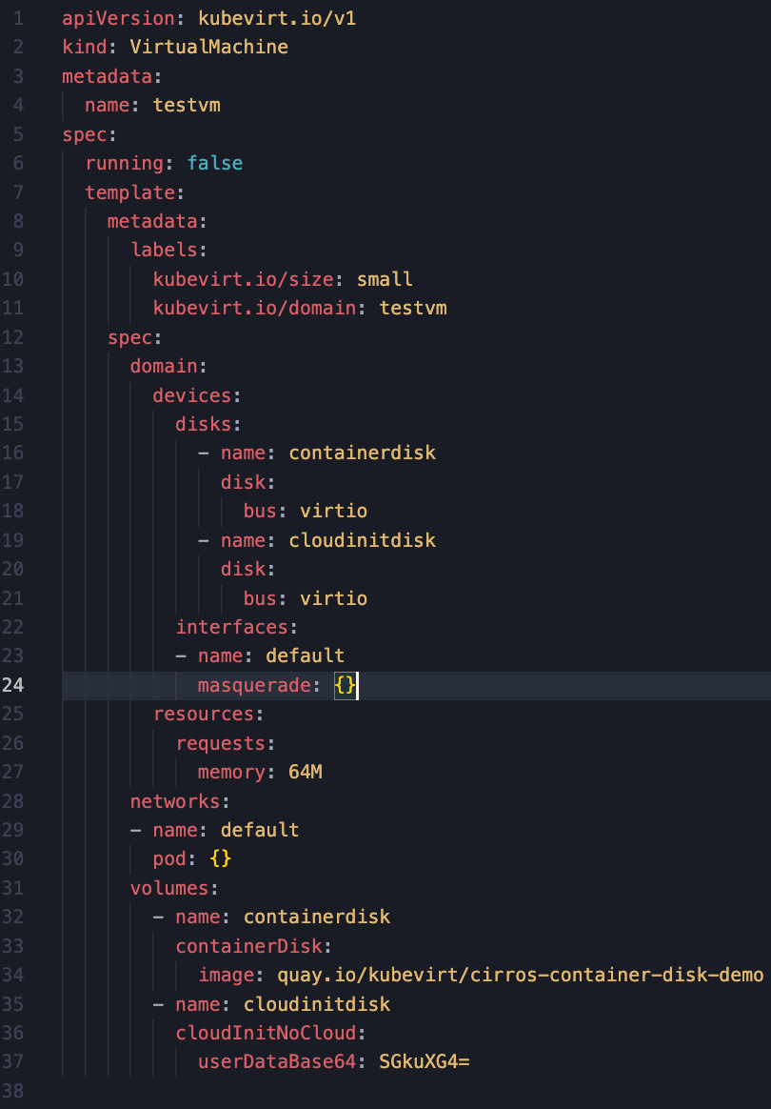
How to Create a VM?
Create a manifest file for the definition of VM
Apply the manifest
Start the vm via virtctl

Slide 13
Kubevirt Horizontal Scaling

Slide 14
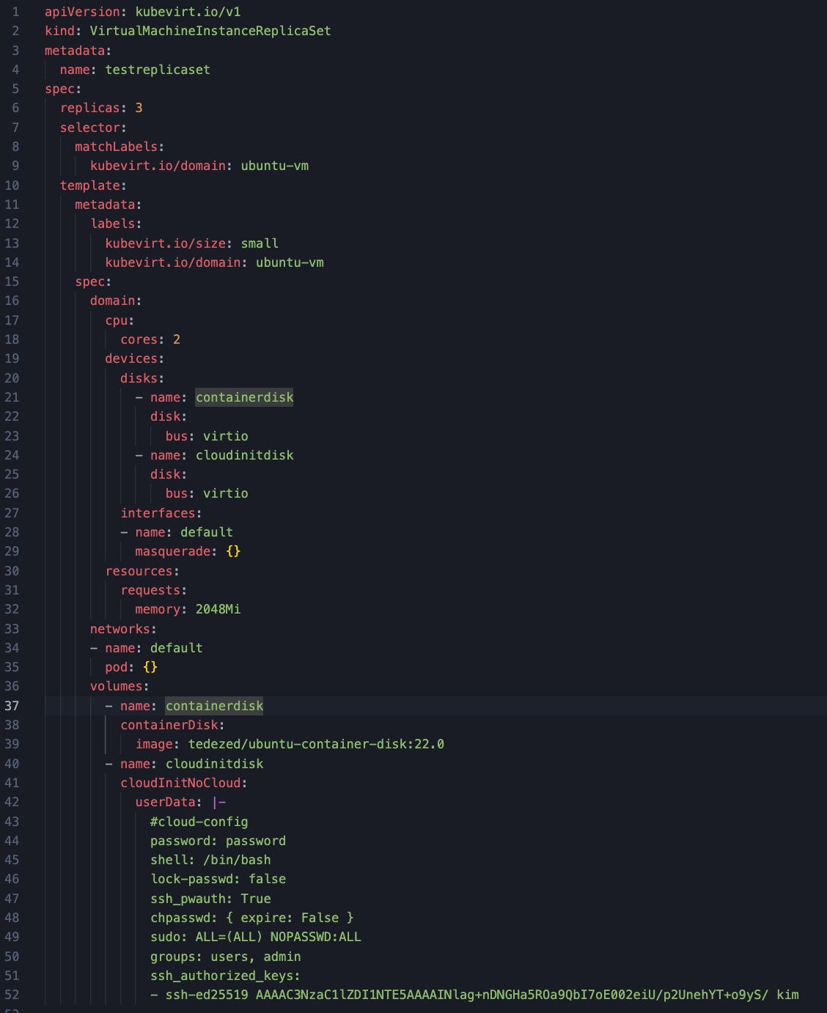

Slide 15
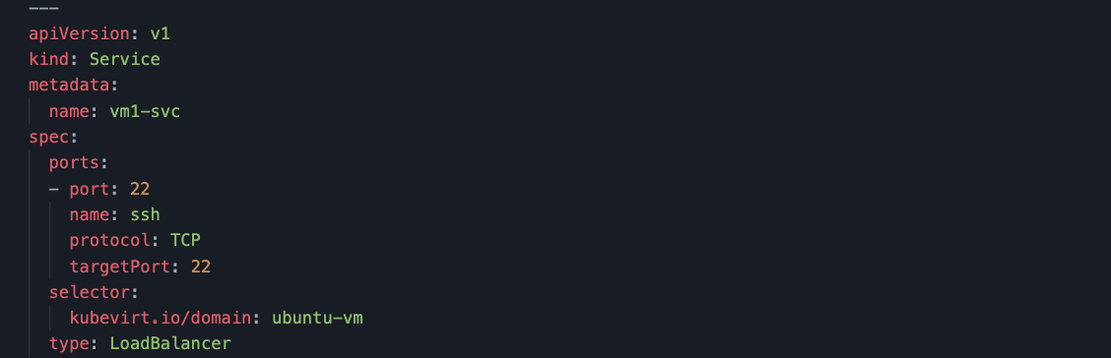

Slide 16
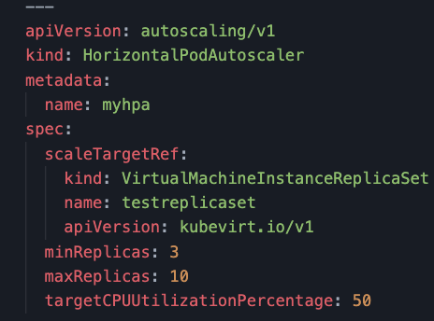

Slide 17
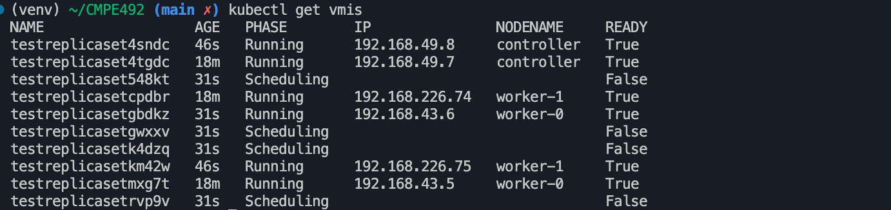

Slide 18
Live Vm Migration

Slide 19
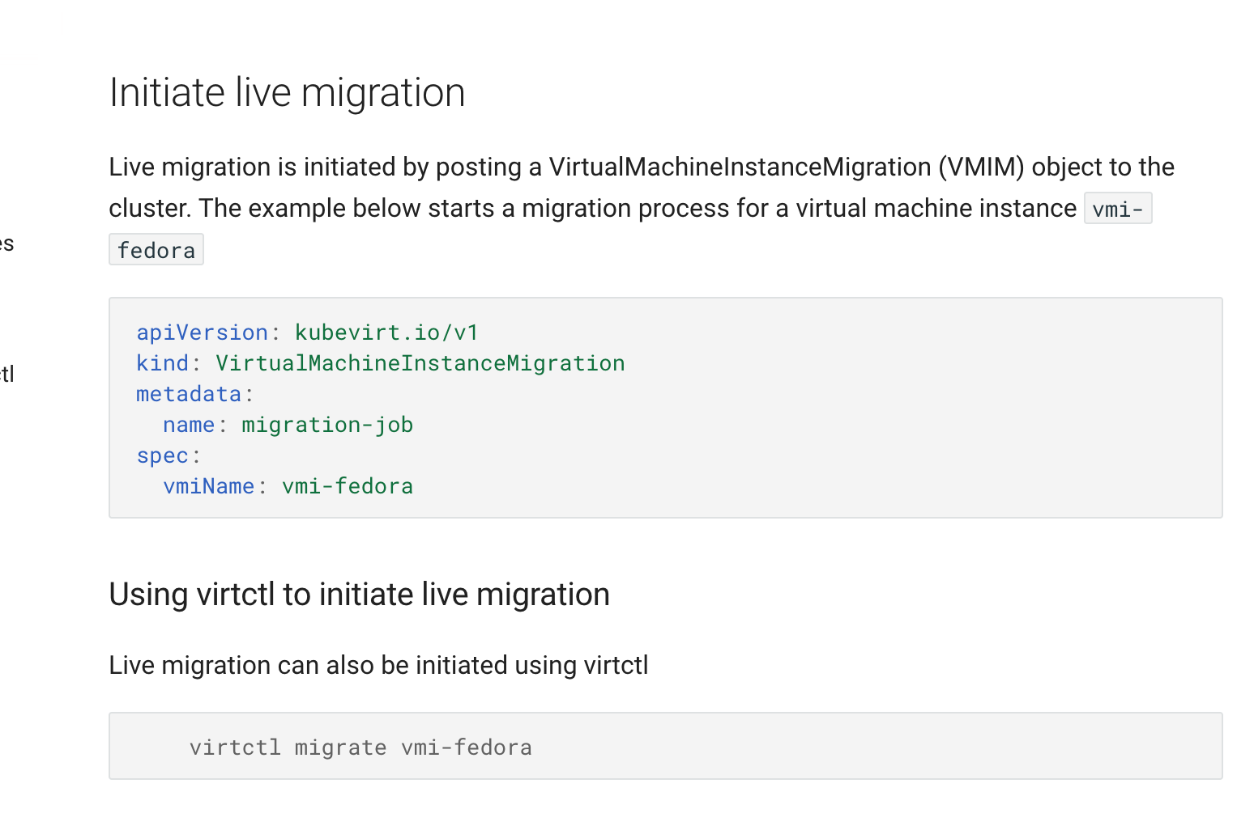
Live Migration
Live Migration is a common virtualization feature supported by KubeVirt where virtual machines running on one cluster node move to another cluster node without shutting down the guest OS or its applications.

Slide 20
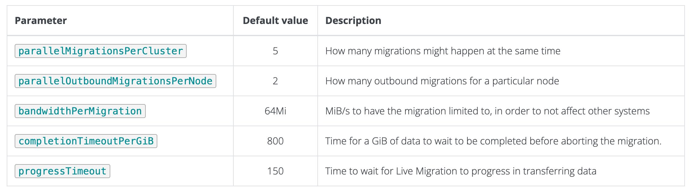
Paramaters

Slide 21
Container Migration
Goal: Intra and Inter Cluster Stateful Container/Pod Migration
The simplest way to migrate a running pod in Kubernetes is to stop it and deploy a new pod to a different server. This approach respects the “cattle” principle, but has two major drawbacks:
Unless the application immediately dumps its runtime state to disk upon receiving the SIGTERM signal, any state is lost after the migration.
Any open TCP connections will stop working, which may create inconsistencies between clients and the server.
Checkpoint Tools: DMTCP and CRIU

Slide 22
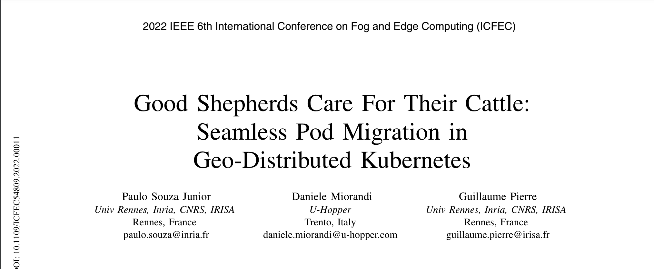
https://ieeexplore.ieee.org/stamp/stamp.jsp?tp=&arnumber=9799256

Slide 23
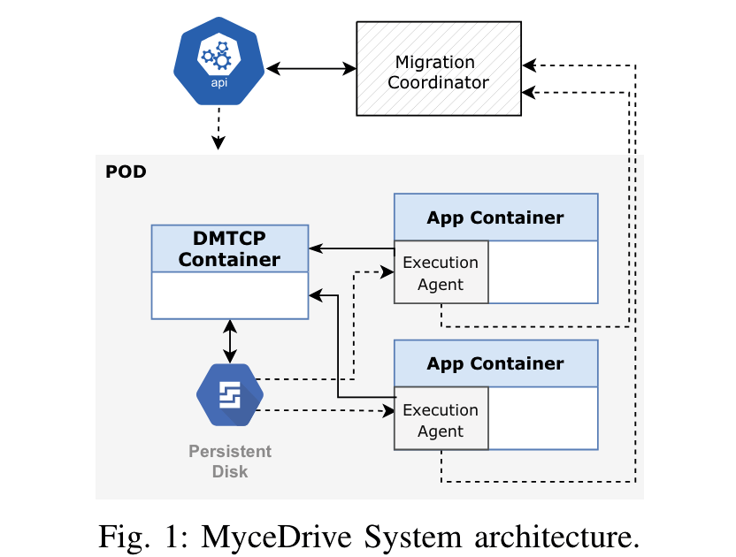
DMTCP: Distributed MultiThreaded Checkpointing

Slide 24
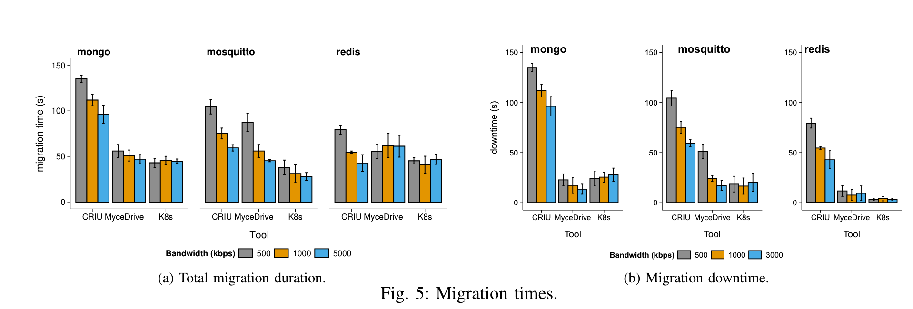
Evaluation

Slide 25
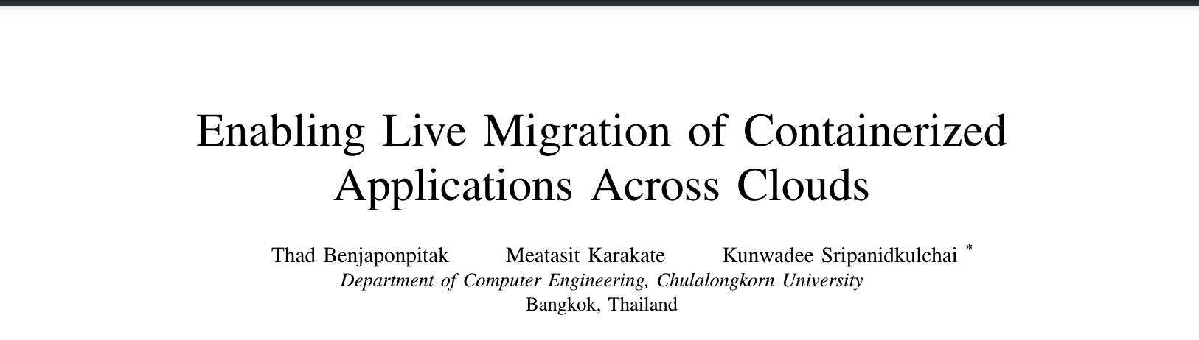
https://ieeexplore.ieee.org/stamp/stamp.jsp?tp=&arnumber=9155403

Slide 26
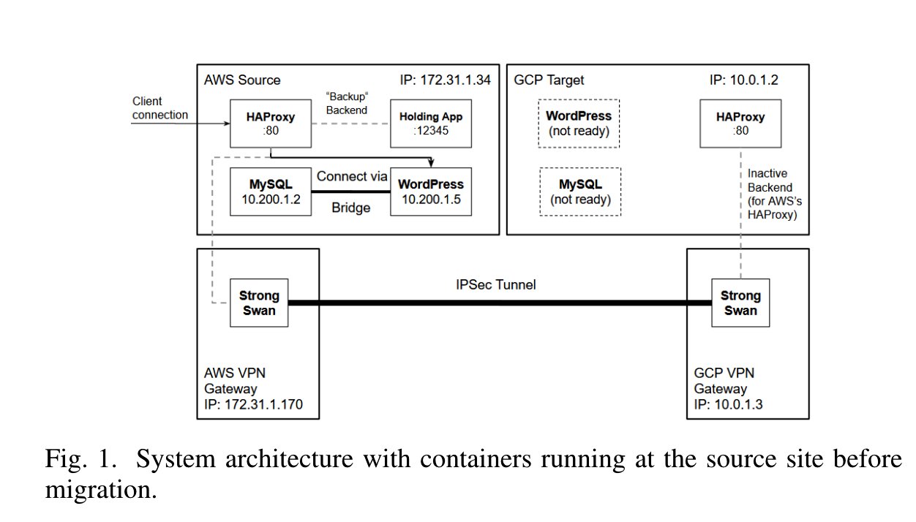
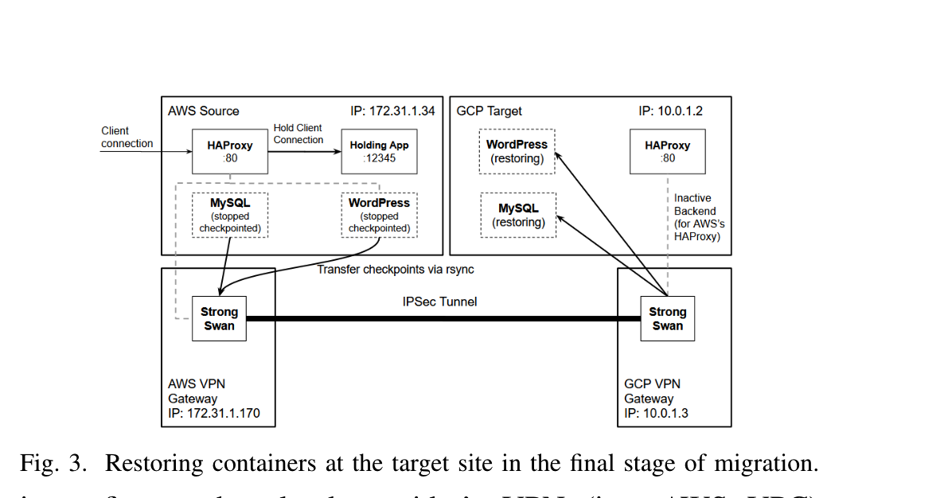
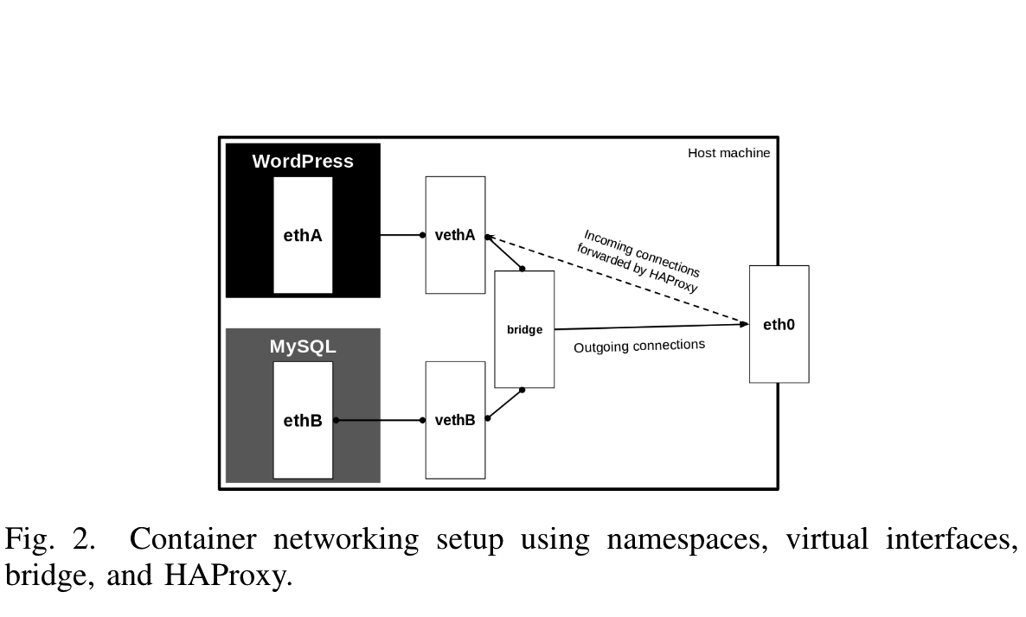
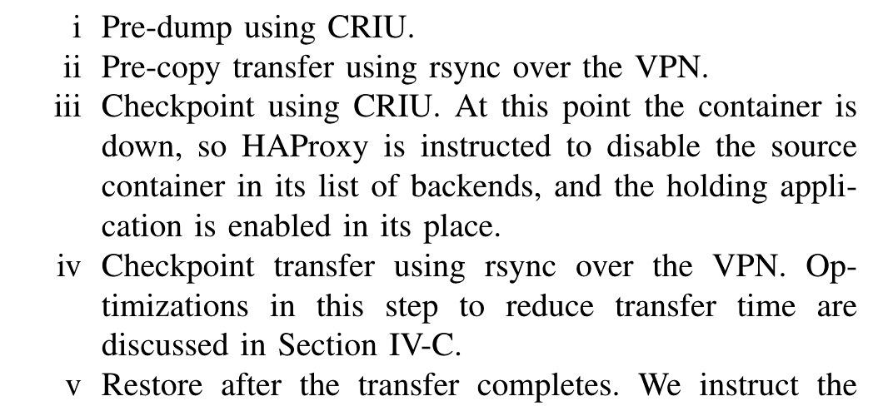

Slide 27
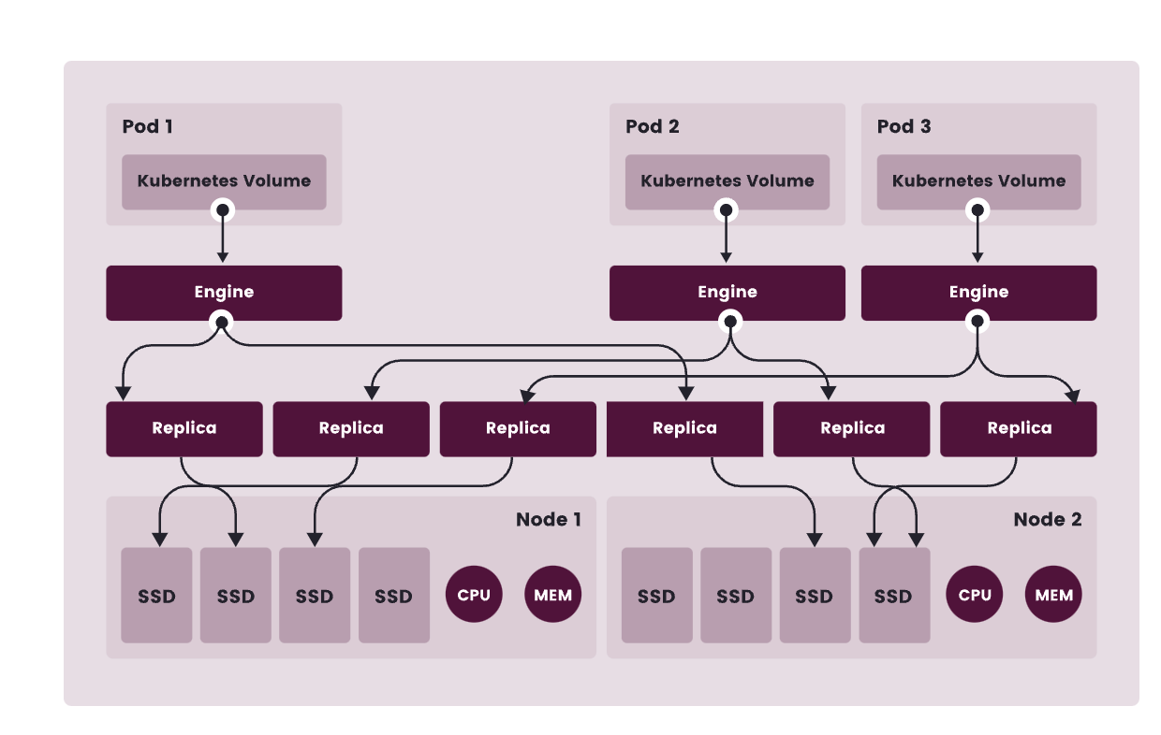
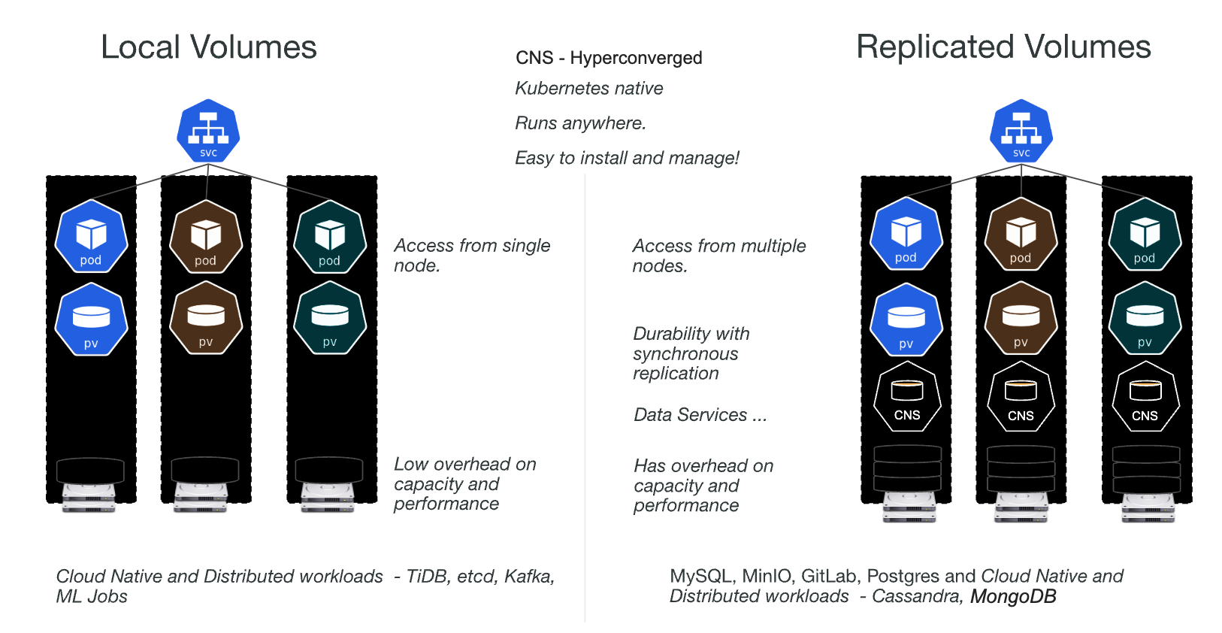
Persistent Storage Options for Container Migration
Ceph & Rook
Longhorn
OpenEBS
Longhorn
OpenEBS

