Slide 1
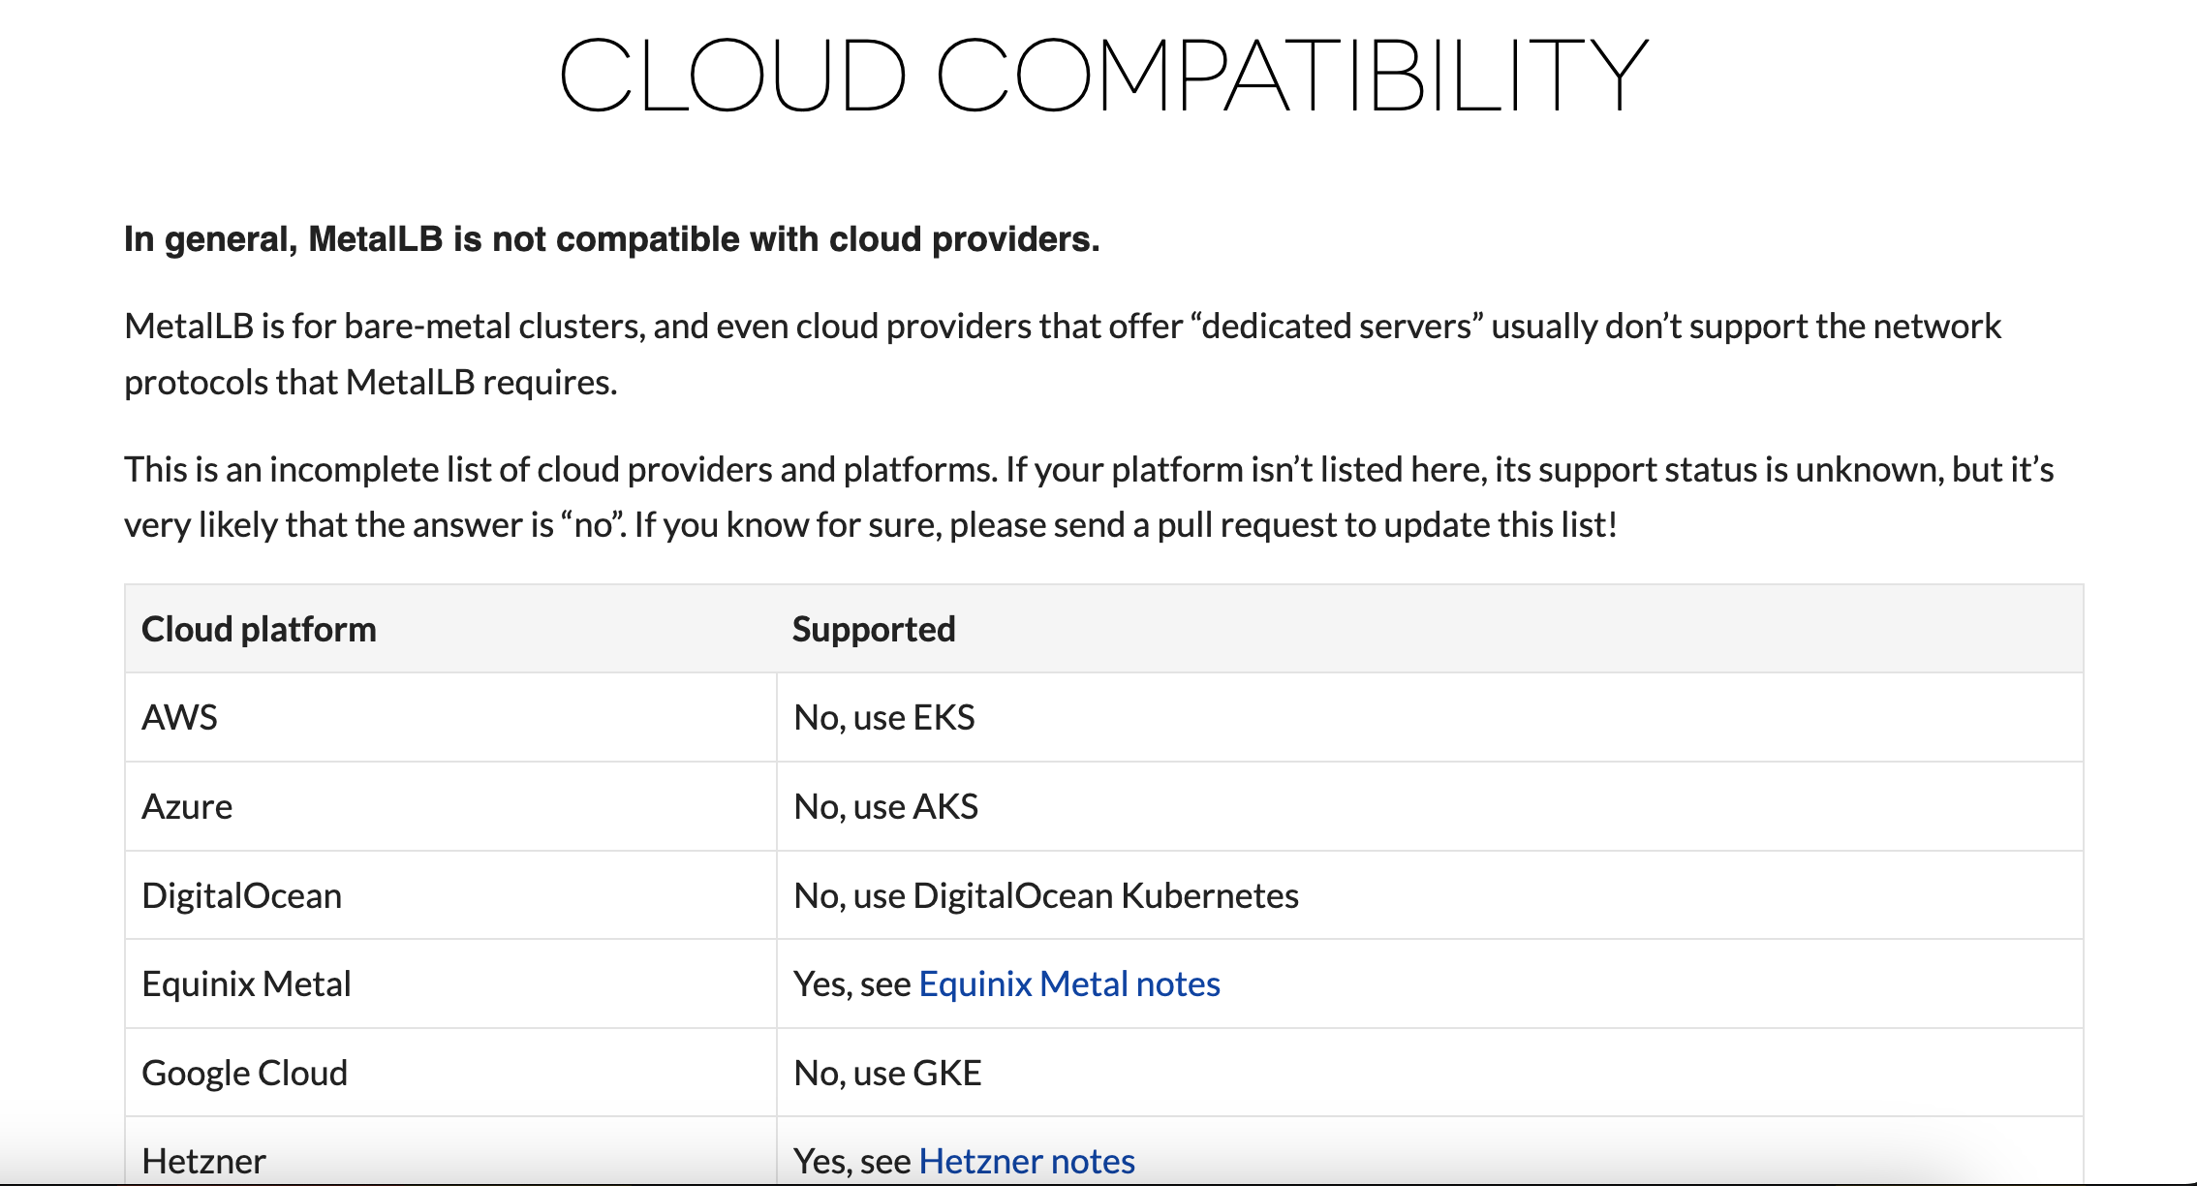
Cloud Controller Manager

Slide 2
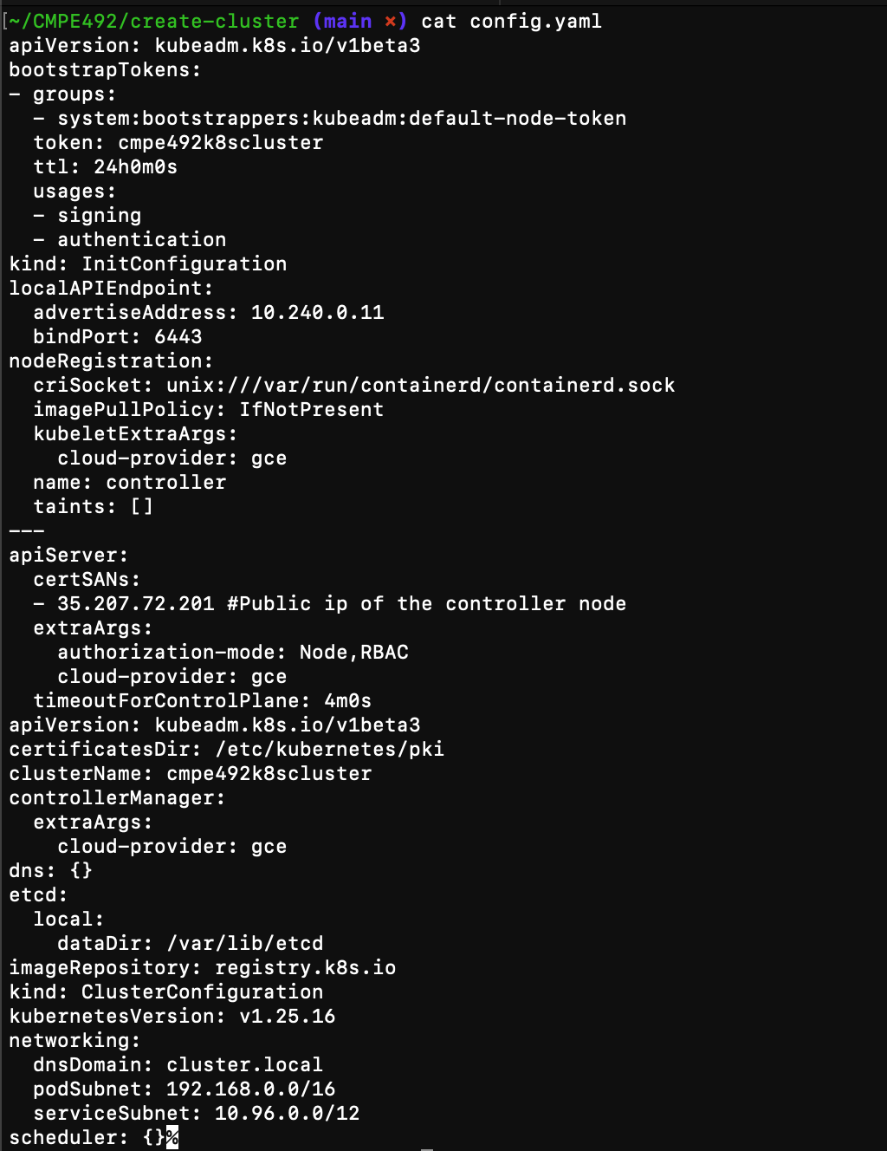
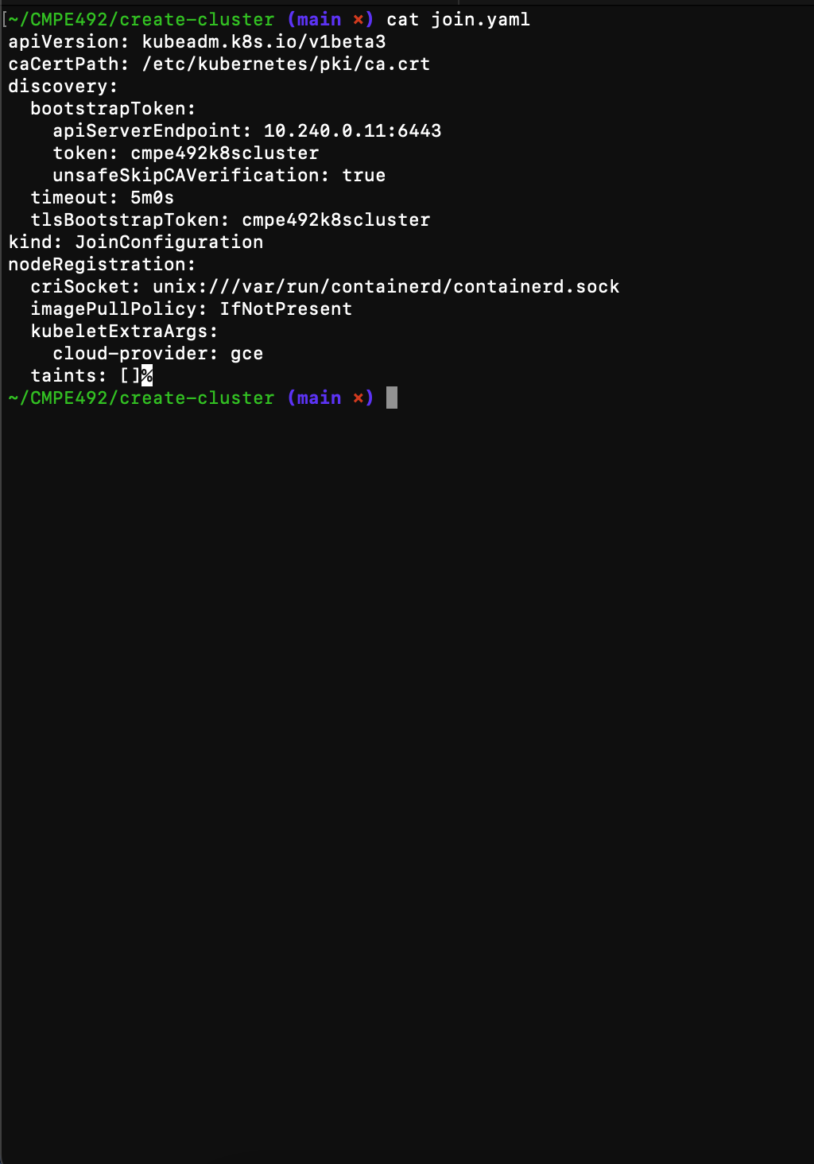

Slide 3
CSI Driver (https://github.com/kubernetes-sigs/gcp-compute-persistent-disk-csi-driver/blob/master/docs/kubernetes/user-guides/driver-install.md)

Slide 4
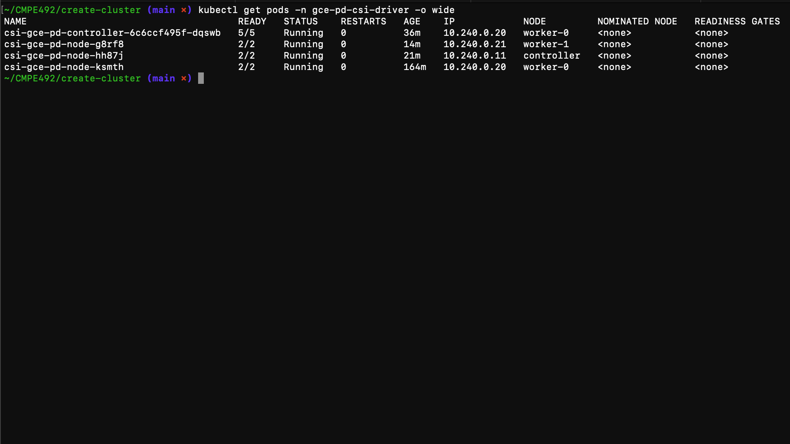

Slide 5
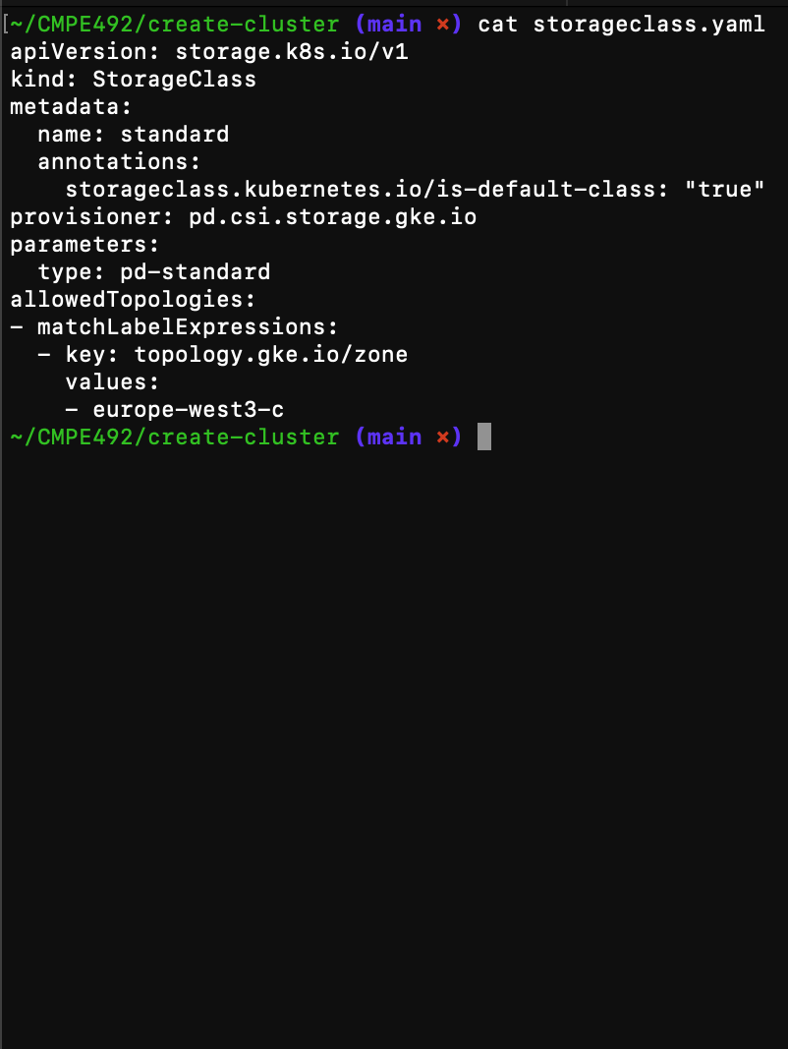
Storage Class (storageclass.yaml)

Slide 6
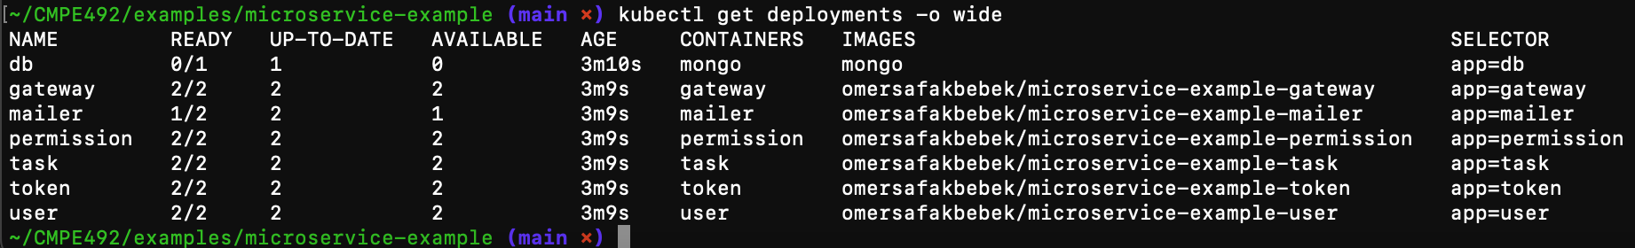
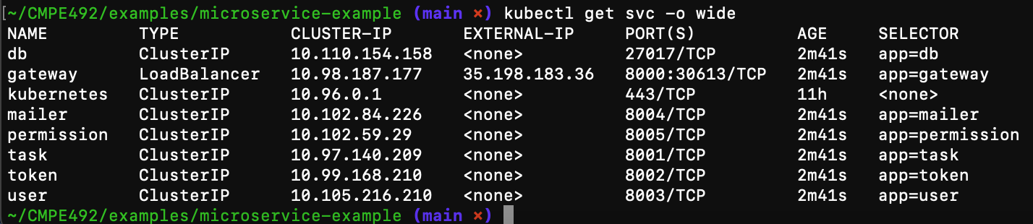
Microservice example resourceları

Slide 7
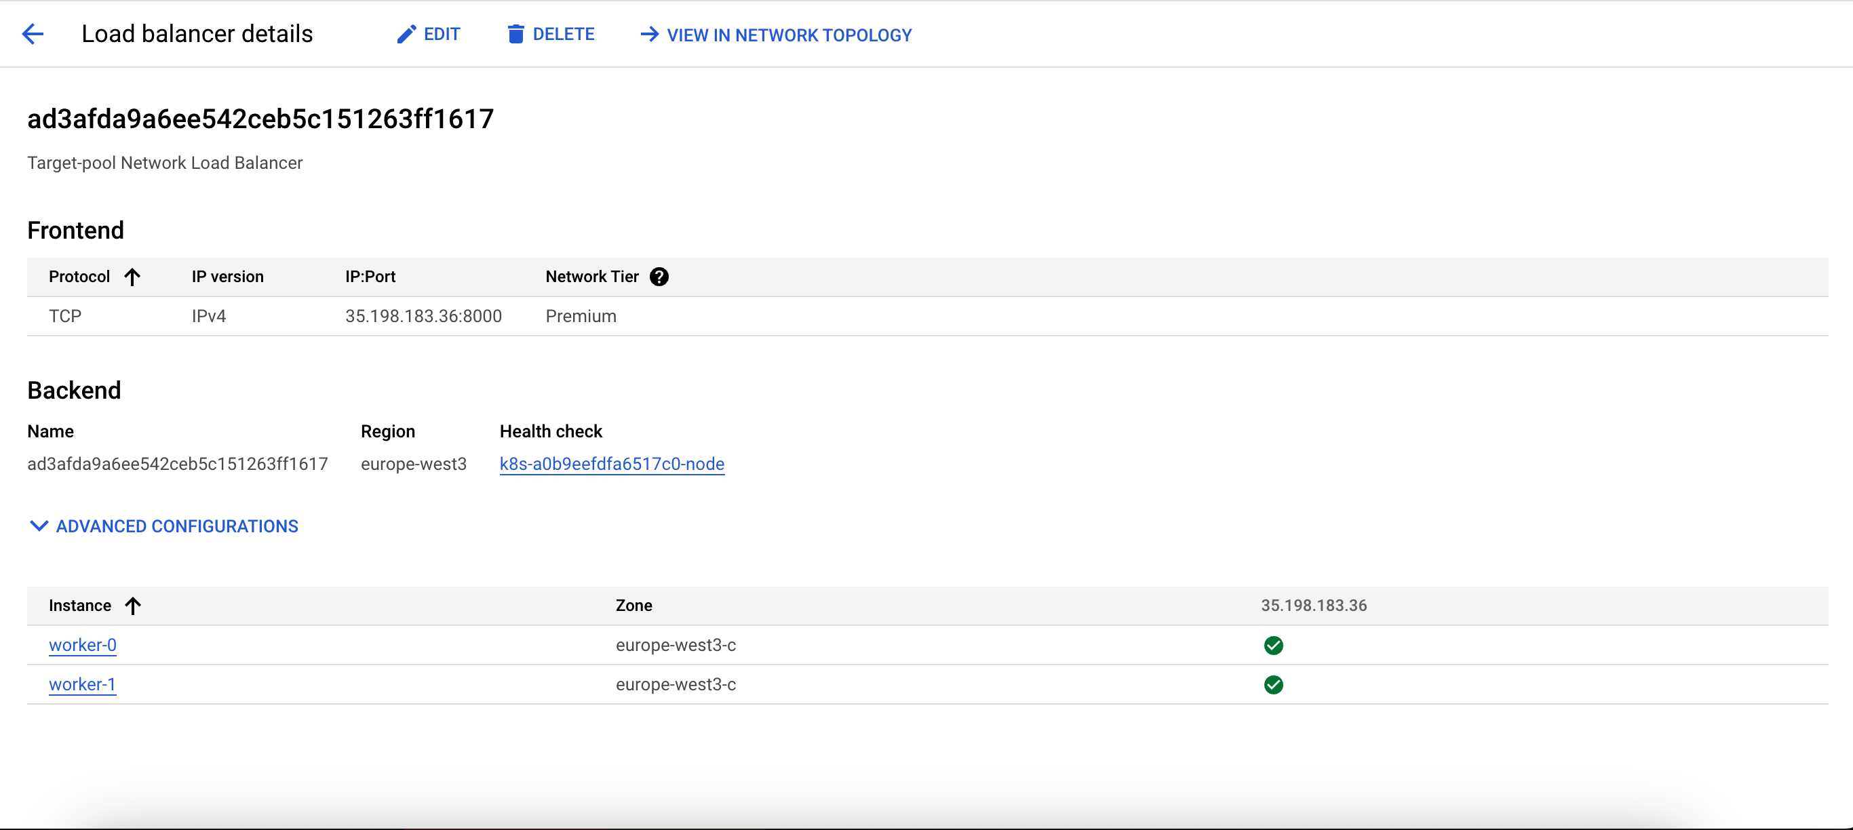
Load balancer

Slide 8
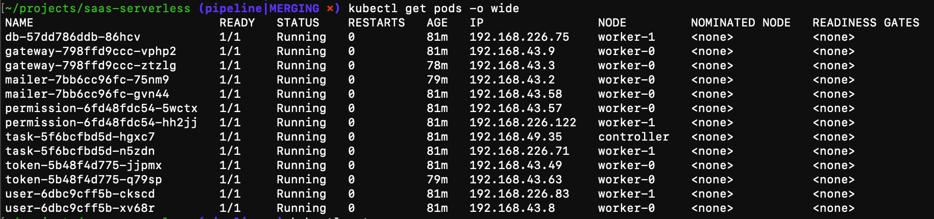

Slide 9
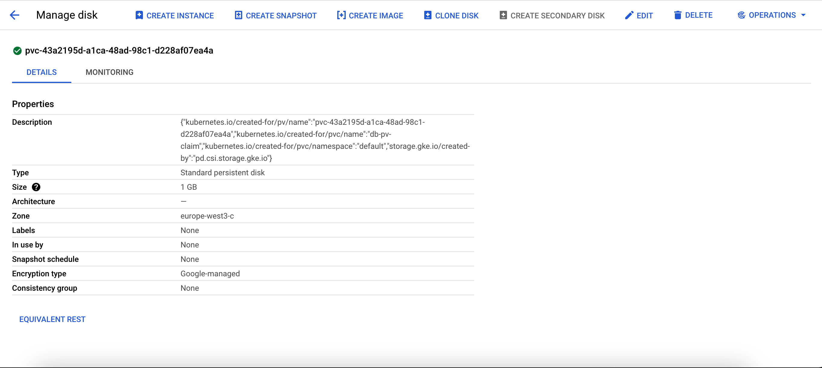
Gcp Disk

Slide 10
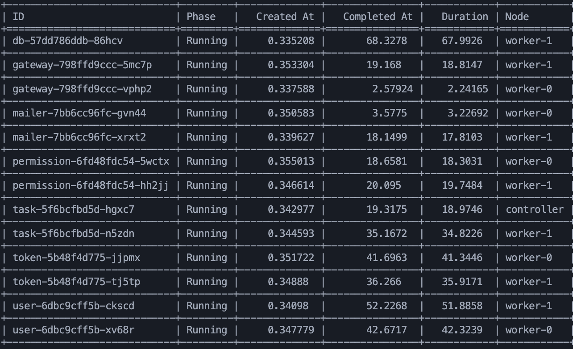
Client Library(https://github.com/kubernetes-client/python)
kubectl kustomize > kust-out.yaml

Slide 11
Kubernetes api vs kubectl
Most operations can be performed through the kubectl command-line interface or other command-line tools, such as kubeadm, which in turn use the API.
http://localhost:8081/#/ (Swagger api)

