Slide 1
Load Balancer

Slide 2
Traffic from the external load balancer is directed at the backend Pods. The cloud provider decides how it is load balanced.
To implement a Service of type: LoadBalancer, Kubernetes typically starts off by making the changes that are equivalent to you requesting a Service of type: NodePort. The cloud-controller-manager component then configures the external load balancer to forward traffic to that assigned node port.
https://kubernetes.io/docs/concepts/services-networking/service/#loadbalancer

Slide 3
You can configure a load balanced Service to omit assigning a node port, provided that the cloud provider implementation supports this.
You can optionally disable node port allocation for a Service of type: LoadBalancer, by setting the field spec.allocateLoadBalancerNodePorts to false. This should only be used for load balancer implementations that route traffic directly to pods as opposed to using node ports. By default, spec.allocateLoadBalancerNodePorts is true and type LoadBalancer Services will continue to allocate node ports. If spec.allocateLoadBalancerNodePorts is set to false on an existing Service with allocated node ports, those node ports will not be de-allocated automatically. You must explicitly remove the nodePorts entry in every Service port to de-allocate those node ports.
https://kubernetes.io/docs/concepts/services-networking/service/#loadbalancer

Slide 4
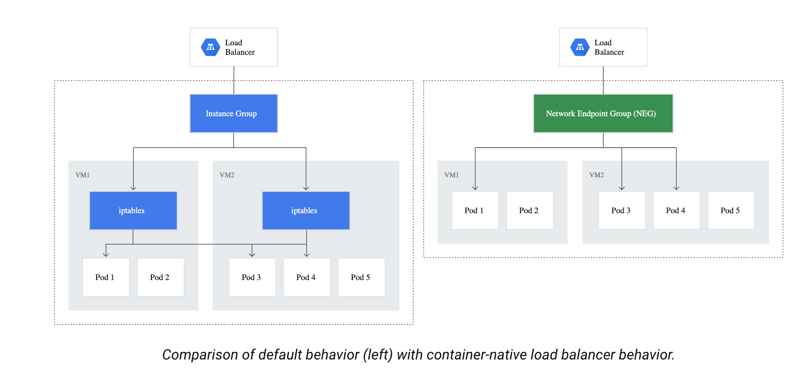
GCP Container-Native Load Balancing
kube-proxy configures nodes' iptables rules to distribute traffic to Pods. Without container-native load balancing, load balancer traffic travels to the node instance groups and gets routed using iptables rules to Pods which might or might not be in the same node. With container-native load balancing, load balancer traffic is distributed directly to the Pods which should receive the traffic, eliminating the extra network hop. Container-native load balancing also helps with improved health checking since it targets Pods directly.
https://cloud.google.com/kubernetes-engine/docs/concepts/container-native-load-balancing

Slide 5
Default Gcp Load Balancer Behaviour
https://www.stackrox.io/blog/kubernetes-networking-demystified/

Slide 6
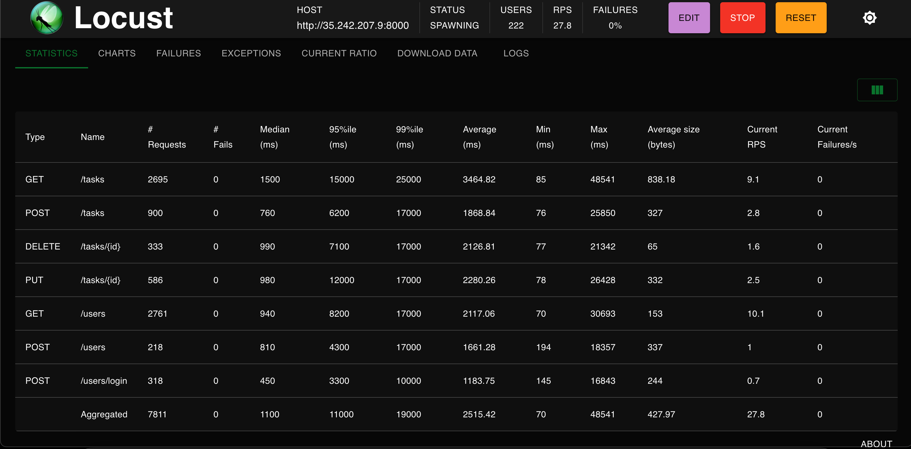
Locust

Slide 7
Autoscaling

Slide 8
Metrics Server
Metrics Server is a scalable, efficient source of container resource metrics for Kubernetes built-in autoscaling pipelines.
Metrics Server collects resource metrics from Kubelets and exposes them in Kubernetes apiserver through Metrics API for use by Horizontal Pod Autoscaler and Vertical Pod Autoscaler. Metrics API can also be accessed by kubectl top, making it easier to debug autoscaling pipelines.
Metrics Server offers:
A single deployment that works on most clusters (see Requirements)
Fast autoscaling, collecting metrics every 15 seconds.
Resource efficiency, using 1 mili core of CPU and 2 MB of memory for each node in a cluster.
Scalable support up to 5,000 node clusters.

Slide 9
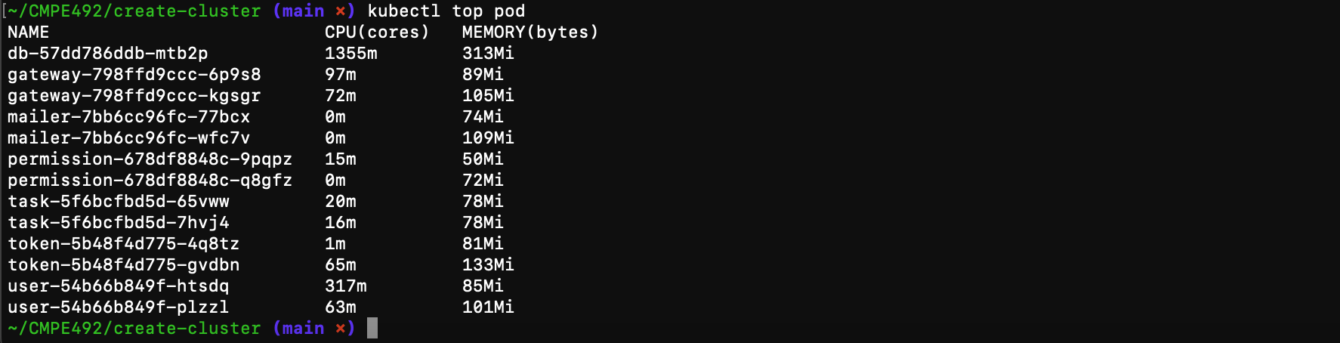

Slide 10
Horizontal Autoscaling
Horizontal scaling means that the response to increased load is to deploy more Pods. This is different from vertical scaling, which for Kubernetes would mean assigning more resources (for example: memory or CPU) to the Pods that are already running for the workload.

Slide 11
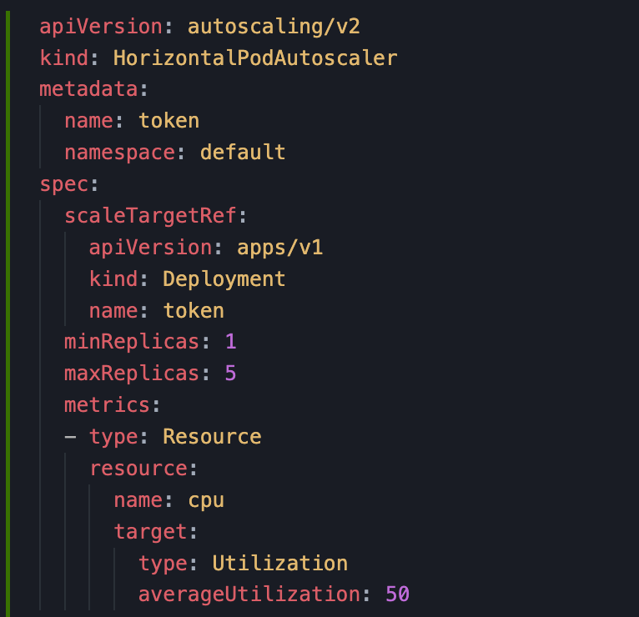

Slide 12
Vertical Autoscaling
Vertical Pod Autoscaler (VPA) frees users from the necessity of setting up-to-date resource limits and requests for the containers in their pods. When configured, it will set the requests automatically based on usage and thus allow proper scheduling onto nodes so that appropriate resource amount is available for each pod. It will also maintain ratios between limits and requests that were specified in initial containers configuration.
"Auto": VPA assigns resource requests on pod creation as well as updates them on existing pods using the preferred update mechanism. Currently, this is equivalent to "Recreate" (see below). Once restart free ("in-place") update of pod requests is available, it may be used as the preferred update mechanism by the "Auto" mode.
"Recreate": VPA assigns resource requests on pod creation as well as updates them on existing pods by evicting them when the requested resources differ significantly from the new recommendation (respecting the Pod Disruption Budget, if defined). This mode should be used rarely, only if you need to ensure that the pods are restarted whenever the resource request changes. Otherwise, prefer the "Auto" mode which may take advantage of restart-free updates once they are available.
"Initial": VPA only assigns resource requests on pod creation and never changes them later.
"Off": VPA does not automatically change the resource requirements of the pods. The recommendations are calculated and can be inspected in the VPA object.

Slide 13
