Slide 1
Ansible

Slide 2
Create VMS (1 controller + n worker)
Install required packages on all nodes
Initialize the cluster on the controller node
Join worker nodes to the k8s cluster
Install Calico CNI plugin
Install the metrics server
Copy kubectl config to the local machine
Install gcp compute persistent disk csi driver
Setup storage class
Deploy the application
Get the external ip of the load balancer
Run the load generator for 1 minute (locust)
Delete the VMS

Slide 3
HELM
Helm is a tool that automates the creation, packaging, configuration, and deployment of Kubernetes applications by combining your configuration files into a single reusable package.
Helm is an open source package manager for Kubernetes. It provides the ability to provide, share, and use software built for Kubernetes.

Slide 4
Kubernetes deploys using YAML configuration files. For complex deployments with frequent updates, it can be difficult to keep track of all the different versions for these files. Helm is a handy tool that maintains a single deployment YAML file with version information. This file lets you set up and manage a complex Kubernetes cluster with a few commands.

Slide 5
HELM CHARTS
A Helm chart is a package that contains all the necessary resources to deploy an application to a Kubernetes cluster. This includes YAML configuration files for deployments, services, secrets, and config maps that define the desired state of your application.

Slide 6
CONFIGS
The config contains application configurations that you usually store in a YAML file. Resources in the Kubernetes cluster are deployed based on these values.

Slide 7
RELEASES
A running instance of a chart is known as a release. When you run the helm install command, it pulls the config and chart files and deploys all the Kubernetes resources.

Slide 8
Architecture
Helm’s architecture has two main components: client and library.
A Helm client is a command-line utility for end users to control local chart development and manage repositories and releases. Just like using the MySQL database client to run MySQL commands, you use the Helm client to run Helm commands.
The Helm library does all the heavy lifting. It contains the actual code to perform the operations specified in the Helm command. The combination of config and chart files to create any release is handled by the Helm library.

Slide 9
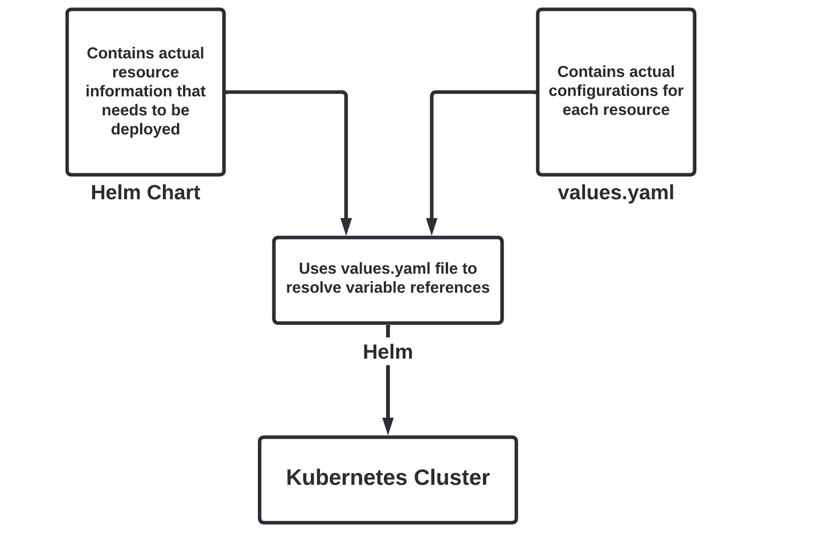

Slide 10
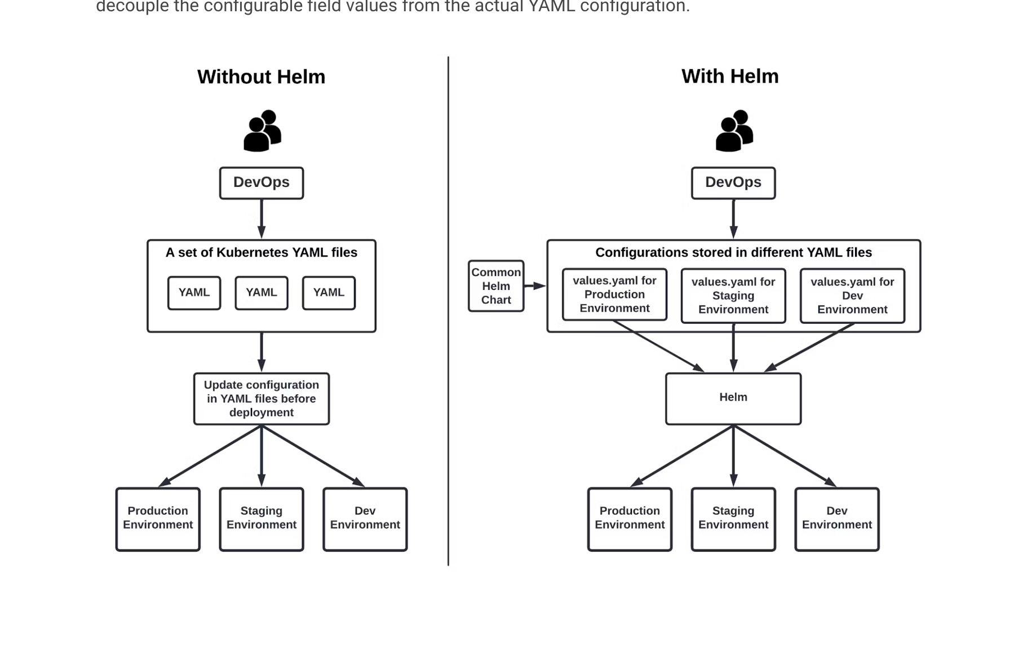

Slide 11
HELM REPOSITORIES
https://artifacthub.io/packages/search?kind=0

Slide 12
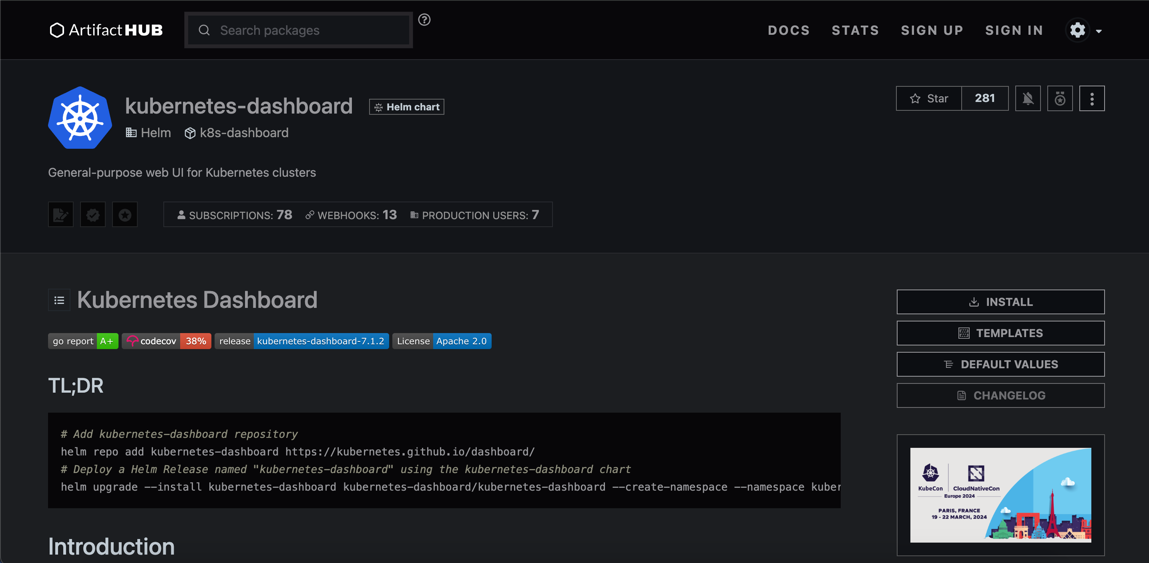
helm repo add kubernetes-dashboard https://kubernetes.github.io/dashboard/
helm upgrade --install kubernetes-dashboard kubernetes-dashboard/kubernetes-dashboard --create-namespace --namespace kubernetes-dashboard

