Slide 1
Rancher

Slide 2
Rancher is a Kubernetes management tool to deploy and run clusters anywhere and on any provider.
Rancher can provision Kubernetes from a hosted provider, provision compute nodes and then install Kubernetes onto them, or import existing Kubernetes clusters running anywhere.
Rancher is a complete container management platform for Kubernetes, giving you the tools to successfully run Kubernetes anywhere.

Slide 3
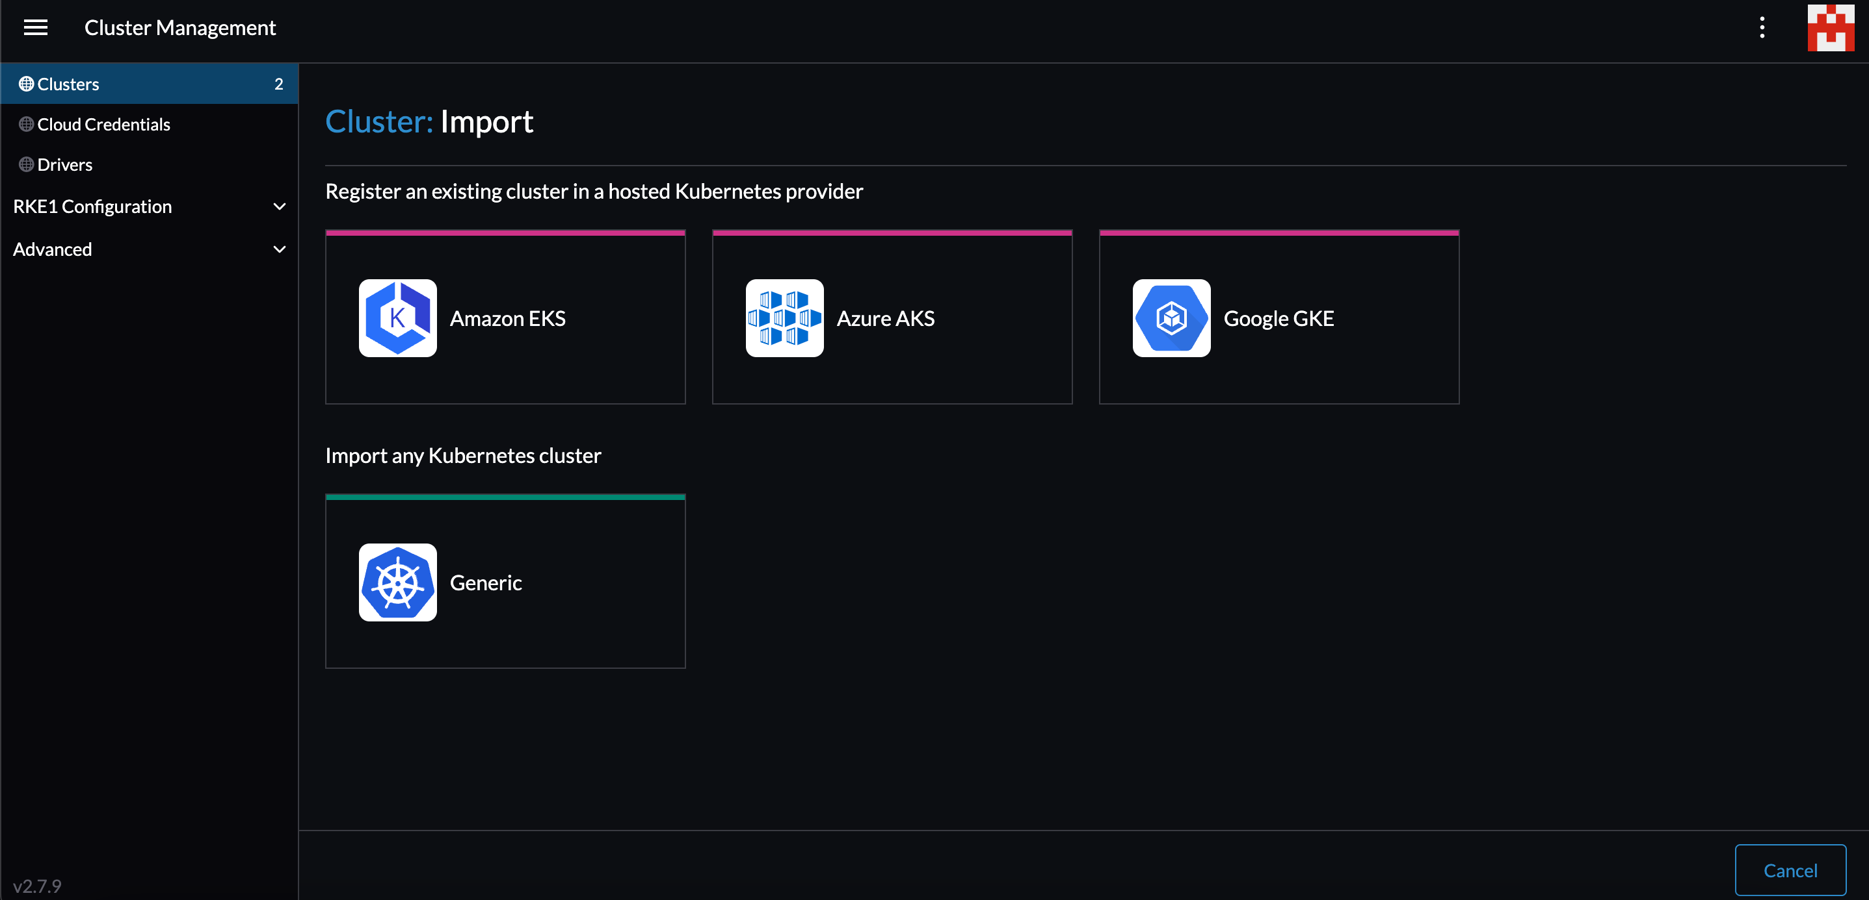

Slide 4
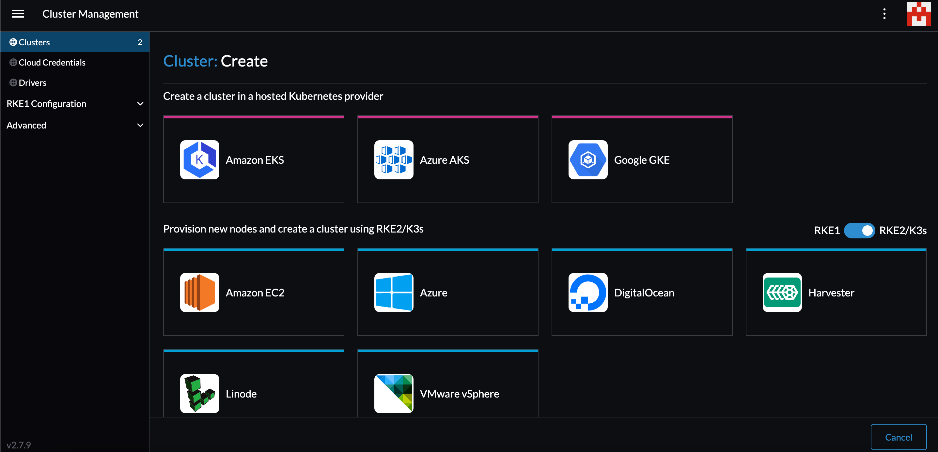

Slide 5
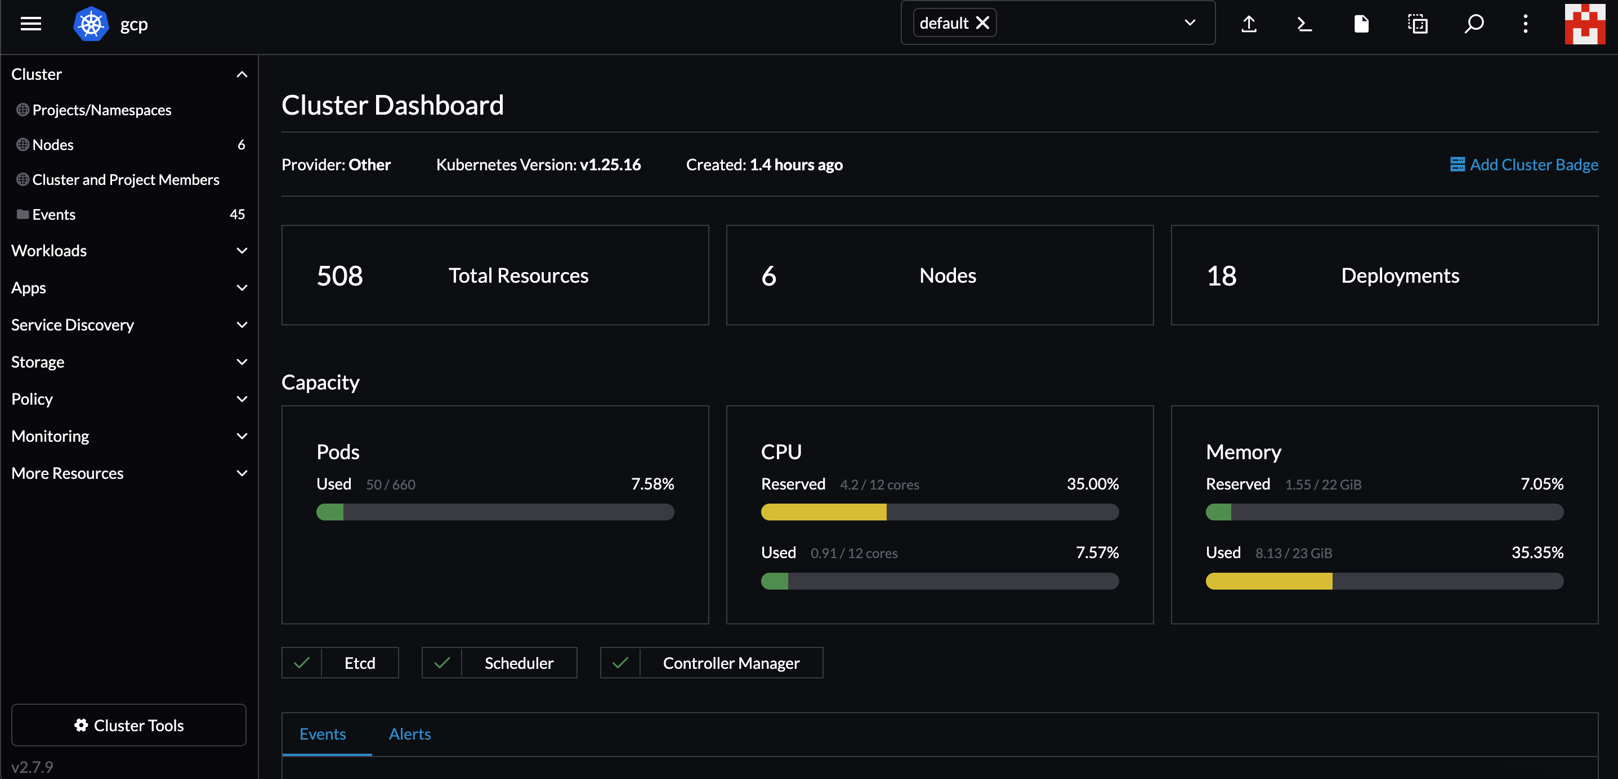

Slide 6
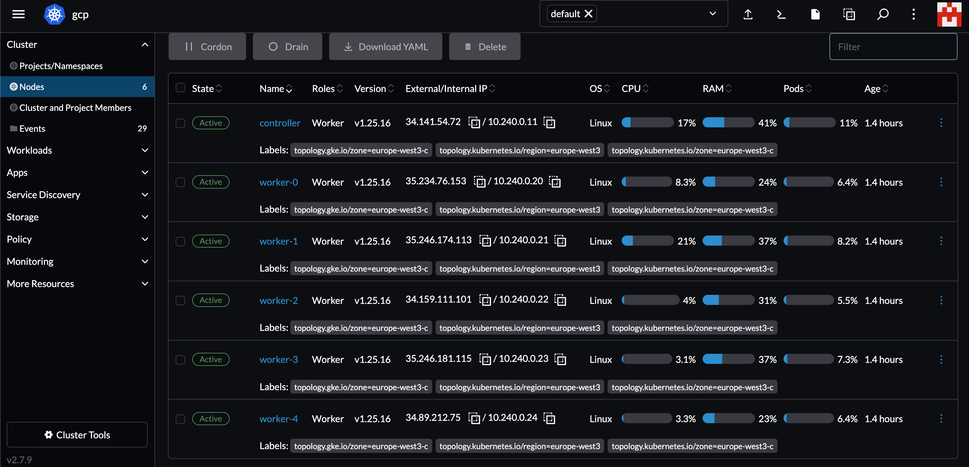

Slide 7
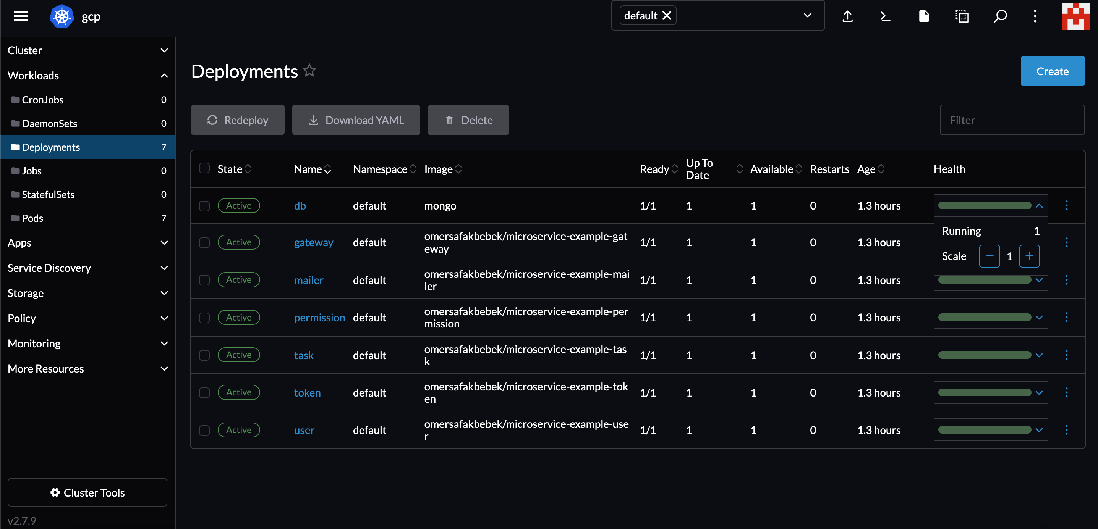

Slide 8
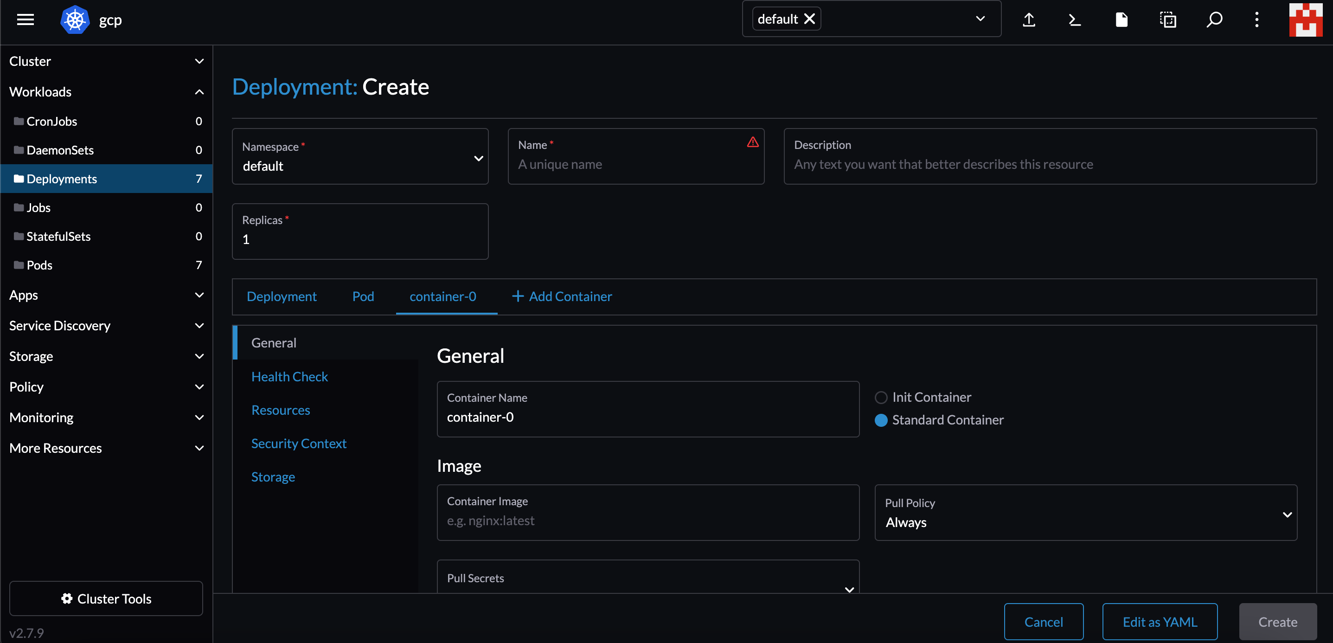

Slide 9
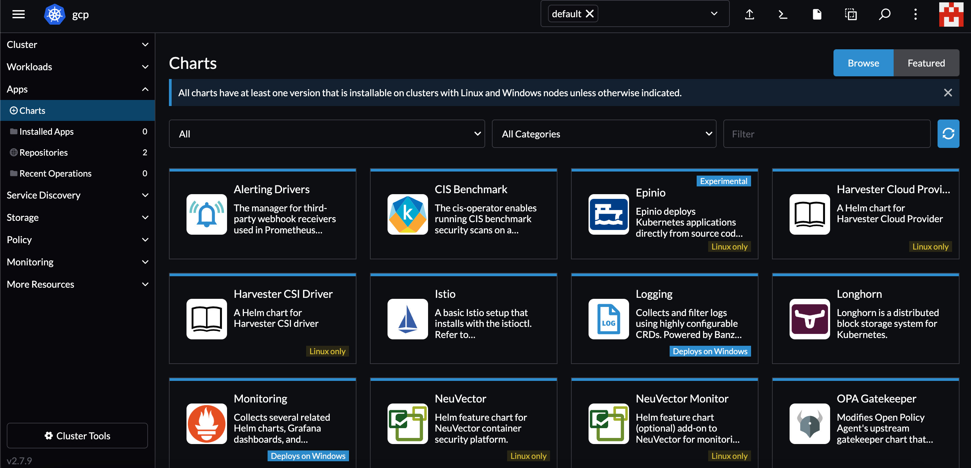

Slide 10
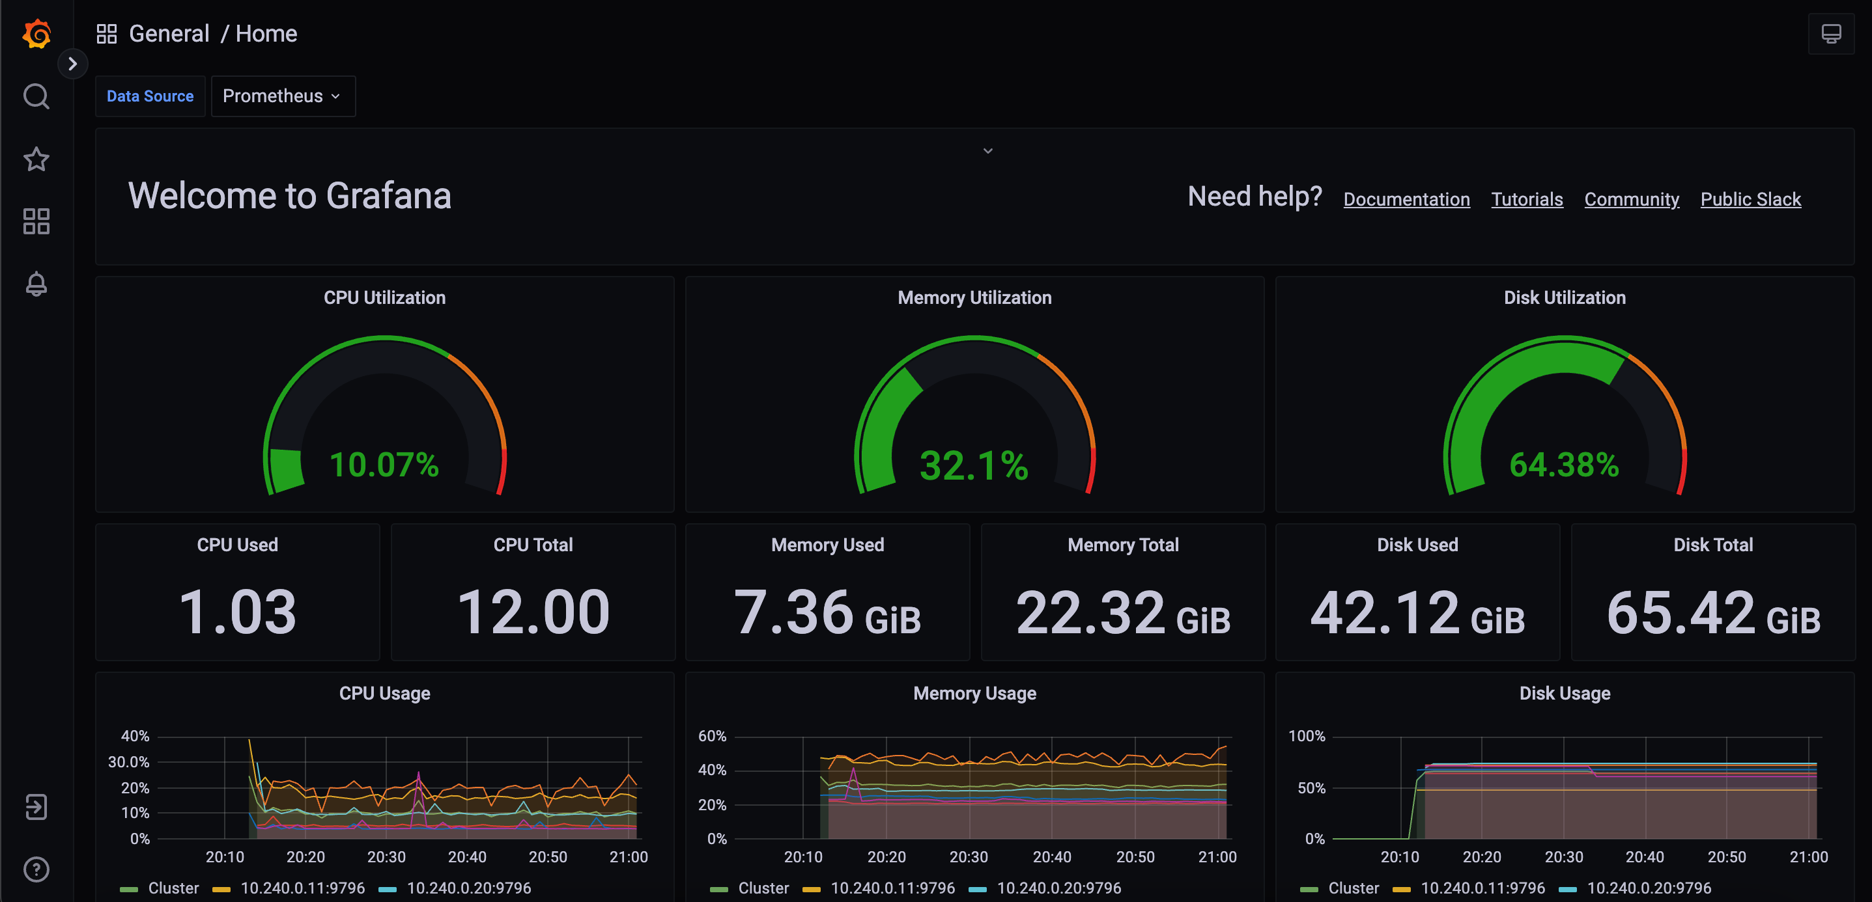

Slide 11
Addons

Slide 12
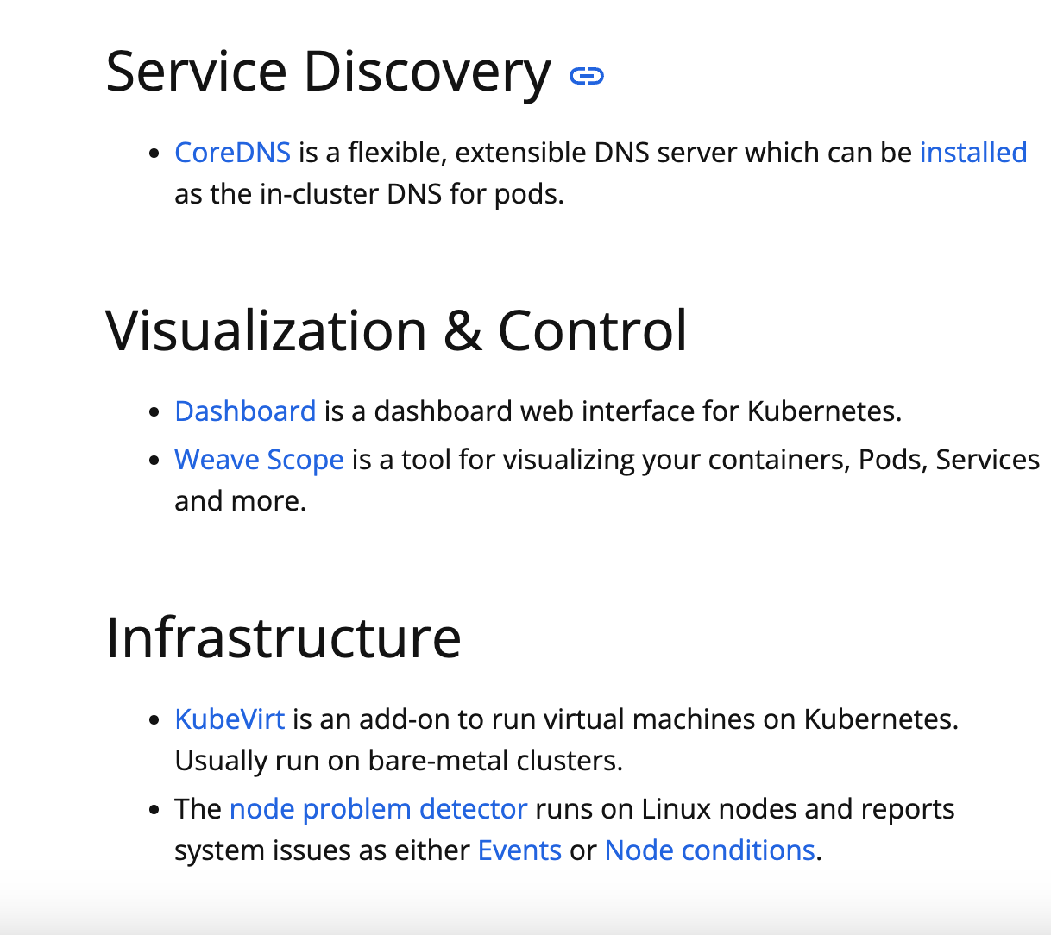
Add-ons extend the functionality of Kubernetes

Slide 13
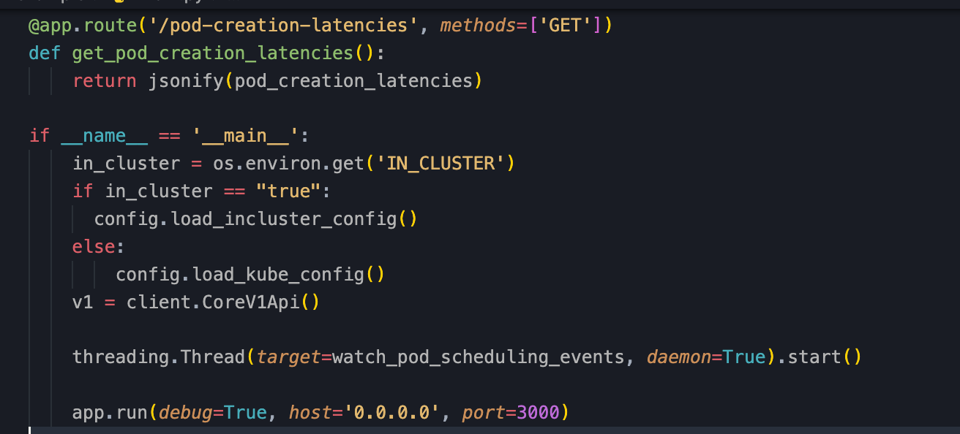

Slide 14
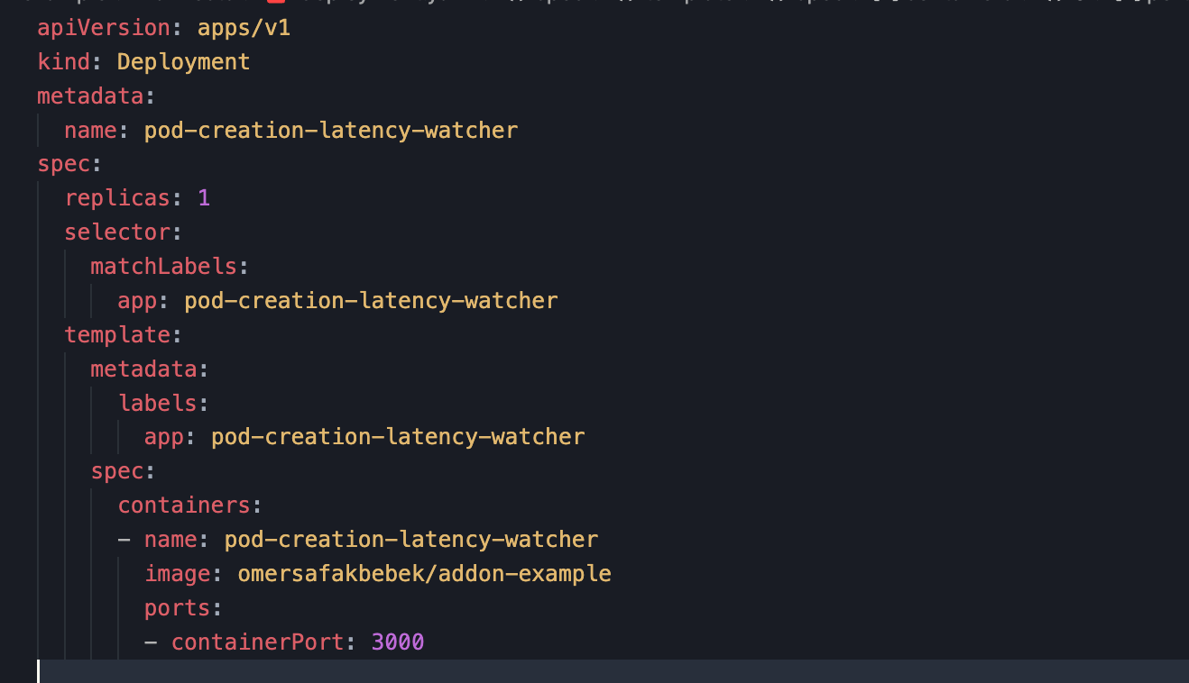

Slide 15
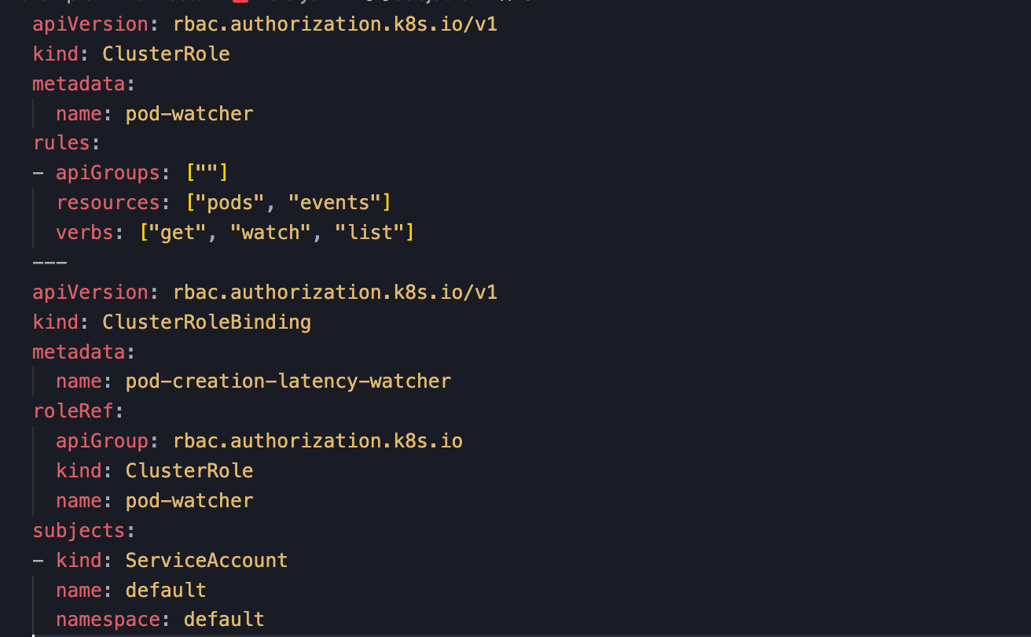

Slide 16
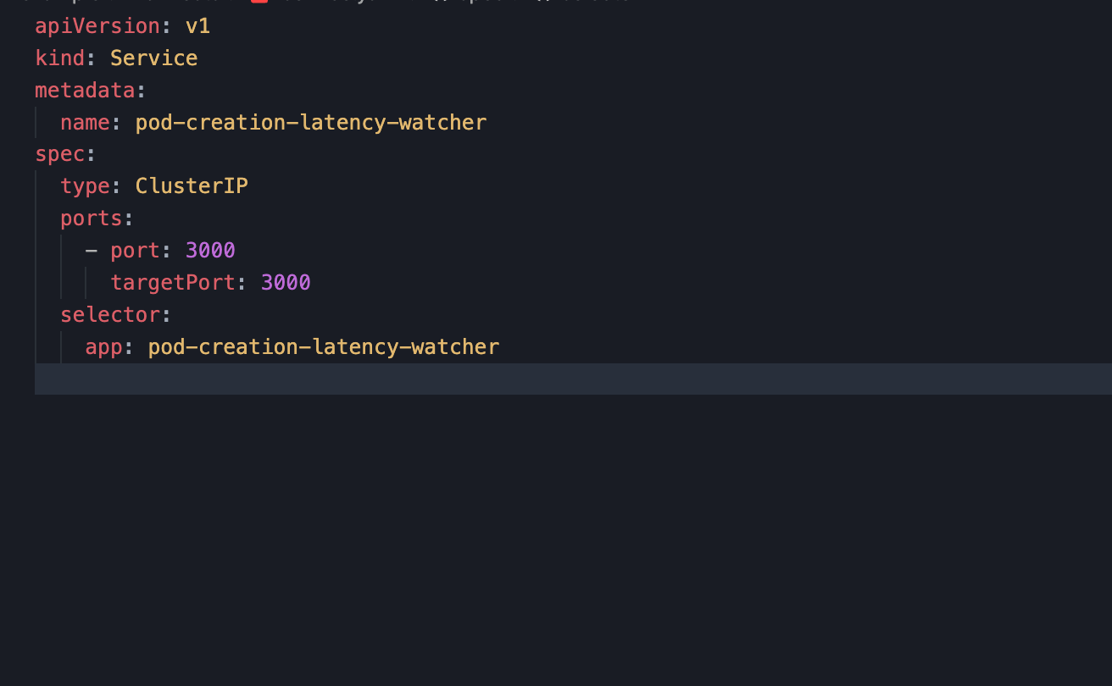

Slide 17
