Slide 1
Horizontal Scaling

Slide 2
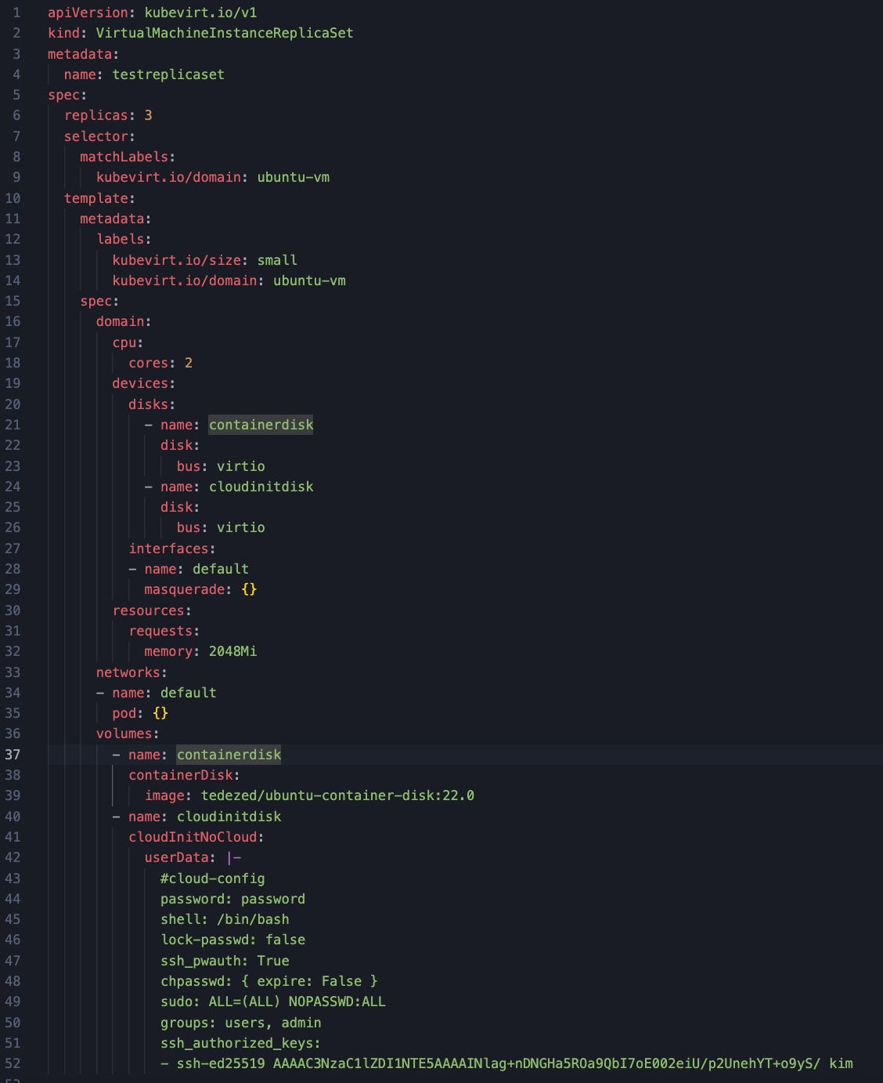

Slide 3
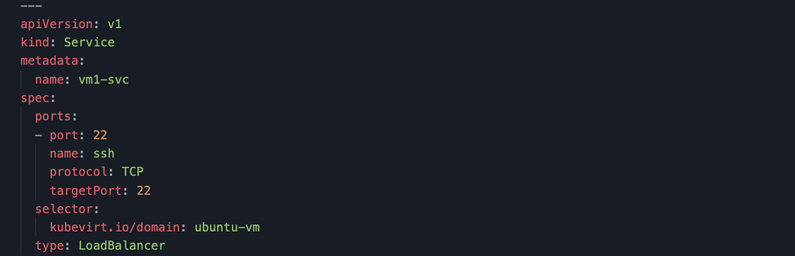

Slide 4
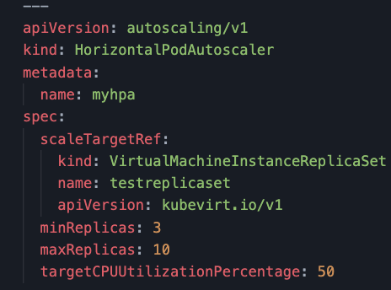

Slide 5
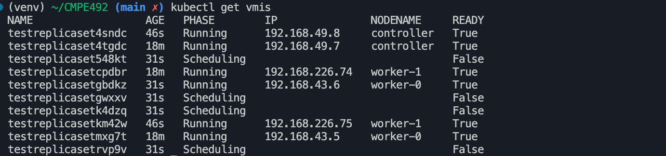

Slide 6
Application

Slide 7
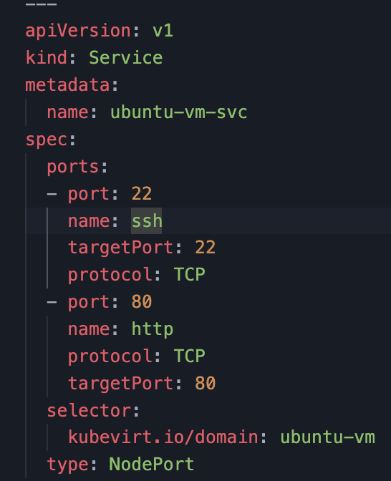
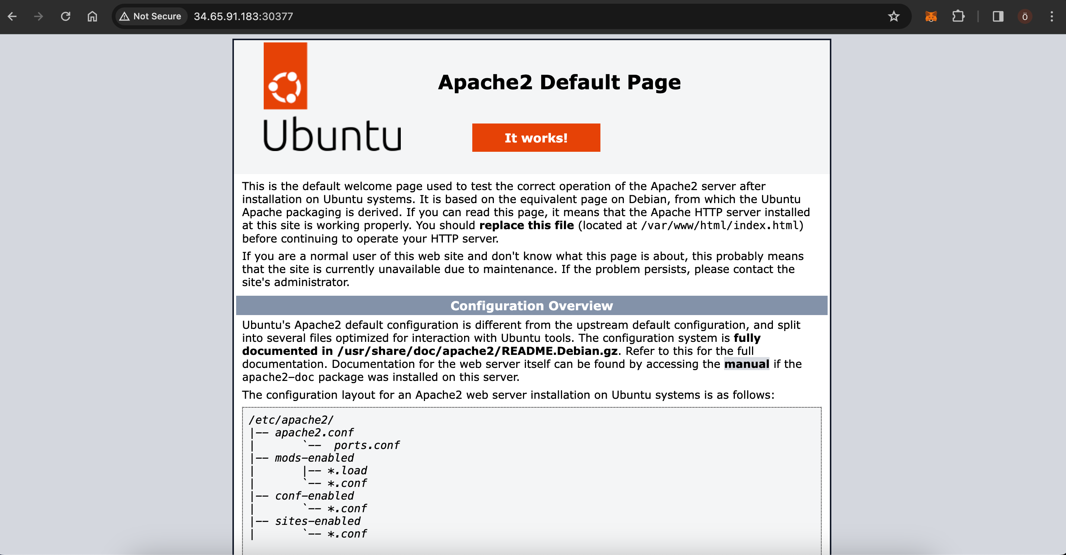

Slide 8
KubeVirt supports the ability to assign a startup script to a VirtualMachineInstance instance which is executed automatically when the VM initializes.
These scripts are commonly used to automate injection of users and SSH keys into VMs in order to provide remote access to the machine. For example, a startup script can be used to inject credentials into a VM that allows an Ansible job running on a remote host to access and provision the VM.
Startup scripts are not limited to any specific use case though. They can be used to run any arbitrary script in a VM on boot.

