Slide 1
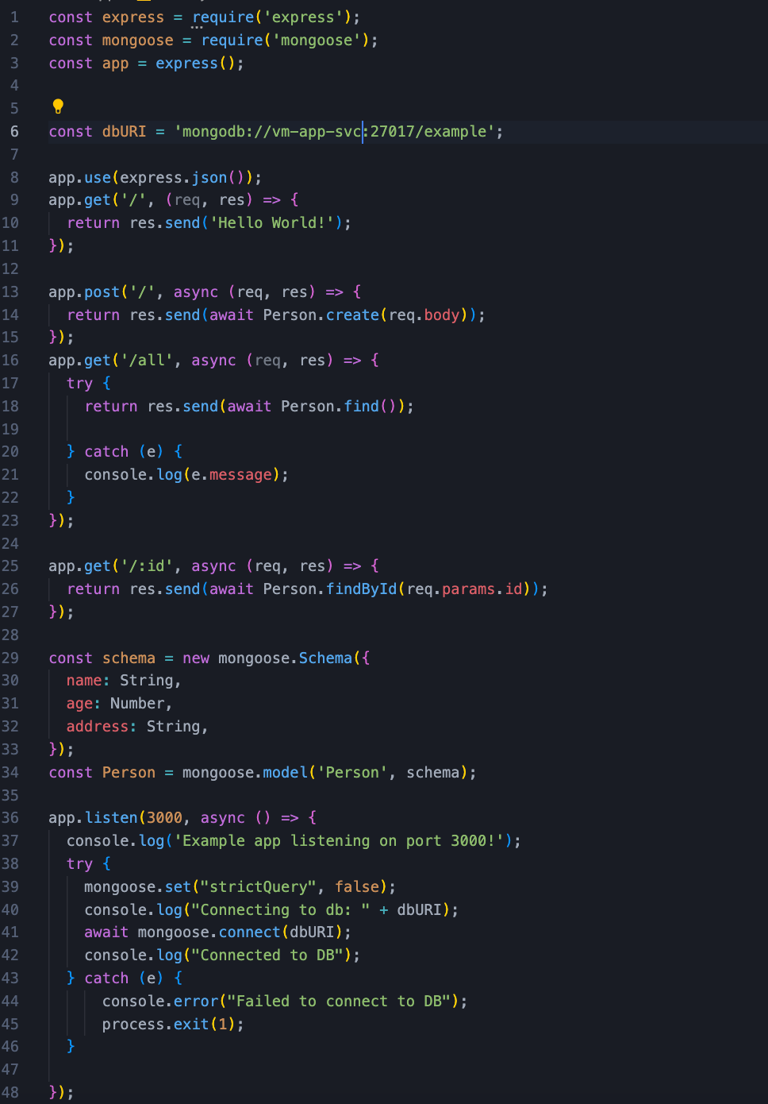
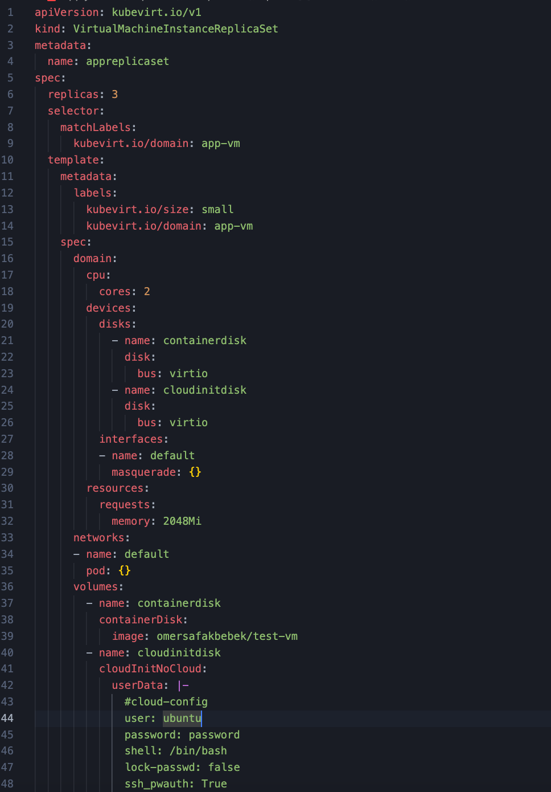
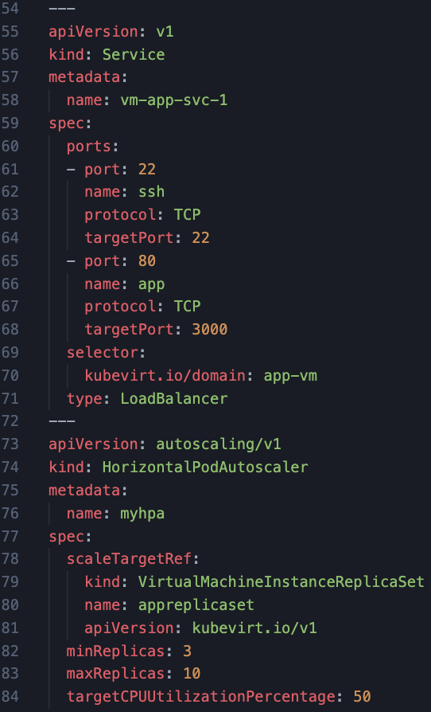
App

Slide 2
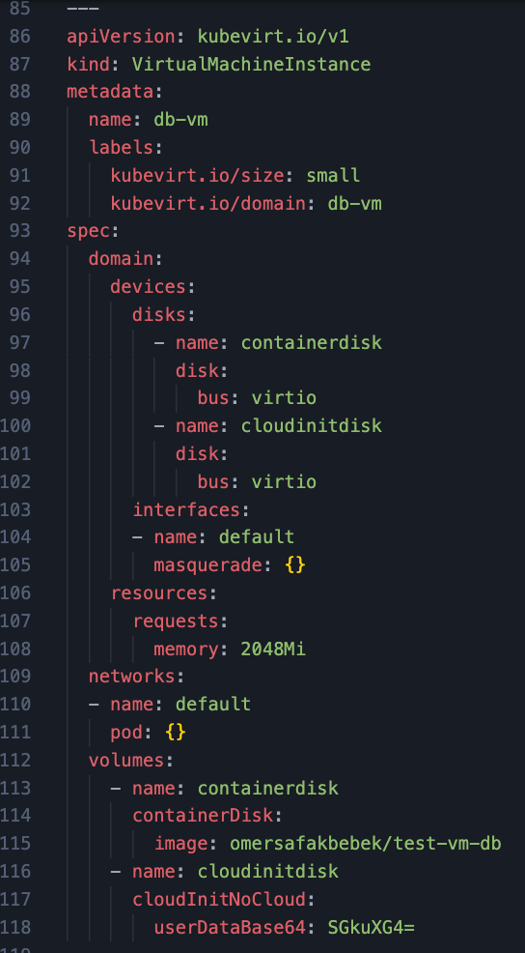
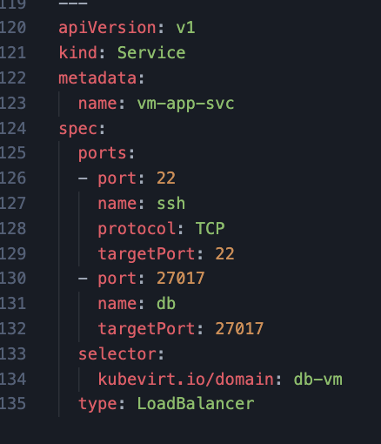
DB

Slide 3
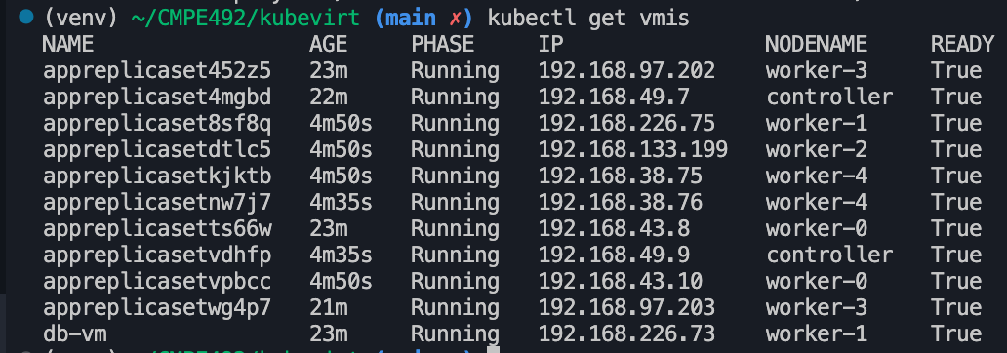
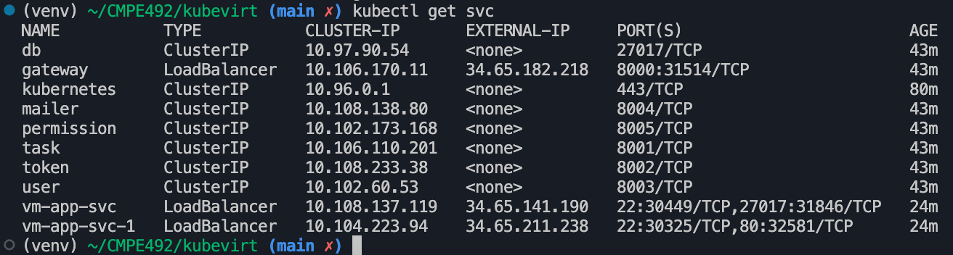
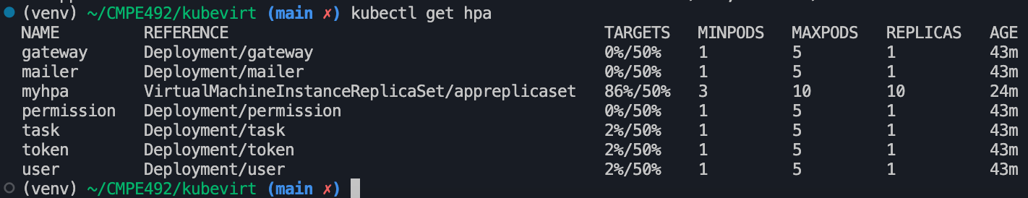
Resources

Slide 4
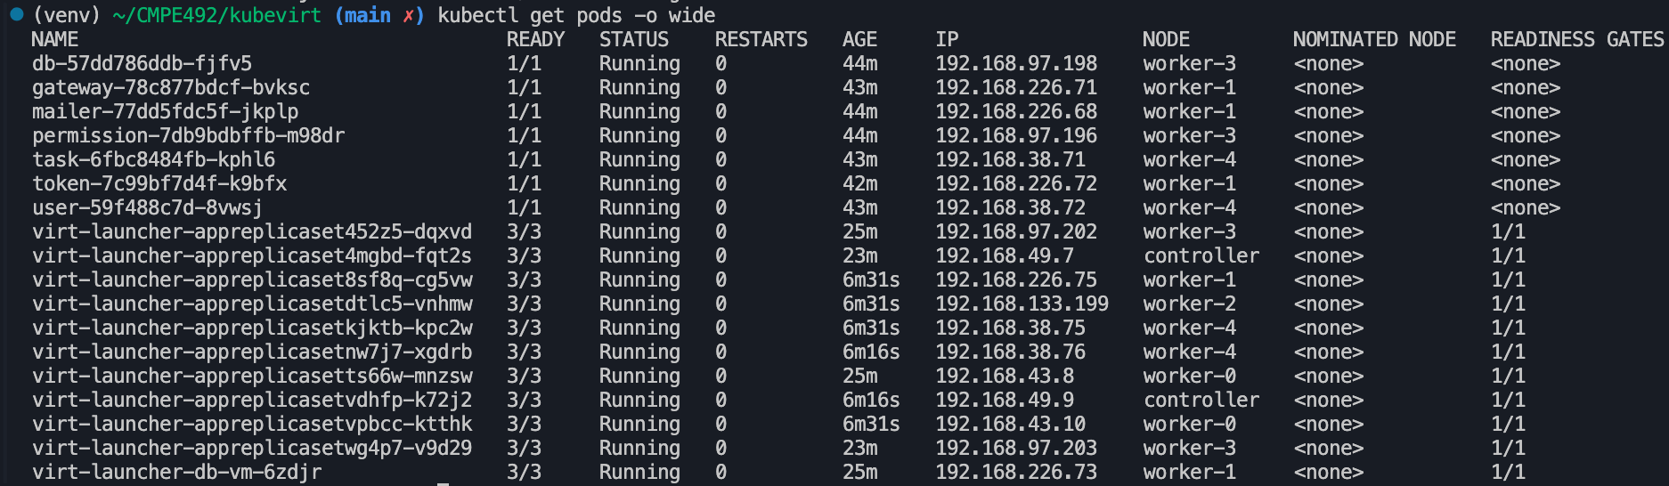
Resources

Slide 5
Live Vm Migration

Slide 6
Live Migration is a common virtualization feature supported by KubeVirt where virtual machines running on one cluster node move to another cluster node without shutting down the guest OS or its applications.

Slide 7
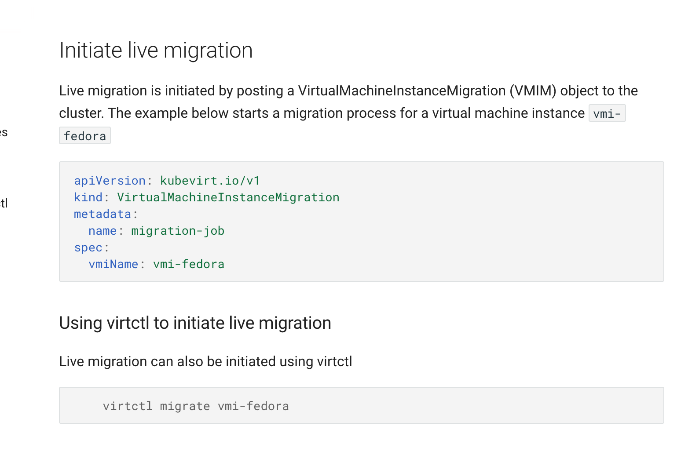

Slide 8
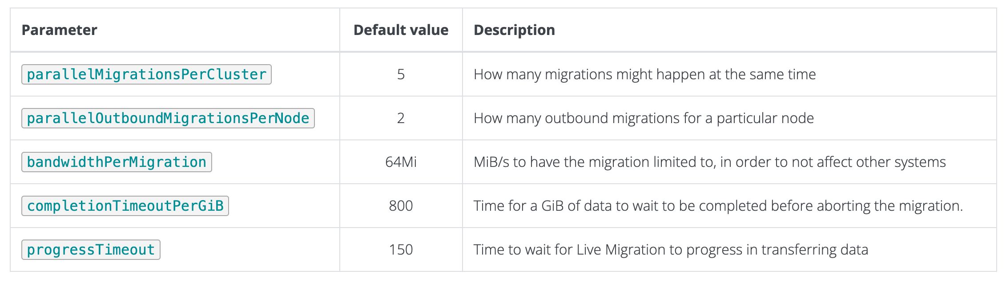
Paramaters

Slide 9
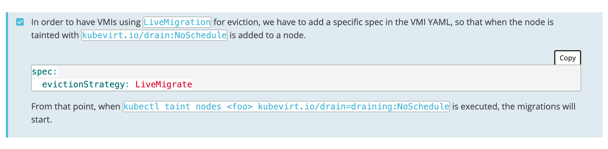
Node Eviction (VM)
Sometimes, a node requires to be put on maintenance and it includes workloads on it, either containers or, in KubeVirt’s case, VM’s.
It is possible to use selectors, for example, move all the virtual machines to another node via kubectl drain <nodename>, for example, evicting all KubeVirt VM’s from a node can be done via:
kubectl drain <node name> --delete-local-data --ignore-daemonsets=true --force --pod-selector=kubevirt.io=virt-launcher
If we omit the --pod-selector, we’ll force eviction of all Pods and VM’s from a node.

Slide 10
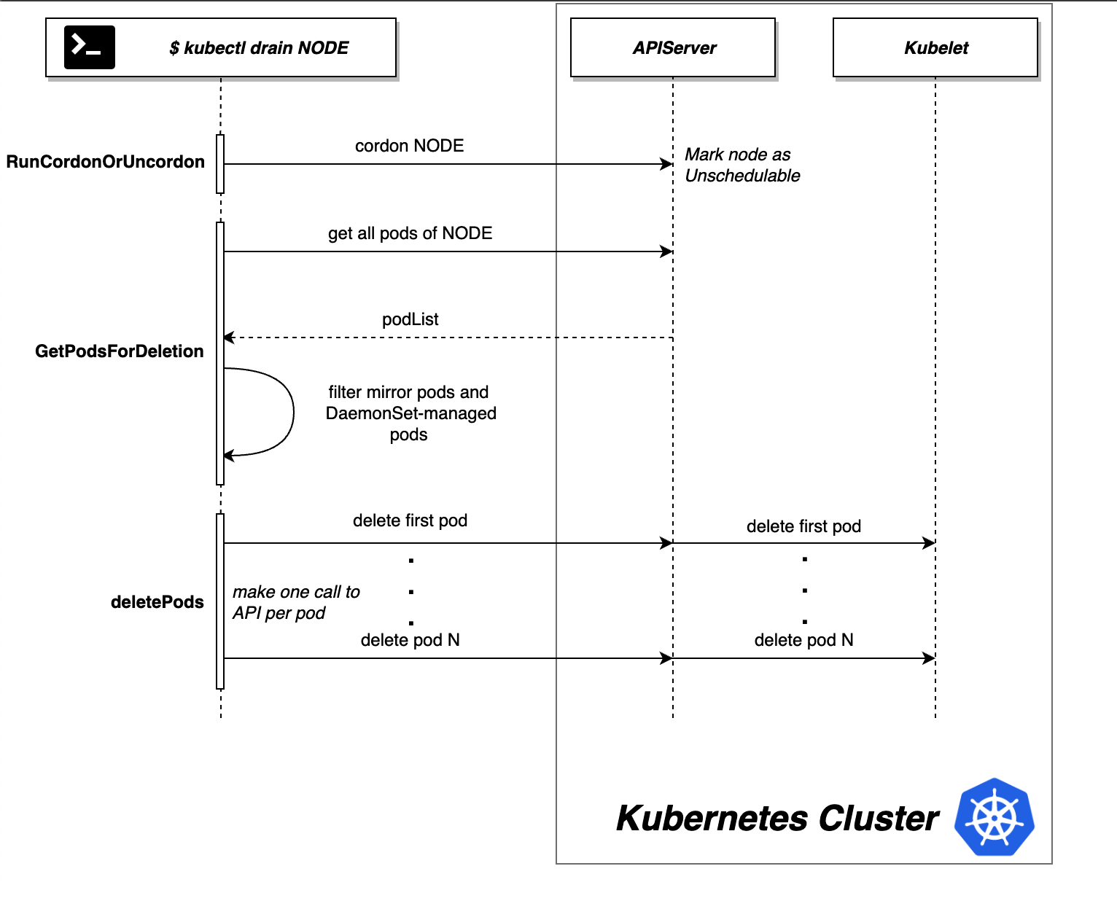
Node Eviction (Pod)
Pods do not, by themselves, self-heal. If a Pod is scheduled to a node that then fails, the Pod is deleted; likewise, a Pod won't survive an eviction due to a lack of resources or Node maintenance. Kubernetes uses a higher-level abstraction, called a controller, that handles the work of managing the relatively disposable Pod instances.

Slide 11
Pod Migration
Kubernetes, Google’s open source project for cluster orchestration, does not presently support live migration of its pods, the system’s units of organization. There have been discussions among the project maintainers around live pod migration, but to our knowledge the feature is not actively being worked on
The simplest way to migrate a running pod in Kubernetes is to stop it and deploy a new pod to a different server. This approach respects the “cattle” principle, but has two major drawbacks:
Unless the application immediately dumps its runtime state to disk upon receiving the SIGTERM signal, any state is lost after the migration.
Any open TCP connections will stop working, which may create inconsistencies between clients and the server.

Slide 12
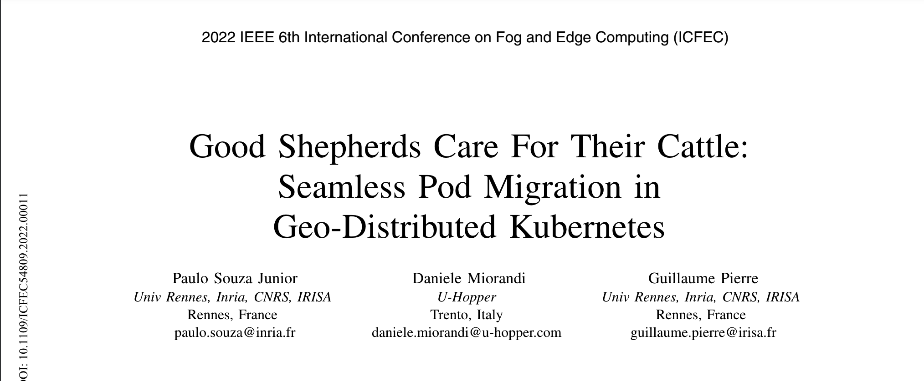
https://ieeexplore.ieee.org/stamp/stamp.jsp?tp=&arnumber=9799256

Slide 13
This paper presents MyceDrive, a pod migration technique integrated within the Kubernetes container orchestration system. Following the pet/cattle analogy, MyceDrive avoids killing a healthy running pod and waiting for Kubernetes to restart a new one when it is, instead, possible to migrate it to a different server. Migration is totally transparent to the application running inside the pod as well as the clients having open TCP connections to the migrated pod. MyceDrive relies on DMTCP [5] to checkpoint the container’s memory state and open network connections at the migration time, and to resume this saved state in the new pod. MyceDrive integrates in regular Kubernetes deployments with no need for any specific CPU architecture, OS, kernel modules or hypervisor

