Slide 1
Storage Options

Slide 2
CEPH
Ceph is a distributed storage system that provides file, block and object storage and is deployed in large scale production clusters.
Rook is an open source cloud-native storage orchestrator, providing the platform, framework, and support for Ceph storage to natively integrate with cloud-native environments.
Rook automates deployment and management of Ceph to provide self-managing, self-scaling, and self-healing storage services. The Rook operator does this by building on Kubernetes resources to deploy, configure, provision, scale, upgrade, and monitor Ceph.
We recommend Rook as the way to run Ceph in Kubernetes or to connect an existing Ceph storage cluster to Kubernetes.

Slide 3
LONGHORN
Longhorn is a lightweight, reliable, and powerful distributed block storage system for Kubernetes.

Slide 4
With Longhorn, you can:
Use Longhorn volumes as persistent storage for the distributed stateful applications in your Kubernetes cluster
Partition your block storage into Longhorn volumes so that you can use Kubernetes volumes with or without a cloud provider
Replicate block storage across multiple nodes and data centers to increase availability
Store backup data in external storage such as NFS or AWS S3
Create cross-cluster disaster recovery volumes so that data from a primary Kubernetes cluster can be quickly recovered from backup in a second Kubernetes cluster
Schedule recurring snapshots of a volume, and schedule recurring backups to NFS or S3-compatible secondary storage
Restore volumes from backup
Upgrade Longhorn without disrupting persistent volumes

Slide 5
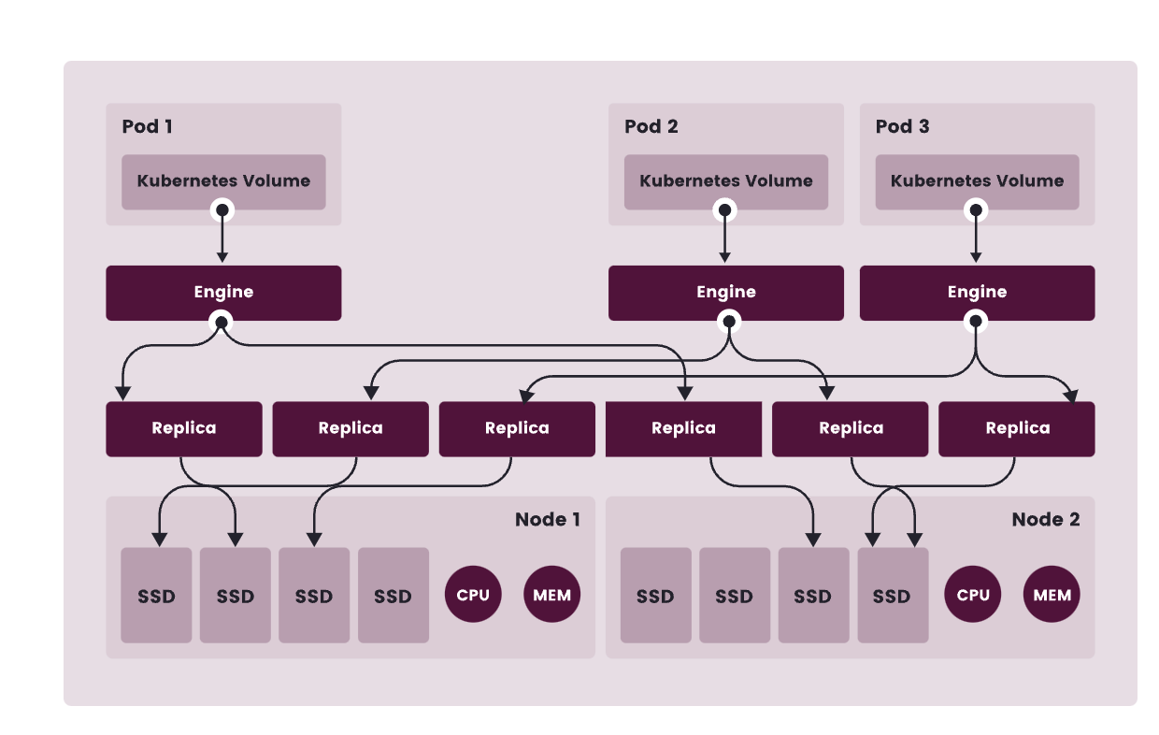
Longhorn Architecture
Longhorn creates a dedicated storage controller for each volume and synchronously replicates the volume across multiple replicas stored on multiple nodes.

Slide 6
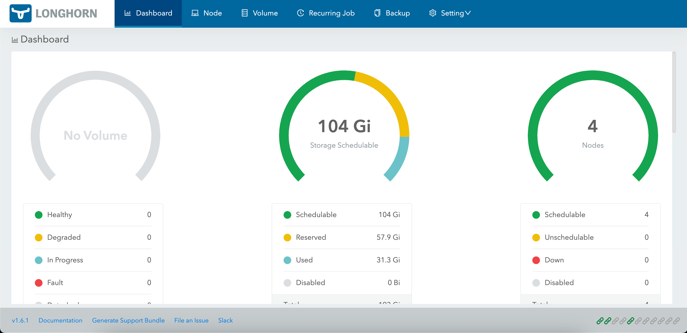
Can be installed with helm

Slide 7
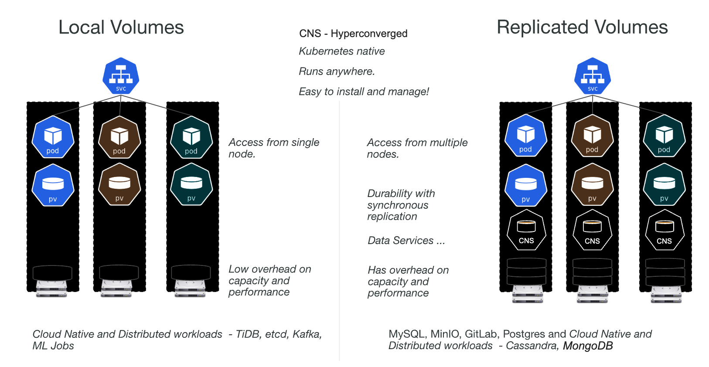
OpenEBS
OpenEBS turns any storage available to Kubernetes worker nodes into Local or Replicated Kubernetes Persistent Volumes
Can be installed with helm

Slide 8
Container Migration

Slide 9
CRIU
Checkpoint/Restore In Userspace, or CRIU (pronounced kree-oo, IPA: /krɪʊ/, Russian: криу), is a Linux software. It can freeze a running container (or an individual application) and checkpoint its state to disk. The data saved can be used to restore the application and run it exactly as it was during the time of the freeze. Using this functionality, application or container live migration, snapshots, remote debugging, and many other things are now possible.
Dump
Copy
Restore

Slide 10
Kubelet Checkpoint API
Checkpointing a container is the functionality to create a stateful copy of a running container. Once you have a stateful copy of a container, you could move it to a different computer for debugging or similar purposes.

Slide 11
How does it work?
With the help of CRIU it is possible to checkpoint and restore containers. CRIU is integrated in runc, crun, CRI-O and containerd and forensic container checkpointing as implemented in Kubernetes uses these existing CRIU integrations.
Requirements:
CRIU
CRI-O
--enable-criu-support=true
For Kubernetes, you need to run your cluster with the ContainerCheckpoint feature gate enabled.

Slide 12
Example
sudo curl -X POST "<https://localhost:10250/checkpoint/kubevirt/virt-handler-wggw4/virt-handler>" --insecure --cert /etc/kubernetes/pki/apiserver-kubelet-client.crt --key /etc/kubernetes/pki/apiserver-kubelet-client.key
checkpointing of kubevirt/virt-handler-wggw4/virt-handler failed (rpc error: code = Unimplemented desc = method CheckpointContainer not implemented)

