Slide 1
CloudNativePG
VolSync
PortWorx
Migration

Slide 2
CloudNativePG

Slide 3
CloudNativePG is a comprehensive open source platform designed to seamlessly manage PostgreSQL databases within Kubernetes environments, covering the entire operational lifecycle from initial deployment to ongoing maintenance. The main component is the CloudNativePG operator.
CloudNativePG is the Kubernetes operator that covers the full lifecycle of a highly available PostgreSQL database cluster with a primary/standby architecture, using native streaming replication.

Slide 4
Scope
The goal of CloudNativePG is to increase the adoption of PostgreSQL, one of the most loved DBMS in traditional VM and bare metal environments, inside Kubernetes, thus making the database an integral part of the development process and GitOps CI/CD automated pipelines.
CloudNativePG has been designed by Postgres experts with Kubernetes administrators in mind. Put simply, it leverages Kubernetes by extending its controller and by defining, in a programmatic way, all the actions that a good DBA would normally do when managing a highly available PostgreSQL database cluster.

Slide 5
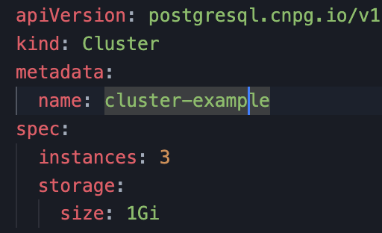
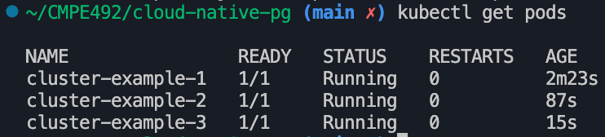
It defines a new Kubernetes resource called Cluster representing a PostgreSQL cluster made up of a single primary and an optional number of replicas that co-exist in a chosen Kubernetes namespace for High Availability and offloading of read-only queries.
Applications that reside in the same Kubernetes cluster can access the PostgreSQL database using a service which is solely managed by the operator, without having to worry about changes of the primary role following a failover or a switchover. Applications that reside outside the Kubernetes cluster, need to configure a Service or Ingress object to expose the Postgres via TCP. Web applications can take advantage of the native connection pooler based on PgBouncer.

Slide 6
Main Features
Direct integration with Kubernetes API server for High Availability, without requiring an external tool
Self-Healing capability, through:
failover of the primary instance by promoting the most aligned replica
automated recreation of a replica
Planned switchover of the primary instance by promoting a selected replica
Scale up/down capabilities
Definition of an arbitrary number of instances (minimum 1 - one primary server)
Definition of the read-write service, to connect your applications to the only primary server of the cluster
Definition of the read-only service, to connect your applications to any of the instances for reading workloads
Declarative management of PostgreSQL configuration, including certain popular Postgres extensions through the cluster spec: pgaudit, auto_explain, pg_stat_statements, and pg_failover_slots

Slide 7
Use Cases

Slide 8
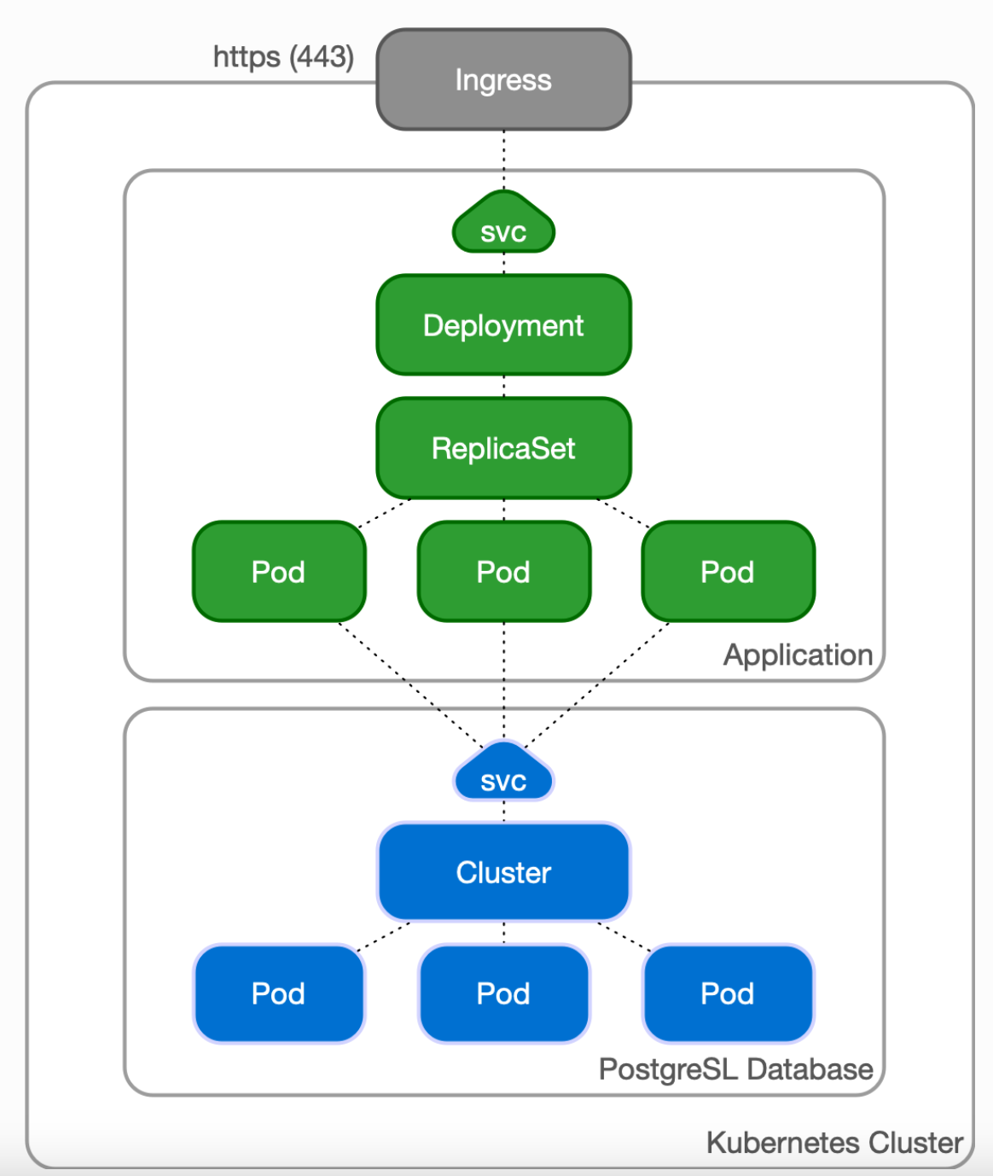
Case 1: Applications inside Kubernetes

Slide 9
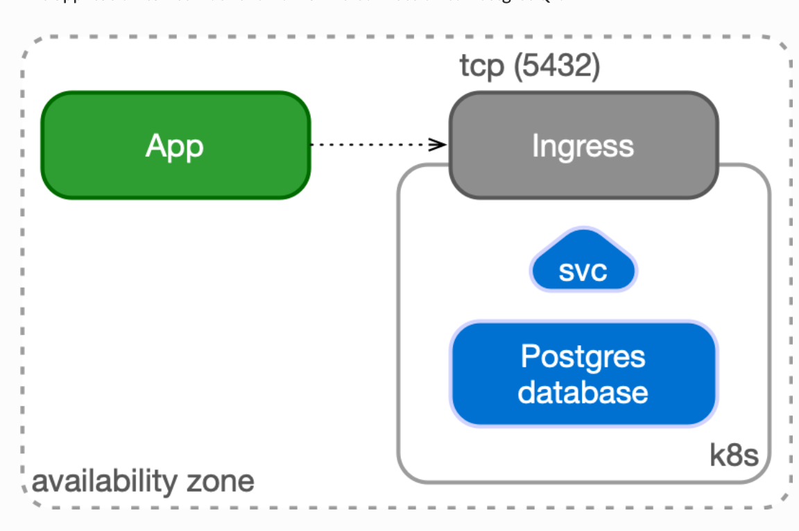
Case 2: Applications outside Kubernetes

Slide 10
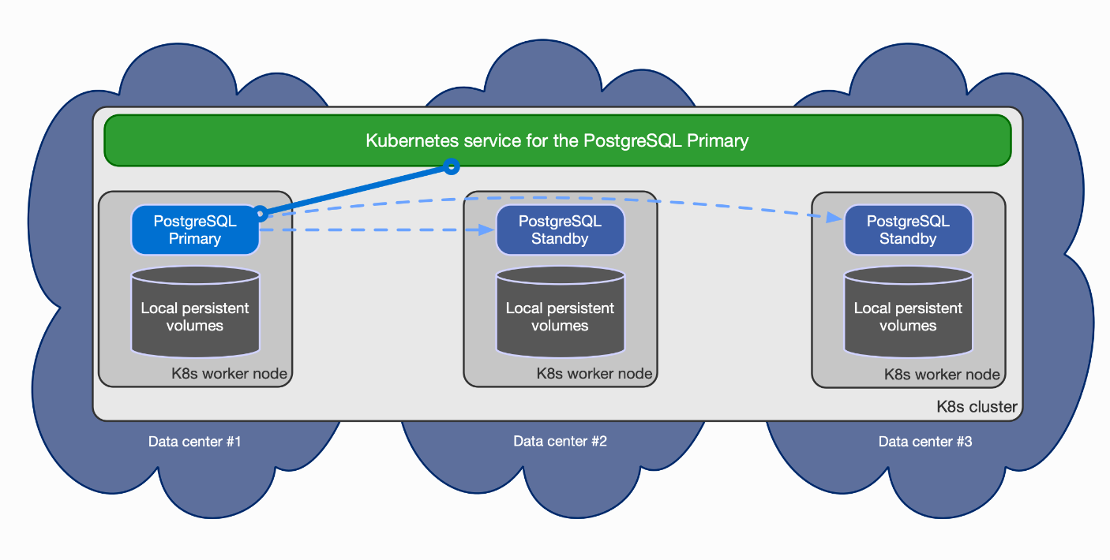
Architecture

Slide 11
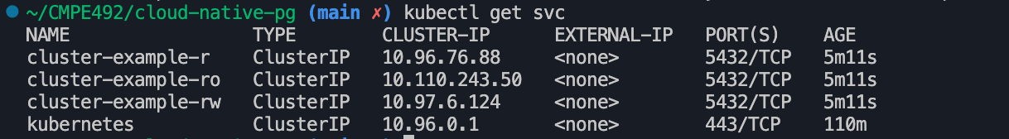

Slide 12
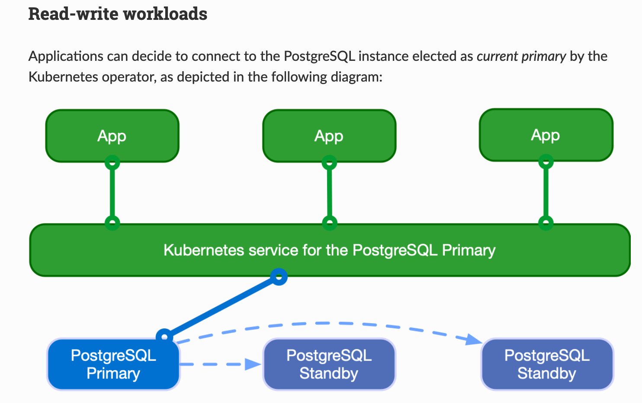
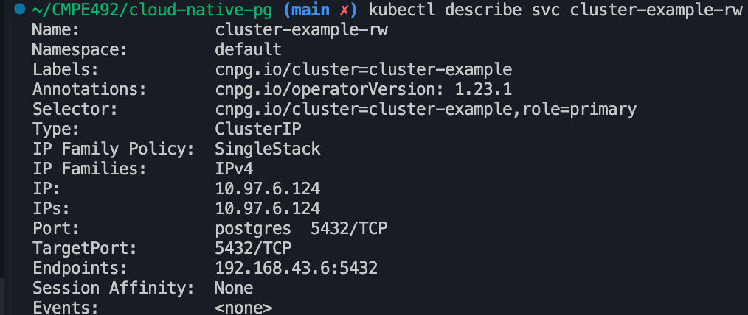

Slide 13
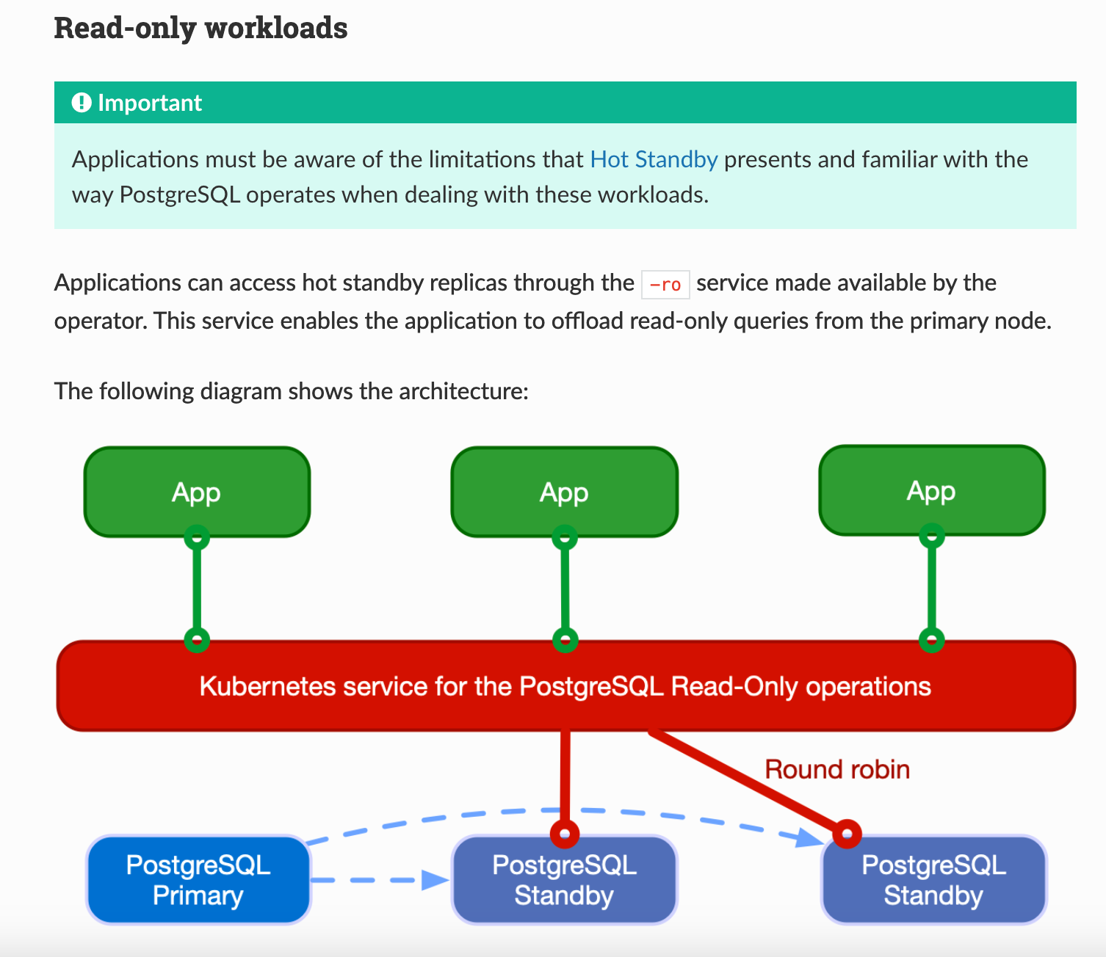
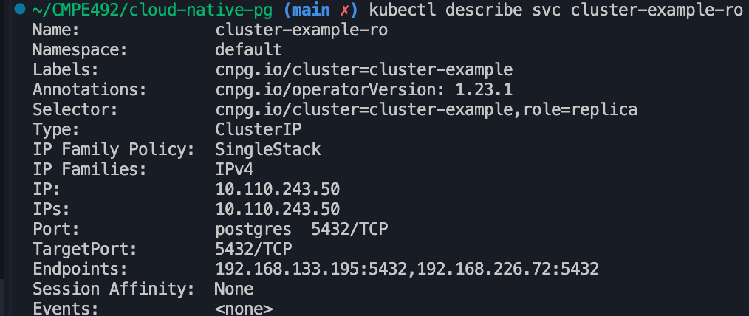

Slide 14
VolSync

Slide 15
VolSync is a Kubernetes operator that performs asynchronous replication of persistent volumes within, or across, clusters. The replication provided by VolSync is independent of the storage system. This allows replication to and from storage types that don’t normally support remote replication. Additionally, it can replicate across different types (and vendors) of storage.

Slide 16
Use Cases
Case (1) - Async DR
As an application owner, I’d like to ensure my application’s data is replicated off-site to a potentially different secondary cluster in case there is a failure of the main cluster. The remote copy should be crash-consistent such that my application can restart at the remote site.
Once a failure has been repaired, I’d like to be able to “reverse” the synchronization so that my primary site can be brought back in sync when the systems recover.

Slide 17
Case (2) - Off-site analytics
As a data warehouse owner, I’d like to periodically replicate my primary data to one or more secondary locations where it can be accessed, read-only, by a scale-out ML or analytics platform.

Slide 18
Case (3) - Testing w/ production data
As a software developer, I’d like to periodically replicate the data from the production environment into an isolated staging environment for continuous testing with real data prior to deploying application updates.

Slide 19
Case (4) - Application migration
As an application owner, I’d like to migrate my production stateful application to a different storage system (either on the same or different Kubernetes cluster) with minimal downtime. I’d like to have the bulk of the data synchronized in the background, allowing for minimal downtime during the actual switchover.

Slide 20
PortWorx

Slide 21
Migration
Container / Pod Migration
Longhorn
PostgreSQL / Application
CloudNativePG
VolSync

