Slide 1

Data Science Project: What Makes a Hit Song
By:
Michal Hagoel & Omer Sharoni

Slide 2

Research Question
Can we predict whether a song will become a hit based on multiple factors such as popularity, loudness, length, and more?

Slide 3

Data Collection: Scraping
We used Beautiful Soup and requests to scrape Wikipedia for a list of top songs and artists for each year from the 1950’s all the way to 2023!

Slide 4

Data Collection: API
We enriched the dataset with additional information from the Spotify API with features such as:
Loudness
energy
tempo
In total we used the api to acquire more than 17 new features on each column in our dataset

Slide 5

Data Cleaning
Removed duplicates and other inconsistencies from the dataset
We removed some more data later on using our EDA

Slide 6
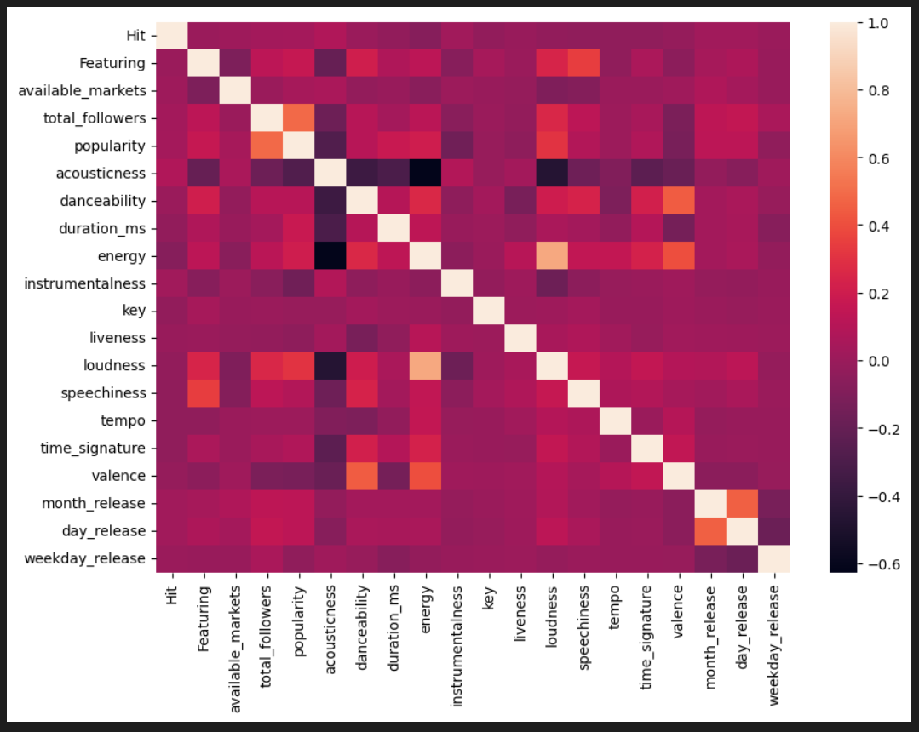
Data Visualization & EDA
We used graphs to better understand our data
We plotted the most popular artists, weekday releases and more to get a better understanding of what are the key features for us
We plotted a correlation heatmap and found 2 columns, energy and loudness, that were closely correlated.

Slide 7

Prediction Models
SVC model
Naive Bayes
Decision Tree
KNN
Random Forest

Slide 8

Results
We built several prediction models and evaluated their performance.
The best model achieved an accuracy score of 0.889.
This means that we were able to correctly predict whether a song would become a hit 89% of the time.
This is a promising result and suggests that we can use machine learning to predict hit songs.

Slide 9

Conclusion
Our project set out to predict whether a song will become a hit based on multiple factors.
We scraped data from Wikipedia and enriched it with information from the Spotify API, cleaned the data, visualized it, and built prediction models.
We achieved an accuracy score of 0.889 in predicting hit songs.
Our results suggest that machine learning can be used to predict which songs will become hits, which may have implications for the music industry.

Slide 10
References
Wikipedia - https://en.wikipedia.org/wiki/Billboard_Year-End_Hot_100_singles_of_2022
(1950– 2023)
Spotify API - https://developer.spotify.com/documentation/web-api/reference/#/operations/get-track

