Slide 1
Chapter 1
Software Engineering Principles and C++ Classes

Slide 2
Chapter Objectives
Learn about software engineering principles
Discover what an algorithm is and explore problem-solving techniques
Become aware of structured design and object-oriented design programming methodologies
Learn about classes
Learn about private, protected, and public members of a class
Explore how classes are implemented

Slide 3
Chapter Objectives
Become aware of Unified Modeling Language (UML) notation
Examine constructors and destructors
Learn about the abstract data type (ADT)
Explore how classes are used to implement ADT
Learn about information hiding
Explore how information hiding is implemented in C++

Slide 4
Software Life Cycle
Life cycle: the many phases a program goes through from the time it is conceived until the time it is retired
Three fundamental stages of a program
  Development
  Use
  Maintenance

Slide 5
Software Development Phase
Analysis
  Understand problem
  Requirements analysis
  Data analysis
  Divide problem into subproblems and perform analysis

Slide 6
Software Development Phase
Design
  Algorithm
  Structured Design
    Divide problem into subproblems and analyze each subproblem
  Object-Oriented Design
    Identify components (objects) which form the basis of solution
    Determine how these objects interact with one another

Slide 7
Object-Oriented Design (OOD)
Three basic principles
  Encapsulation: ability to combine data and operations in a single unit
  Inheritance: ability to create new data types from existing data types
  Polymorphism: ability to use the same expression to denote different operations

Slide 8
Software Development Phase
Implementation
  Write and compile programming code to implement classes and functions discovered in design phase

Slide 9
Software Development Phase
Testing and Debugging
  Test the correctness of the program to make sure it does what it is supposed to do
  Find and fix errors
  Run program through series of specific tests, test cases

Slide 10
Software Development Phase
Testing and Debugging
  Black-box testing: test based on inputs and outputs, not the internal working of the algorithm or function
  White-box testing: relies on the internal structure and implementation of a function or algorithm; ensures that every part of the function or algorithm executes at least once

Slide 11
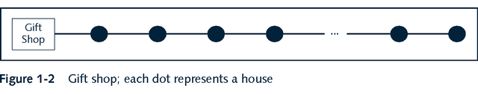
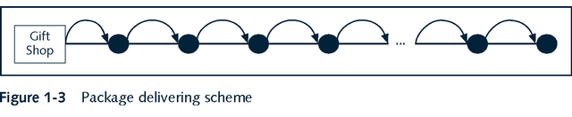
Algorithm Analysis:
Big-O Notation

Slide 12
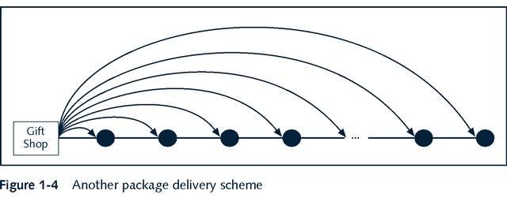
Algorithm Analysis:
Big-O Notation

Slide 13
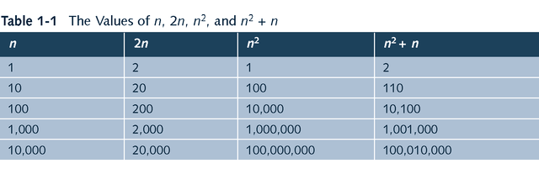
Algorithm Analysis:
Big-O Notation

Slide 14
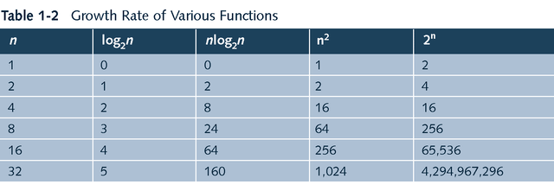
Algorithm Analysis:
Big-O Notation

Slide 15
Algorithm Analysis:
Big-O Notation
Definition: Let f be a function of n.The term “asymptotic” means the study of the function f as n becomes larger and larger without bound.

Slide 16
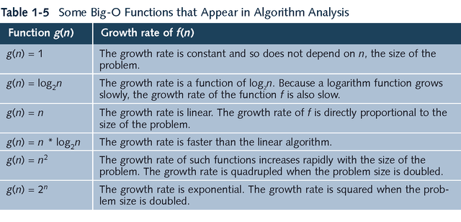
Algorithm Analysis:
Big-O Notation

Slide 17
Classes
class: reserved word; collection of a fixed number of components
Components: member of a class
Members accessed by name
Class categories/modifiers
  private
  protected
  public

Slide 18
Classes
private: members of class not accessible outside class
public: members of class accessible outside class
Class members: can be methods or variables
Variable members: declared like any other variables

Slide 19
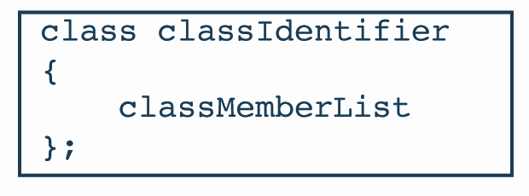

Syntax for Defining a Class

Slide 20
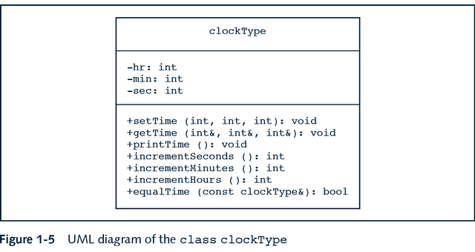
UML Diagram class clockType

Slide 21
UML Diagram
Top box: Name of class
Middle box: data members and their data types
Bottom box: member methods’ names, parameter list, return type of method
+ means public method
- means private method
# means protected method

Slide 22
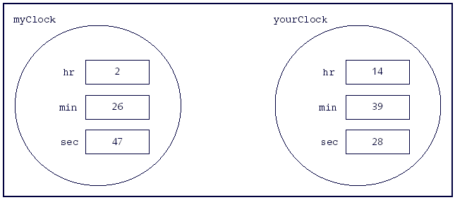
Example: class Clock

Slide 23
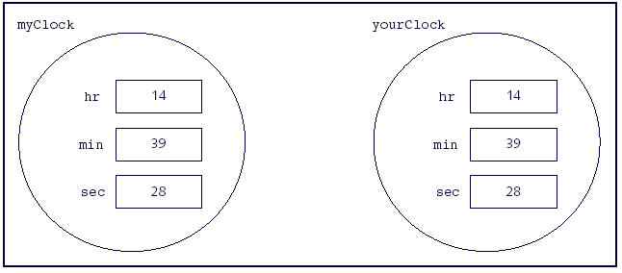
Example: class Clock
After myClock = yourClock;

Slide 24
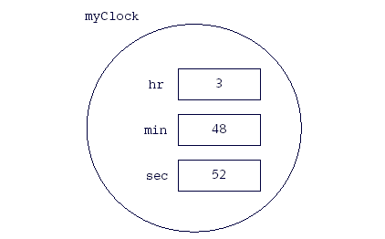
Example: class Clock
After myClock.setTime(3,48,52);

Slide 25

Constructors
Syntax to invoke the default constructor:
Syntax to invoke a constructor with a parameter:

Slide 26
Destructors and Structs
Destructors
  Function like constructors
  Do not have a type
  Only one per class
  Can have no parameters
  Name of destructor is (-) character followed by name of class
Structs
  Special type of class
  By default all members are public
  struct is a reserved word
  Defined just like a class

Slide 27
Abstract Data Types
Definition
A data type that specifies the logical properties without the implementation details
Examples: stacks, queues, binary search trees

Slide 28
Information Hiding
Implementation file: separate file containing implementation details
Header file (interface file): file that contains the specification details

Slide 29
Programming Example:
Candy Machine
(Problem Statement)
A common place to buy candy is from a candy machine. A new candy machine is bought for the gym, but it is not working properly. The machine sells candies, chips, gum, and cookies. You have been asked to write a program for this candy machine so that it can be put into operation.
The program should do the following:
    Show the customer the different products sold by the candy machine.
    Let the customer make the selection.
    Show the customer the cost of the item selected.
    Accept money from the customer.
    Release the item.

Slide 30
Programming Example:
Candy Machine
(Input and Output)
Input
  Item Selection
  Cost of Item
Output
  The selected item

Slide 31
Programming Example:
Candy Machine
Components
  Cash Register
  Several Dispensers

Slide 32
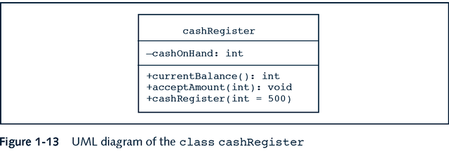
Programming Example:
Candy Machine

Slide 33
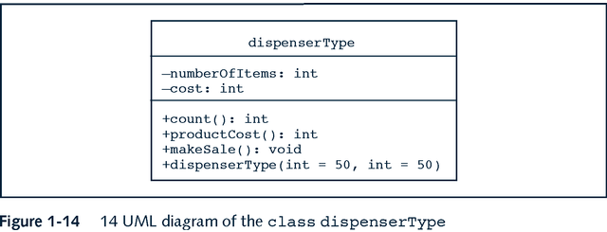
Programming Example:
Candy Machine

Slide 34
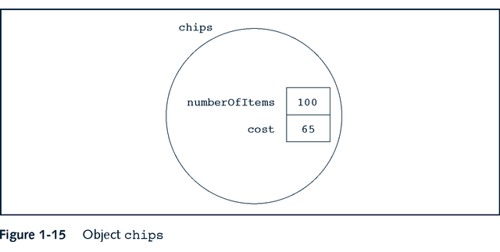
Programming Example:
Candy Machine

Slide 35
Object-Oriented Design
Simplified methodology
  1. Write down detailed description of problem
  2. Identify all (relevant) nouns and verbs
  3. From list of nouns, select objects
  4. Identify data components of each object
  5. From list of verbs, select operations

Slide 36
Object-Oriented Design
Example
Problem Statement
  Write a program to input the dimensions of a cylinder and calculate and print the surface area and volume
Nouns: dimensions, surface area, volume, cylinder
Verbs: input, calculate, print
Object: cylinder
  Data members: dimensions (NOT SA or volume)
  Function members: input, calculate SA, calculate volume, print

