Slide 1
Boston University – MET Omer TAS MRI –SEGMENTATION
“This dataset contains brain MR images together with manual FLAIR abnormality segmentation masks. The images were obtained from The Cancer Imaging Archive (TCIA). They correspond to 110 patients included in The Cancer Genome Atlas (TCGA) lower-grade glioma collection with at least fluid-attenuated inversion recovery (FLAIR) sequence and genomic cluster data available”
14 attributes

Slide 2
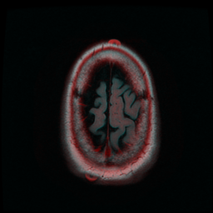
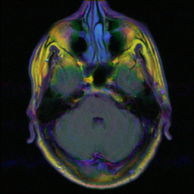
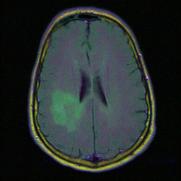
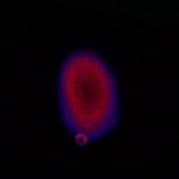

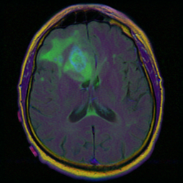

Slide 3
Data Preprocessing
Data.csv
Last row removed missing class labels and attributes
Missing values replaced with either mode or mean
Removed attibutes
Cleandata.csv
'Unnamed: 0' , "Patient”>> (TCGA_CS_4942 ), "tumor_tissue_site”

Slide 4
Project.py,
tree.py, logistic.py, knn.py, bayes.py,svm.py
Model | TP | FP | TN | FN | accuracy | TPR | TNR
Tree | 26 | 0 | 9 | 0 | 100.0% | 100.0% | 100.0%
Logistic | 25 | 7 | 2 | 1 | 77.14% | 96.15% | 22.22%
Best KNN | 25 | 9 | 0 | 0 | 71.43% | 96.15% | 0.0%
Naïve Bayes | 22 | 7 | 2 | 4 | 68.57% | 84.62% | 22.22%
Best SVM | 26 | 9 | 0 | 0 | 74.29% | 100.0% | 0.0%

Slide 5
5 random new instance
Tree | logistic | KNN | Bayes | SVM | Ensemble
1 | 1 | 0 | 1 | 1 | 1
1 | 0 | 0 | 0 | 0 | 0
1 | 1 | 1 | 1 | 1 | 1
0 | 0 | 0 | 1 | 0 | 0
0 | 0 | 0 | 1 | 0 | 0

Slide 6
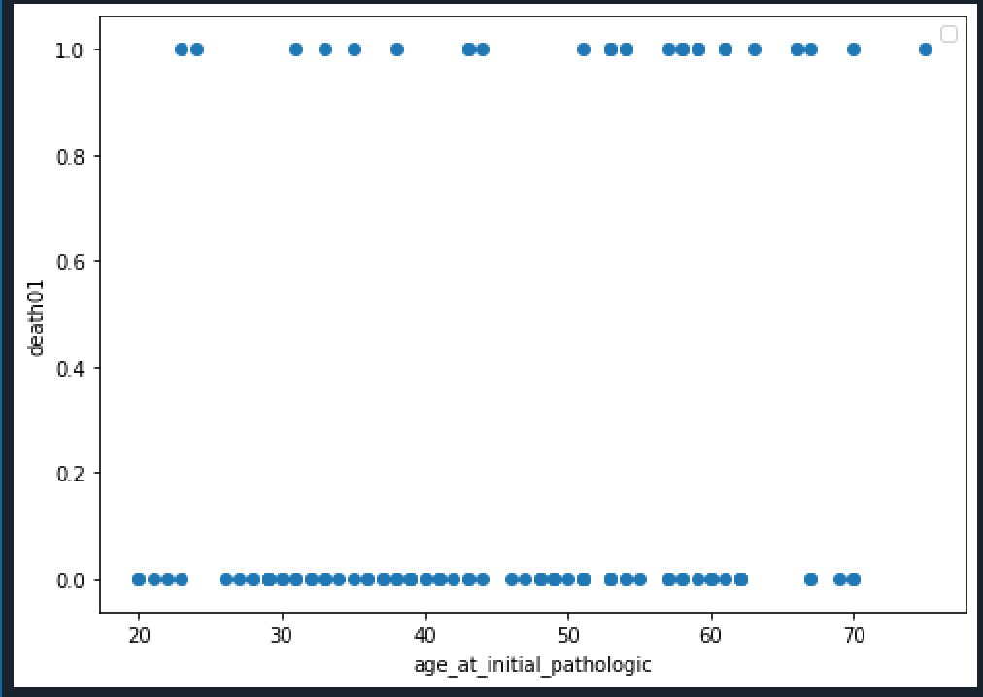

Slide 7
